Slide 1
AIR POLLUTION IN PETROCHEMICAL INDUSTRIES

Slide 2
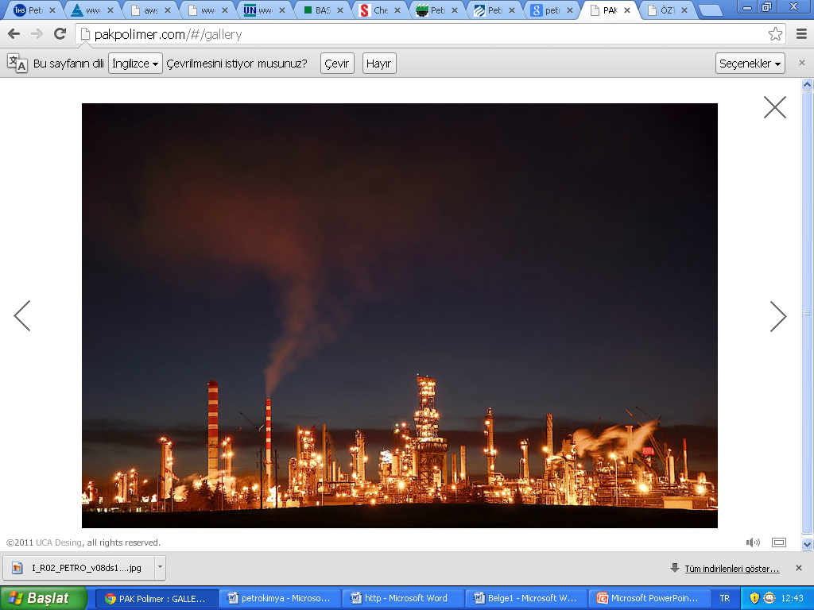
Overview of petrochemical industries
Petrochemicals are chemicals made from petroleum (crude oil) and natural gas.

Slide 3
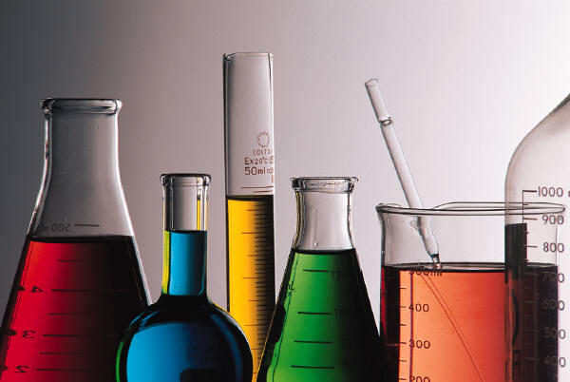
Primary Petrochemicals
"Primary Petrochemicals" include: olefins (ethylene, propylene and butadiene) aromatics (benzene, toluene, and xylenes); and methanol.

Slide 4
PETROCHEMICAL Intermediates and Derivatives
Some typical petrochemical intermediates are:
vinyl acetate for paint, paper and textile coatings vinyl chloride
polyvinyl chloride (PVC)
resin manufacture
ethylene glycol for polyester - textile fibers

Slide 6
Source of environmental pollution from the petroleum industry
Air emissions from the petroleum industry can be classified as ;
Combustion emissions
Process emissions
Fugitive emissions
From storage and handling of petroleum liquids
Secondary emissions
http://www.eolss.net/sample-chapters/c09/e4-14-04-03.pdf

Slide 7
Combustion emissions are produced with onsite burning of
fuels for energy production and transportation purposes.
Fugitive emissions are released through leaking valves,pumps and other process devices.
Process emissions are generated in the process units and released from process vents.
Storage and handling emissions are contributed from the storage and manipulation of natural gas and crude oil,as well as their intermediate and finished derivatives
The water system of a production or processing site (tanks ,ponds) are the main source of secondary emissions.
http://www.eolss.net/sample-chapters/c09/e4-14-04-03.pdf

Slide 8
The Principal Pollutants From These Air
Emission Sources
Nitrogen oxides
Sulfur oxides
Carbon monoxide, CO2 & Particulate
Additional pollutants …
Hydrogen sulfide
Volatile organic compounds
Methane & ethane
Benzene
Toluene, xylenes etc.
http://www.slideshare.net/mechportal/air-pollution-in-petroleum-industry

Slide 9
PETROCHEMICAL INDUSTRIES IN THE WORLD
The world petrochemical industry has changed drastically in the last twenty to thirty years.
The United States, Western Europe and Japan previously dominated production of primary petrochemicals, not only to supply their own domestic demand but also to export to other world markets.

Slide 10
Fossil fuels - coal, crude oil or petroleum, natural gas liquids, and natural gas - are the primary sources of basic petrochemicals.
The most important use of fossil fuels is in the production of energy. In 2010, annual world energy production from fossil fuels, hydroelectric power and nuclear power amounted to 433 quadrillion

Slide 11
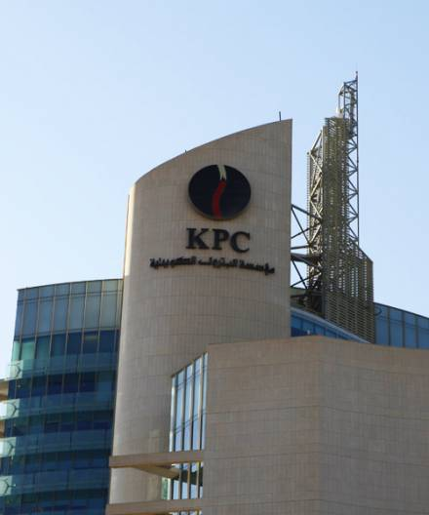
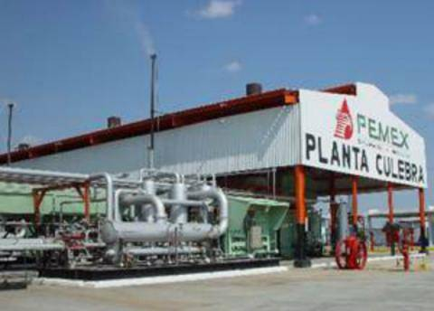
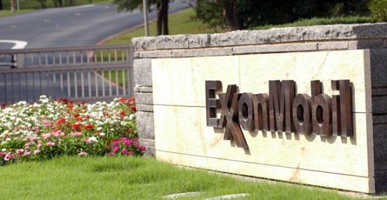
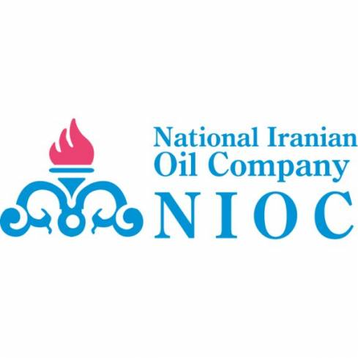
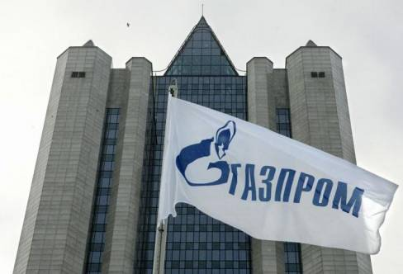

Slide 12
PETROCHEMICAL INDUSTRIES IN TURKEY
The Turkish petrochemicals industry has shown considerable growth since 1970.
There are two petrochemical complexes, one is the Petkim-Aliaga complex in Izmir and the other one is the Tüpraş (Turkish Petroleum Refineries Corporation) - Körfez Petrochemical and Refinery in Kocaeli.

Slide 13
In these two complexes a wide range of petrochemicals, all common plastics (HDPE, LDPE, PS, PVC, and PP), aromatics, ethylene glycol, carbon black, synthetic rubber, and caustic soda are produced.
The total production of these petrochemicals reaches about 2.9 million tons/year, and meets about 25 % of domestic demand.

Slide 15
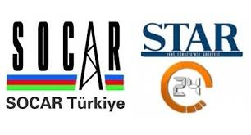
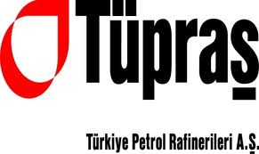
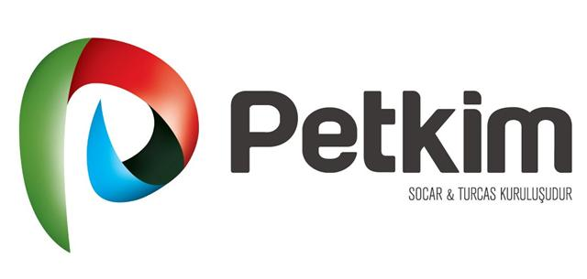

Slide 16
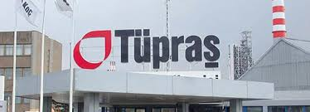
TÜPRAS-TÜRKİYE PETROL RAFİNERİLERİ A.Ş.
Tüpraş -Türkiye Petrol Rafinerileri A.Ş. refines petroleum. The Company produces LPG, naphtha, gasoline, diesel fuel, fuel, heating oil, jet fuel, lubricants, and asphalt..
Under a series of reorganizations of Turkey's state-owned enterprises in 1983, which was aimed at rationalizing their activities and making them more productive, it was decided to bring the country's government-owned refineries under the control of a single entity.

Slide 17
ABOUT TÜPRAŞ
On 25 October 1983 at an extraordinary general meeting of İPRAŞ (Istanbul Petroleum Refinery Inc.), which had been in operation since 1961, the Company's articles of incorporation were amended and its name was changed to TÜPRAŞ (Turkish Petroleum Refineries Corporation).
The new company was formally registered and announced on 16 November 1983. Under the new charter, the Izmir and Batman refineries that had previously belonged to Türkiye Petrolleri A.O. and the Kırıkkale Refinery (which was then under construction) were turned over to TÜPRAŞ., which was at that time operating the İzmit Refinery that it had built.
http://www.oib.gov.tr/portfoy/tupras/information.htm

Slide 18
REFINING CAPACITY
When it was founded, TÜPRAŞ. had a crude oil processing capacity of 17.2 million tons a year. With the completion of the last phase of the İzmir Refinery Debottlenecking Project in 1984, total capacity was increased slightly to 17.6 million tons/year.
file:///C:/Users/Toshiba/Desktop/T%C3%9CPRA%C5%9E%20-%20TURKISH%20PETROLEUM%20REFINERIES%20CORPORATION.htm

Slide 19
Greenhouse Gases and Monitoring of Air Emission
İn TÜPRAŞ
In all refineries, the Intergovernmental Panel of Climate Change’s (IPCC) Tier-1 approach is applied in order to calculate greenhouse gas emissions.
IPCC:
The Summary for Policymakers of the Working Group I contribution to the Fifth Assessment Report was approved, and the full report accepted, by the IPCC on 27 September 2013.
The finalized version of the Summary for Policymakers was published on 11 November 2013
http://www.ipcc.ch/

Slide 20
IPCC Working Group I Contribution to AR5 :
The Twelfth Session of Working Group I (WGI-12) was held from 23 to 26 September 2013 in Stockholm, Sweden.
At the Session, the Summary for Policymakers (SPM) of the Working Group I contribution to the IPCC Fifth Assessment Report (WGI AR5) was approved and the underlying scientific and technical assessment accepted.
The Fifth Assessment Report (AR5) will provide a clear view of the current state of scientific knowledge relevant to climate change. It will comprise three Working Group (WG) reports and a Synthesis Report (SYR).
http://www.climatechange2013.org/

Slide 21
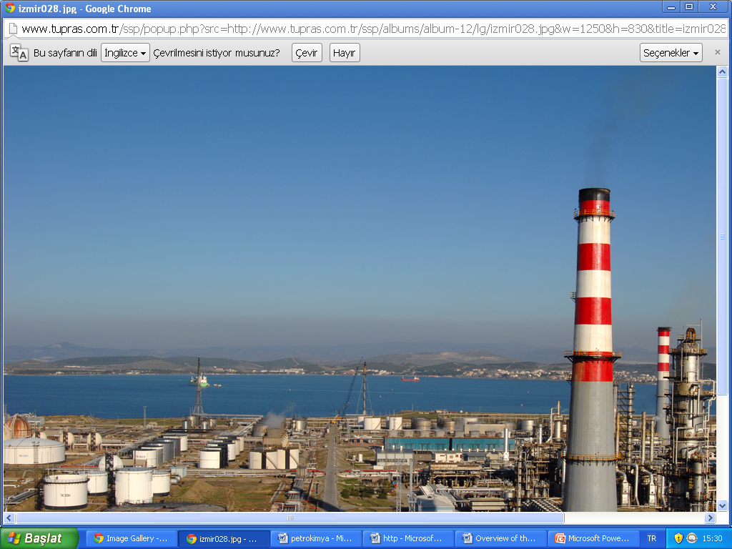
With the identification of the emission of greenhouse gases, projects for energy efficiency and saving have been initiated and continue at full speed.
In all refineries, emission reports were renewed, since the two year period indicated in the regulation expired and new units were added.

Slide 22
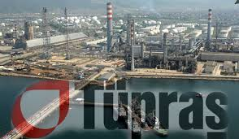
In order to decrease the Volatile Organic Compound (VOC) emissions of the refineries, double impermeability systems have been installed in product tanks.
In addition, halon based fire extinguishers have been replaced with FM-200 based fire extinguishers which do not harm the ozone layer
http://www.tupras.com.tr/detailpage.en.php?lPageID=6307

Slide 23
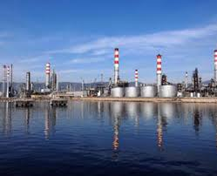
Monitoring of water Quality
All Tüpraş refineries possess the discharge permits required by the Regulation on Water Pollution Control.
At the İzmir Refinery, the İzmit Refinery’s Waste Water Recycling Units and in all other refineries, a total of 11.2 million m³ of water was processed and recycled to be used as cooling water, boiler feed water or in steam productionsg.
http://www.tupras.com.tr/detailpage.en.php?lPageID=6307

Slide 24
PRECAUTINARY MEASURES TO CHECK AIR POLLUTIONS PROBLEMS
By using absorbers
Application of vapour recovery system
Standardization of the height of the flare stacks
Air regulation control during the combustion of natural gas
Pre burning treatment to the various effluents before discharging to atmosphere
Good design of equipments
Replacement of the damages of greenery near installations, work centers etc.
http://www.slideshare.net/mechportal/air-pollution-in-petroleum-industry

Slide 25
Additional Requirements to Reduce Pollution
Storage tanks
EPA is phasing in requirements to reduce VOC emissions from new & modified tanks over on year, to ensure enough combustion devices are available to reduce the emissions.
Requirement applies to both oil and natural gas production
EPA did not change air toxics standards for storage tanks; however emissions storage tanks in natural gas production sector will be counted toward determining a major source under the air toxics standards for oil & natural gas production.

Slide 26
Centrifugal compressors
VOC reduction required for compressors with wet seal systems only; requirements do not apply in the natural gas transmission and storage segments, where VOC emissions generally are low
Reciprocating compressors
Rule requires replacement of rod packing, which can leak VOCs as it wears.
Rule provides an alternative schedule for rod packing replacement that does not require monitoring and documentation of operating hours.

Slide 27
Pneumatic controllers
Used to regulate conditions such as pressure and temperature.
Rule affects high-bleed controllers, allows use only for critical applications, such as emergency shutoff valves.
Requirements apply to controllers used in both oil and gas sectors; (in natural gas sector, applies only to sources upstream of the transmission line).
Glycol dehydrators
Covered under two air toxics standards (oil and natural gas production; natural gas processing plants)
Both standards retain existing standards for large dehydrators at major sources, set new standards for small dehydrators (not “area sources.”)
http://www.epa.gov/airquality/oilandgas/pdfs/20120417presentation.pdf

Slide 28
references
http://www.ihs.com/products/chemical/planning/ceh/petrochemical-industry.aspx
http://www.semplastik.com.tr/pdf/D8_petkim_sunum.pdf
http://see-industry.com/industrial-statii.aspx?br=57&rub=322&id=895
http://www.elmhurst.edu/~chm/vchembook/325petrochem.html
http://www.tupras.com.tr/detailpage.en.php?lPageID=6307
http://www.csb.gov.tr/dosyalar/images/file/Sanayi_Kaynakli_Hava_ Kirliliginin_Kontrolu_Yonetmeligi.pdf
http://www.slideshare.net/mechportal/air-pollution-in-petroleum-industry

Slide 29
THANKS TO
LISTEN ….
H.PINAR KIRLI
PINAR GÖZDE TOPRAK
DEMET ÇAKIR

