Slide 1
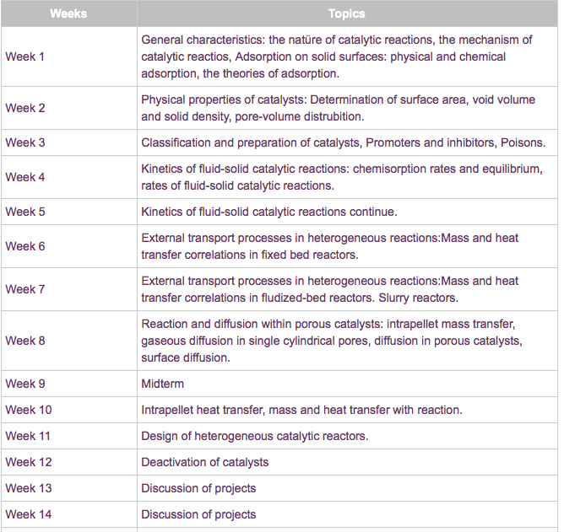
Kinetics: Rates and Mechanisms of Chemical Reactions

Slide 2
Kinetics: Rates and Mechanisms of Chemical Reactions
Focusing on Reaction Rate
Expressing the Reaction Rate
The Rate Law and Its Components
Integrated Rate Laws: Concentration Changes over Time
Theories of Chemical Kinetics
Catalysis: Speeding Up a Reaction

Slide 3
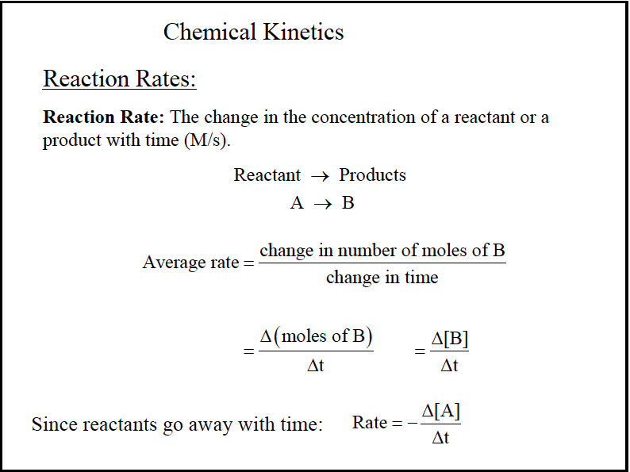

Slide 4
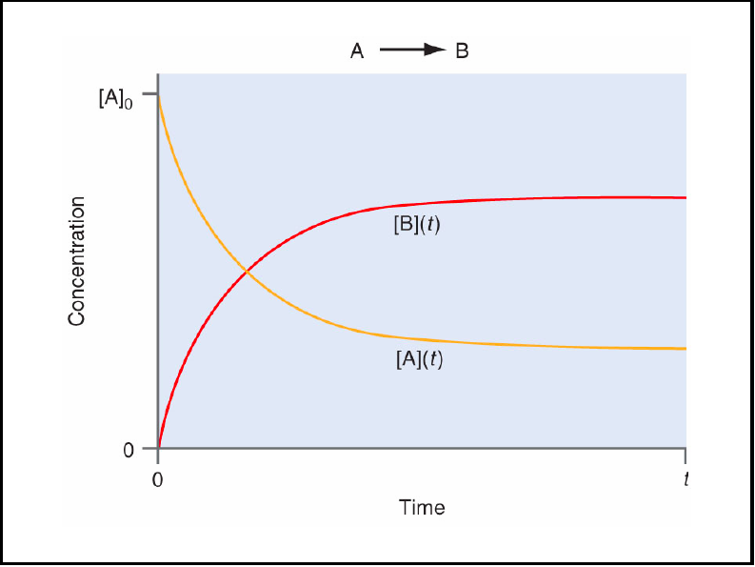

Slide 5
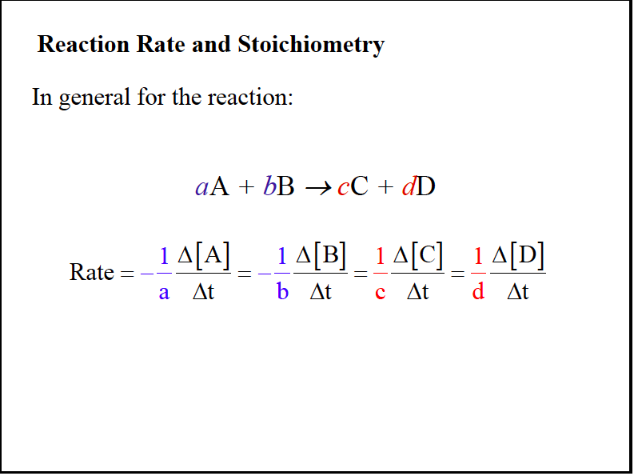

Slide 6
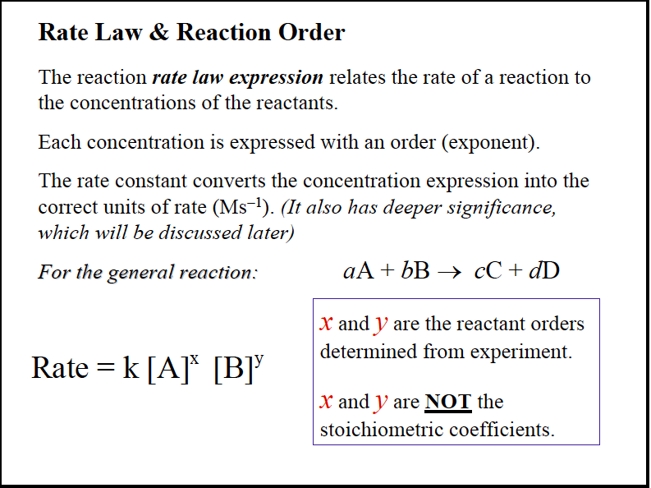

Slide 7
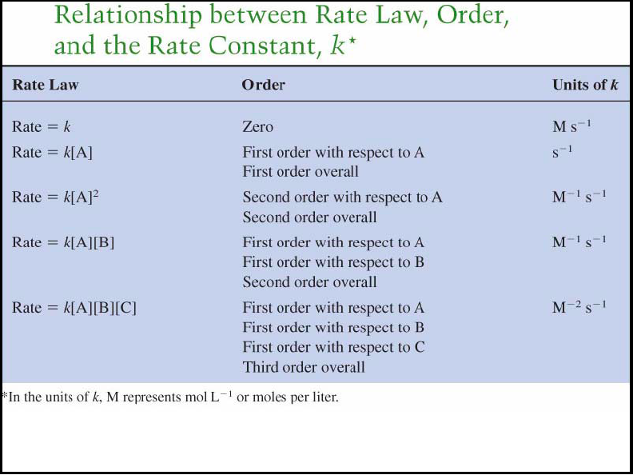

Slide 8
Expressing the Reaction Rate
Reaction rate is measured in terms of the changes in concentrations of reactants or products per unit time.
For the general reaction A → B, we measure the concentration of A at t₁ and at t₂:
change in concentration of A
conc A₂ - conc A₁
Δ[A]
Δt
Rate =
= -
= -
change in time
t₂ - t₁
Square brackets indicate a concentration in moles per liter.
The negative sign is used because the concentration of A is decreasing. This gives the rate a positive value.

Slide 9
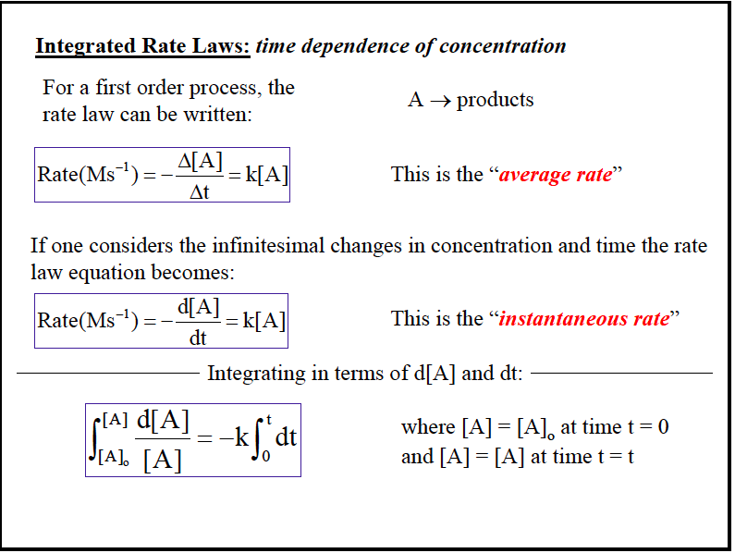

Slide 10
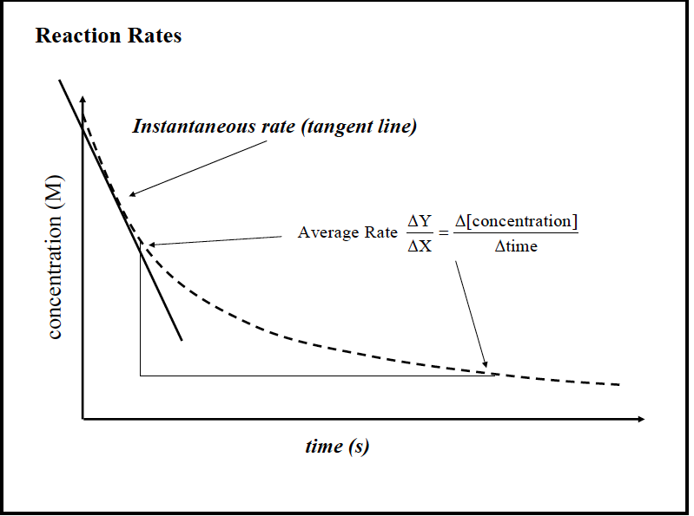

Slide 12
Factors That Influence Reaction Rate
Particles must collide in order to react.
The higher the concentration of reactants, the greater the reaction rate.
  A higher concentration of reactant particles allows a greater number of collisions.
The physical state of the reactants influences reaction rate.
  Substances must mix in order for particles to collide.
The higher the temperature, the greater the reaction rate.
  At higher temperatures particles have more energy and therefore collide more often and more effectively.

Slide 13
Table 16.1 Concentration of O₃ at Various Times in its Reaction with C₂H₄ at 303 K
Concentration of O₃ (mol/L)
Time (s)
0.0
3.20x10⁻⁵
Δ [C₂H₄]
10.0
2.42x10⁻⁵
rate = -
Δt
20.0
1.95x10⁻⁵
Δ [O₃]
= -
30.0
1.63x10⁻⁵
Δt
40.0
1.40x10⁻⁵
50.0
1.23x10⁻⁵
60.0
1.10x10⁻⁵

Slide 14
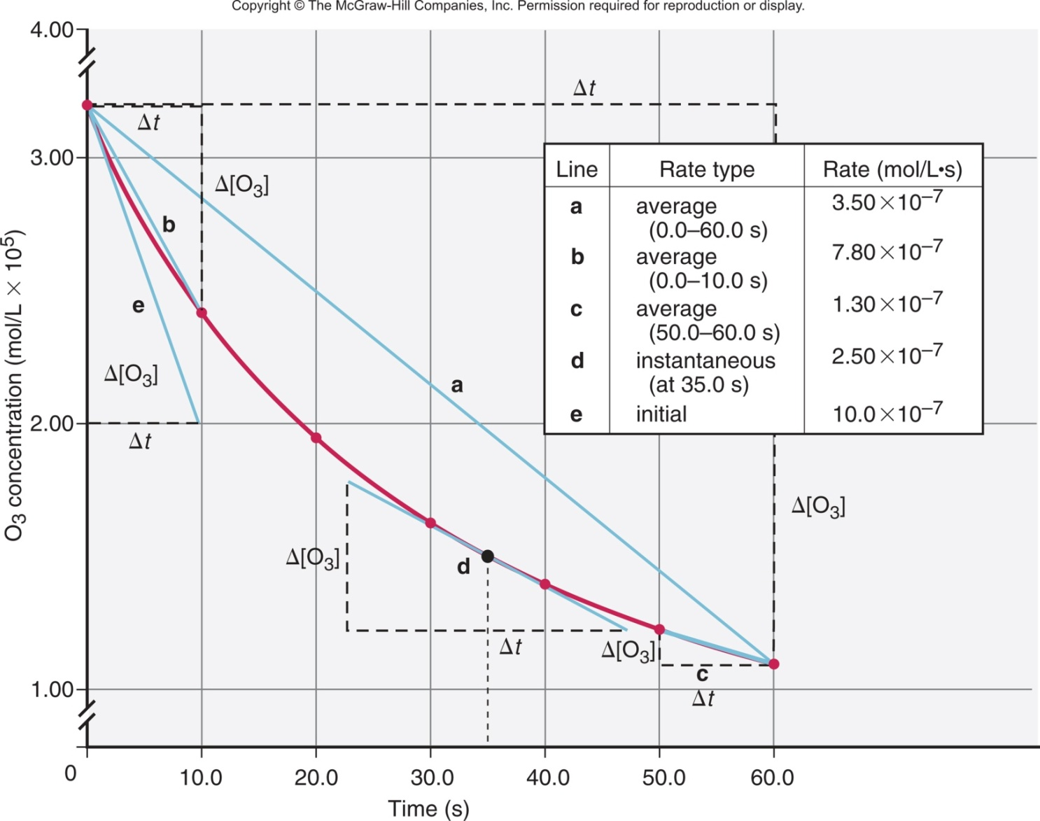
Figure 16.5 Three types of reaction rates for the reaction of O₃ and C₂H₄.

Slide 15
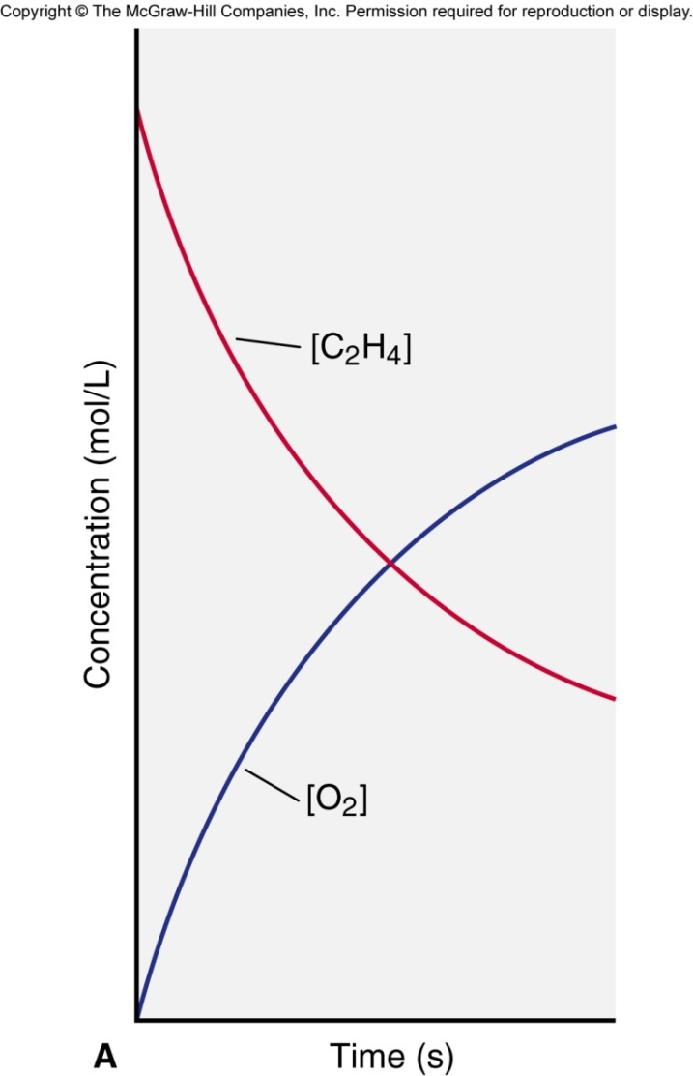
Figure 16.6A Plots of [reactant] and [product] vs. time.
C₂H₄ + O₃ → C₂H₄O + O₂
[O₂] increases just as fast as [C₂H₄] decreases.
Δ[C₂H₄]
Δt
Δ[O₃]
Δt
Rate = -
= -
Δ[C₂H₄O]
Δt
Δ[O₂]
Δt
=
=

Slide 16
The Rate Law
For any general reaction occurring at a fixed temperature
aA + bB → cC + dD
Rate = k[A]^{m}[B]^{n}
The term k is the rate constant, which is specific for a given reaction at a given temperature.
The exponents m and n are reaction orders and are determined by experiment.
The values of m and n are not necessarily related in any way to the coefficients a and b.

Slide 17
Reaction Orders
A reaction has an individual order “with respect to” or “in” each reactant.
For the simple reaction A → products:
If the rate doubles when [A] doubles, the rate depends on [A]¹ and the reaction is first order with respect to A.
If the rate quadruples when [A] doubles, the rate depends on [A]² and the reaction is second order with respect to [A].
If the rate does not change when [A] doubles, the rate does not depend on [A], and the reaction is zero order with respect to A.

Slide 18
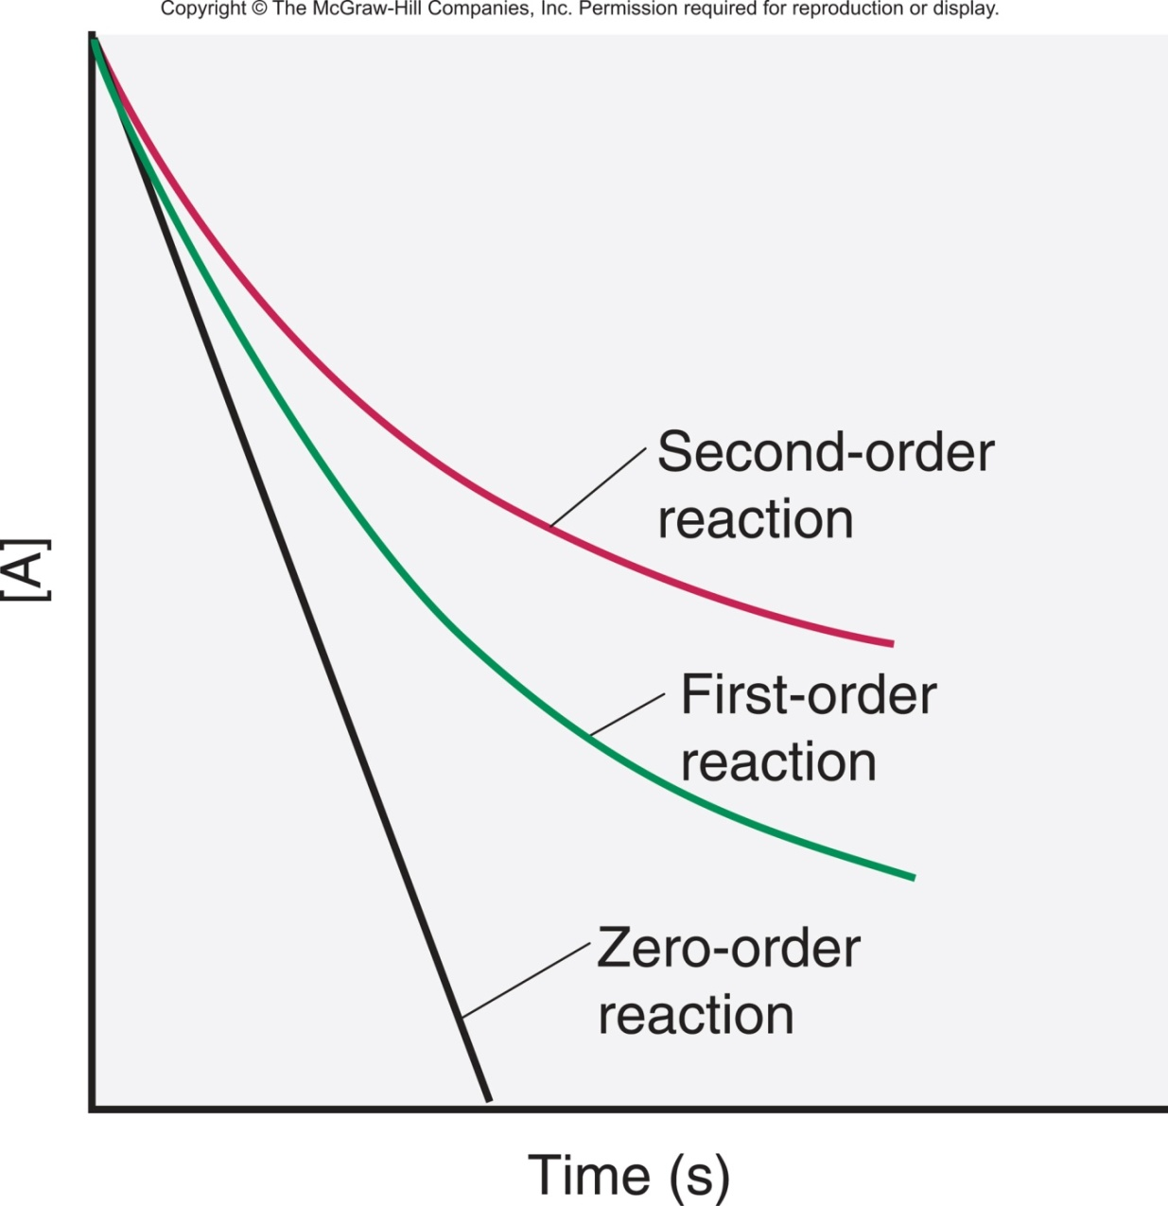
Figure 16.7 Plots of reactant concentration, [A], vs. time for first-, second-, and zero-order reactions.

Slide 19
Sample Problem 16.1
Expressing Rate in Terms of Changes in Concentration with Time
PROBLEM:
Hydrogen gas has a nonpolluting combustion product (water vapor). It is used as a fuel abord the space shuttle and in earthbound cars with prototype engines:
2H₂(g) + O₂(g) → 2H₂O(g)
(a) Express the rate in terms of changes in [H₂], [O₂], and [H₂O] with time.
(b) When [O₂] is decreasing at 0.23 mol/L·s, at what rate is [H₂O] increasing?
PLAN:
We choose O₂ as the reference because its coefficient is 1. For every molecule of O₂ that disappears, two molecules of H₂ disappear, so the rate of [O₂] decrease is ½ the rate of [H₂] decrease. Similarly, the rate at which [O₂] decreases is ½ the rate at which [H₂O] increases.

Slide 20
Sample Problem 16.1
SOLUTION:
Δ[O₂]
Δt
1
2
Δ[H₂]
Δt
1
2
Δ[H₂O]
Δt
(a)
Rate = -
= -
=
(b) Calculating the rate of change of [H₂O]:
1
2
Δ[H₂O]
Δt
Δ[O₂]
Δt
= -
= -(-0.23 mol/L·s)
Δ[H₂O]
Δt
= 2(0.23 mol/L·s)
= 0.46 mol/L·s
Notes:
20

Slide 21
Figure 16.9 Information sequence to determine the kinetic parameters of a reaction.
Series of plots of concentration vs. time
Determine slope of tangent at t₀ for each plot.
Initial rates
Compare initial rates when [A] changes and [B] is held constant (and vice versa).
Reaction orders
Substitute initial rates, orders, and concentrations into rate = k[A]^{m}[B]^{n}, and solve for k.
Rate constant (k) and actual rate law

Slide 22
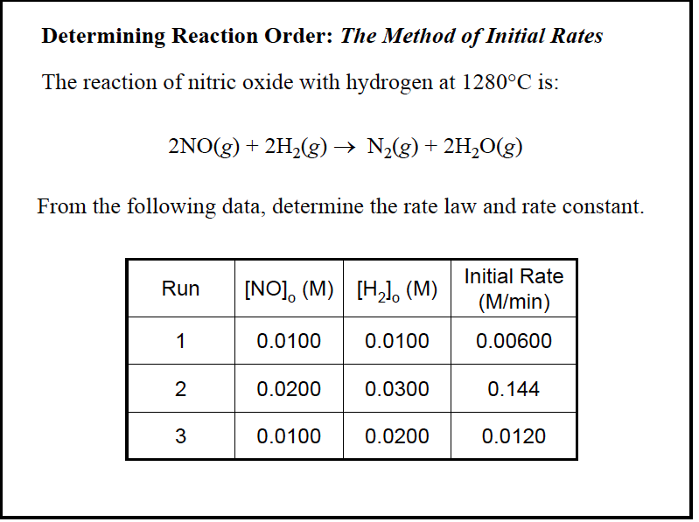

Slide 23
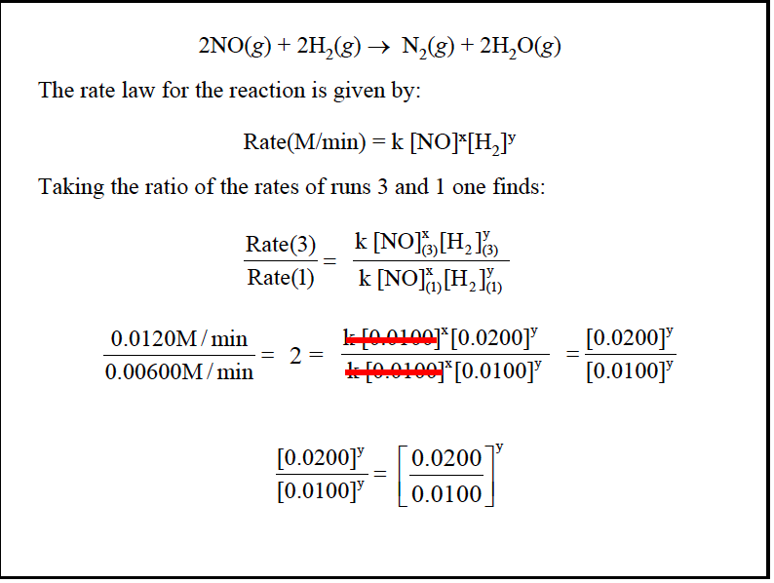

Slide 24
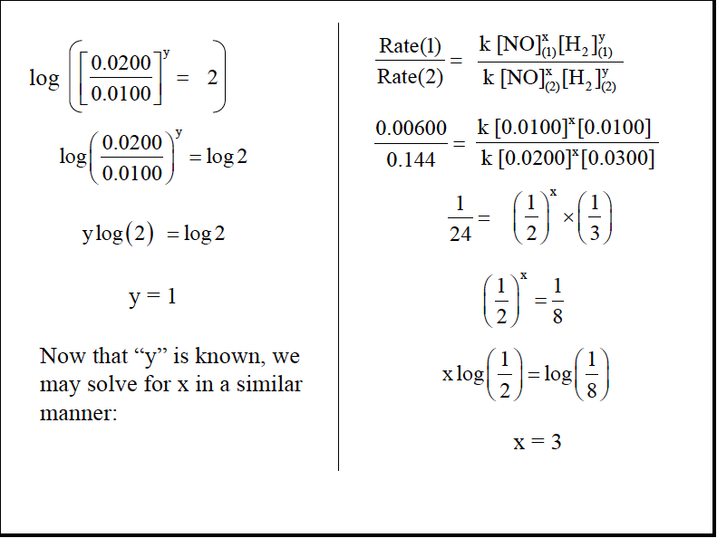

Slide 25
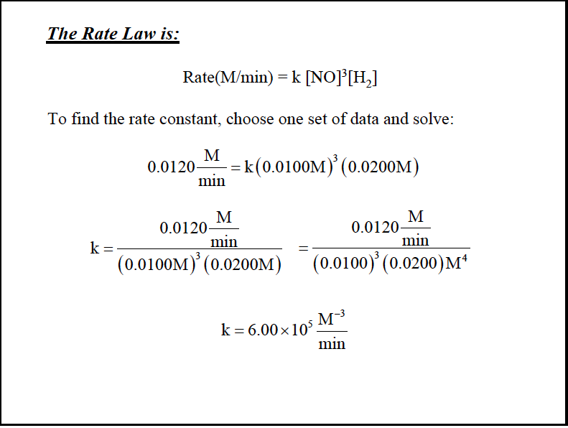

Slide 26
Table 16.2 Initial Rates for the Reaction between A and B
Experiment | Initial Rate (mol/L·s) | Initial [A] (mol/L) | Initial [B] (mol/L)
1 | 1.75x10⁻³ | 2.50x10⁻² | 3.00x10⁻²
2 | 3.50x10⁻³ | 5.00x10⁻² | 3.00x10⁻²
3 | 3.50x10⁻³ | 2.50x10⁻² | 6.00x10⁻²
4 | 7.00x10⁻³ | 5.00x10⁻² | 6.00x10⁻²
[B] is kept constant for experiments 1 and 2, while [A] is doubled. Then [A] is kept constant while [B] is doubled.

Slide 27
Finding m, the order with respect to A:
We compare experiments 1 and 2, where [B] is kept constant but [A] doubles:
m
2
n
2
m
2
Rate 2
Rate 1
k[A] [B]
k[A] [B]
[A]
[A]
[A]₂
[A]₁
m
=
=
=
m
1
n
1
m
1
m
3.50x10⁻³ mol/L·s
1.75x10⁻³mol/L·s
5.00x10⁻² mol/L
2.50x10⁻² mol/L
=
Dividing, we get 2.00 = (2.00)^{m} so m = 1

Slide 28
Finding n, the order with respect to B:
We compare experiments 3 and 1, where [A] is kept constant but [B] doubles:
m
3
n
3
n
3
Rate 3
Rate 1
k[A] [B]
k[A] [B]
[B]
[B]
[B]₃
[B]₁
n
=
=
=
m
1
n
1
n
1
m
3.50x10⁻³ mol/L·s
1.75x10⁻³mol/L·s
6.00x10⁻² mol/L
3.00x10⁻² mol/L
=
Dividing, we get 2.00 = (2.00)^{n} so n = 1

Slide 29
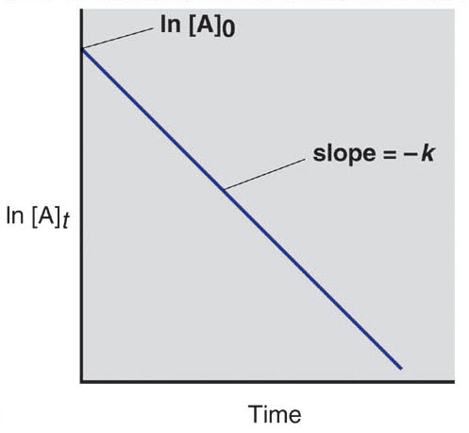
Figure 16.10A Graphical method for finding the reaction order from the integrated rate law.
First-order reaction
integrated rate law
ln
[A]₀
= - kt
[A]_{t}
straight-line form
ln[A]_{t} = -kt + ln[A]₀
A plot of ln [A] vs. time gives a straight line for a first-order reaction.

Slide 30
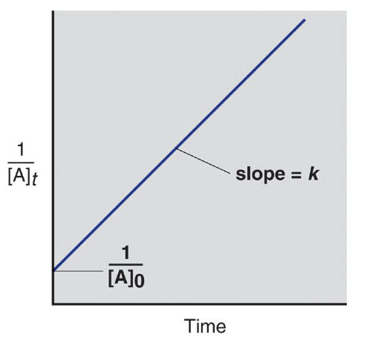
Figure 16.10B Graphical method for finding the reaction order from the integrated rate law.
Second-order reaction
integrated rate law
1
1
-
= kt
[A]_{t}
[A]₀
straight-line form
1
1
= kt +
[A]_{t}
[A]₀
1
[A]
A plot of vs. time gives a straight line for a second-order reaction.

Slide 31
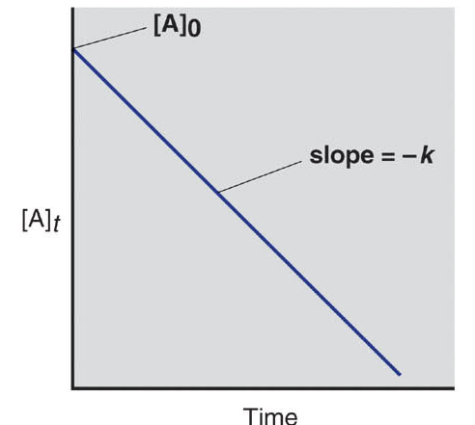
Figure 16.10C Graphical method for finding the reaction order from the integrated rate law.
Zero-order reaction
integrated rate law
[A]_{t} - [A]₀ = - kt
straight-line form
[A]_{t} = - kt + [A]₀
A plot of [A] vs. time gives a straight line for a first-order reaction.

Slide 32
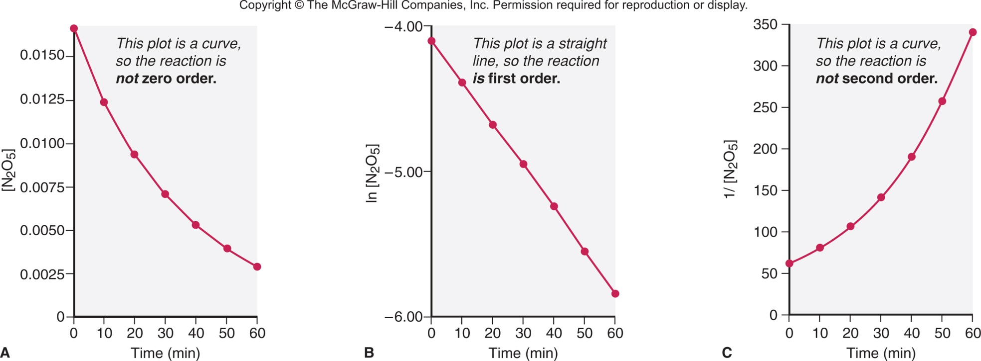
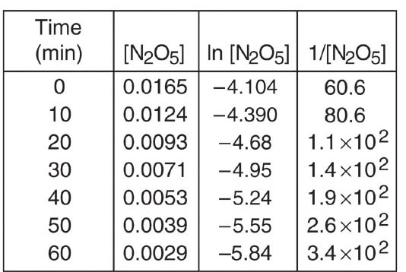
Figure 16.11
Graphical determination of the reaction order for the decomposition of N₂O₅.
The concentration data is used to construct three different plots. Since the plot of ln [N₂O₅] vs. time gives a straight line, the reaction is first order.

Slide 33
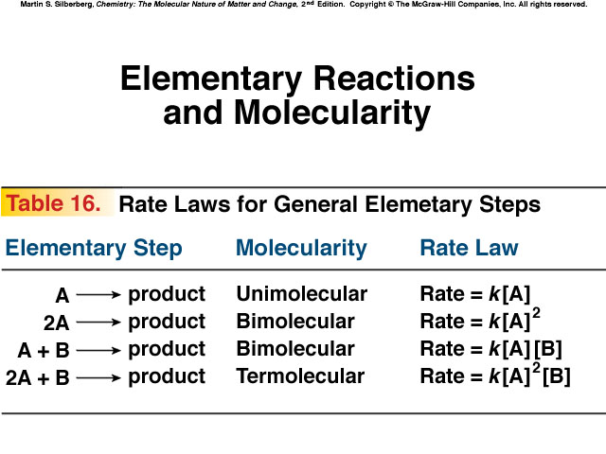

Slide 34
Reaction Mechanism
Chemical equation: Summary
Mechanism: Series of elementary steps
Elementary Steps: Reactions with rate laws
from molecularity
Molecularity: Number of species that must
collide to produce reaction

Slide 35
Intermediates
  appear in steps
  produced in one step
  used in subsequent
  not in overall equation

Slide 36
Rate-determining step
In a multi-step process:
SLOWEST step
Determines overall reaction rate

Slide 37
Determining Molecularity and Rate Laws for Elementary Steps
PROBLEM:
The following elementary steps are proposed for a reaction mechanism:
  (1) NO₂Cl(g) → NO₂(g) + Cl(g)
  (2) NO₂Cl(g) + Cl(g) → NO₂(g) + Cl₂(g)
(a) Write the overall balanced equation.
(b) Determine the molecularity of each step.
(c) Write the rate law for each step.
PLAN:
We find the overall equation from the sum of the elementary steps. The molecularity of each step equals the total number of reactant particles. We write the rate law for each step using the molecularities as reaction orders.

Slide 38
Sample Problem 16.10
SOLUTION:
(a) Writing the overall balanced equation:
(1) NO₂Cl(g) → NO₂(g) + Cl(g)
(2) NO₂Cl(g) + Cl(g) → NO₂(g) + Cl₂(g)
2NO₂Cl(g) → 2NO₂(g) + Cl₂(g)
(b)
Step(1) is unimolecular.
Step(2) is bimolecular.
(c)
rate₁ = k₁[NO₂Cl]
rate₂ = k₂[NO₂Cl][Cl]
Notes:
38

Slide 39
The Rate-Determining Step of a Reaction
The slowest step in a reaction is the rate-determining or rate-limiting step.
The reaction NO₂(g) + CO(g) → NO(g) + CO₂(g)
has been proposed to occur by a two-step mechanism:
NO₂(g) + NO₂(g) → NO₃(g) + NO(g) [slow; rate-determining]
(2) NO₂(g) + CO(g) → NO₂(g) + CO₂(g) [fast]
Observed rate law: rate = k[NO₂]²
The rate law for the rate-determining step becomes the rate law for the overall reaction.

Slide 40
Model for Kinetics
Collision Theory
rate determined by particle collisions
collision frequency and energy
Transition State Theory
how reactants convert to products

Slide 41
Collision Theory and Concentration
The basic principle of collision theory is that particles must collide in order to react.
An increase in the concentration of a reactant leads to a larger number of collisions, hence increasing reaction rate.
The number of collisions depends on the product of the numbers of reactant particles, not their sum.
Concentrations are multiplied in the rate law, not added.

Slide 42
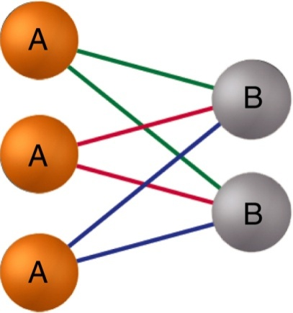
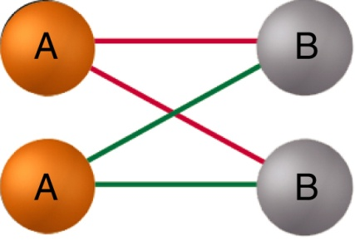
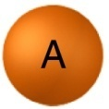
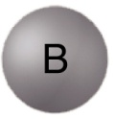
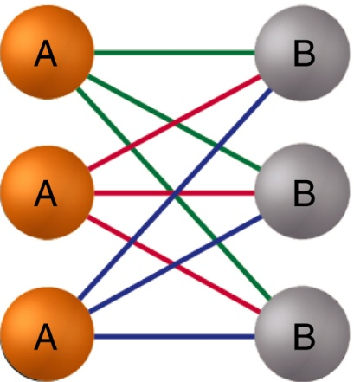
Figure 16.13 The number of possible collisions is the product, not the sum, of reactant concentrations.
add another
6 collisions
4 collisions
add another
9 collisions

Slide 43
Temperature and the Rate Constant
Temperature has a dramatic effect on reaction rate.
For many reactions, an increase of 10°C will double or triple the rate.
Experimental data shows that k increases exponentially as T increases. This is expressed in the Arrhenius equation:
k = rate constant
A = frequency factor
E_{a} = activation energy
k = rate constant
A = frequency factor
E_{a} = activation energy
-E_{a}/RT
k = Ae
-E_{a}/RT
k = Ae
Higher T
larger k
increased rate

Slide 44
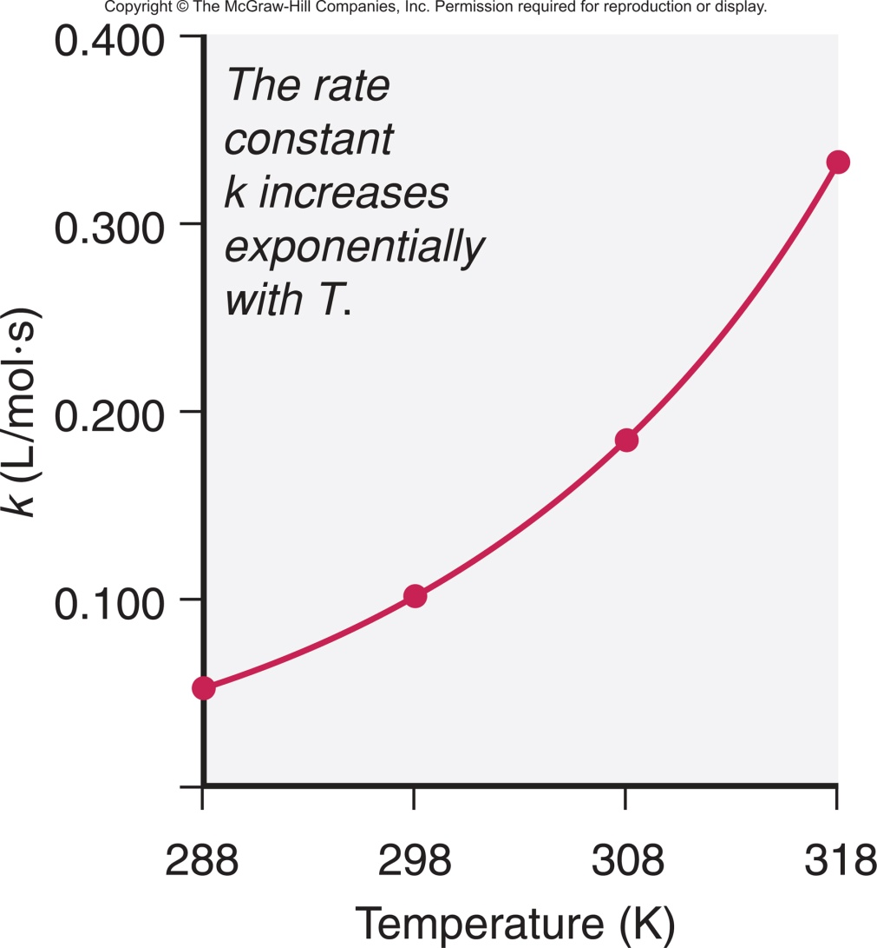
Figure 16.14 Increase of the rate constant with temperature for the hydrolysis of an ester.
Expt | [Ester] | [H₂O] | T (K) | Rate (mol/L·s) | k (L/mol·s)
1 | 0.100 | 0.200 | 288 | 1.04x10⁻³ | 0.0521
2 | 0.100 | 0.200 | 298 | 2.20x10⁻³ | 0101
3 | 0.100 | 0.200 | 308 | 3.68x10⁻³ | 0.184
4 | 0.100 | 0.200 | 318 | 6.64x10⁻³ | 0.332
Reaction rate and k increase exponentially as T increases.

Slide 45
Activation Energy
In order to be effective, collisions between particles must exceed a certain energy threshold.
When particles collide effectively, they reach an activated state. The energy difference between the reactants and the activated state is the activation energy (E_{a}) for the reaction.
The lower the activation energy, the faster the reaction.
Smaller E_{a}
larger f
larger k
increased rate

Slide 46
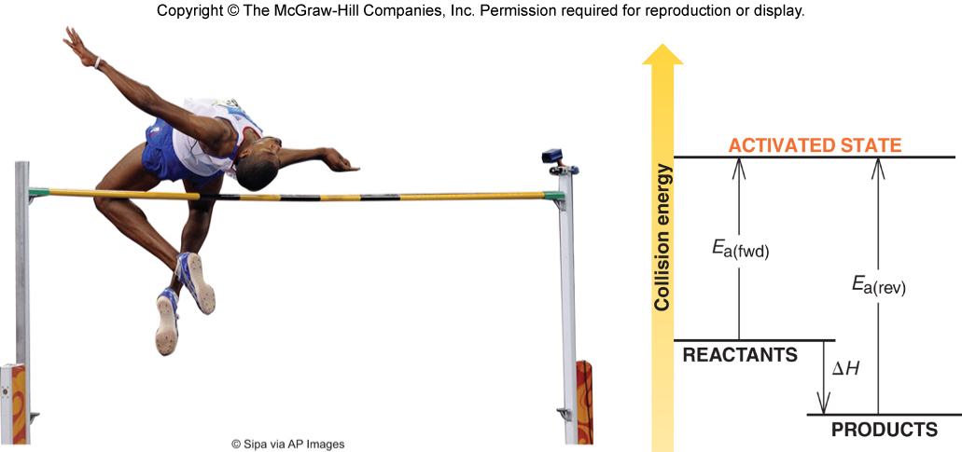
Figure 16.15 Energy-level diagram for a reaction.
Collisions must occur with sufficient energy to reach an activated state.
This particular reaction is reversible and is exothermic in the forward direction.

Slide 47
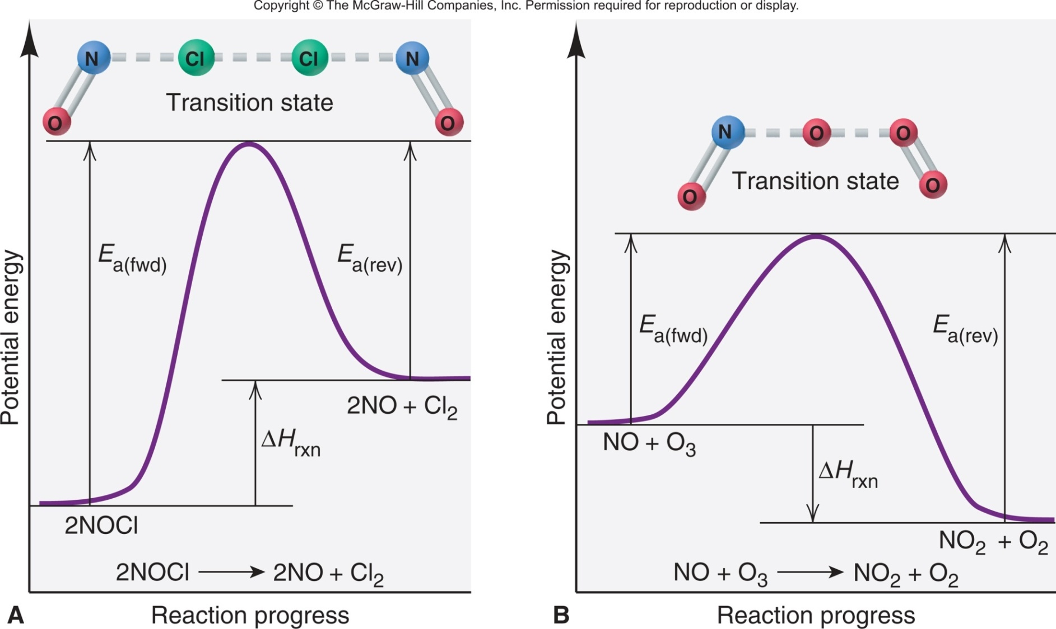
Figure 16.21 Reaction energy diagrams and possible transition states for two reactions.

Slide 48
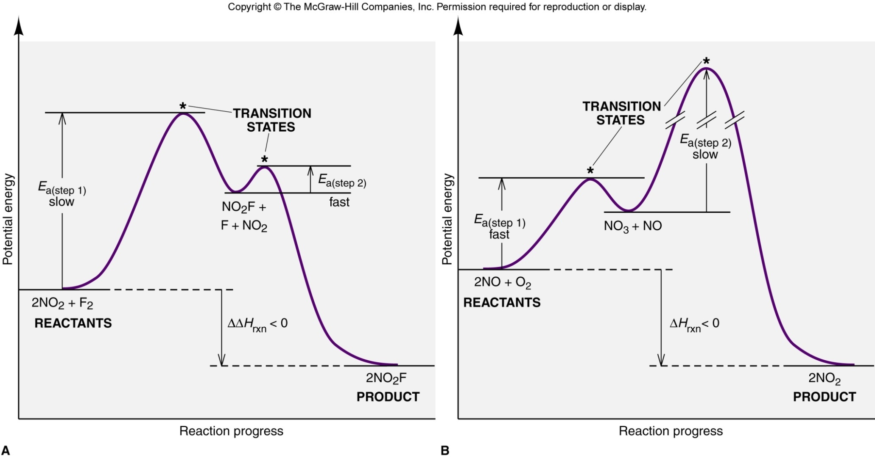
Figure 16.22
Reaction energy diagram for the two-step reaction of (A) NO₂ and F₂ and of (B) NO and O₂.
Each step in a multi-step reaction has its own transition state, which occurs at the energy maximum for that step.

Slide 49
Transition State Theory
E_{a} and internal energy:
Bonds breaking and forming
Atoms rearranging
“Transition State”
Unstable intermediate
At point of highest energy

Slide 50
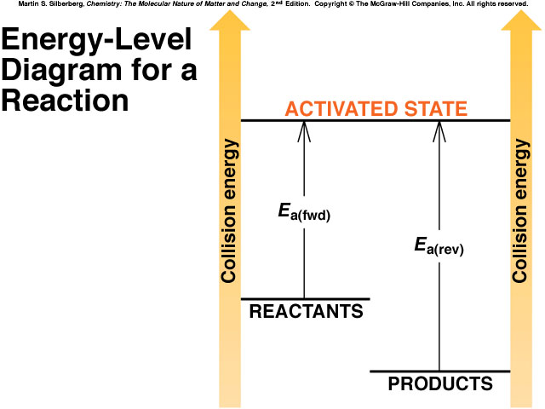
forward reaction
reverse reaction

Slide 51
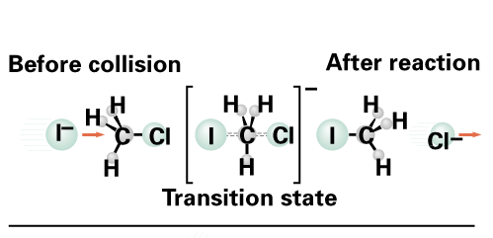
I⁻ + CH₃Cl → Cl⁻ + CH₃I

Slide 52
Temperature and Collision Energy
An increase in temperature causes an increase in the kinetic energy of the particles. This leads to more frequent collisions and reaction rate increases.
At a higher temperature, the fraction of collisions with sufficient energy equal to or greater than E_{a} increases. Reaction rate therefore increases.

Slide 53
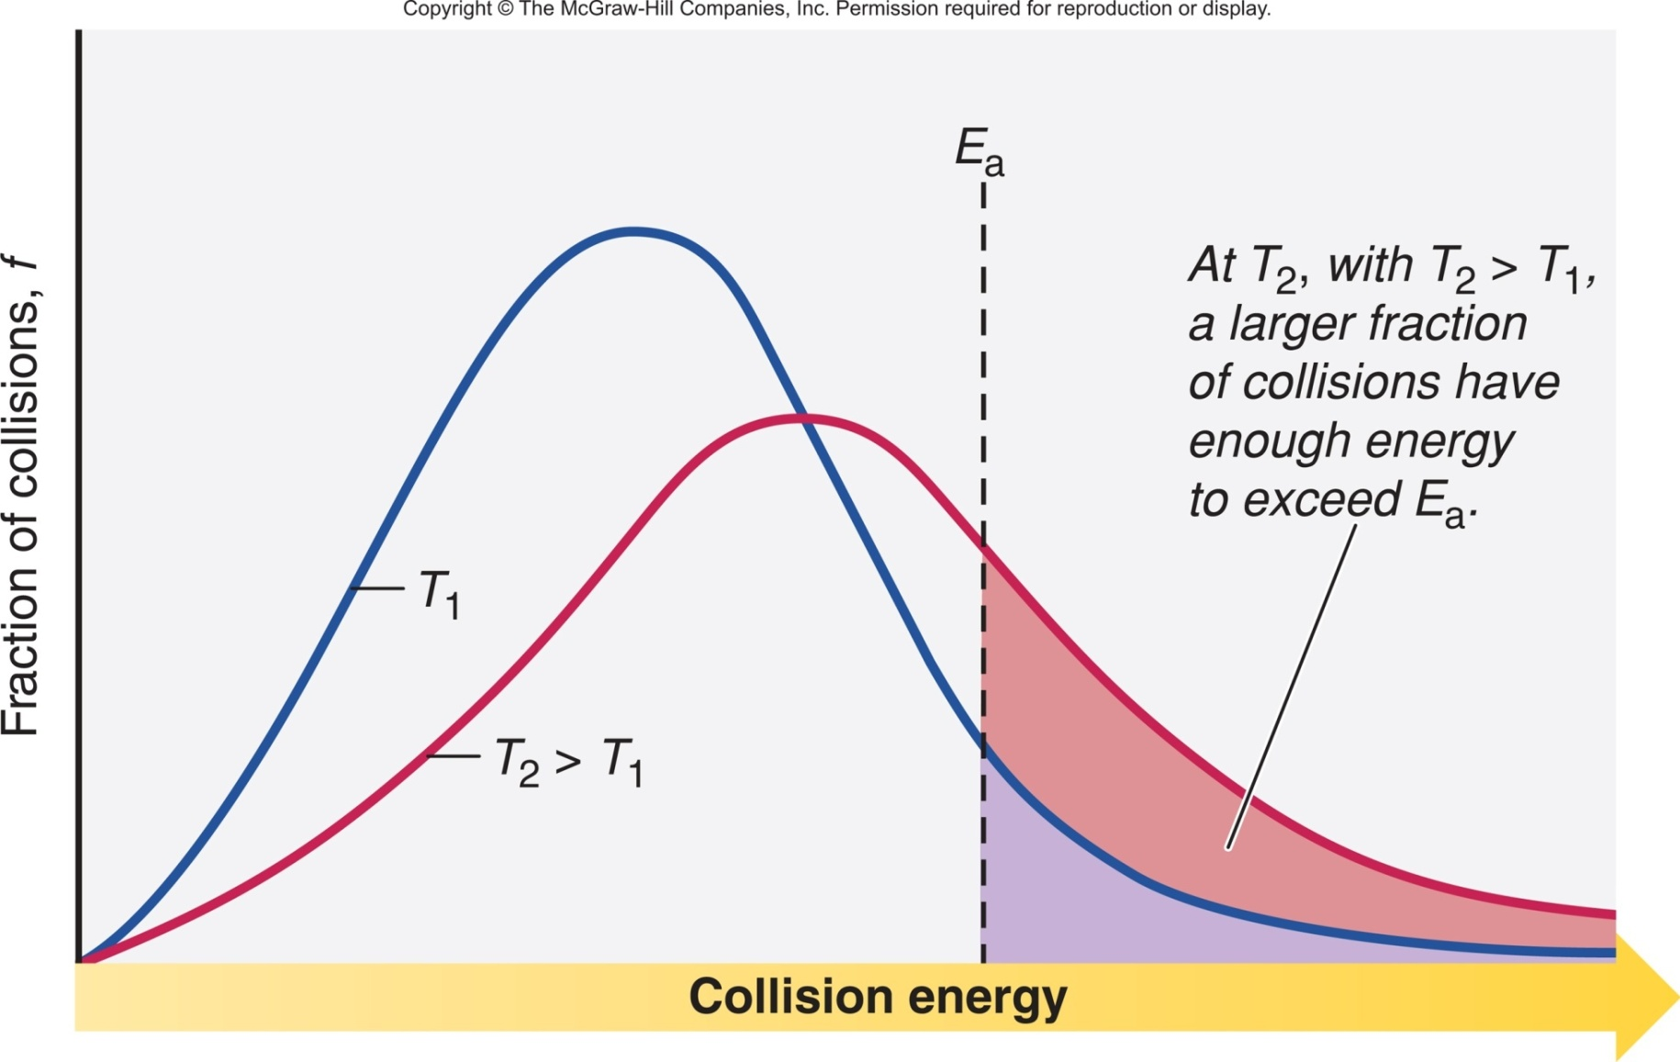
Figure 16.16
The effect of temperature on the distribution of collision energies.

Slide 54
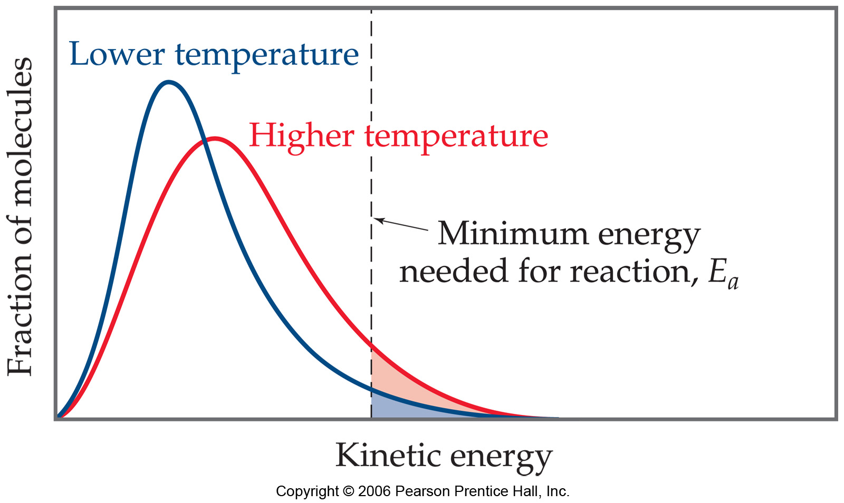
Maxwell–Boltzmann Distributions
Temperature is defined as a measure of the average kinetic energy of the molecules in a sample.
At any temperature there is a wide distribution of kinetic energies.

Slide 55
Maxwell–Boltzmann Distributions
As the temperature increases, the curve flattens and broadens.
Thus at higher temperatures, a larger population of molecules has higher energy.

Slide 56
Maxwell–Boltzmann Distributions
If the dotted line represents the activation energy, as the temperature increases, so does the fraction of molecules that can overcome the activation energy barrier.
As a result, the reaction rate increases.

Slide 57

Maxwell–Boltzmann Distributions
This fraction of molecules can be found through the expression:
where R is the gas constant and T is the temperature in Kelvin .

Slide 58
Sample Problem 16.9
Drawing Reaction Energy Diagrams and Transition States
PROBLEM:
A key reaction in the upper atmosphere is
O₃(g) + O(g) → 2O₂(g)
The E_{a(fwd)} is 19 kJ, and the ΔH_{rxn} for the reaction as written is -392 kJ. Draw a reaction energy diagram, predict a structure for the transition state, and calculate E_{a(rev)}.
PLAN:
The reaction is highly exothermic (ΔH_{rxn} = -392 kJ), so the products are much lower in energy than the reactants. The small E_{a(fwd)} (19 kJ) means that the energy of the reactants lies only slightly below that of the transition state. We calculate the value of E_{a(rev)} from the value of ΔH and E_{a(fwd)}.
To predict the transition state structure, we note that one O-O bond of O₃ breaks and a new O-O bond forms.

Slide 59
Sample Problem 16.9
SOLUTION:
ΔH_{rxn} = E_{a(fwd)} – E_{a(rev)}
So E_{a(rev)} = + E_{a(fwd)} - ΔH_{rxn} = 19 kJ – (-392 kJ) = 411 kJ
E_{a}= 19 kJ
transition state
E_{a(rev)}= (392 + 19) kJ =
411kJ
ΔH_{rxn} = -392 kJ

Slide 60
Molecular Structure and Reaction Rate
For a collision between particles to be effective, it must have both sufficient energy and the appropriate relative orientation between the reacting particles.
The term A in the Arrhenius equation is the frequency factor for the reaction.
k = Ae
-E_{a}/RT
A = pZ
p = orientation probability factor
Z = collision frequency
The term p is specific for each reaction and is related to the structural complexity of the reactants.

Slide 61
Collision Theory (Bimolecular Collsions)
Z: no. of bimolecular collisions per second
f_{a}: fraction with E_{a}
P: fraction with correct orientation
E_{a}: activation energy

Slide 62
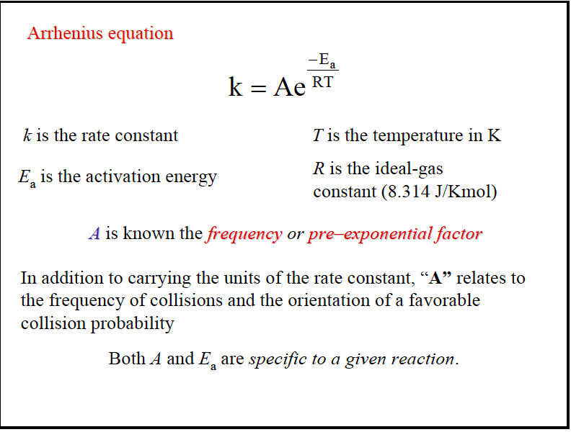

Slide 63
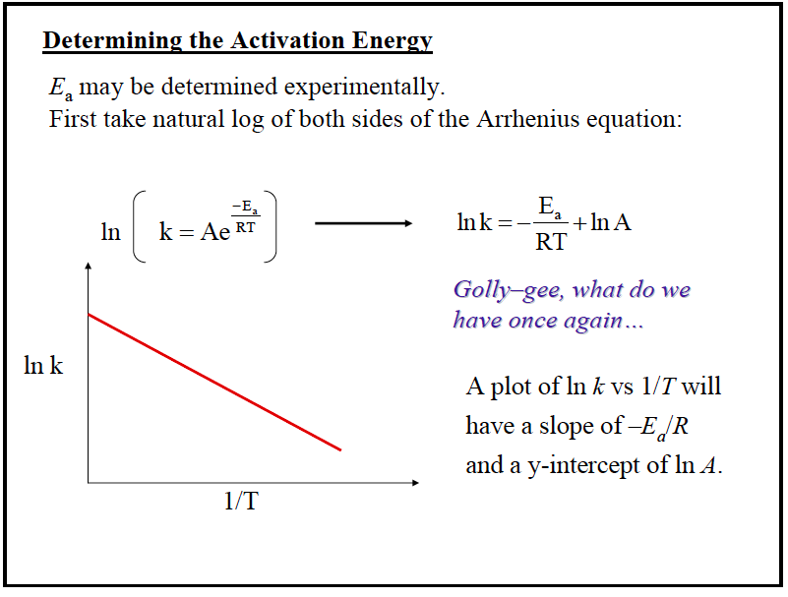

Slide 64
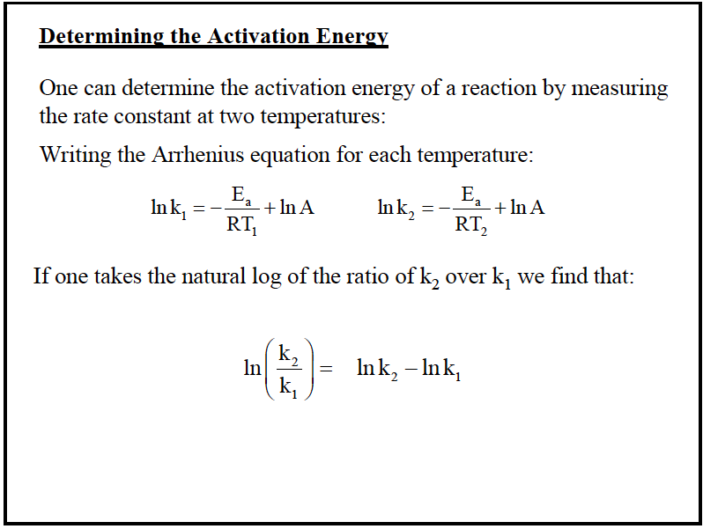

Slide 65
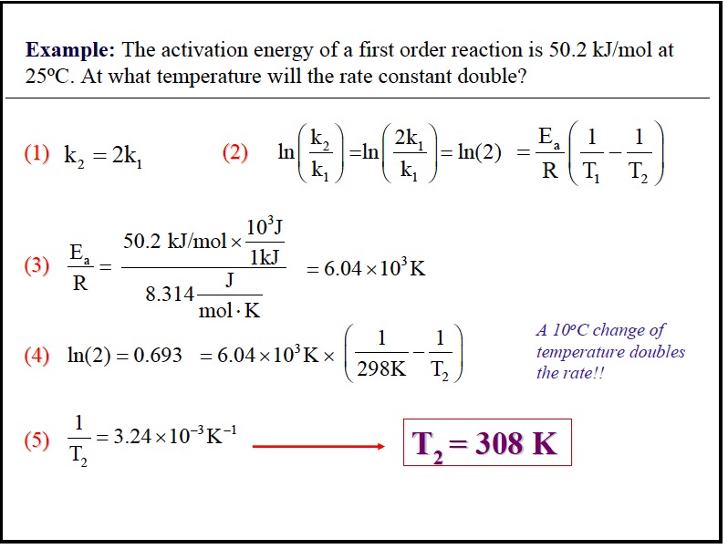

Slide 66
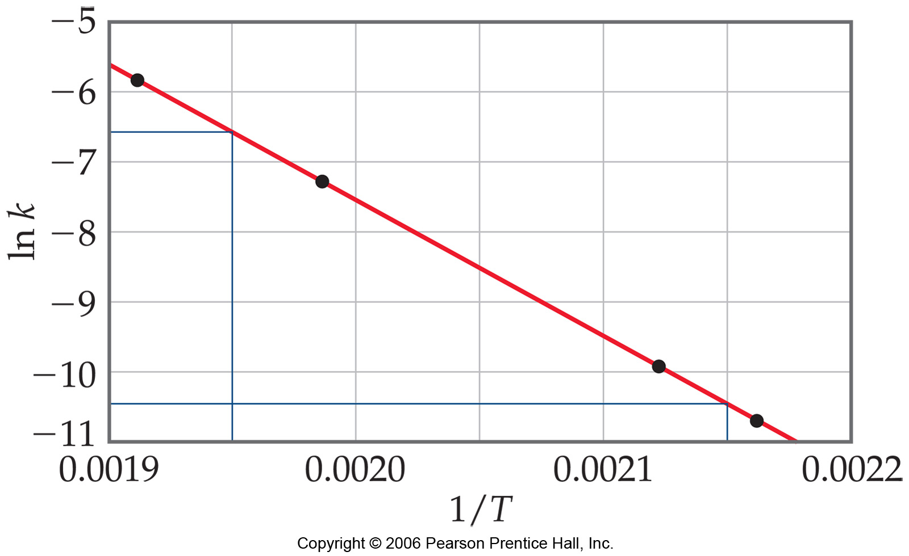

Arrhenius Equation
Taking the natural logarithm of both sides, the equation becomes
1
RT
y = mx + b
When k is determined experimentally at several temperatures, E_{a} can be calculated from the slope of a plot of ln k vs. 1/T.

Slide 67
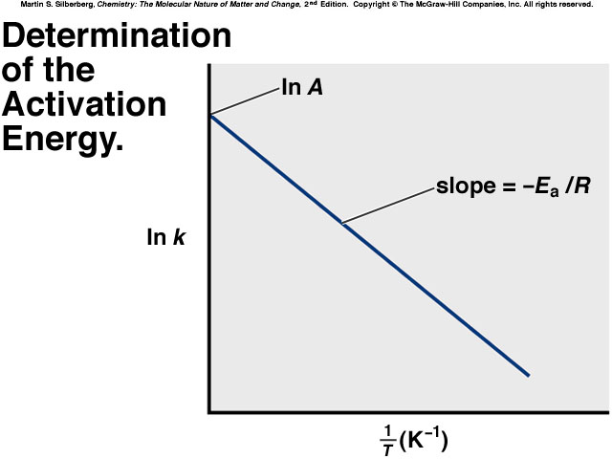
Arrhenius Equation
k: rate constant
E_{a}: activation energy (minimum required)
T: absolute temperature
R: universal gas constant
A: orientation factor
Energy & orientation requirements for reaction

Slide 68
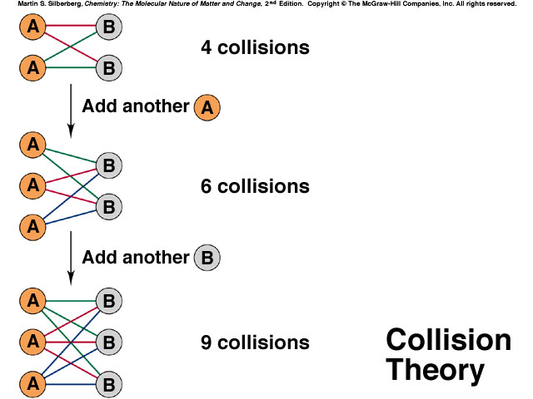

Slide 69
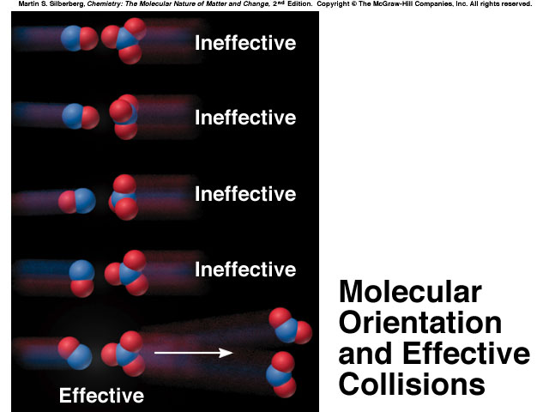

Slide 70
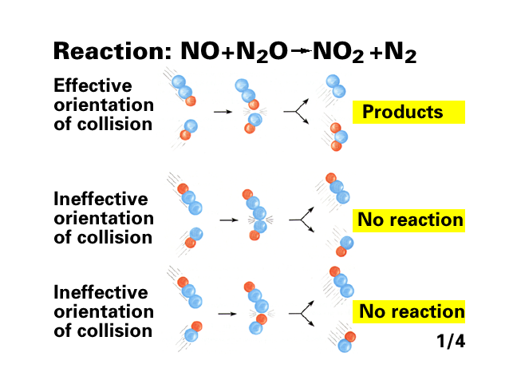

Slide 71
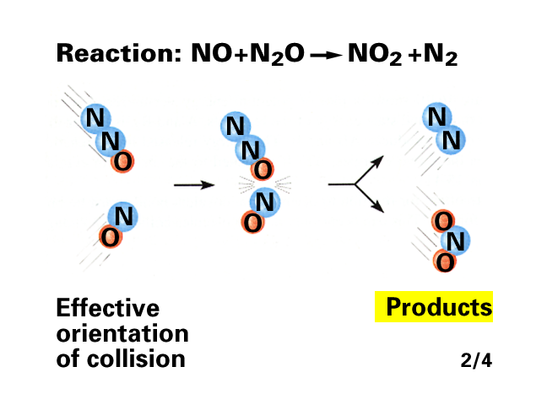

Slide 72
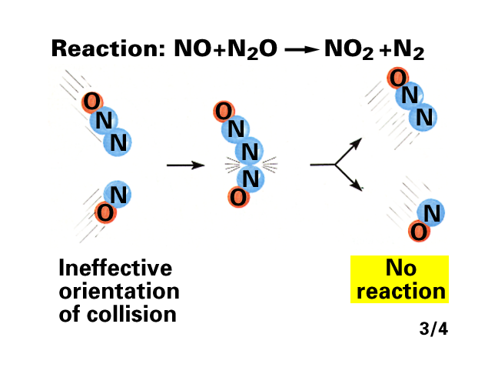

Slide 73
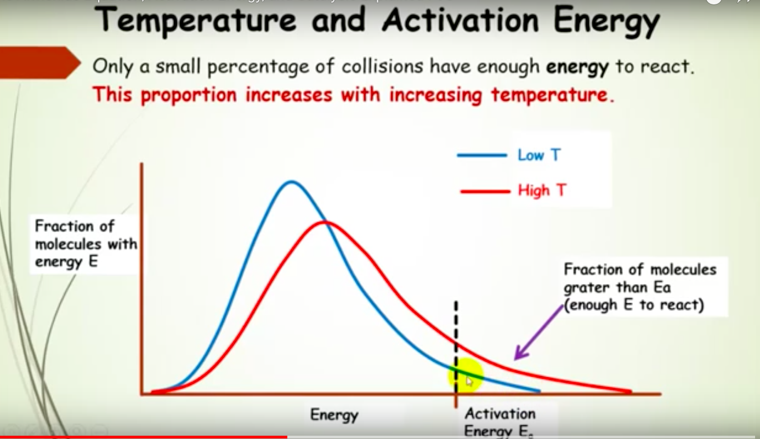

Slide 74
Table 16.6 The Effect of E_{a} and T on the Fraction (f) of Collisions with Sufficient Energy to Allow Reaction
E_{a} (kJ/mol) | f (at T = 298 K)
50 | 1.70x10⁻⁹
75 | 7.03x10-14
100 | 2.90x10⁻¹⁸
T | f (at E_{a} = 50 kJ/mol)
25°C (298 K) | 1.70x10⁻⁹
35°C (308 K) | 3.29x10⁻⁹
45°C (318 K) | 6.12x10⁻⁹

Slide 75
Calculating Activation Energy
E_{a} can be calculated from the Arrhenius equation:
E_{a} 1
R T
k = Ae
-E_{a}/RT
so ln k = ln A -
straight-line form
If data is available at two different temperatures:
k₂
k₁
E_{a}
R
1
T₂
1
T₁
ln
= -
−

Slide 76
Sample Problem 16.8
Determining the Energy of Activation
PROBLEM:
The decomposition of hydrogen iodide,
2HI(g) → H₂(g) + I₂(g), has rate constants of 9.51x10⁻⁹ L/mol·s at 500. K and 1.10x10⁻⁵ L/mol·s at 600. K.
Find E_{a}.
PLAN:
We are given two rate constants and two temperatures, so we can use the Arrhenius equation to solve for E_{a}.
SOLUTION:
E_{a}
R
-1
k₂
k₁
1
1
k₂
k₁
1
1
ln
= -
−
so E_{a} = -R
ln
−
T₂
T₁
T₂
T₁
1.10x10⁻⁵ L/mol·s
9.51x10⁻⁹ L/mol·s
-1
E_{a} = -(8.314 J/mol·K)
ln
1
1
−
600.K
500. K
= 1.76x10⁵ J/mol = 1.76x10² kJ/mol

Slide 77
The Rate-Determining Step of a Reaction
The slowest step in a reaction is the rate-determining or rate-limiting step.
The reaction NO₂(g) + CO(g) → NO(g) + CO₂(g)
has been proposed to occur by a two-step mechanism:
NO₂(g) + NO₂(g) → NO₃(g) + NO(g) [slow; rate-determining]
(2) NO₂(g) + CO(g) → NO₂(g) + CO₂(g) [fast]
Observed rate law: rate = k[NO₂]²
The rate law for the rate-determining step becomes the rate law for the overall reaction.

Slide 78
Correlating Mechanism with the Rate Law
A valid mechanism must meet three criteria:
The elementary steps must add up to the overall balanced equation.
The elementary steps must be reasonable.
The mechanism must correlate with the observed rate law.
A mechanism is a hypothesis –we cannot prove it is correct, but if it is consistent with the data, and can be used to predict results accurately, it is a useful model for the reaction.

Slide 79
Mechanisms with a Slow Initial Step
The overall reaction 2NO₂(g) + F₂(g) →2NO₂F(g) has an experimental rate law Rate = k[NO₂][F₂].
The accepted mechanism is
NO₂(g) + F₂(g) → NO₂F(g) + F(g) [slow; rate determining]
NO₂(g) + F(g) → NO₂F(g) [fast]
2NO₂(g) + F₂(g) →2NO₂F(g)
The elementary steps sum to the overall balanced equation:
Both steps are bimolecular and are therefore reasonable.
rate₁ = k₁[NO₂[F₂]
rate₂ = k₂[NO₂][F]
Step 1 is the slow step, and rate₁ correlates with the observed rate law.
The mechanism is therefore reasonable.

Slide 80
Mechanisms with a Fast Initial Step
The overall reaction 2NO (g) + O₂(g) →2NO₂(g) has an experimental rate law Rate = k[NO]²[O₂].
A proposed mechanism is
NO(g) + O₂(g) D NO₃(g) [fast]
NO₃(g) + NO(g) → 2NO₂(g) [slow; rate determining]
2NO (g) + O₂(g) →2NO₂(g)
The elementary steps sum to the overall balanced equation:
Both steps are bimolecular and are therefore reasonable.
rate_{1(fwd)} = k₁[NO][O₂]
rate_{1(rev)} = k₋₁[NO₃]
rate₂ = k₂[NO₃][NO]
When equilibrium (1) has been established
rate_{1(fwd)} = rate_{1(rev)}
k₁[NO][O₂] = k₋₁[NO₃]

Slide 81
k₁
k₋₁
[NO₃] =
[NO][O₂]
k₁
k₋₁
rate₂ = k₂[NO₃][NO] = k₂
[NO][O₂]
[NO]
The ratio of rate constants is itself a constant, equal to the overall rate constant for the reaction, so
rate₂ = k[NO]²[O₂] which is consistent with the observed rate law.
For any mechanism, only reactants involved up to and including the slow (rate-determining) step appear in the overall rate law.

Slide 82
Figure 16.22
Reaction energy diagram for the two-step reaction of (A) NO₂ and F₂ and of (B) NO and O₂.
Each step in a multi-step reaction has its own transition state, which occurs at the energy maximum for that step.

Slide 83
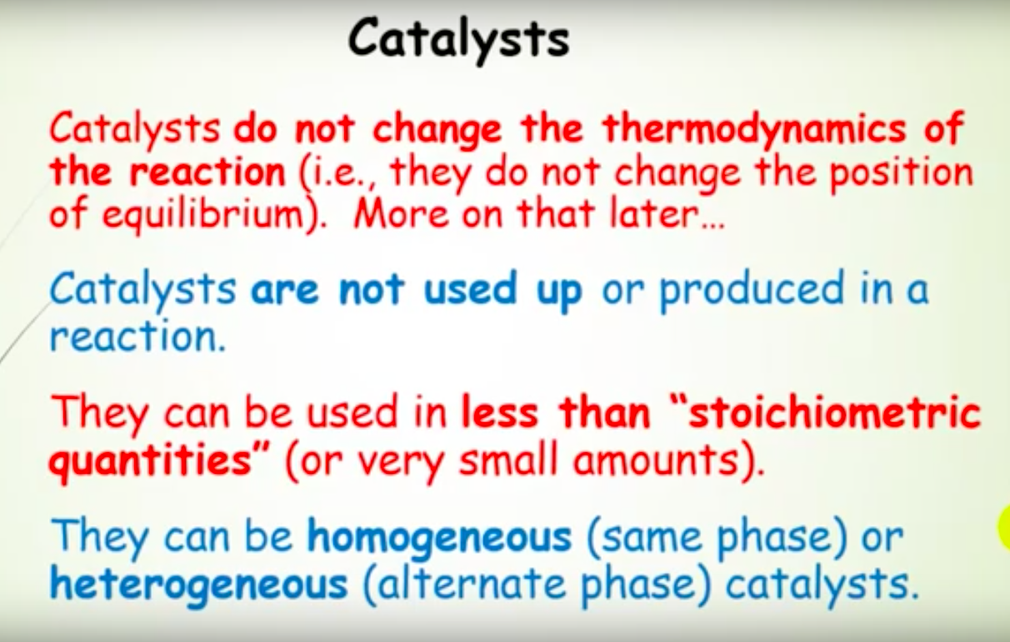

Slide 84
What is a Catalyst ?
  Catalyst is a substance that increases the rate of the reaction at which a chemical system approaches equilibrium , without being substantially consumed in the process.
  Catalyst affects only the rate of the reaction, i.e.Kinetics
  It changes neither the thermodynamics of the reaction nor the equilibrium composition.

Slide 85
Chemical Reaction
Thermodynamic
Thermodynamics says NOTHING about the rate of a reaction.
Thermodynamics : Will a reaction occur ?
Kinetics : If so, how fast ?

Slide 86
Kinetic Vs. Thermodynamic
A reaction may have a large, negative ΔG_{rxn}, but the rate may be so slow that there is no evidence of it occurring.
  Conversion of graphite to diamonds is a thermodynamic favor process (ΔG -ve ).
    C _{(graphite)}  C _{(diamond)}
  Kinetics makes this reaction nearly impossible (Requires a very high pressure and temperature over long time)

Slide 87
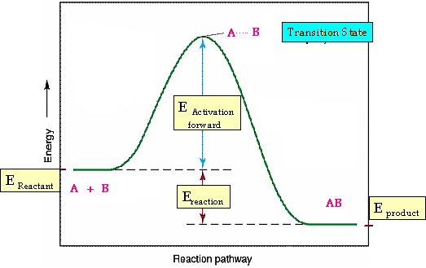
Kinetic Vs. Thermodynamic
Reaction Profile
Reaction path for conversion of A + B into AB

Slide 88
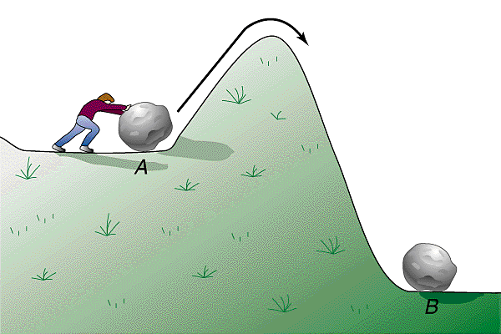
Activation Energy
Definition
Activation Energy : The energy required to overcome the reaction barrier. Usually given a symbol E_{a} or ∆G≠
The Activation Energy (Ea) determines how fast a reaction occurs, the higher Activation barrier, the slower the reaction rate. The lower the Activation barrier, the faster the reaction

Slide 89
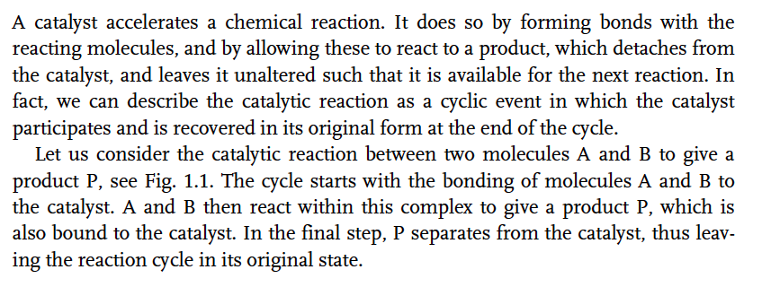


Slide 90


Slide 91
Action of Catalysts
CH4003 Lecture Notes 11 (Erzeng Xue)
Catalysis & Catalysts
Catalysis action - Reaction kinetics and mechanism
Catalyst action leads to the rate of a reaction to change.
This is realised by changing the course of reaction (compared to non-catalytic reaction)
  Forming complex with reactants/products, controlling the rate of elementary steps in the process. This is evidenced by the facts that
    The reaction activation energy is altered
    The intermediates formed are different from
    those formed in non-catalytic reaction
    The rates of reactions are altered (both
    desired and undesired ones)
  Reactions proceed under less demanding conditions
    Allow reactions occur under a milder conditions, e.g. at lower temperatures for those heat sensitive materials
uncatalytic
catalytic
energy
reactant
product
reaction process

Slide 92

Activation Energy
Catalyst Affect
This means , the catalyst changes the reaction path by lowering its activation energy and consequently the catalyst increases the rate of reaction.

Slide 93
Catalysis: Speeding up a Reaction
A catalyst is a substance that increases the reaction rate without itself being consumed in the reaction.
In general, a catalyst provides an alternative reaction pathway that has a lower total activation energy than the uncatalyzed reaction.
A catalyst will speed up both the forward and the reverse reactions.
A catalyst does not affect either ΔH or the overall yield for a reaction.

Slide 94


Slide 95


Slide 97


Slide 98
Types of Catalysts & Catalytic Reactions
CH4003 Lecture Notes 11 (Erzeng Xue)
Catalysis & Catalysts
The types of catalysts
  Classification based on the its physical state, a catalyst can be
    gas
    liquid
    solid
  Classification based on the substances from which a catalyst is made
    Inorganic (gases, metals, metal oxides, inorganic acids, bases etc.)
    Organic (organic acids, enzymes etc.)
  Classification based on the ways catalysts work
    Homogeneous - both catalyst and all reactants/products are in the same phase (gas or liq)
    Heterogeneous - reaction system involves multi-phase (catalysts + reactants/products)
  Classification based on the catalysts’ action
    Acid-base catalysts
    Enzymatic
    Photocatalysis
    Electrocatalysis, etc.

Slide 99

Adsorption, activation, reaction, desorption

Slide 100


Slide 101

Figure
The metal-catalyzed hydrogenation of ethene.
A heterogeneous catalyst is in a different phase than the reaction mixture.

Slide 102

Figure 16.24 The catalyzed decomposition of H₂O₂.
A homogeneous catalyst is in the same phase as the reaction mixture.
A small amount of NaBr is added to a solution of H₂O₂.
Oxygen gas forms quickly as Br⁻(aq) catalyzes the H₂O₂ decomposition; the intermediate Br₂ turns the solution orange.

Slide 103

Figure 16.26A Two models of enzyme action.
The lock-and-key model visualizes the enzyme active site having a fixed shape. This shape matches the shape of its substrate(s). The active site is therefore specific to its substrate.

Slide 104

Figure 16.26B Two models of enzyme action.
The induced-fit model visualizes the enzyme active site changing shape in order to bind its substrate(s) more effectively. The active site is still selective towards certain substrates.

Slide 105


Slide 106


Slide 107


Slide 108


Slide 109


Slide 110
Dynamic (Catalytic) Properties of Catalysts:
Definitions and Specifications.

Slide 111


Slide 112


Slide 113
Catalytic Reaction Processes
CH4003 Lecture Notes 12 (Erzeng Xue)
Catalysis & Catalysts
General requirements for a good catalyst
  Activity - being able to promote the rate of desired reactions
  Selective - being to promote only the rate of desired reaction and also retard the undesired reactions
  Note: The selectivity is sometime considered to be more important than the activity and sometime it is more difficult to achieve
  (e.g. selective oxidation of NO to NO₂ in the presence of SO₂)
  Stability - a good catalyst should resist to deactivation, caused by
      the presence of impurities in feed (e.g. lead in petrol poison TWC.
      thermal deterioration, volatility and hydrolysis of active components
      attrition due to mechanical movement or pressure shock
  A solid catalyst should have reasonably large surface area needed for reaction (active sites). This is usually achieved by making the solid into a porous structure.

Slide 114
Solid Catalysts
CH4003 Lecture Notes 12 (Erzeng Xue)
Catalysis & Catalysts
Some common solid support / carrier materials
  Alumina
    Inexpensive
    Surface area: 1 ~ 700 m²/g
    Acidic
  Silica
    Inexpensive
    Surface area: 100 ~ 800 m²/g
    Acidic
  Zeolite
    mixture of alumina and silica,
    often exchanged metal ion present
    shape selective
    acidic
  Other supports
    Active carbon (S.A. up to 1000 m²/g)
    Titania (S.A. 10 ~ 50 m²/g)
    Zirconia (S.A. 10 ~ 100 m²/g)
    Magnesia (S.A. 10 m²/g)
    Lanthana (S.A. 10 m²/g)
Active site
porous
solid
pore

Slide 115


Slide 116
Adsorption On Solid Surface
CH4003 Lecture Notes 13 (Erzeng Xue)
Catalysis & Catalysts
Applications of adsorption process
  Adsorption is a very important step in solid catalysed reaction processes
  Adsorption in itself is a common process used in industry for various purposes
    Purification (removing impurities from a gas / liquid stream)
    De-pollution, de-colour, de-odour
    Solvent recovery, trace compound enrichment
    etc…
    Usually adsorption is only applied for a process dealing with small capacity
    The operation is usually batch type and required regeneration of saturated adsorbent
  Common adsorbents: molecular sieve, active carbon, silica gel, activated alumina.
  Physisorption is an useful technique for determining the surface area, the pore shape, pore sizes and size distribution of porous solid materials (BET surface area)

Slide 117
Applications of Catalysis
CH4003 Lecture Notes 11 (Erzeng Xue)
Catalysis & Catalysts
Industrial applications
  Almost all chemical industries have one or more steps employing catalysts
  Petroleum, energy sector, fertiliser, pharmaceutical, fine chemicals …
  Advantages of catalytic processes
  Achieving better process economics and productivity
    Increase reaction rates - fast
    Simplify the reaction steps - low investment cost
    Carry out reaction under mild conditions (e.g. low T, P) - low energy consumption
  Reducing wastes
    Improving selectivity toward desired products - less raw materials required, less unwanted wastes
    Replacing harmful/toxic materials with readily available ones
  Producing certain products that may not be possible without catalysts
  Having better control of process (safety, flexible etc.)
  Encouraging application and advancement of new technologies and materials
  And many more …

Slide 118
Applications of Catalysis
CH4003 Lecture Notes 11 (Erzeng Xue)
Catalysis & Catalysts
Environmental applications
  Pollution controls in combination with industrial processes
    Pre-treatment - reduce the amount waste/change the composition of emissions
    Post-treatments - once formed, reduce and convert emissions
    Using alternative materials
    …
  Pollution reduction
    gas - converting harmful gases to non-harmful ones
    liquid - de-pollution, de-odder, de-colour etc
    solid - landfill, factory wastes
    …
  And many more …
Other applications
  Catalysis and catalysts play one of the key roles in new technology development.

