Slide 1
CATALYSIS AND CATALYTIC REACTION MECHANISM PART 1

Slide 2
CATALYST-DEFINITION
A catalyst is a substance that affects the rate of a reaction but emerges from the process unchanged.
A catalyst usually changes a reaction rate by promoting a different molecular path ("mechanism") for the reaction.
Catalyst affect yield and selectivity
Changes only the rate of reaction; it does not affect the equlibrium.

Slide 3
Students should be able to;
DISCUSS the steps in a heterogeneous reaction
(adsorption, surface reaction, and desorption)
DESCRIBE the rate limiting step.
EXPLAIN different types of surface reaction (single
site, dual site, and Eley-Rideal)
ANALYZE data to DEVELOP a rate law for
Langmuir- Hinshelwood kinetics.
ERT 208/4 REACTION ENGINEERING
SEM 2 (2009/2010)

Slide 4
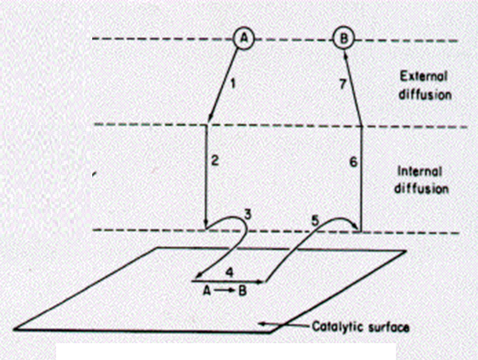
Steps in Catalytic Reaction
External diffusion
External diffusion
Internal diffusion
Internal diffusion
Adsorption
Surface reaction
Desorption

Slide 5
Steps in Catalytic Reaction
Mass transfer (diffusion) of the reactant from the bulk to the external transport.
Internal diffusion
Adsorption
Reaction on the surface
Desorption
Diffusion of the reactant
Mass transfer of the product
* Steps 3, 4 and 5 are MOST important

Slide 6
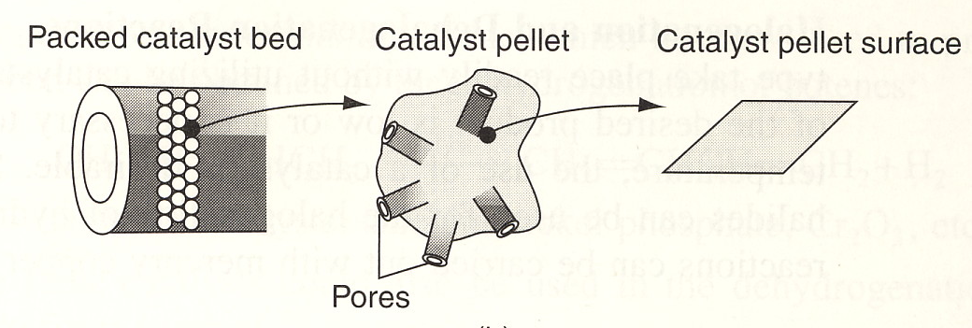
HETEROGENEOUS CATALYTIC REACTIONS
Heterogeneous catalyst works in general term;
(1)Adsorption
(2)Surface Reaction
(3)Desorption
Fig 1: Schematic Diagram of Tubular Reactor Packed with Catalytic Pellets
ERT 208/4 REACTION ENGINEERING
SEM 2 (2009/2010)

Slide 7
HETEROGENEOUS CATALYTIC REACTIONS…cont….
Steps in Catalytic Reaction;
Mass transfer (diffusion) of the reactant(s)(eg. Species A)
Diffusion of the reactant from the pore mouth through the catalyst pores to the immediate vicinity of the internal catalytic surface.
Adsorption of reactant A onto the catalyst surface
Reaction on the surface of the catalyst (eg; A ------B)
Desorption of the products (eg. B) from the surface
Diffusion of the products from the interior of the pellet to the pore mouth at the external surface
Mass transfer of the products from the external pellet surface to the bulk fluid.
ERT 208/4 REACTION ENGINEERING
SEM 2 (2009/2010)

Slide 8
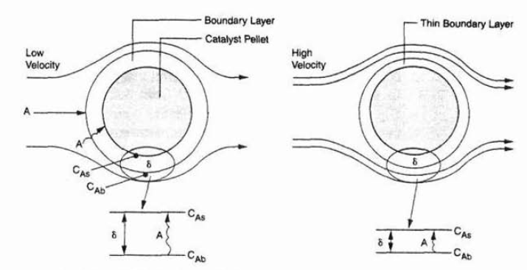
STEP 1:Difussion of the reactant from the bulk to the external transport.

Slide 9
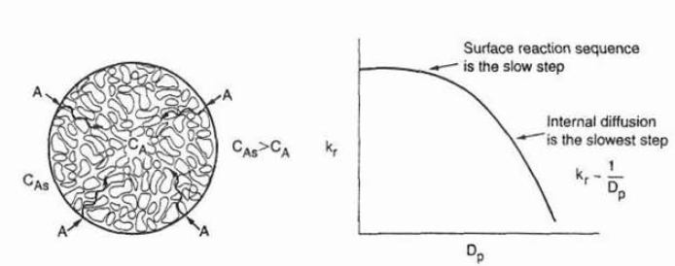
STEP 2:Internal diffusion

Slide 10
HETEROGENEOUS CATALYTIC REACTIONS…cont….
Info ;
Overall rate of reaction is equal to the rate of the slowest step in the mechanism.
If diffusion steps (1,2,6 &7) > fast than reaction steps (3,4 &5) – conc in the immediate vicinity of the active sites are indistinguishable from those in the bulk fluid.
- the transport / diffusion steps not effect the overall rate of the reaction.
If reaction steps (3,4&5) > fast than diffusion steps;
- mass transport does effect the reaction rate
ERT 208/4 REACTION ENGINEERING
SEM 2 (2009/2010)

Slide 11
HETEROGENEOUS CATALYTIC REACTIONS…cont….
In system where diffusion from the bulk gas @ liquid to catalyst surface or to the mouths of catalyst pores effects the rate, changing the flow conditions past the catalyst should change the overall reaction rate.
For porous catalyst, diffusion within the catalyst pores may limit the rate of reaction.
The overall rate will be unaffected by external flow conditions even though diffusion effects the overall reaction rate.
ERT 208/4 REACTION ENGINEERING
SEM 2 (2009/2010)

Slide 12
STEP 3:Adsorption Isotherms
A atom,molecule,or atomic combination
One unit of species A will be adsorbed on the site S
S
Active site

Slide 13
(1) ADSORPTION ISOTHERMS
Chemisorptions is usually a necessary part of a catalytic process.
Where,
S = active sites (alone will donate a vacant site with no atom, molecule/complex adsorp on it)
A.S = mean one unit of “A” will be adsorbed on the site “S”.
ERT 208/4 REACTION ENGINEERING
SEM 2 (2009/2010)

Slide 14
STEP 3:Adsorption Isotherms
SITE BALANCE:
C_{t} =total concentration of sites
C_{v}= Vacant site

Slide 15
(1)ADSORPTION ISOTHERMS…continue…
Steps to Describe Isotherm??
Proposed model system
Isotherm model is compared with the experimental data shown on the curve.
If model predicted the curve (agree with exp)-the model reasonably describe what is occurring physically in the real system.
ERT 208/4 REACTION ENGINEERING
SEM 2 (2009/2010)

Slide 16
(1)ADSORPTION ISOTHERMS…continue…
Example:
Adsorption of Carbon Monoxide
on Metal
1st Step: Proposed model system
– 2 model proposed:
a)As molecule (nondissosiated) - CO
b) As atom (dissociative) - C and O
ERT 208/4 REACTION ENGINEERING
SEM 2 (2009/2010)

Slide 17
(1)ADSORPTION ISOTHERMS…continue…
MODEL 1: As molecule (nondissosiated) – CO
(MOLECULAR ADSORPTION)
Rate of adsorption:
Rate of desorption:
Net rate of adsorption:
ERT 208/4 REACTION ENGINEERING
SEM 2 (2009/2010)

Slide 18
(1)ADSORPTION ISOTHERMS…continue…
The rate of attachment (adsorption):
Rate of adsorption for “CO” molecules to the surface directly proportional ;
to no. of collision that these molecules will make with the surface per second.
To the product of partial pressure of “CO” & conc of vacant sites.
The rate of detachment (desorption):
Rate of detachment for “CO” molecules to the surface directly proportional ;
Conc of sites occupied by molecules, C_{CO.S}
ERT 208/4 REACTION ENGINEERING
SEM 2 (2009/2010)

Slide 19
(1)ADSORPTION ISOTHERMS…continue…
Because of CO is the only material adsorbed on the catalyst, the site balance gives;
At equilibrium;
ERT 208/4 REACTION ENGINEERING
SEM 2 (2009/2010)

Slide 20
(1) ADSORPTION ISOTHERMS…continue…
(1)
(2)
(1) In (2);
ERT 208/4 REACTION ENGINEERING
SEM 2 (2009/2010)

Slide 21
(1) ADSORPTION ISOTHERMS…continue…
MODEL 2: As atom (dissosiated) – C and O
(ATOM ADSORPTION)
Rate of adsorption:
Rate of desorption:
Net rate of adsorption:
ERT 208/4 REACTION ENGINEERING
SEM 2 (2009/2010)

Slide 22
(1) ADSORPTION ISOTHERMS…continue…
The rate of attachment (adsorption):
Rate of adsorption for “C and O” atoms to the surface directly proportional ;
Pressure of CO in the system cz this rate governs the no. of gaseous collision with the surface
2 adjacent vacant site are required (C.S and O.S)
2 vacant site occuring adjacent to one another is proportional to square of conc of vacant sites.
To the product of CO partial pressure & square of vacant
The rate of detachment (desorption):
Rate of detachment for “C and O” atoms to the surface directly proportional ;
2 occupied sites must be adjacent
_{To} the product of occupied site conc (C.S and O.S)
ERT 208/4 REACTION ENGINEERING
SEM 2 (2009/2010)

Slide 23
(1) ADSORPTION ISOTHERMS…continue…
Is adsorption equilibrium constant
ERT 208/4 REACTION ENGINEERING
SEM 2 (2009/2010)

Slide 24
(1) ADSORPTION ISOTHERMS…continue…
Because of C and O is the only material adsorbed on the catalyst, the site balance gives;
At equilibrium;
ERT 208/4 REACTION ENGINEERING
SEM 2 (2009/2010)

Slide 25
(1) ADSORPTION ISOTHERMS…continue…
From,
For ;
ERT 208/4 REACTION ENGINEERING
SEM 2 (2009/2010)

Slide 26
(1) ADSORPTION ISOTHERMS…continue…
From site balance,
Substitute in site balance;
Solving for Cv;
ERT 208/4 REACTION ENGINEERING
SEM 2 (2009/2010)

Slide 27
(1) ADSORPTION ISOTHERMS…continue…
From;
and
Solving for Co.s ;
ERT 208/4 REACTION ENGINEERING
SEM 2 (2009/2010)

Slide 28
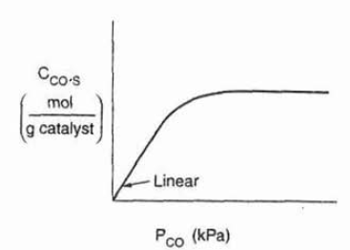
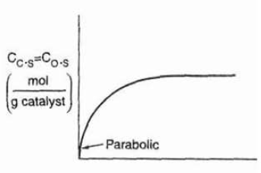
STEP 3:Adsorption Isotherms
MODEL 1
MOLECULAR
(NONDISSOCIATED ADSORPTION)
CO is adsorbed as molecules CO
MODEL 2
DISSOCIATIVE ADSORPTION
CO is adsorbed as C and O
LANGMUIR ISOTHERM

Slide 29
STEP 4:SURFACE REACTION
SINGLE SITE
DUAL SITE
ELEY-RIDEAL

Slide 30
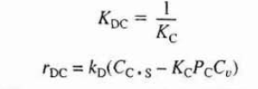
STEP 5:DESORPTION
The rate of desorption of C

Slide 31
The Rate-Limiting Step
When heterogeneous reactions are carried out at steady state. The rates of each of the three reaction steps in series (adsorption, surface reaction and desorption) are equal to one another:
One particular step in the series is usually found to be rate-limiting or rate-controlling.

Slide 32
ALGORITHM FOR DETERMINING RXN MECHANISM AND RATE LIMITING STEP
Select a mechanism
Assume a rate limiting step:
Choose the surface rxn first
Find the expression for concentration of adsorbed species.
Write a site balance
Derive the rate law
Compare with data

Slide 33
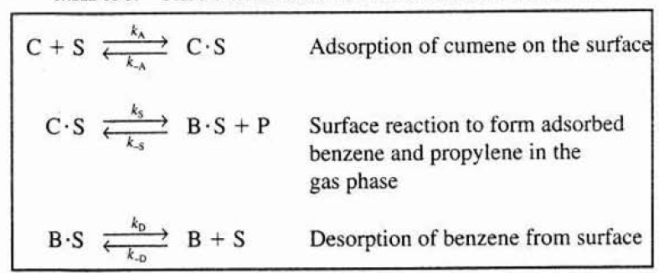
Synthesizing Rate law, Mechanism and Rate Limiting step
EXAMPLE: Cumene decomposition
CUMENE (C)
BENZENE (B) + PROPYLENE (P)

Slide 34
EXERCISE 1
Synthesize the rate law for each mechanism;
ADSORPTION
SURFACE REACTION
DESORPTION

Slide 35
Rate law

Slide 36
Is the Adsorption of Cumene Rate-Limiting?
Rate of adsorption;
Assume adsorption is rate-limiting, thus;
k_{A} is small and k_{s} and k_{D} are large
The ratio very small ~approximately zero;

Slide 37
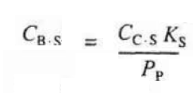
Surface reaction
Desorption
Rearrange;

Slide 38
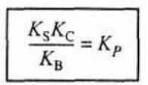
Rate of Adsorption;

Slide 39
To eliminate C_{v} ;
Cumene rxn rate law if
adsorption are limiting step

Slide 40
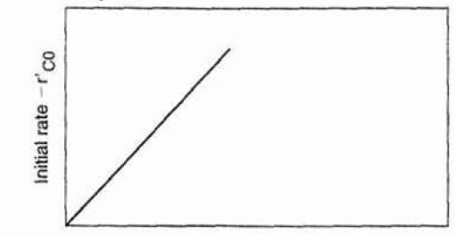
Initially, no products are present; consequently,
P_{P} = P_{B} = 0.
If the cumene decomposition is adsorption rate limited, the initial rate will be linear with the initial partial pressure of cumene

Slide 41
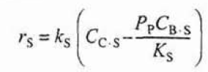
Is the Surface Reaction Rate-Limiting?
Rate of surface reaction;
Assume surface reaction is rate-limiting, thus;
k_{S} is small and k_{A} and k_{D} are large
Cumene rxn rate law if
Surface reaction are limiting step
The initial rate;

Slide 42
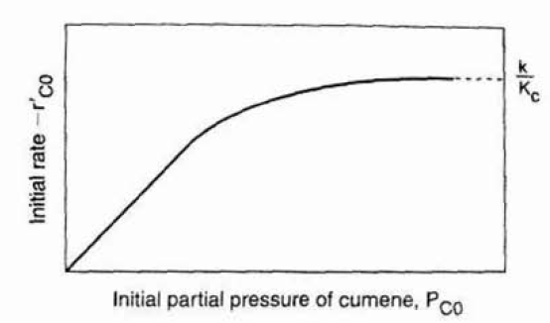
Is the Surface Reaction Rate-Limiting?

Slide 43
Is the Desorption of Benzene Rate-Limiting?
Rate of desorption of benzene;
Assume desorption is rate-limiting, thus;
k_{D} is small and k_{A} and k_{S} are large
Cumene rxn rate law if
desorption are limiting step
The initial rate;

Slide 44
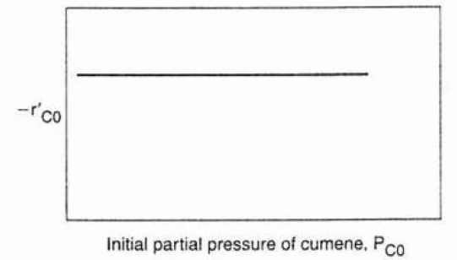
Is the Desorption of Benzene Rate-Limiting?

Slide 45
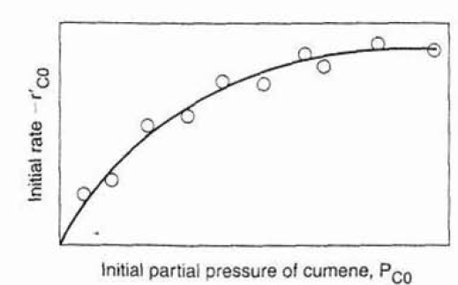
SUMMARY OF THE CUMENE DECOMPOSITION
Surface limited reaction mechanism is consistent with experimental data

