Slide 1
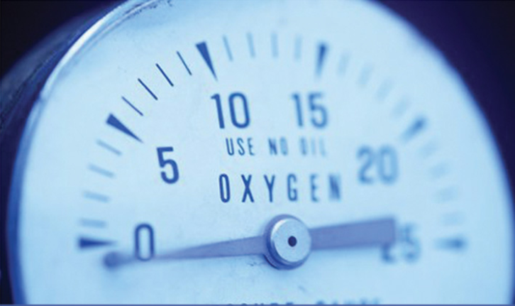
KMÜ378 - PROCESS INSTRUMENTATION
Dr. Kadriye özlem hamaloğlu

Slide 2
KMÜ378 - PROCESS INSTRUMENTATION
Course Content | -Introduction to the control and instrumentation systems. -Pressure, flow, humidity, light, radioactivity temperature and concentration measurements. -Basic transducer definitions.
Reference books | [1] W. Dunn, Fundamentals of Industrial Instrumentation and Process Control McGraw Hill, 2005. [2] N. A. Anderson. Instrumentation for Process Measurement and Control, CRC Pres, 1997

Slide 3
COURSE OUTLINE
Weeks | Topics
Week 1 | Introduction to the control and instrumentation systems
Week 2 | Pressure Measurement
Week 3 | Level measurement
Week 4 | Flow measurement
Week 5 | Heat and Temperature measurements
Week 6 | Humidity, viscosity, pH measurements
Week 7 | 1. midterm
Week 8 | Density and Concentration measurements
Week 9 | Other Analytical measurements
Week 10 | Control valves
Week 11 | Calibration of Equipments and calibration
Week 12 | Process flow charts
Week 13 | Computer aided control and instrumentation
Week 14 | Project presentations
Week 15 | Preparation to final exam
Week 16 | Final exam

Slide 4
Introductıon to control and ınstrumentatıon systems

Slide 5
INSTRUMENTATION
FIRST AND THE MOST
IMPORTANT STEP
OF PROCESS CONTROL
Notes:
If you don’t collect the information from the system you cannot control it

Slide 6
What ıs ınstrumentatıon?
Instrumentation is about measurement and control.
An instrumentation system is an assembly of various instruments and components interconnected to measure, analyse and control the electrical, thermal, hydraulic and other non-electrical physical quantities.
An instrumentation system obtains data about a physical system either
    - for the purpose of collecting information about that process or
    - for the feedback control of the process.
Instruments are devices which are used in measuring attributes of process systems.

Slide 7
INSTRUMENTATION
Human body nerves,
Instrumentation sensors
thermocouples, pressure and
flow sensors to measure
the different parameters in the plant
for process monitoring and for process control.
Sensors, transmitters
and converters
electrical and
electronic devices
transform physical
properties
into electrical current
Sensors are essential elements of safe and profitable plant operation. This can be achieved only if the proper sensors are selected and installed in the correct locations.
Notes:
Human body uses nerves,

Slide 8
GOOD INFORMATION=GOOD CONTROL
Measurements have got to be one of the most important equipment in any processing plant.
Since successful process control requires appropriate instrumentation, engineers should understand the principles of common instruments.

Slide 9
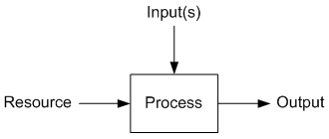
A process is broadly defined as an operation that uses resources to transform inputs into outputs.
In other words, series of continuous or regularly recurring steps or actions intended to achieve a predetermined result, as in heat treating metal, or manufacturing acid.
It is the resource that provides the energy into the process for the transformation to occur.
What ıs a Process?

Slide 10
Process Control
Process control maintains desired conditions in a physical system by adjusting selected variables in the system.
Terminology:
The manipulated variable (MV) is a measure of resource being fed into the process, for instance how much thermal energy.
A final control element (FCE) is the device that changes the value of the manipulated variable.
The controller output (CO) is the signal from the controller to the final control element.
The process variable (PV) is a measure of the process output that changes in response to changes in the manipulated variable.
The set point (SP) is the value at which we wish to maintain the process variable at.
Process control is the act of controlling a final control element to change the manipulated variable to maintain the process variable at a desired set point.

Slide 11
Termınology for Home Heatıng Control
Consider a house in a cold climate which is to be maintained near a desired temperature by a furnace
  Control Objective
  Measured Process Variable (PV)
  Set Point (SP)
  Controller Output (CO)
  Manipulated Variable
  Disturbances (D)
Notes:
Temperaturere of the room is determined by a thermostat
This temperature is compared with the desired temperature or range of temperature
If the temperature is below than the desired, the furnace and the pump are turned on; if the temperature is above the furnace and pump are turned off.

Slide 12
WHY DO WE NEED PROCESS CONTROL?
In any industrial plant the aim is to produce standard and high quality products and sell them at prices which make profit. These purposes can be achieved in a successfully designed and controlled processes.
Safety First: people, environment, equipment
Meeting final product standarts
Minimizing waste production
Minimizing environmental impact
Minimizing energy use
Maximizing overall production rate

Slide 13
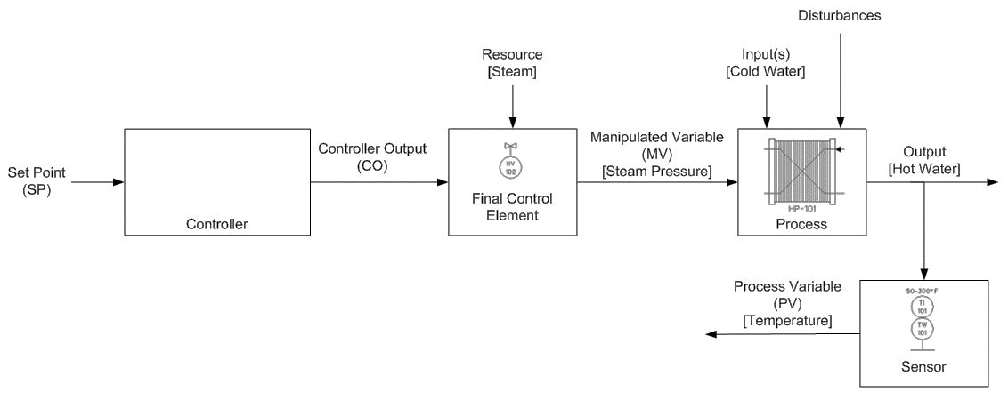
What ıs Open Loop Control?
In open loop control, the controller output is not a function of the process variable.
In open loop control we are not concerned that a particular set point be maintained, the controller output is fixed at a value until it is changed by an operator.
Many processes are stable in an open loop control mode and will maintain the process variable at a value in the absence of a disturbances.
Disturbances are uncontrolled changes in the process inputs or resources.

Slide 14
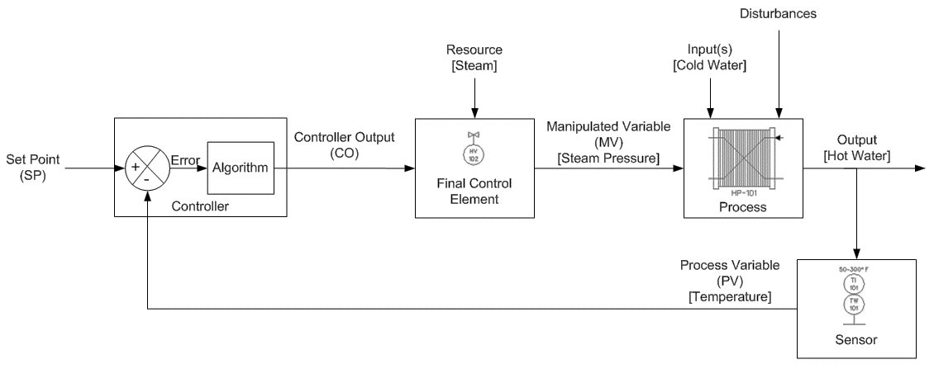
What ıs Closed Loop Control?
In closed loop control, the controller output is determined by difference between the process variable and the set point.
Closed loop control is also called feedback or regulatory control.
The output of a closed loop controller is a function of the error.
Error is the deviation of the process variable from the set point and is defined as E = SP - PV.

Slide 15
Five Processes to Control
T__________
P__________
F____
L_____
C______

Slide 16
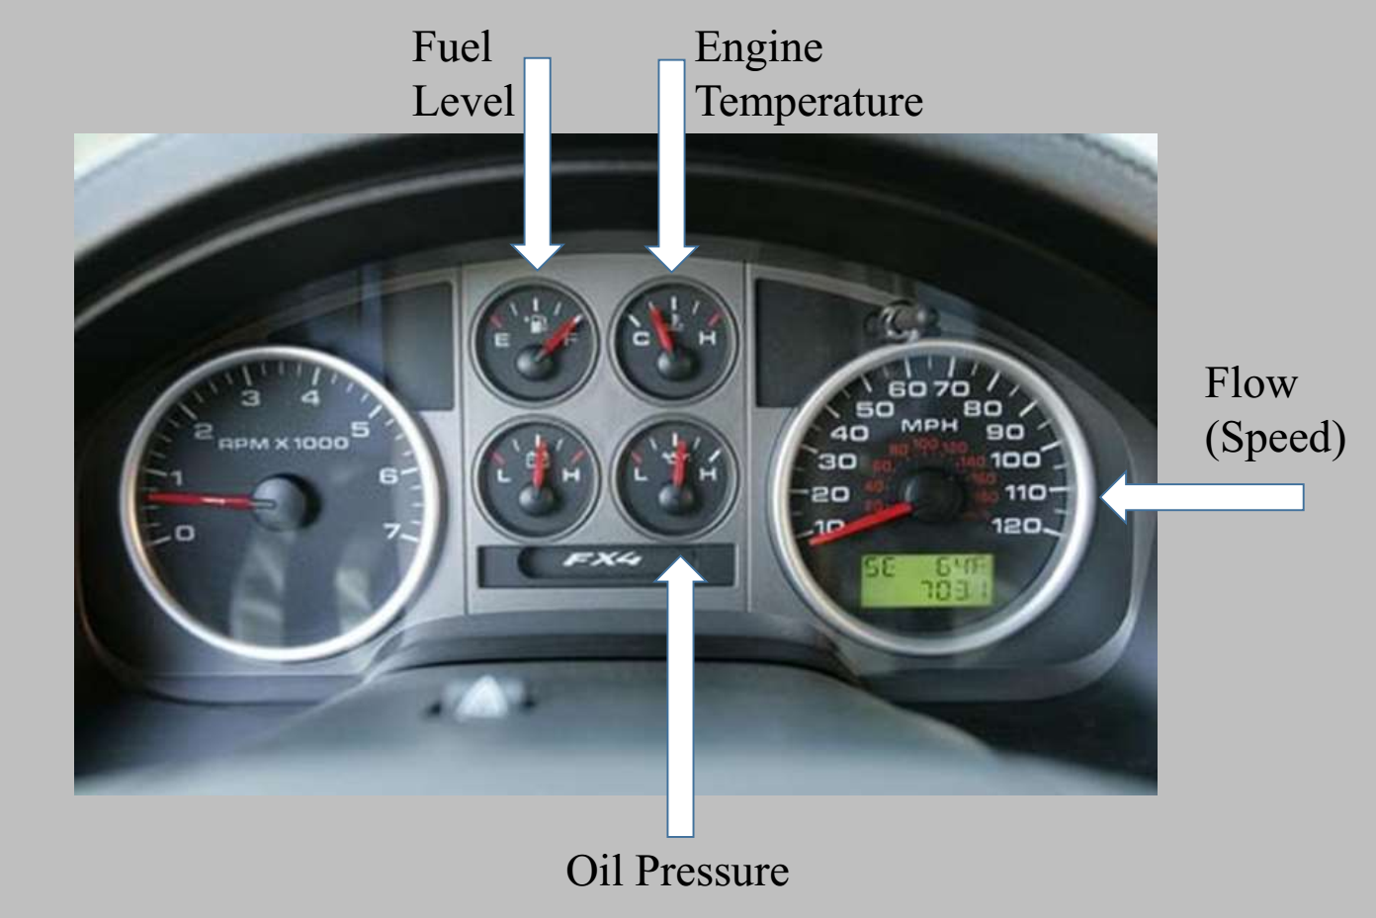
A classIc example of these processes In every day lIfe

Slide 17


