Slide 1
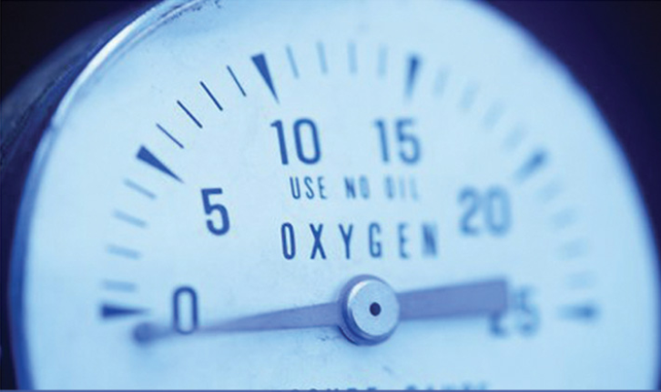
Pressure measurement

Slide 2
pressure
Pressure (P ) expresses the magnitude of normal force (F-N) per unit area (A-m²) applied on a surface
Pressure is the ratio between a force acting on a surface and the area of that surface.

Slide 3
PRESSURE UNITS
Standard Unit of Pressure is Pascal
Units: Pa(= N/m²⁾, psi(=lbf/in²), bar (=10⁵ Pa=100 kPa), mbar (=100 Pa=1 hPa), atm (=101.3 kPa), mmHg (or Torr), inHg, etc.
1 Pa = 1 N/m²
DR. KADRİYE ÖZLEM HAMALOĞLU
15.10.2018

Slide 4
Pressure measurements
Pressure measurements can be divided into three different categories:
–Absolute pressure
–Gauge pressure and
–Differential pressure

Slide 5
Absolute, Gauge and DIFferentIAL
Gauge pressure is defined relative to atmospheric conditions.
The units of gauge pressure are psig, however gauge pressure is often denoted by psi as well.
Absolute pressure is defined as the pressure relative to an absolute vacuum.
The units of absolute pressure are psia.
Differential pressure uses a reference point other than full vacuum or atmospheric pressure.

Slide 6
Absolute, Gauge and DIFferentIAL

Slide 7
Gauge pressure
Gauge pressure is the pressure relative to the local atmospheric or ambient pressure.
In measurements a gauge is used to record the pressure difference between the system and the atmospheric pressure. This is called gauge pressure and can be stated by the following equation:
Where P_{abs} : Absolute pressure
P_{atm} : Atmospheric pressure
(standard is: 101.3 kPa =14.696 psi=760 mmHg=29.92 inHg)
P_{gauge} : Gauge pressure

Slide 8
Gauge pressure
If the pressure of a system is below atmospheric, it is called vacuum pressure.
When pressure is measured by a gauge, the quantity obtained usually excludes the ambient atmospheric pressure and is therefore called overpressure,
Poverpressure = Pgauge
In many cases, gauge pressure is more important than the absolute pressure because we read gauge pressure in pressure measuring devices (like manometers).

Slide 9
ABSOLUTE PRESSURE
If atmospheric pressure is included, then the resulting pressure is called absolute pressure Pabsolute = Patmospheric + Pgauge
The absolute pressure is measured relative to the absolute zero pressure - the pressure that would occur at absolute vacuum.
P=Pg+Po
P=absolute pressure
Pg=gauge pressure
Po=atmospheric pressure.

Slide 10
DIFFERENTIAL PRESSURE
Differential pressure is the difference in pressure between two points.

Slide 11
ATMOSPHERIC PRESSURE
The atmospheric pressure is the pressure in the surrounding air at or "close" to the surface of the earth.
The atmospheric pressure varies with temperature and altitude above sea level.
Atmospheric pressure is the pressure exerted at the surface of a body by a column of air in an atmosphere.
1 atmosphere on Earth = 760 millimeters of mercury (760 Torr) and 101,325 Pascals.

Slide 12
STANDARD ATMOSPHERIC PRESSURE
The Standard Atmospheric Pressure (atm) is used as a reference for gas densities and volumes.
The Standard Atmospheric Pressure is defined at sea-level at 273ºK (0ºC) and is 1.01325 bar or 101325 Pa (absolute). The temperature of 293ºK (20ºC) is also used.

Slide 13
Statıc pressure & dynamıc pressure
STATIC PRESSURE IS FOR A FLUID WITH IS NOT IN MOTION
EX: FLUID IN A TANK
P= F/S P= ρ.g.h
DYNAMIC PRESSURE IS FOR A FLUID IN MOTION IN PIPES

Slide 14
Statıc pressure
P= F/S
F= m.g
P= mg/S = (mgxh)/ (Sxh) =( mgh/V)
m/V= ρ
P= ρ.g.h

Slide 15
Dynamıc pressure
THE PRESSURE OF A FLUID IN A PIPE IS MEASURED BY A PRESSURE GAUGE.
FLOW CALCULATED BY BERNOUILLI EQUATION

Slide 16
BERNOUILLI EQUATION
The Bernoulli Equation can be considered to be a statement of the conservation of energyprinciple appropriate for flowing fluids.
The qualitative behavior that is usually labeled with the term "Bernoulli effect" is the lowering of fluid pressure in regions where the flow velocity is increased.
This lowering of pressure in a constriction of a flow path may seem counterintuitive, but seems less so when you consider pressure to be energy density.
In the high velocity flow through the constriction, kinetic energy must increase at the expense of pressure energy.

Slide 17
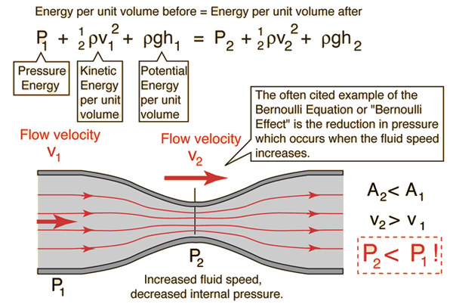
BERNOUILLI EQUATION

Slide 18
Prımary Pressure Measurıng Devıces
Diaphragm
Bourdon Gage
Strain Gage
Quartz Gage
Piezoresistive Gauge
Manometer

Slide 19
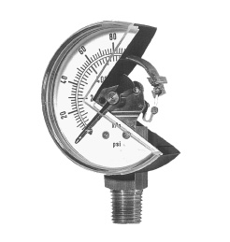
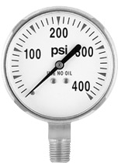
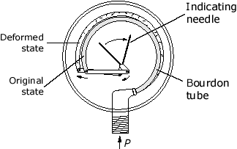
Pressure Measurıng Devıces
Bourdon Gage:
Principles: change in curvature of the tube is proportional to difference of pressure inside from that outside the tube
Applications: tire pressure, pressure at the top or along the walls of tanks or vessels

Slide 20
Bourdon Gage
Pressure gauge having a Bourdon tube as its sensitive element
A hard metal tube ( bronze or brass) is flattened and one end is closed.
Under pressure, the tube is bent into a curve or arc.
The open end is attached to a header by which the pressure can be introduced inside the tube

Slide 21
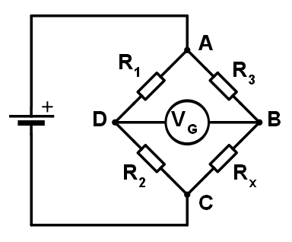
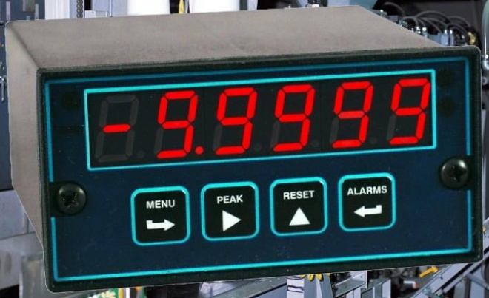
Pressure Measurıng Devıces
Strain Gage
Principles: ∆ P → ∆ Resistance → ∆ Voltage
Applications: Sensors for internal combustion engines, automotive, research etc.

Slide 22
Straın Gage
A strain gauge (sometimes referred to as a strain gage) is a sensor whose resistance varies with applied force; It converts force, pressure, tension, weight, etc., into a change in electrical resistance which can then be measured.
When external forces are applied to a stationary object, stress and strain are the result. Stress is defined as the object's internal resisting forces, and strain is defined as the displacement and deformation that occur.

Slide 23
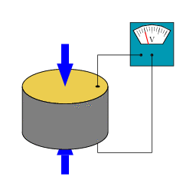
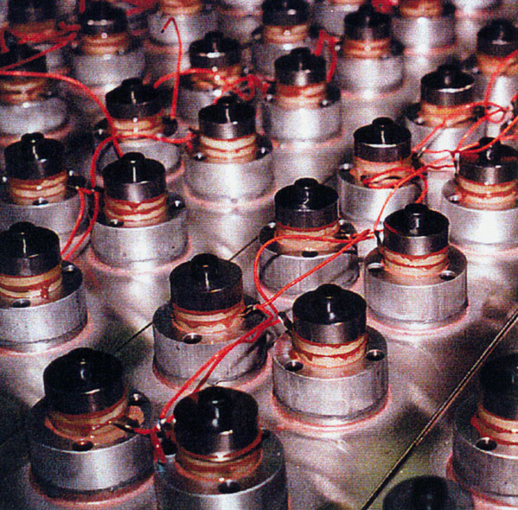
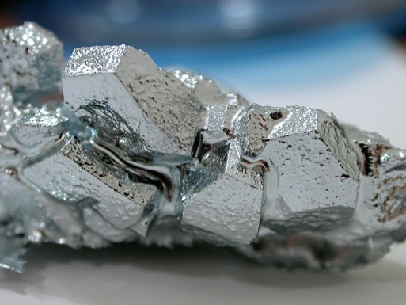
Pressure Measurıng Devıces
Quartz Gage
Principles: ∆ Pressure → ∆ Charge → ∆ Voltage
Applications: measurements with high accuracy, good repeatability, high resolution.
e g. Quartz Clock

Slide 24
Quartz gauges
Quartz gauges utilize quartz as the active sensing element because it is the most nearly perfectly elastic material known.
The technical definition of elastic is that for an applied stress or pressure, the quartz sensing element will always give the same distortion or strain.

Slide 25
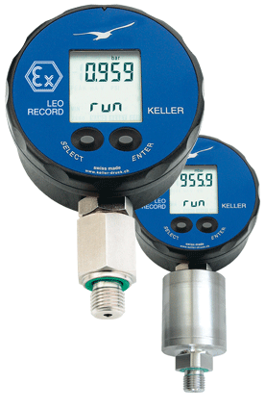
Pressure Measurıng Devıces
Piezoresistive Gauge
Digital Manometer
Principles: ∆Pressure = ∆Charge = ∆Resistance = ∆Voltage
Applications: Very accurate for small pressure differentials
e.g. Difference between indoor and outdoor pressure

Slide 26
Pıezoresıstıve Gauge
Piezoresistive strain gauges are a semiconductor material which changes in resistance when the material stretched or compressed.

Slide 27
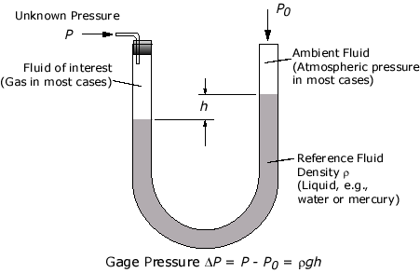
Pressure Measurıng Devıces
U-tube Manometer
Principles: Hydrostatic Law ∆P=ρ g h

Slide 28
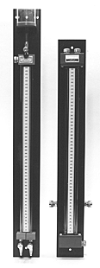
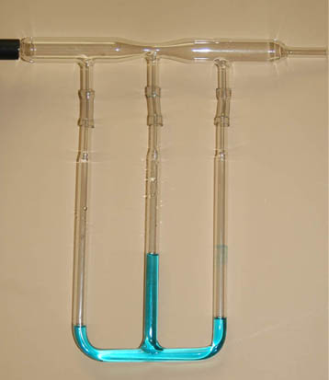
Pressure Measurıng Devıces
U-tube Manometer
Mercury Water Manometer
Air Water Manometer
Applications: air pressure, pipe pressure, etc.

Slide 29
questıon
A tank open to atmosphere holds water with a depth of 7 m.
Density of water = 1000 kg/m³
What is the pressure in a gauge at the bottom of the tank in Pa ?
A crude oil, in a tank at 60 kPa top absolute pressure, has a specific gravity of 0.89 and a pressure of the bottom of 345 kPa ( gauge).
What is the level of the oil in the tank ?

Slide 30
homework
Derive the bernoulli equation from mechanical energy balance

