Slide 1
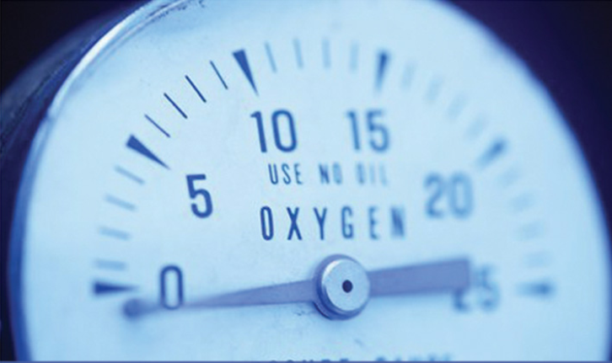
TEMPERATURE MEASUREMENT

Slide 2

WHAT IS TEMPERATURE?

Slide 3
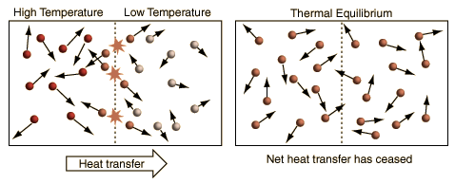
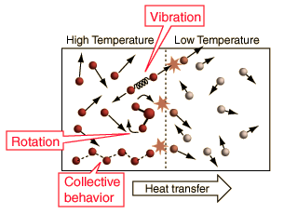
AN OVERLY SIMPLIFIED DESCRIPTION OF TEMPERATURE
"Temperature is a measure of the tendency of an object to spontaneously give up energy to its surroundings. When two objects are in thermal contact, the one that tends to spontaneously lose energy is at the higher temperature.“
(Schroeder, Daniel V. An Introduction to Thermal Physics, 1st Edition (Ch, 1). Addison-Wesley.)

Slide 4
DESCRIPTION OF TEMPERATURE IN OUR WORDS
Temperature is a physical quantity that expresses the subjective perceptions of hot and cold.
A scalar quantity that determines the direction of heat flow between two bodies
……..

Slide 5
How ıs heat transferred?
Conduction
Convection
Radiation

Slide 6
temperature
Temperature is actually the macroscopic manifestation of the
energy level of atoms and molecules.
This implies that there is a lower limit to temperature, the absolute zero. This is the temperature at which the atoms stop moving.
Note that many thermodynamic equations are based on temperature scales starting at absolute zero (such as the ideal gas equation).

Slide 7
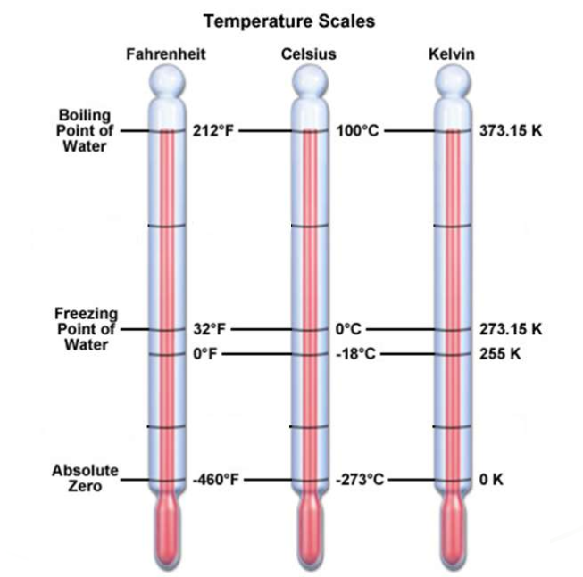
Temperature scales
Normally measured using one of the following scales.
1. Fahrenheit.[°F]
2. Celsius or centigrade. [°C]
3. Kelvin .[K]
Celsius, Fahrenheit, Kelvin, Rankine
• °C = (°F – 32)/1.8
• °F = 32 + 1.8*(°C)
• K = °C + 273.15
• °R = (°C + 273.15)*1.8
• °R = °F + 459.67
• °R = 1.8*K
1 °C change in temp = 1 K change in temp = 1.8 °F change in temp

Slide 8
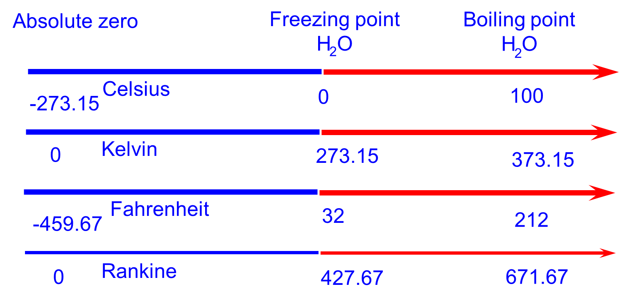
TEMPERATURE SCALES

Slide 9
Temperature standards
International Temperature Scale of 1990: ITS-90
Triple point of hydrogen -259.3467 °C
Triple point of water 0.01 °C
Melting point of gallium 29.7646 °C
Boiling point of water at 1 atm 100 °C (Not a std)
Freezing point of Indium 156.5985 °C
Freezing point of tin 231.928 °C
Freezing point of copper 1084.62 °C

Slide 10
Temperature measurement
Temperature measurement in today’s industrial environment has a wide variety of needs and applications.
It is a very critical and widely measured variable for all engineers.
The industry has developed a large number of sensors and devices to handle this demand.

Slide 11
basıc types of temperature measurement
Four basic types of temperature measurement include:
1) Mechanical (Liquid-in-glass thermometers, bimetallic thermometer, pressure thermometer, etc.)
2) Thermojunctive (Thermocouples)
3) Thermoresistive ((Resistance Temperature Detectors)RTDs and thermistors)
4) Radiative (Infrared and optical pyrometers)

Slide 12
Temperature measurıng devıces
Filled systems -- Liquid-in-glass (Expansion ∝ temperature)
– Inexpensive, accurate; fragile, no remote sensing
Bimetallic (Deflection of dissimilar bonded metals ∝ temperature)
– Inexpensive, rugged; low precision, no remote sensing
Pressure thermometers
  -Simple structure, high mechanical strength, low cost, requires no external energy.
Thermocouple (voltage across dissimilar metal junctions ∝ temp.)
– Inexpensive; least sensitive among electronic type, non-linear
RTD (Resistance of metal ∝ temperature)
– Accurate, linear; expensive, power source, self-heating
Thermistor (Resistance across semiconductor ∝ temperature)
– Fast response; fragile, power source, non-linear, self-heating
Pyrometer (Radiation ∝ temperature)
– Wide range, remote sensing; expensive, low precision, power
Mechanical
Thermojunctive
Thermoresistive
Radiative

Slide 13
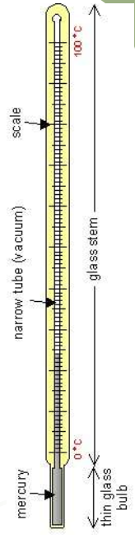
Lıquıd – ın – Glass Thermometer
Construction
1.Bulb: The reservoir for containing most of the thermometric liquid (mercury).
2.Stem: The glass tube having a capillary bore along which the liquid moves with changes in temperature.
3. Scale: A narrow-temperature-range scale for reading a reference temperature
Liquid | Range (°C)
Mercury | -35 to 510
Alcohol | -80 to 70
Pentene | -200 to 30
Toluene | -80 to 100

Slide 14
Lıquıd – ın – Glass Thermometer
The basis of the thermometer’s operation is the thermal expansion of a working fluid(mercury in this case)
The volume of mercury changes slightly with temperature; the small change in volume drives the narrow mercury column a relatively long way up the tube.
The space above the mercury may be filled with nitrogen or it may be at less than atmospheric pressure, a partial vacuum.
The accuracy of a thermometer is greatly dependent on the manufacturing process, but also can be affected by usage.

Slide 15
ADVANTAGES & DISADVANTAGES
Advantages:
1) Simplicity in use & low cost.
2) Portable device.
3) Checking physical damage is easy.
4) Power source not require.
5) Repeatable, calibration does not drift.
Disadvantages:
1) Can not be used for automatic recording.
2) Time lag in measurement.
3) Range is limited to about 300 °C .

Slide 16
Pressure thermometers
A pressure thermometer operates by the expansion of a gas or a liquid.
Its types are:
1) Liquid Pressure Thermometer
2) Vapour Pressure Thermometer
A pressure thermometer measures temperature indirectly by measuring pressure.
The gauge is a pressure gauge, but is typically calibrated in units of temperature instead.

Slide 17
Vapor pressure thermometers
The saturated vapor pressure of a volatile liquid is used as a measure of the temperature.
These thermometers are very sensitive but the scale is not linear.
The measurement accuracy is 1%. The typical temperature range is from - 20° C to 280° C depending on the nature of the gas.

Slide 18
Lıquıd pressure thermometer
It’s a temperature measuring device whose operation is based on thermal expansion of a liquid.
The insides of the thermo-sensor cylinder, capillary, and Bourdon tube are filled with liquid which changes volume with varying temperature.
The liquid in the thermo-sensor cylinder is expanded and contracted as the temperature changes, and the pressure change in the Bourdon tube that is transmitted through the capillary is indicated as a temperature.
Liquid filled thermometers have scales with divisions from 10° to 0.01°C.
The measurement accuracy depends on the depth of immersion of the thermometer in the medium to be measured.

Slide 19
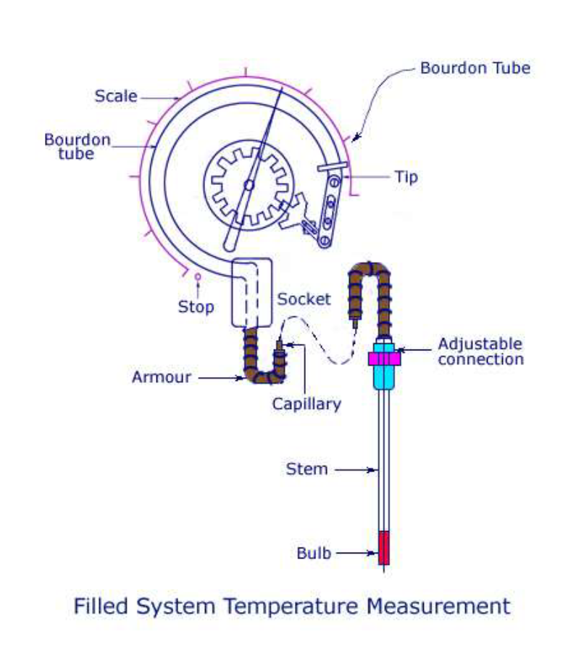
lıquıd pressure thermometers

Slide 20
ADVANTAGES & DISADVANTAGES
Applications:
1. Suitable for most heating and ventilation applications.
2. Used in dairy, brewing and food industries.
3. A common application of this type of thermometer is measurement of outside temperature from the inside of a building.
Advantages:
1. Simple structure, high mechanical strength.
2. Low cost, requires no external energy.
Disadvantages:
1. Temperature range is limited, usually 80-400 ℃.
2. Slow response time.

Slide 21
SEALED BELLOW
The sealed bellows type is filled with a gas, vapor or liquid.
It responds to change in temperature by variation in volume and pressure causing expansion or contraction.
Gas filled bellows can make the sensor sensitive to both external pressure and temperature
Liquid Filled bellows can function in a number of transducer applications.
Applications:
1. Used in fuel and air density controls.
2. Used in passive actuation in a vacuum or
pressure chamber.
3. Used as transducers

Slide 22
Bulb and Capıllary Sensor
Bulb and capillary elements are used where temperatures are to be measured in ducts, pipes, tanks or similar locations remote from the controller.
• The bulb is filled with liquid, gas or refrigerant depending on the temperature range required.
• Expansion of the fluid in the heated bulb exerts a pressure which is transmitted by the capillary to the diaphragm and there it is translated into movement.

Slide 23
ADVANTAGES & DISADVANTAGES
The linear movement is directionally proportional to the temperature.
• Advantages:
1. Typically inexpensive
2. Easily understood wiring
• Disadvantages:
1. Sensing bulb must be perfectly horizontal, which is difficult to set.
2. Diaphragm case must be mounted in a separate, warmer location for effective operation.

Slide 24
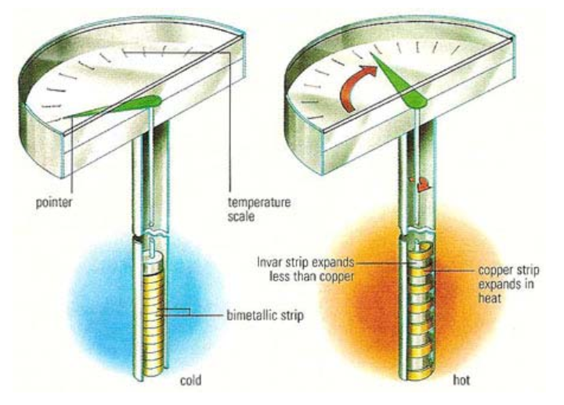
Bımetallıc sensors
The temperature is measured by means of a bimetal system inside the temperature sensor.
The bimetal is made from two metal strips, permanently joined together, each metal having a different thermal expansion coefficient.
This causes the strip to deflect in proportion to the temperature variation.
The actual bimetal system consists of a bimetal strip that is either helically or spirally wound, depending on the size of the sensor and the temperature range to be measured.
Two basic principles of operation is to be followed in the case of
a bimetallic sensor.
1) A metal tends to undergo a volumetric dimensional change
(expansion/contraction), according to the change in temperature.
2) Different metals have different co-efficient of temperatures.
The rate of volumetric change depends on this co-efficient of temperature.

Slide 25
BIMETALLIC HELIX
Cross section of a Bimetallic thermometer

Slide 26
CONSTRUCTION
A change in temperature causes the free end of the strip to expand or contract due to the different coefficients of expansion of the two metals.
This movement is linear to the change in temperature and the deflection of the free end can be read out by attaching a pointer to it. This reading will indicate the value of temperature.
Bimetallic strips are available in different forms like helix type, cantilever, spiral, and also flat type.
Invar (An alloy of Nickel and Iron) is the most commonly used low expansion materials.
Nickel-Iron alloys with Chromium and Manganese added are often used for thermal expansion materials.

Slide 27
Bımetallıc sensors
The device consists of a bimetallic strip of two different metals .
They are bonded together to form a spiral or a twisted helix.
Both these metals are joined together at one end by either welding or riveting.
It is bonded so strong that there will not be any relative motion between the two.

Slide 28
ADVANTAGES & DISADVANTAGES
Advantages
1)Power source not required
2)Robust, easy to use and cheap.
3) Can be used to 500 °C.
Disadvantages
1) Not very accurate.
2) Limited to applications where manual reading is acceptable.
3) Not suitable for very low temperatures because the expansion of metals tend to be too similar, so the device becomes a rather insensitive thermometer

Slide 29
Electrıcal Temperature Measurıng Instruments
Change in electrical properties of sensor for estimating temperature
1. Resistance Temperature Detectors (RTD)
2. Thermistors
3. Thermocouples and Thermopiles

Slide 30
Resıstance Temperature Detectors (RTD)
Use change in resistance of suitable metals to indicate temperature.
Commonly used metals are platinum, nickel, copper which show a positive change in resistance with increase in temperature.
The variation in resistance R at temperature can be written as
RT = R0 [ 1 + α T + β T²]
RT = Resistance at temperature T °C
R0 = Resistance at 0° C
or RT = R0 [ 1 + α T]
α and β are constant whose value depends on the RTD materials.

Slide 31
RTD elements
RTD elements
1) Resistance element or bulb
2) Suitable electrical leads
3) An indicating-recording or resistance measuring instrument
Small laboratory type - wound on a crossed mica former and enclosed in a Pyrex tube.
Larger industrial type - Insulated ceramic former
The resistance coil and the ceramic former are protected the metal wire.
The tube may be evacuated or filled with an inert gas to protect the metal wire.
Copper leads are generally preferred for connecting the thermometers to the Wheatstone bridge.

Slide 32
ADVANTAGES & DISADVANTAGES
Advantages
1) The sensor can be easily installed and replaced.
2) Good measurement accuracy (± 0.25% of scale range)
3) Fast response and good reproducibility.
4) Resistance to corrosion, chemicals, and oxidation.
5) Wide temperature range. (-180 °C to 760 °C
6) Remote temperature sensing is possible.
7) No reference junction required.
8) Stable and accurate performance over a long time.
9) No necessity for any temperature compensation.
Disadvantages
1) More expansive than other instruments.
2) Large bulb size compared to thermocouple.
3) Required a separate bridge circuit system.
4) External power source required.
5) The self heating caused by current flow affects the accuracy of the instrument.

Slide 33
thermıstors
Thermistor are thermally sensitive semiconductor materials having a negative temperature coefficient of resistance.
The resistance of a Thermistor decrease as the temperature increase and vice versa.
RT = Resistance at absolute temperature T (K)
R0 = Resistance at absolute temperature T0(K)
β = Constant depending upon material of the
Thermistor Temperature range -108°C to 300°C.

Slide 34
thermıstors
Thermistors are made from mixtures of oxides of manganese, nickel, copper, iron, cobalt, titanium, and uranium.
For cryogenic application doped germanium and carbon impregnated glass are used.
Production of Thermistors - Powder metallurgy part m/f.
For temperature measurement its attached to the body surface and connected one arm with Wheatstone bridge.
Balance position no change in galvanometer, temperature change the resistance change and unbalanced the bridge circuit.

Slide 35
ADVANTAGES & DISADVANTAGES
Advantages
1) Small size and low cost.
2) Fast temperature response.
3) High sensitivity.
4) Suitable for precise temperature measurement and control.
5) Need simple electric circuitry.
6) No need reference junction.
Disadvantages
1) Response is non linear.
2) Not suitable for measurement of high temperature.
3) Required external power source and bridge circuit.
4) Temperature span is limited.

Slide 36
Comparıson of RTD and Thermıstors

Slide 37
thermocouples
Thermo means heat and couple means to make the junction.
Thermocouple works on thermoelectric effect.
It consist of
(1) Sensing element with thermal wall (Sheathing), measuring Junction
(2) Lead wire
(3) Reference junction
(4) Current measuring and indicating device, millivoltmeter or potentiometer type instrument.

Slide 38
thermocouples
A Thermocouple consist of two dissimilar metals or alloys which develop Electromagnetic field (EMF).
When the reference and measuring junctions are at different temperature.
The reference junction or cold junction is usually maintained at some constant temperature, such as 0°C.
Thermocouples are temperature sensors that are made from two different metals. A voltage is generated when the metals are brought together to form a junction and there are temperature differences between them.
Thermocouple circuits are governed by fundamental physical laws that affect their ability to take measurements.

Slide 39
thermocouples
The two dissimilar wires welded or soldered to from two junction.
The wires are insulated from each other and covered by protective sheathing.
Thermal EMF developed upon the difference between measuring junction and reference junction temperature.
The magnitude of the electric voltage developed by thermocouple due to temperature different between junction.
Measure the small voltage change using millivoltmeter or the potentiometer type instrument.

Slide 40
Types of thermocouples

Slide 41
ADVANTAGES & DISADVANTAGES
Advantages
1) Thermocouple have a better response.
2) They have a higher range of temperature measurements.
3) They sensing elements of thermocouple is easily installed.
4) Cheaper than RTD.
5) Very convenient for measuring the temperature at one particular point in a piece of apparatus.
Disadvantages
1) Lower accuracy and as such they cannot be used for precision work.
2) Limited life of thermocouple.
3) The circuitry for thermocouple is very complex.
4) Expensive wire.
5) Need known reference.

Slide 42
Comparıson of Thermocouples and Thermıstors

Slide 43
Comparıson of Thermocouples, rtd and Thermıstors

Slide 44
pyrometer
‘Pyro’ is the Greek word which means Fire and ‘meter’ means measure.
The measurement of high temperature (Above 1400° C) without physical contact between hot body and the measuring instrument is called Pyrometry and the measuring instruments are called pyrometers.
It depends upon the relationship between the temperature of a hot body and the electromagnetic radiation emitted by the body.
The radiant energy emitted from a body increase with temperature, is used in measuring temperature particularly in the higher ranges.
TYPES PYROMETERS
1) Total radiation Pyrometer.
2) Optical Pyrometer.

Slide 45
Total radıatıon Pyrometer
A device which measure the total intensity of radiation emitted from a body is called radiation pyrometer.
1) Total Radiation Pyrometer – In this method, the total heat emitted from the hot source is measured at all wavelengths.
2) Selective Radiation Pyrometer – In this method, the heat radiated from the hot source is measured at a given wavelength

Slide 46
Total Radıatıon Pyrometer.
The radiation pyrometer has an optical system, including a lens, a mirror and an adjustable eye piece.
It collects the radiation from an object (hot body) whose temperature is measured.
A mirror is used to focus this radiation on a thermocouple.
This energy which is concentrated on the thermocouple raise its temperature and in turn generates an EMF.
This EMF is then measured either by the galvanometer or potentiometer method (Milli-voltmeter).
Thus rise of the temperature is a function of the amount of radiation emitted from the object.

Slide 47
ADVANTAGES & DISADVANTAGES
Advantages
1) Temperature range 700° C to 2000° C.
2) Accuracy ± 2 % of scale.
3) High speed of response.
4) Can be measure the temperature of an object may either stationary or moving.
5) Direct contact is not necessary with the object whose temperature is to be measured.
6) Measurement is independent of the distance between the target and measuring instrument.
Disadvantages
1) The scale is non-linear.
2) Cooling is required to protect the instrument when overheating.
3) Presence of dust and dirt on the mirror or lens causes instrument to read too low.

Slide 48
Applıcatıon
1) They are used for temperatures above the practical operating range of thermocouples.
2) They can be used in the environments which contaminate or limit the life of thermocouple.
3) Used for moving targets.

Slide 49
optıcal pyrometer
An optical pyrometer Works on the principle that matters glow above 480° C and the colour of visible radiation proportional to the temperature of the glowing matter.
The amount of light radiated from the glowing matter (Solid or Liquid) is measured and employed to determine the temperature.

Slide 50
optıcal pyrometer
An optical pyrometer can measure temperature ranging from 700° C to 4000° C.
An optical pyrometer is sighted at the hot body and focused.
In the beginning filament will ppear dark as compared to the background which is bright (being hot).
By varying the resistance (R) in the filament circuit more and more current is fed into it, till filament becomes equally bright as the background and hence disappears.
The current flowing in the filament at this stage is measured with the help of an ammeter which is calibrated directly in terms of temperature.
If the filament current is further increased, the filament appears brighter as compared to the background which then looks dark.

Slide 51
ADVANTAGES & DISADVANTAGES
Advantages
1) Temperature range 700° C to 4000° C.
2) Accuracy ± 5 % of scale.
3) High speed of response.
4) Can be measure the temperature of an object may either stationary or moving.
5) Direct contact is not necessary with the object whose temperature is to be measured.
6) Measurement is independent of the distance between the target and measuring instrument.
Disadvantages
1) The lower measuring is limited to 700°C.
2) The device is not useful for obtaining continuous values of temperatures at small intervals.

Slide 52
Applıcatıon
1) Used to measure temperatures of liquid metals or highly heated materials.
2) Can be used to measure furnace temperatures.

Slide 53
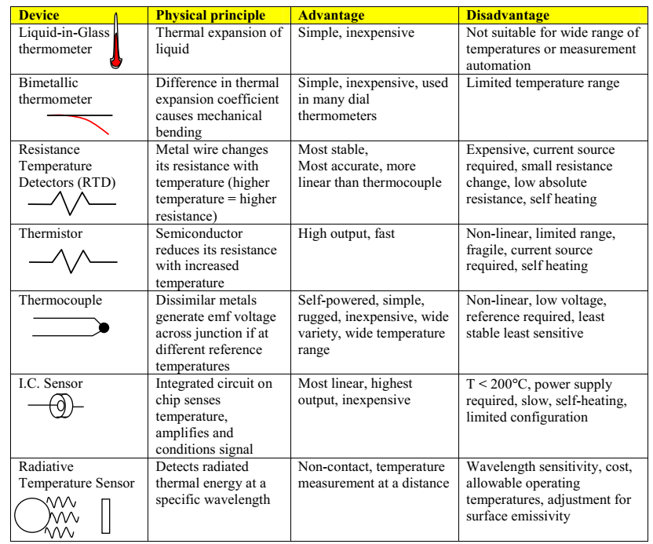
General Comparıson of temperature measurement devıces

Slide 54

See you on 5th of november at 14:00 pm ☺

