Slide 1
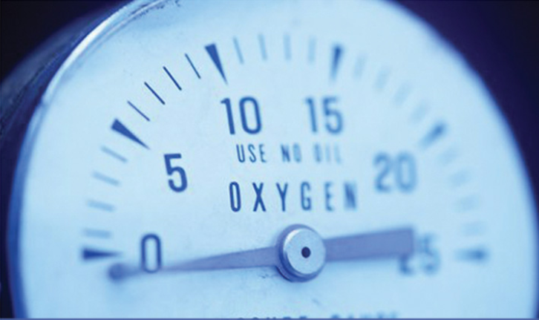
LEVEL MEASUREMENT

Slide 2
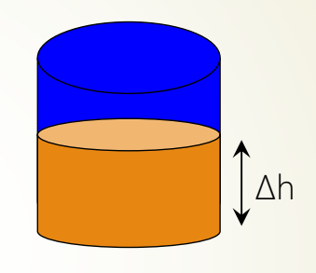
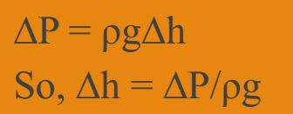
What ıs level?
The liquid level is expressed in terms of length of the
liquid column or in terms of the pressure the column
exerts over a datum level.

Slide 3
Level measurement
Level is another common process variable that is measured in many industries.
The method used will vary widely depending on the nature of the industry, the process, and the application.
In modern manufacturing industries which use many solvents, chemicals, steam and other liquids and in power plants which use vast amount of water, the accurate measurement of liquid level is very essential.
Level measurement – the act of establishing the height of a liquid surface in reference to a zero point.

Slide 4
What ıs measured?
The measured medium can be liquid, gas or solid and stored in vessels (open/closed tanks), silos, bins and hoppers.
    Units of level can be expressed in:
    feet (meters)
    gallons (liters)
    pounds (kilograms)
    cubic volume (ft³, m³)

Slide 5
Selectıon crıterıa
When determining the type of level sensor that should be used for a given application, there are a series of questions that must be answered:
Open tank or closed tank?
Can the level sensor be inserted into the tank or should it be completely external? Contact or non-contact?
Continuous measurement or point measurement?
Direct or Indirect measurement?
What type of material is being measured? Liquid or Solid? Clean or Slurry?

Slide 6
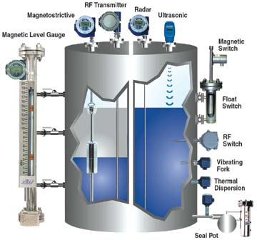
Methods – Direct or Indirect (inferential)
Hydrostatic Head
Float
Load Cells
Magnetic Level Gauge
Capacitance Transmitters
Magnetostrictive
Ultrasonic
Microwave
Laser
Radar
Guided Wave Radar
Dip Stick
Vibration

Slide 7
Direct or Indirect measurement?
Generally, there are two methods used in industries for measuring liquid level
Direct: Level is measured by direct contact with the fluid surface.
Either the fluid surface is visible to be compared directly to a scale, or direct contact is made with the fluid surface.
Indirect: Level is inferred by means other than direct contact with the fluid surface.
Fluid level is inferred by its effect on some type of device.

Slide 8
Dırect measurement
This is the simplest method of measuring liquid level where the level is measured directly by means of the following liquid level indicators
Direct methods sense the surface or interface of the liquid and is not affected by changes in material density (Specific Gravity)
TYPES
Hook Type Level Indicator
Sight Glass Level Indicator
Float Type Level Indicator

Slide 9
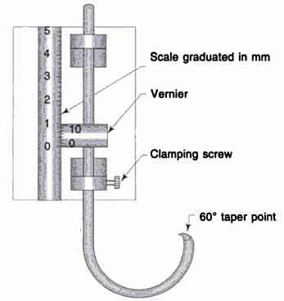
Hook-type Level Indıcator
When the level of liquid in an open tank is measured directly on a scale, it is sometimes difficult to read the level accurately because of parallax error.
Hook- type Level Indicator

Slide 10

Hook-type Level Indıcator
Construction
Consist of a wire of corrosion resisting alloy (such as stainless steel) about 0.063mm diameter, bent into U-shaped with 1 arm longer than the other.
The shorter arm is pointed with a 60⁰ taper, while the longer 1 is attached to a slider having a Vernier scale, which moves over the main scale & indicates the level.
Working
The hook is pushed below the surface of liquid whose level is to be measured and gradually raised until the point is just about a break through the surface.
It is then clamped & the level is read on the scale

Slide 11
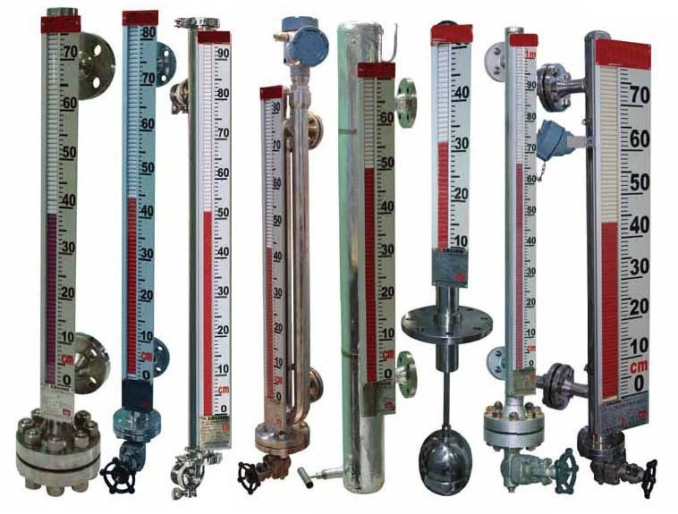
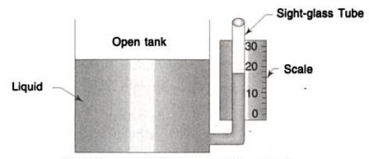
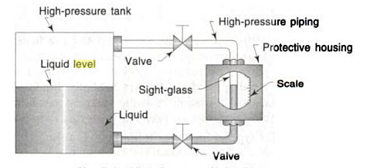
Sıght Glass
Sight glass is used for the continuous indication of liquid level within a tank or vessel.
A sight glass instrument consists of a graduated tube of toughened glass which is connected to the interior of the tank at the bottom in which the water level is required. The level of liquid in the sight glass will be the same as the level of liquid in the tank.
Simple sight glasses may be just a plastic or glass tube connected to the bottom of the tank at one end and the top of the tank at the other.
Sight Glass for an Open Tank
High Pressure Sight Glass

Slide 12
Sıght Glass for open tanks
As the level of liquid in the tank rises and falls, the level in the sight glass also rises and falls accordingly. Thus, by measuring the level in the sight glass, the level of liquid in the tank is measured. In sight glass, it is not necessary to use the same liquid as in the tank. Any other desired liquid also can be used.

Slide 13
Sıght Glass-advantages & dısadvantages
Advantages
Direct reading is possible.
Special designs are available for use up to 316⁰C and 10,000 psi.
Glassless designs are available in numerous materials for corrosion resistance.
Disadvantages
It is read only where the tank is located, which is not always convenient.
Since sight glasses are located on the outside of the tanks, the liquid in the sight glass may freeze in cold weather even though the liquid inside the tank does not, and thus, it may cause error in the reading.
Heavy, viscous liquids or liquids containing material which fall out of solution and clog the tube cannot be measured satisfactorily by a sight glass.
Overlapping gauges are needed for long level spans.
Accuracy & readability depend on the cleanliness of glass and fluid.

Slide 14
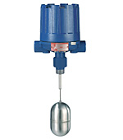
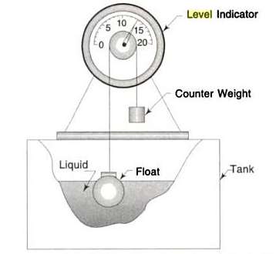
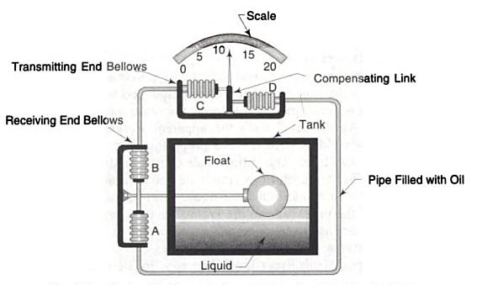
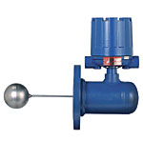
Float Type Level Indıcator
These instruments work on the Archimedes principle according to which a body when placed in a liquid is buoyed up by a force equal to the weight of the displaced liquid, and the apparent change in weight of the body is directly proportional to the level of liquid in which it is placed.
The displacer is attached to a torque tube assembly whose rotary motion is used for read out/control.
With selection of suitable material for float, float cage, and torque tube, it’s possible to use this instrument over a wide range of pressure and for many liquids.
Float rides the surface level to provide the measurement. Many different styles are available.
Float-operated Liquid Level Indicator
Hydraulic Transmission System for Level Indication

Slide 15
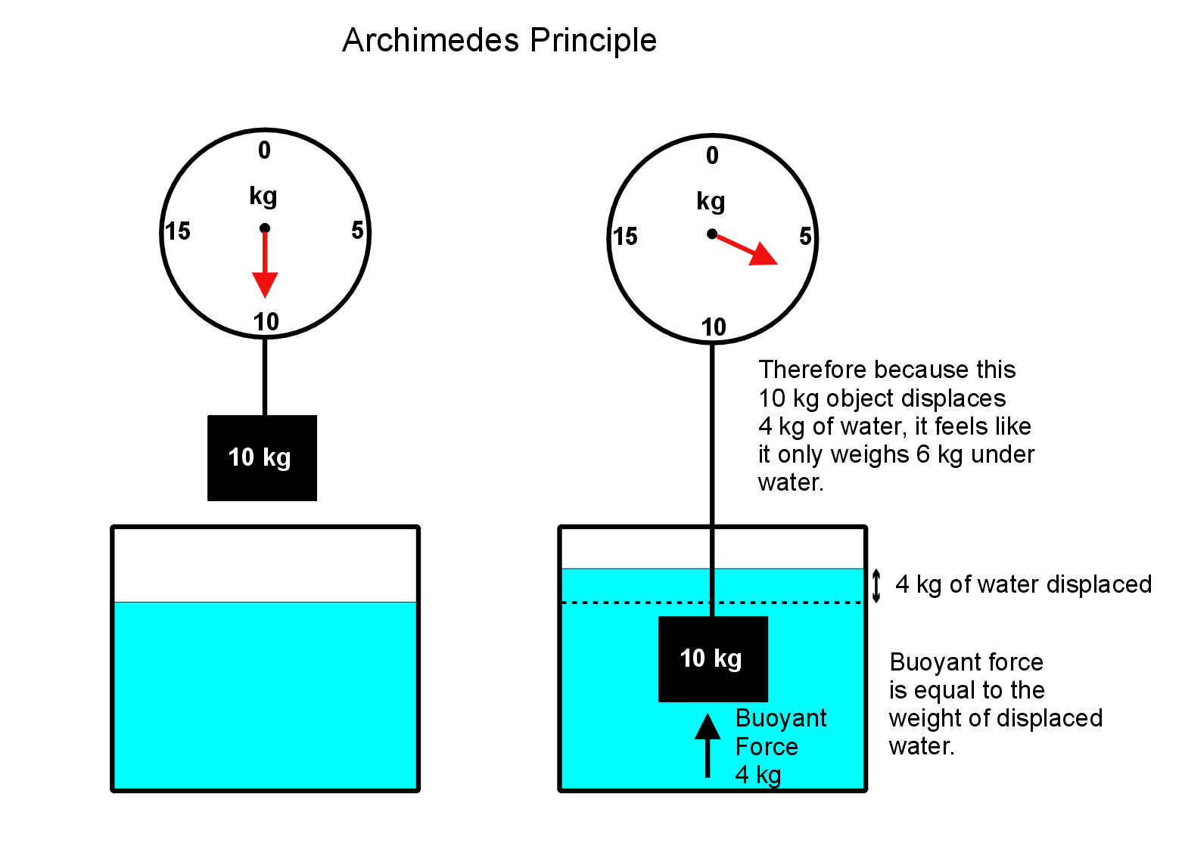

ArchımEdes Prıncıple
A body wholly or partly immersed in a fluid is buoyed up with a force equal to the weight of the fluid displace by the body

Slide 16
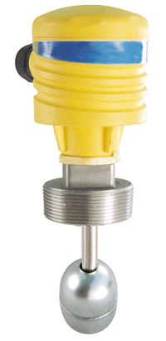
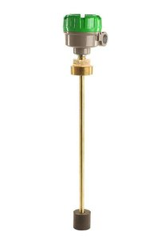
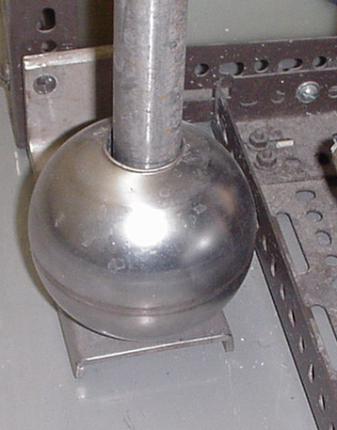
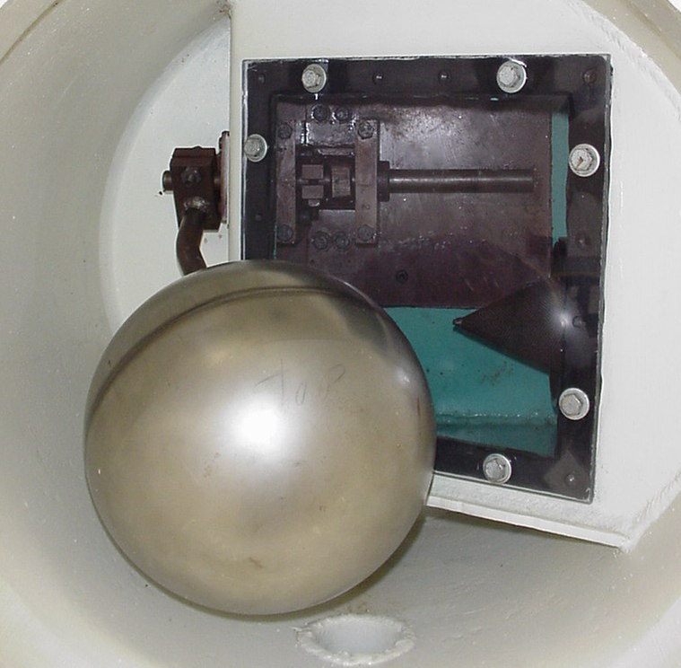
Float Type Level Indıcator examples

Slide 17
Float Type Level Indıcator- advantages & dısadvantages
Advantages
It is possible to read the liquid levels in a tank from the ground level even if the tank is kept below the ground level.
Its cost is low & has reliable design.
It operates over a large temperature range.
There is a choice of corrosion-resistant materials to make these.
Disadvantages
They are normally limited to moderate pressures.
They are tailored to tank geometry.

Slide 18
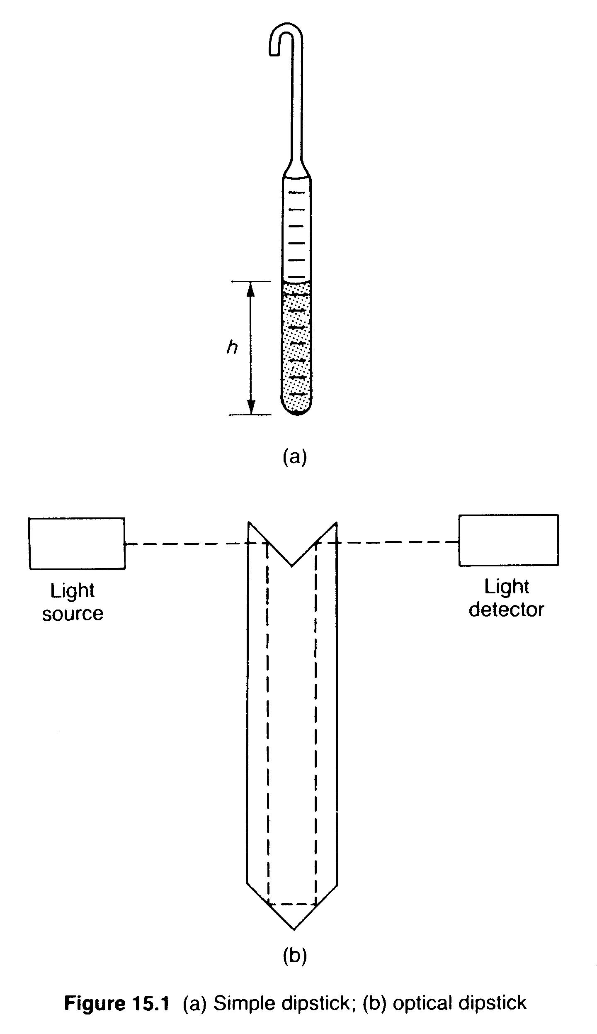
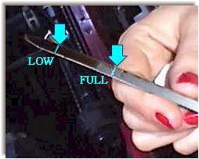
Dıp Stıck
Simple and cheap
Can be used with any wet material and not affected by density.
Can not be used with pressurized tanks
Visual indication only (electronic versions are available)
Dip Stick
RodGauge - similar to a dipstick found in a car, it has weighted line markings to indicate depth or volume
Notes:
RodGauge - similar to a dipstick found in a car, it has weighted line markings to indicate depth or volume
2. A rod gauge provides an inferred measurement for level.
ANS: False, the level reading is obtained directly

Slide 19
Indırect measurement
Indirect methods measures liquid level by measuring some other physical parameter such as pressure, weight, or temperature.
Measures another process variable (e.g. head pressure or weight) in order to infer level.
TYPES
    Hydrostatic Pressure Type
    (Pressure gauge method, Air bellows, Air purge system, Liquid purge system)
    Electrical Type
    (Capacitance level indicators, Radiation level detector)
    Optical Type (Optical level detector, fiber optic level detector)
    Ultrasonic and radar level sensor

Slide 20
Hydrostatıc Pressure Type
Pressure Gauge Method
The simple method used for liquid level measurement in an open tank.
P= ρ×g×h
Where:
P= pressure in psi or N/m2
ρ= density of the liquid
h= height of the liquid (often called head) in inch or meter

Slide 21
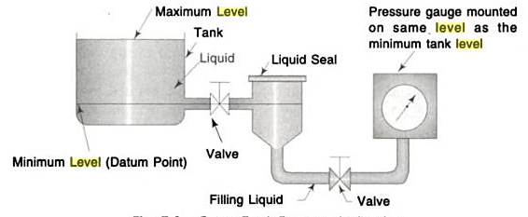
Pressure Gauge Method
Construction & Working
The pressure gauge level indicator consists of a pressure gauge connected at the lowest level of the tank.
The level at which the pressure gauge is fitted is known as the reference level & the static pressure measured by the gauge is a measure of the height of liquid column above the reference level & hence the liquid level.
A liquid seal is connected with the piping on the tank including a shut-off valve while measuring corrosive or highly viscous liquids.
This liquid seal consists of a fluid with which the measuring system is filled.
This filling liquids transmits the pressure head of the measured liquid.
The free surface of the filling liquid is kept in indirect contact with the measured liquid.
These 2 liquids must not mix or react chemically.

Slide 22
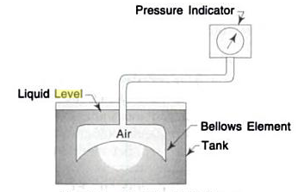
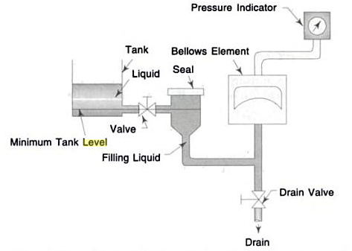
Hydrostatıc Pressure Type
B. Air Bellows
- Used for liquid level measurement where an indicator cannot be conveniently located at the specified datum line.
Figure shows an industrial application of air bellows in which closed-box air bellows is connected to the process fluid tank via a seal (liquid level measurement).
Liquid seals are used while measuring corrosion or viscous liquids level.
Flexible Air Bellows
A Closed-box Air Bellows Connected to the
Pressure Fluid Tank

Slide 23
AIR BELLOWS
Construction & Working
Consists of the bellows element which is connected by the tubing with the pressure indicator.
Air is sealed in the cavity above the bellows and inside the tubing to the pressure indicator.
When the tank is empty, the sealed air is uncompressed & corresponds to zero on the pressure indicator.
As the tank is filled with liquid, the head of liquid in the tank flexes the bellows, which compresses the air above the bellows.
The compression of sealed air is transmitted to the indicator which is calibrated in terms of the tank liquid level.
Air bellows may be constructed for various applications and ranges.

Slide 24
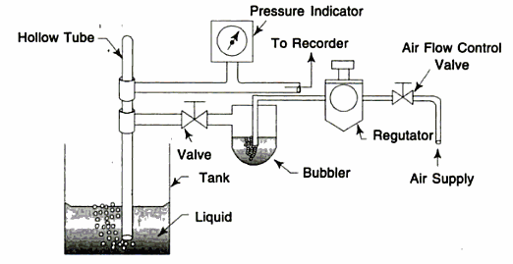
HydrostatIc Pressure Type
C. Air Purge System
Also known as bubbler tube.
This system is one of the most popular hydrostatic pressure type of liquid level measuring system which is suitable for any liquid.
Air Purge System

Slide 25
Bubblers
-Bubblers allow the indicator to be located anywhere.
-The air pressure in the tube varies with the head pressure of the height of the liquid.
P
Instrument input does not matter
Regulated purge system
(air or nitrogen)
Can’t be used in closed tanks or where purging a liquid is not allowed (soap).
Very popular in the paper industry because the air purge keeps the tube from plugging.
Bottom of tube determines reference point
Notes:
The air bubbler is another pressure-type level sensor where you install a dip tube in a tank with its open end a few inches from the bottom. A fluid forces itself through the tube; when the fluid bubbles escape from the open end, the pressure in the tube equals the hydrostatic head of the liquid. As liquid level (head) varies, the pressure in the dip tube changes correspondingly.
For tanks that operate under pressure or vacuum, installing a bubbler system becomes slightly more complex, because the liquid level measurement is a function of the difference between the purge gas pressure and the vapor pressure above the liquid. Because differential pressure is now involved, the transducer used is normally a dP cell.
One disadvantage of using a bubbler is limited accuracy. Another is bubblers will introduce foreign matter into the process. Liquid purges can also upset the material balance of the process, and gas purges can overload the vent system on vacuum processes. If the purge medium fails, not only do you lose the level indication on the tank, but you also expose the system to process material, which can cause plugging, corrosion, freezing, or safety hazards
4.The purge level measurement instrument is not used to measure pulp in a vat because the tube will become clogged with sludge.
ANS: False, the purge keeps the tube clean

Slide 26
Aır Purge System
Construction
Consists of a hollow tube inserted in the liquid of the tank.
2 connectors are made with the bubbler tube (1 to regulated air supply & the other to a pressure gauge), calibrated in terms of liquid level.
A bubbler is connected in the air supply line which serves simply as a visual check to the flow of the supply air.
A level recorder may be connected with the pressure gauge to keep the continuous record of liquid level.

Slide 27
Aır Purge System
Working
When there is no liquid in the tank or the liquid level in the tank is below the bottom end of the bubbler tube, the air flows out of the bottom of the bubble tube & the pressure gauge indicates zero.
As the liquid level in the tank increases, the air flow is restricted by the depth of liquid and the air pressure acting against liquid head appears as back pressure to the pressure gauge.
This back pressure causes the pointer to move on a scale, calibrated in terms of liquid level.
The full range of head pressure can be registered as level by keeping the air pressure fed to the tube, slightly above maximum head pressure in the tank.
The range of the device is determined by the length of the tube.
Because air is continuously bubbling from the bottom of the tube, the tank liquid does not enter the bubbler tube and hence, the tube is said to be purged.
The common purging fluid air, but if air reacts with the tank fluid or is absorbed, different gases (like carbon or nitrogen) are chosen depending on liquid properties.

Slide 28
Aır Purge System- advantages
Advantages
The pressure gauge can be placed above or below the tank level & can be kept as far away as 500ft (12.7m) from the tank with the help of piping.
This type of device is well-suited for measuring the level of corrosive or abrasive liquids.

Slide 29
Hydrostatıc Pressure Type
D. Liquid Purge System
When an air purge system is unsuitable, because air bubbling through liquid may interface with its crystallization, a liquid purge system is used.
The construction & working of liquid purge system is the same as an air purge system, the only difference is that in place of air, water or light material oil is used as the purge liquid.
The nature of the purging liquid must be such that the introduction of small quantities of it into the plant will not affect the product on process.
It should be free flowing & not vaporize at the temperature of the pipe line.
The purging liquid may be either soluble or insoluble in the vessel liquid.
The rate of flow of the purging liquid is normally adjusted to about 1 gallon/hour.
The supply liquid pressure is determined by the range of liquid level to the monitored.

Slide 30
Electrıcal Type
A. Capacitance Level Indicator
The principle of operation of capacitance level indicator is based upon the familiar capacitance equation of a parallel plate capacitor given by:
C = K (A/D)
Where, C = Capacitance (Farad)
K = Dielectric constant
A = Area of plate (m²)
D = Distance between 2 plates (meter)

Slide 31
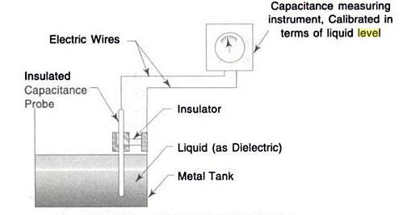
Capacıtance Level Indıcator
A capacitor consists of two plates separated from each other by an insulating material called a dielectric.
In applications involving capacitance measuring devices, one side of the process container acts as one plate and an immersion electrode is used as the other.
The dielectric is either air or the material in the vessel.
The dielectric varies with the level in the vessel.
This variation produces a change in capacitance that is proportional to level.
Thus, level values are inferred from the measurement of changes in capacitance, which result from changes in the level.
Capacitance Level Indicator

Slide 32
Capacıtance Level Indıcator
When the level of liquid in tank rises, the capacitance increases.
When liquid level in the tank decreases, the capacitance also decreases.
This increase & decrease in the capacitance is measured & is displayed on the indicator calibrated in terms of liquid level.
Capacitance Level Indicator

Slide 33
Capacıtance Level Indıcator- ADVANTAGES & DISADVANTAGES
Advantages
It is very useful in a small system.
It is very sensitive.
There are no moving parts exposed to fluid.
It is suitable for continuous indication and/or control.
Remote adjustment of span & zero is possible in this of level indicator.
It is good for use with slurries.
Probe materials for most corrosive fluids are available.
Disadvantages
The performance of a capacitance level indicator is severely affected by dirt & other contaminants, because they change in temperature.
Its sensitivity is adversely affected by changes in temperature.
Measured fluid must have proper dielectric qualities.
They usually require recalibration if measured material changes in composition or moisture content.
Probe length & mounting must suit the tank.

Slide 34
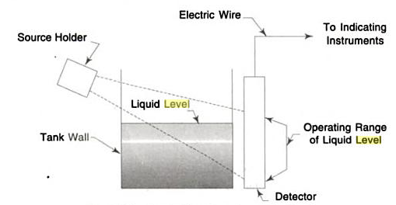
Electrıcal Type
B. Radiation Level Detector
Used where other electrical methods would not survive.
Also the most common reason for using a radiation level detector is that it does not need to come in contact with the liquid being measured.
Radiation Type Level Indicator

Slide 35
RadIatIon Level Detector
Construction & Working
It consists of gamma rays source holder on 1 side of the tank & a gamma detector on the other side of the tank.
The gamma rays from the source are directed towards the detector in a thin band of radiation.
When the gamma rays penetrate the thick wall of the tank, its energy level afterwards is greatly reduced.
The radiation received at the gamma detector is inversely proportional to the thickness of the tank walls & the medium between radiation source & the detector.
That is, the thicker the medium between source & detector, the less radiation received by the detector & vice versa.

Slide 36
RadIatIon Level Detector
Construction & Working (cont.)
When the tank is empty, the gamma rays pass only through the 2 tank walls & the air or vapour in the empty tank.
When liquid enters the tank & its level rises, the radiation beam passes through a path in the liquid, as well as the tank walls.
The liquid in the tank reduces the radiation received by the detector.
The amount of radiation received is inversely proportional to the amount of liquid between the radiation source & the detector.
The difference in the amount of radiation received by the received by the detector, corresponds to the liquid level in the tank.
Thus, when liquid level rises, the amount of radiation received is reduced & vice versa.

Slide 37
RadIatIon Level Detector- advantages & dısadvantages
Advantages
There is no physical contact with the liquid.
They are suitable for molten metals as well as liquids of all types (corrosive, abrasive, highly viscous, adherent)
They are useful at very high temperatures/pressures.
They have good accuracy & response.
They have no moving parts.
Disadvantages
The reading is affected by density change of liquid.
Radiation source holders may be heavy.
Their cost is relatively high.

Slide 38
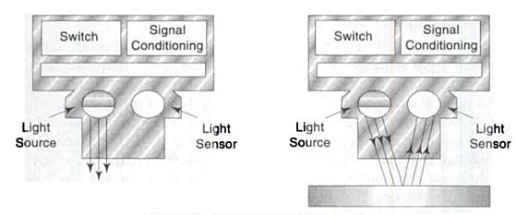
Optical Level Detectors
Working & Construction
Optical level detector make use of visible or infrared light beams to detect the level of liquids or solids.
A beam of light is aimed at the liquid or solids level & is reflected back to a light-sensitive transistor, located in the same holder as the light source.
By adjusting the transistor sensitivity, the unit can be calibrated in the range of point level detection from 6.3mm to 300mm on reflective, opaque liquid (e.g. milk) or on solids services.
When light is passing through a fixed distance in a fluid, the intensity of light received at the detector can be used to determine the concentration of solids in the liquid.
The operating temperature range is -40⁰C to 66⁰C.
Optical Level Detectors

Slide 39
Optical Level Detectors
Advantages
Disadvantages
Use on corrosive, sticking or coating processes.
The reflection of laser light is used in some specialized applications such as the measurement of the thickness of molten glass.
The laser versions of optical level detectors provide high precision on narrow span application.
The detector is adversely affected by changes in reflectivity of the process.

Slide 40
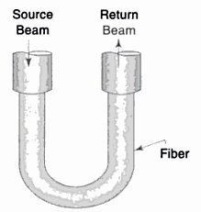
Fiber-optic Level Detectors
Working & Construction
Use the principle of light refraction.
Figure 2.18 illustrates the working of a fiber-optic level detection system.
A light beam travels through the fiber.
When there is no liquid on the fiber, the return beam will have the same intensity as the source beam.
As the liquid covers the fiber, the index of refraction increases, allowing light to escape into the liquid & reducing the strength of the return beam.
Fiber Optic Level Detection Probe

Slide 41
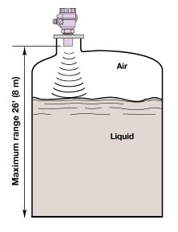
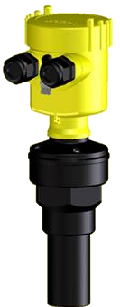
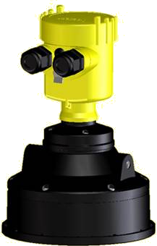
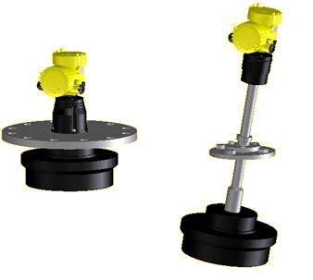
Ultrasonic Level Detector
Non-Contact direct level sensor
Level is a function of the time it takes an ultrasonic pulse to hit the surface and return
Limitations include:
  Surface foam absorbs signal, agitation create reflections
  High Pressure & High Temperatures affect the signal speed
  Vapour and condensate create false echo’s
Notes:
Non-Contact Ultrasonic level sensors transmit and receive ultrasonic waves in the range of 25 – 50 KHz. The transducer is mounted above the maximum level of the media to be measured and the ultrasonic pulse is directed at the surface. As the level of the media moves, the time interval for the signal return also changes. The transmitter converts this time interval to a direct reading of level.
The transmitted wave can be either a continuous wave or a pulsed wave depending on the application. Generally speaking, pulsed waves are short bursts of energy 5 – 10 times stronger than the continuous wave and are used in applications to provide more accurate measurement in conditions of aeration, turbulence, suspended solids, and highly viscous liquids.
Certain process conditions may interfere with the ultrasonic signal. These conditions include high pressure, slurries with a very high percentage of solids, extreme aeration of the liquid, and very aggressive turbulence and splashing.
Vapour and condensate create false echo’s resulting in an incorrect level measurement.

Slide 42
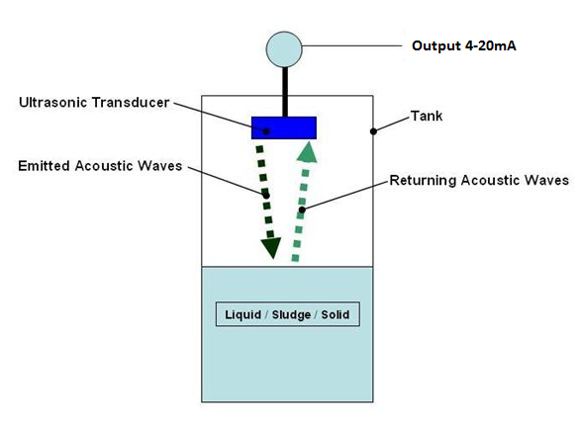
Ultrasonic Level Detector
Working & Construction
Operate on the basic principle of using sound waves to determine liquid solid/slurries level or distance.
A sensor would normally be mounted at the top of a tank and direct a sound wave down towards the surface of the product.
When the sound wave hits the product it is reflected and returned to the sensor.
The greater the distance between the sensor and the product, the longer it will take for the sound wave to travel down and back up again.
The sensors calculate this time interval and give a signal proportional to the distance.
They also compensate for the changes in the speed of sound due to changes in temperature.
Ultrasonic Level Sensor

Slide 43
Ultrasonic Level Detector
Ultrasonic sensors are not suitable for use in all applications.
If the vapours of the product can effect the measurement, and if there is foam on the surface then the sound wave will be scattered and the sensor will not receive a signal that it is able to process accurately.
Ultrasonic level sensor emits high frequency (20 - 200 kHz) acoustic waves.
Ultrasonic Level Sensor

Slide 44
Ultrasonic Level Detector
Advantages
Non-contact type measurement technique.
They have ability to measure level without making physical contact with the proce s material.
They have no mowing parts.
The reliability of the reading is unaffected by changes in the composition, density, moisture content, electrical conductivity, or dielectric constant of the process fluid.
Disadvantages
Temperature compensation is essential in ultrasonic level measurement.
The dirt, irregular and slope surface affect the accuracy of the measurement.
An ultrasonic transmitter is subject to many interferences, which affect the strength of the echo it receives. The echo can be weak due to dispersion & absorption.

Slide 45
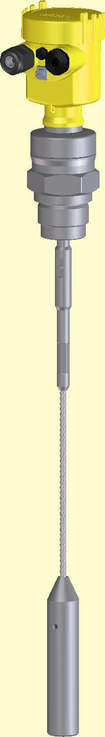
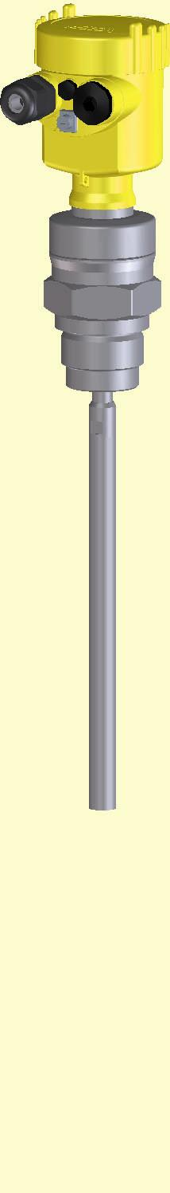
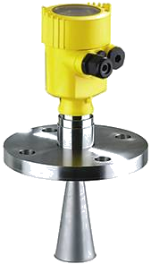
Radar level measurement
Through Air
Radar
Guided Wave
Radar

Slide 46

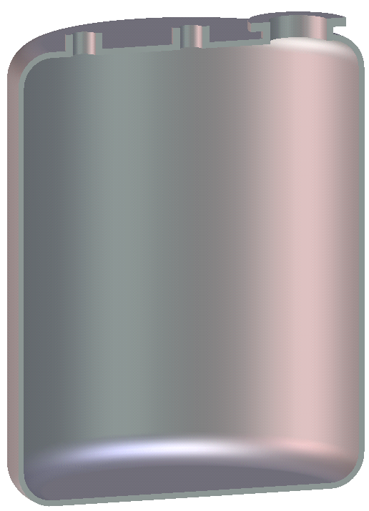
Through Air Radar
Radar is a time of flight measurement.
  Microwave energy is transmitted by the radar.
  The microwave energy is reflected off the product surface
  The radar sensor receives the microwave energy.
  The time from transmitting to receiving the microwave energy is measured.
  The time is converted to a distance measurement and then eventually a level.

Slide 47
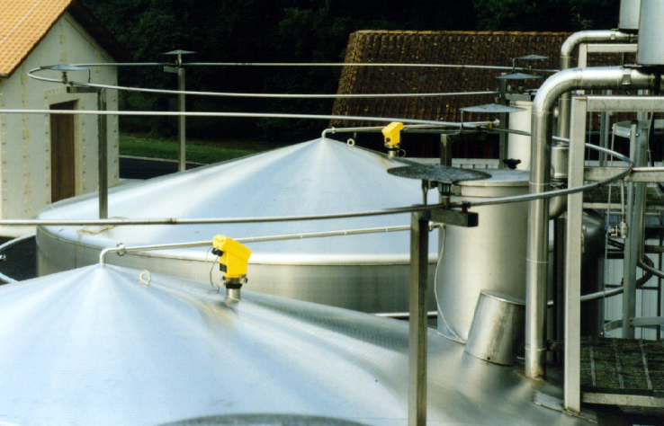
Radar Technology – Why use it?
Radar level measurement
Top mounted
Solids and liquids applications
Non-contact
RADAR is virtually unaffected by the following process conditions:
  Temperature
  Pressure and Vacuum
  Conductivity
  Dielectric Constant (dK)
  Specific Gravity
  Vapor, Steam, Dust or Air Movement
  Build up (depends on radar design)

Slide 48
Radar Technology - Choice of frequency
Radar wavelength = Speed of light / frequency
l = c / f
47.5mm
Frequency 6.3 GHz
wavelength l = 47.5 mm
11.5mm
Frequency 26 GHz
wavelength l = 11.5 mm
High frequency:
shorter wavelength
narrower beam angle
more focused signal
ability to measure smaller vessels
with more flexible mounting
Low frequency:
longer wavelength
wider beam angle
less focused signal
ability to measure in vessels with
difficult application variables

Slide 49
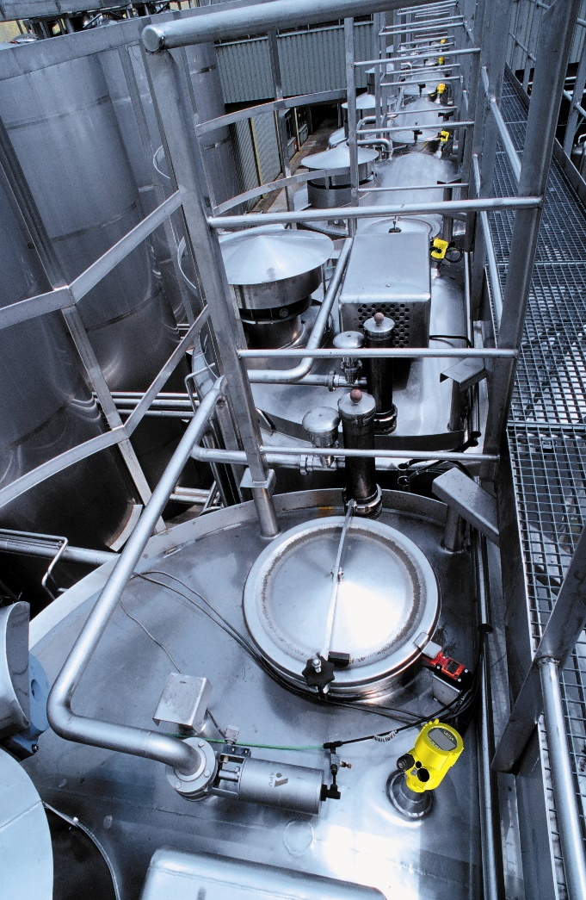
Frequency
Choosing a frequency depends on:
  Mounting options
  Customer’s 100% point
  Vessel dimensions – proximity of connection to sidewall
  The presence of foam
  Agitated product surfaces
  Vapor composition
  Vessel internal structures
  Dielectric constant (dK)

Slide 50

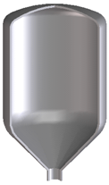

Guided Wave Radar (TDR)
A microwave pulse (2 GHz) is guided along a cable or rod in a 20” diameter or inside a coaxial system.
The pulse is then reflected from the solid or liquid, back to the head of the unit.
The travel time of the pulse is measured and then converted to distance.
GUIDED WAVE RADAR is virtually unaffected by the following process conditions:
  Temperature
  Pressure and Vacuum
  Conductivity
  Dielectric Constant (dK)
  Specific Gravity
  Vapor, Steam, or Dust Air Movement
  Build up (depends on type of build up)
  Foam

Slide 51
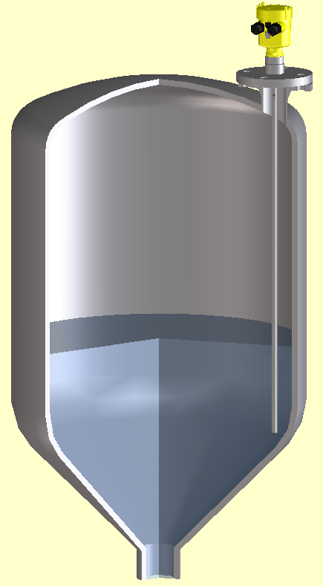
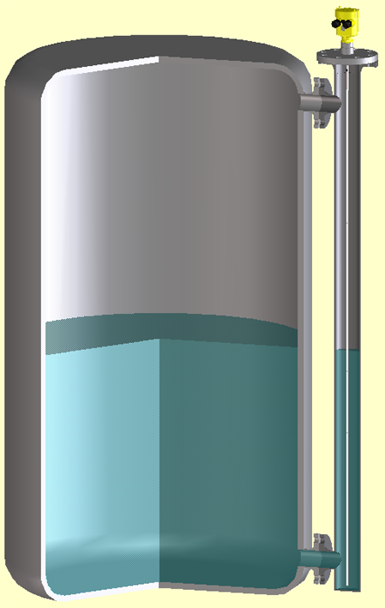
Guided Wave Radar (TDR)
Installation into the vessel
Installation in bridles without worry of build-up or interference from side leg connections
Ideal for replacement of displacers

Slide 52
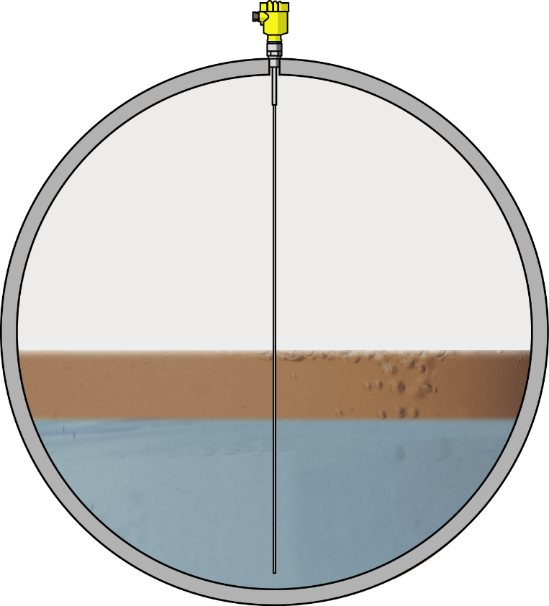
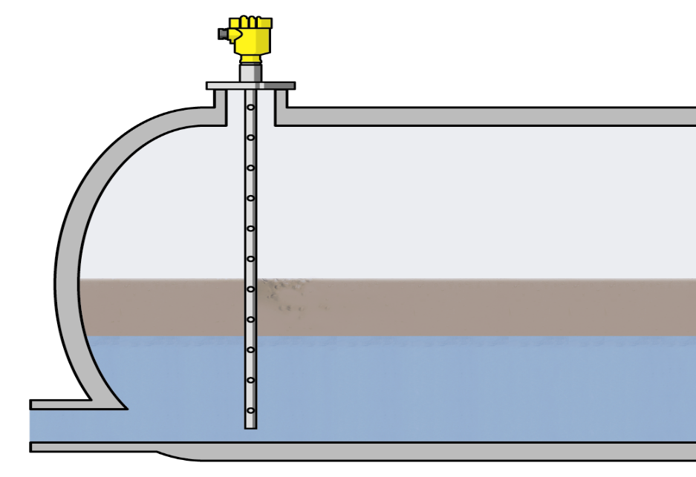
Guided Wave Radar (TDR) example
Interface Measurement
  Oil/Water
  Solvent/Water

Slide 53
radar Level measurement
Advantages
Non-contact technology with no moving parts reduces maintenance cost.
Versatile technology for liquids, slurries, solids, pellets or powders.
Long measuring range up to 40m with adjustable sensitivity to suit most applications.
Simple to install & commission leading to reduced installation cost.
Immune to coatings on tank walls improving reliability & reduces maintenance costs.
Non-invasive technology, with no long probes to insert, internal product build up is reduced.
Suitable for demanding environments such as corrosive, high dust, high vibration & vapours.

Slide 54
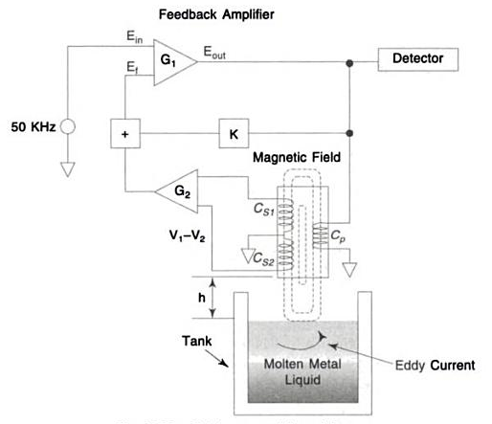
Eddy Current Level Measurement Sensors
Use eddy-current principle to measure the level of molten (liquid) metals or other conducting liquids in a tank.
It consists of 3 coils – 1 primary coil (C_{p}) & 2 secondary coils (C_{S1} & C_{S2}).
Secondary coils are located on either side of the primary coil.
When a high frequency (50KHz) current is applied to the C_{p} a high-frequency magnetic field is generated.
In response to this, an eddy current is generated in the molten metal liquid in the tank & voltages are induced in the C_{S1} & C_{S2} of the sensor.
The difference in these voltages, which can be detected by the sensor, corresponds to changing distance between the sensor & the surface of the liquid in the tank.
This changing distance can be calibrated to read level of the liquid in the tank.
Eddy-current level sensor are best suited for the level measurement & control of molten metals in the mould of continuous casting shops of steel plants.
They can be used for the measurement of level up to 200mm from the surface of the liquid.
Eddy-current Level Sensor

Slide 55
Eddy Current Level Measurement Sensors
Advantages
Eddy-current level sensors are non-contact type measurement technique.
They have no moving parts.
These sensors are small & light with a wide measurement range.
They are highly stable with little thermal drift.
They use differential method, which minimizes the influence of external noise.

Slide 56


