Slide 1
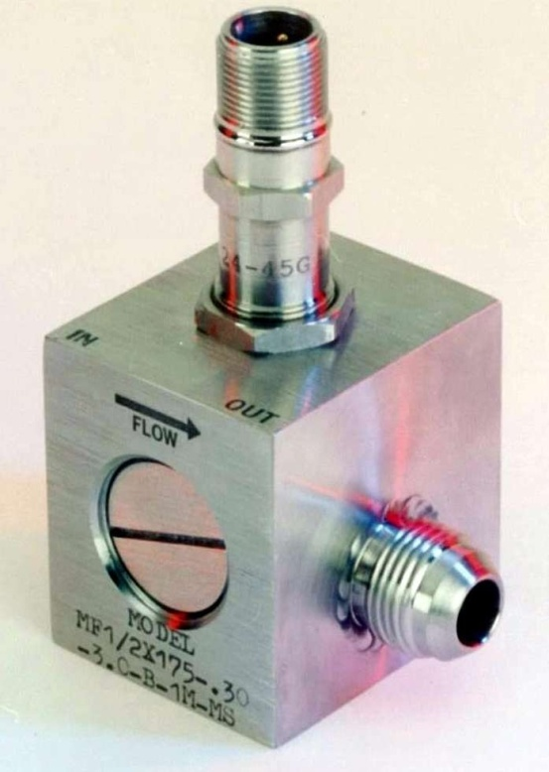
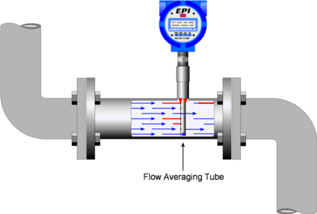
flow MEASUREMENT

Slide 2
Reasons for Flow Metering
Plant control, for product quality and safety reasons.
Filling of containers, stock tanks and transporters.
Energy, mass balancing for costing purpose and monitoring of heat exchangers.
Monitoring of pipelines and on-line analysis equipment.

Slide 3
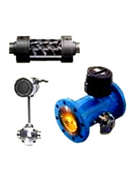
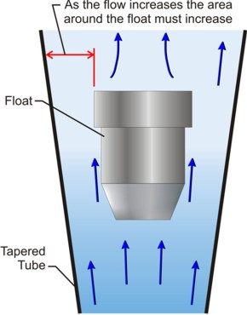
Types of Flow Meters
Differential Pressure Meters
(Orifice Plate, Venturi Tube, Pitot Tube, Rotameter, etc.)
Rotary Meters
(Displacement , Inferential)
New Flow Meters
(Electromagnetic, Vortex Shedding, Ultrasonic,
Cross Correlation, Tracer, Swirl, Fluidic)

Slide 4
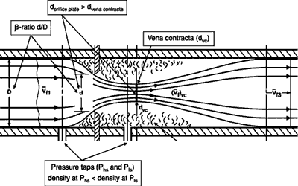
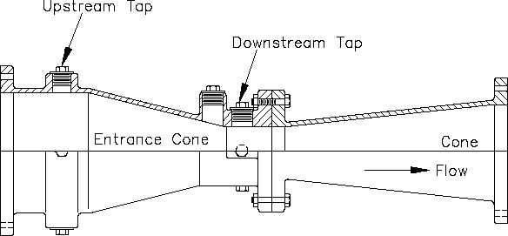
Differential Pressure Meters
Orifice Meter
Dall Tube
Venturi Tube
Pitot Tube
Rota meter
Target mater
Averaging Pitot
Nozzle
Spring Loaded
Intake Meter
Elbow Meter
Bypass Meter
Venturi Meters
Orifice Meters
Flow Nozzles

Slide 5
Parts of differential flow meters
1.Primary element
-Part of meter used to restrict the fluid flow in pipe line to produce differential pressure
Types
Orifice plate
Venturi tubes
Flow nozzles
Pitot tube etc.

Slide 6
Parts of differential flow meters
2. Secondary element
-measure the differential pressure produced by primary elements and convert them to usable forces or signals
Types
Manometers
Bellow meters
Force balance meters etc.

Slide 7
flow rate ın the pıpe
The operating principal is based on the Bernoulli equation and the continuity equation of fluid flow, combining these equations you can find the relationship between the flow rate and pressure drop.

Slide 8
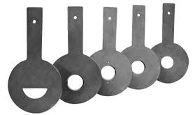
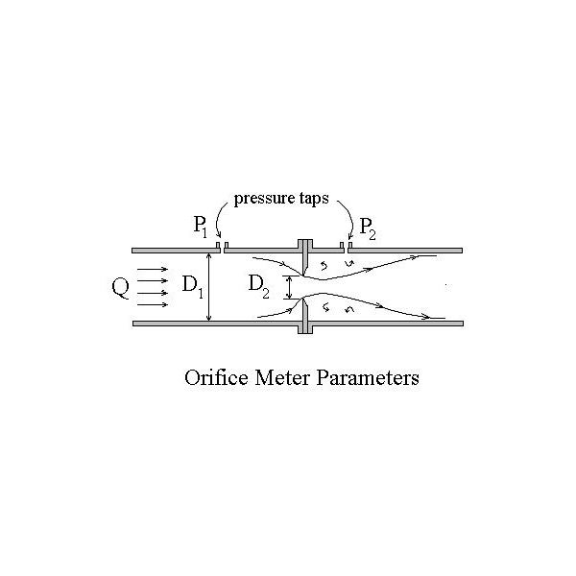
ORIFICE METER
Orifice meter consist of orifice plate, is simply a flat piece of metal with a specific-sized hole bored in it.
Pressure drop caused by friction and turbulence of shear layer downstream of vena contracta
There are four types of orifice plates which are listed below:
  Segmental orifice plate
  Eccentric orifice plate
  Quadrant edge orifice plate
  Concentric orifice plate

Slide 9
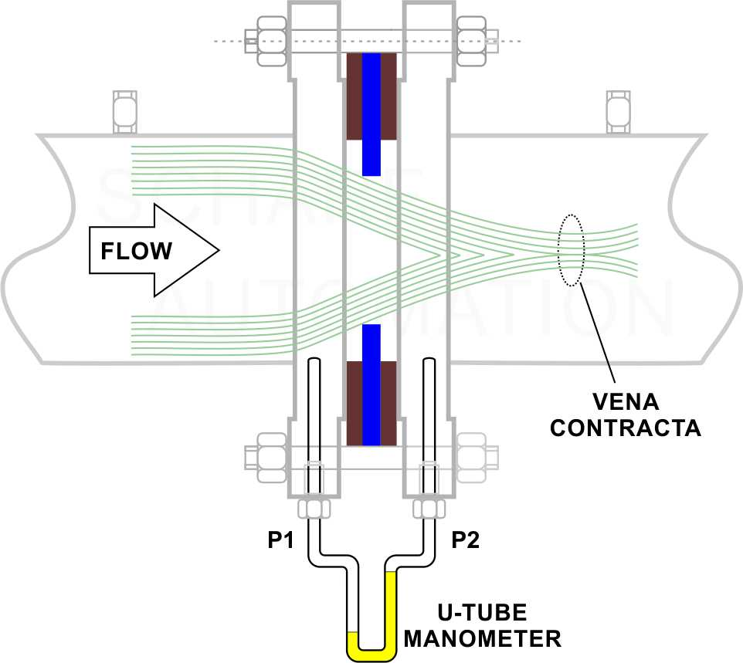
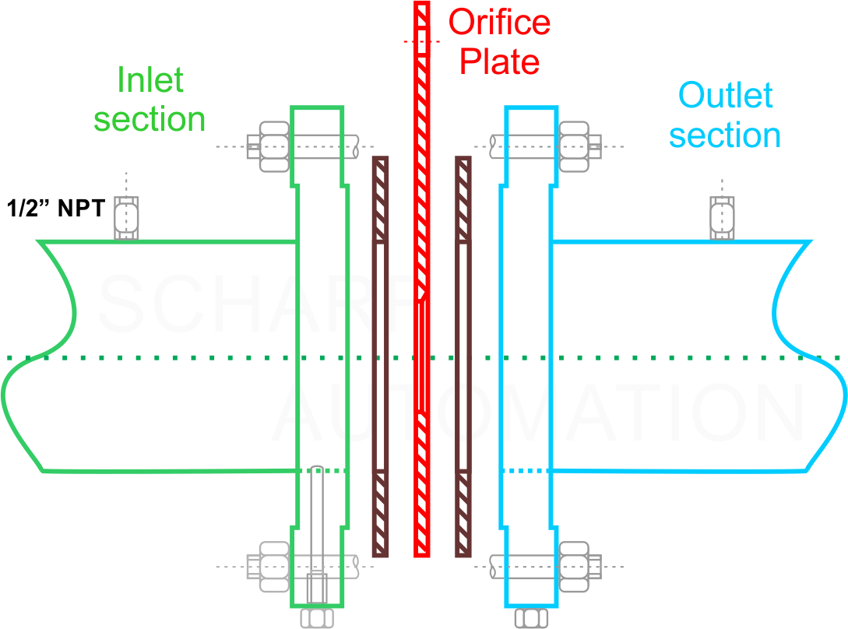
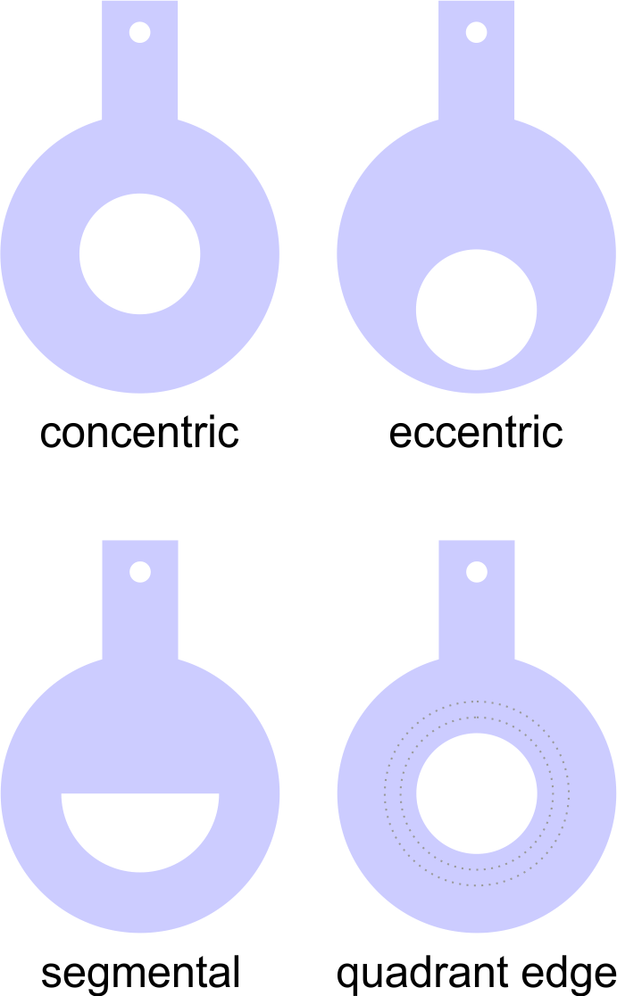
ORIFICE METER

Slide 10

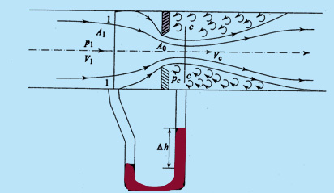


Flow Through an Orifice Meter
Bernoulli Eqn
Equation of continuity

Slide 11
ORIFICE METER
ADVANTAGES:
Its cost is low.
They can be used in a wide range of pipe sizes (3.175 to 18211.8mm).
They can be used with the differential pressure devices.
They are well known and have predictable characteristics.
They are available in any material.
DISADVANTAGES:
They cause relatively high permanent pressure loss.
They tend to clog, thus reducing use in slurry services.
Their accuracy depends upon care during installation.
They have changing characteristics because of erosion, corrosion and scaling.

Slide 12
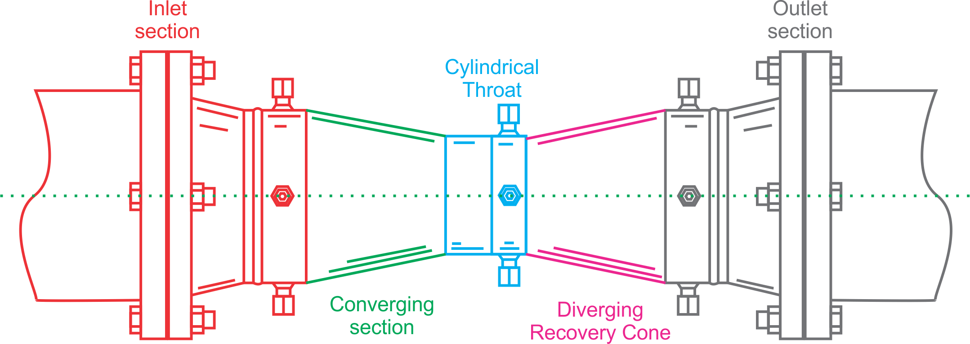
VENTURI METER
Consist of converging diverging section joined by cylindrical throat.
Pressure tapping is located at two different location.
Ultimately pressure drop is measured in term of flow.
As the water enters at the inlet section i.e. in the converging part it converges and reaches to the throat.
The throat has the uniform cross section area and least cross section area in the venturimeter.
As the water enters in the throat its velocity gets increases and due to increase in the velocity the pressure drops to the minimum.
Now there is a pressure difference of the fluid at the two sections. At the section 1(i.e. at the inlet) the pressure of the fluid is maximum and the velocity is minimum. And at the section 2 (at the throat) the velocity of the fluid is maximum and the pressure is minimum.
The pressure difference at the two section can be seen in the manometer attached at both the section.
This pressure difference is used to calculate the rate flow of a fluid flowing through a pipe.

Slide 13
VENTURI METER
Convergent section:
In converging conical inlet section, the cross
section of the stream decreases as a result
pressure head decreases.
Cylindrical section:
Cylindrical throat which provides for the low pressure tap location of the decreased pressure ,in an area where flow velocity neither increasing nor decreasing.
Divergent section:
Diverging recovery cone in which the velocity decreases and the decreased velocity head is recovered in term of pressure head.

Slide 14




VENTURI METER
Bernoulli Eqn
Equation of continuity
DR. KADRİYE ÖZLEM HAMALOĞLU
12.11.2018

Slide 15
VENTURI METER
Advantages:
It causes low permanent pressure loss.
It is widely used for high flow rates.
It is available in very large pipe sizes.
It has well-known characteristics.
It is more accurate over wide flow ranges than orifice plates or nozzles.
It can be used at low and high beta ratios.
Disadvantages:
Its cost is high.
It is generally not useful below 76.2mm pipe size.
It is more difficult to inspect due to its construction.
It has the limitation of a lower Reynolds number of 150,000.

Slide 16
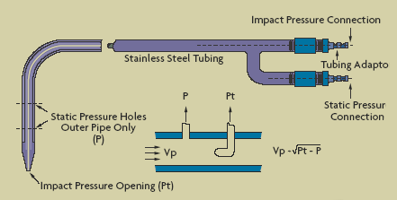
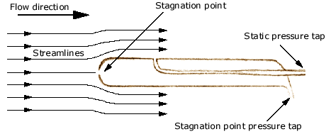
PITOT TUBE
It consists of a tube with an opening at the end. The small hole in the end is positioned such that it faces the flowing fluid. The velocity of the fluid at the opening of the tube decreases to zero (Stagnation point).
Stagnation Pressure = Static Pressure + Dynamic Pressure

Slide 17
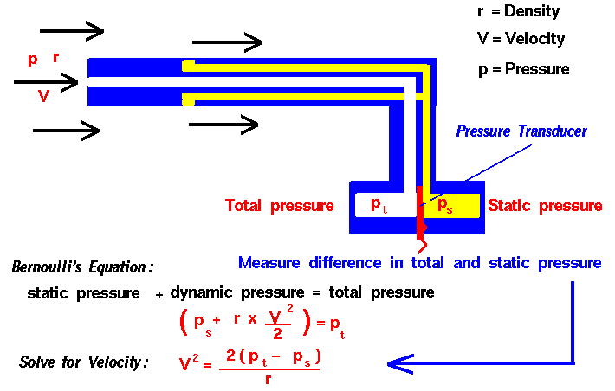

PITOT TUBE

Slide 18
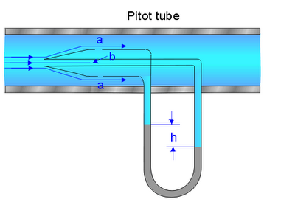
PITOT TUBE
ADVANTAGES:
These tubes have no process loss.
They are economical to install.
Some types can be easily removed from the pipeline.
DISADVANTAGES:
These tubes have poor accuracy.
They are unsuitable for dirty and sticky fluids.
They are sensitive to upstream disturbances.

Slide 19
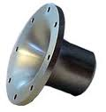
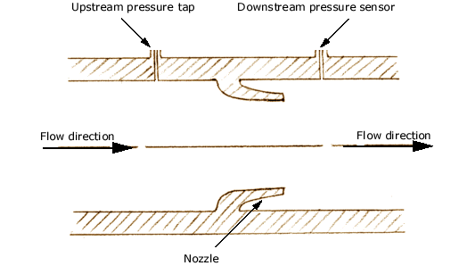
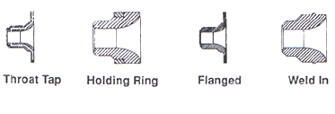
The Nozzle Flow meter
A flow nozzle meter consists of a short nozzle, with a smooth guided entry and a sharp exit is placed in the pipe to change the flow field and create a pressure drop that is used to calculate the flow velocity.
Frictional loss in a flow nozzle meter is much less than in an orifice meter, but higher than in a venturi meter.

Slide 20
The Nozzle Flow meter
ADVANTAGES:
Permanent pressure loss is lower than orifice plate.
It is available in numerous materials.
It is useful for fluids containing solids.
It is widely accepted for high temperature and pressure steam flow.
DISADVANTAGES:
Its cost is higher than orifice plate.
It is limited to moderate pipe sizes.
It requires more maintenance.

Slide 21
Flow through a Nozzle
Basic Equations:
a.) Continuity:
mass in = mass out
b.) Bernoulli’s Eqn.
Total pressure is constant throughout

Slide 22
FLOW THROUGH A NOZZLE
Y = Compressibility Factor=1 for incompressible flow or when ΔP<< P_{abs}
C=Discharge Coefficient=f(Re) and nature of specific flow meter

Slide 23
Flow through a Nozzle
ΔP

Slide 24
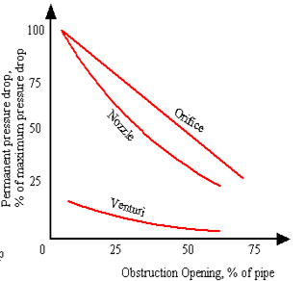
Relative Comparison
As the % opening(Primary element) increases the permanent pressure drop decreases.
At same % opening, the relative pressure drops
Orifice plate > Flow Nozzle > Venturi meter.
More accurate flow measurement is carried out at the expense of more pressure drop.

Slide 25
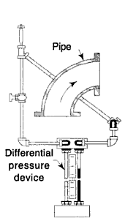
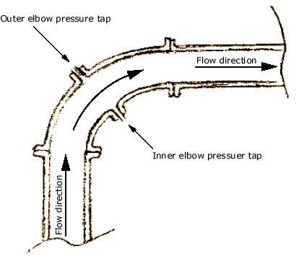
Elbow meters
Elbow meters operate on the principle that when liquid travels in a circular path, centrifugal force is exerted along the outer edges.
When liquid flows through a pipe elbow, the force on the elbow's interior surface is proportional to the density of the liquid times the square of its velocity inversely proportional to the elbow's radius.

Slide 26
Elbow meters
ADVANTAGES:
Elbow meters are easy to add in existing installation where elbow exist.
It cost comparatively low.
It allows no additional pressure loss.
With the elbow taps there are no obstruction in the line.
It has good repeatability.
DISADVANTAGES:
Its accuracy is poor.
Differential pressure developed is relatively small.

Slide 27
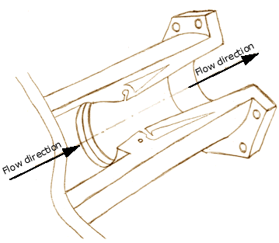
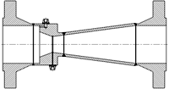
DALL TUBES
The Dall tube is a shortened version of a Venturi meter, with a lower pressure drop than an orifice plate. Dall tube produces much higher(two times) differential pressure as compare to venturi meter.
Inlet shoulder:
The tube consist of a short, straight inlet section followed by an abrupt decrease in the diameter of the tube.
Converging diverging section:
A converging(flow area decreases) and diverging section (flow area increases) is attached by a slot or gap. Where the low pressure measures.

Slide 28
DALL TUBES
ADVANTAGES:
Very low permanent pressure drop - energy savings.
Easy to install - short overall lengths.
Accurate flow metering of clean gases, liquid and steam.
Negligible wear and erosion therefore require less maintenance/inspection
DISADVANTAGES:
Its pressure difference is sensitive to up stream disturbance.
It is not considered for the measuring hot feed water.
Not suited for fluids having suspended solids.

Slide 29
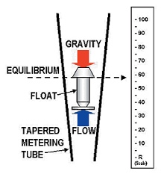
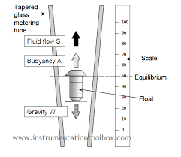
ROTAMETER
Force balance
  -Drag Force
  -Gravity
  -Buoyancy
DR. KADRİYE ÖZLEM HAMALOĞLU
12.11.2018

Slide 30
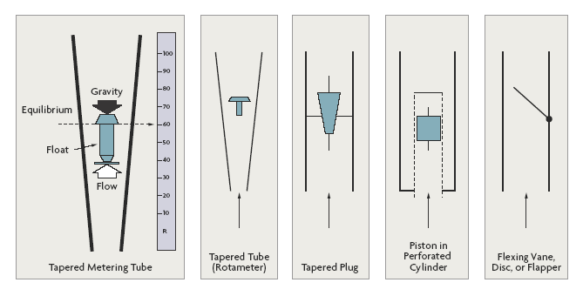
Variable Area ROTAMETERs

Slide 31
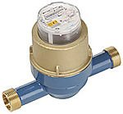
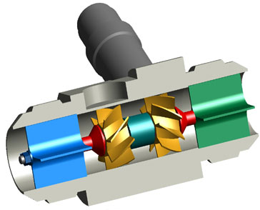
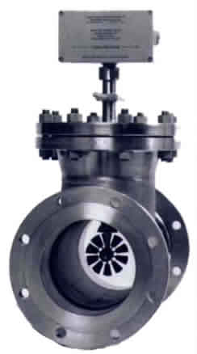
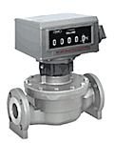
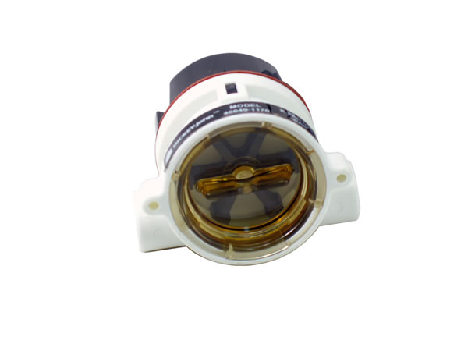

Rotary Meters ( Displacement Meters)
Devices which are used to measure mass or volumetric flow rate of gas or liquid by using a rotating element.
Positive Displacement Rotary Meters
Oval Gear
Nutating Disk
Oscillating Piston
Multi Piston
Rotating Impellers
Rotating Valve
Birotor
Roots Meter
Helix Meters
Inferential Rotary Meters
Turbine Meter
Paddle Wheel Meter
Notes:
-- This family of meters separates the incoming liquid or gas into discrete volumes and is transfering them downstream operates a counting mechanism. They are mainly used where a high order of accuracy is required and stoppage of the flow in an event is not an embarrasment.
--- extensively used for custody transfer of oils and fuels

Slide 32
Posıtıve Displacement Rotary Meters
Positive displacement flow meters, also know as PD meters, measure volumes of fluid flowing through by counting repeatedly the filling and discharging of known fixed volumes.
Principle of Operation
POSITION 1. As the bottom impeller rotates in a counterclockwise direction towards a horizontal position, fluid enters the space between the impeller and cylinder.
POSITION 2. At the horizontal position, a definite volume of fluid is contained in the bottom compartment.
POSITION 3. As the impeller continues to turn, the volume of fluid is discharged out the other side.
POSITION 4. The top impeller, rotating in opposite direction, has closed to its horizontal position confining another known and equal volume of fluid.

Slide 33
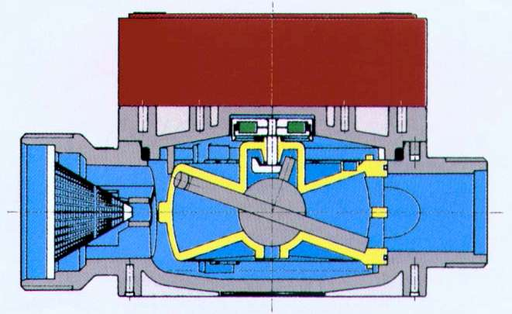
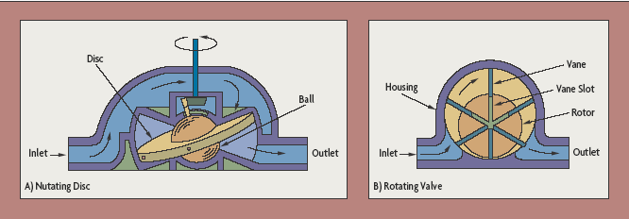
Nutating Disk
A nutating disc meter has a round disc mounted on a spindle in a cylindrical chamber.
By tracking the movements of the spindle, the flowmeter determines the number of times the chamber traps and empties fluid.

Slide 34
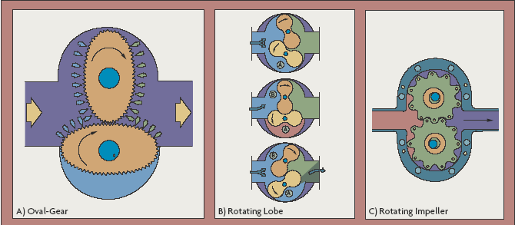
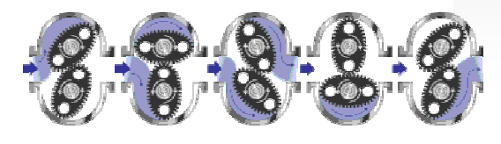
Oval Gear
Two identical oval rotors mesh together by means of slots around the gear perimeter.
The oval shaped gears are used to sweep out an exact volume of the liquid passing through the measurement chamber during each rotation.
The flow rate can be calculated by measuring the rotation speed.

Slide 35
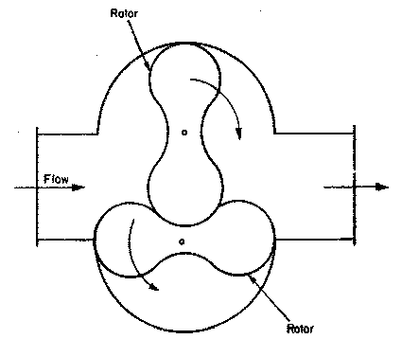
Roots Meter
The roots meter is similar in many respects to the oval gear meter.
Two-lobed impellers rotate in opposite directions to each other within the body housing.
These peanut-shaped gears sweep out an exact volume of liquid passing through the measurement chamber during each rotation.
The flow rate can be calculated by measuring the rotation speed.

Slide 36
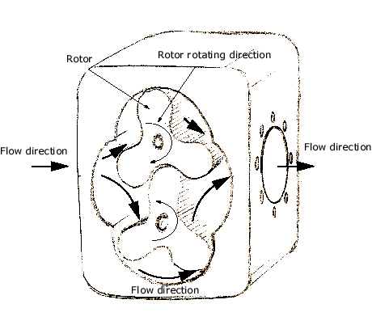
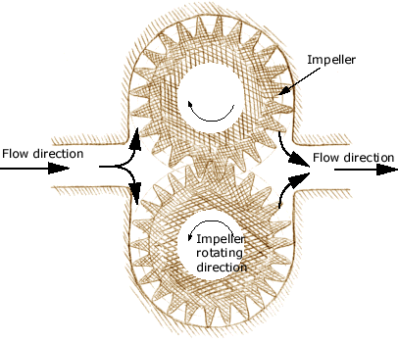
Rotating Impeller
Advantages
-High accuracy over a wide range of
viscosities and flow rates up to 2000
-Cp with proper clearances.
-Extremely good repeatability on high
viscosity fluids, very low slippage,
-Long life if little or no abrasive material in the fluid
-Low pressure drop
- Functions without external power

Slide 37
Posıtıve Displacement Rotary Meters
Advantages
Special construction available for high viscosities and temperatures
Can register near zero flow rate
Measures directly, not an inferential device, for more consistent results
Easy to repair and economical.
Disadvantages
Increased maintenance compared to other meters, more moving parts
May become damaged by flow surges and gas slugs
Chance of corrosion and erosion from abrasive materials
Derated flow rate capacity for high viscosities and temperatures
Relatively high cost for large sizes

Slide 38
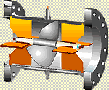
Inferential Meters
The inferential type meters are so-called because rather than measuring the actual volume of fluid passing through them, they “infer” the volume by measuring some other aspect of the fluid flow and calculating the volume based on the measurements
Types
Turbine Meters
Paddle Wheel Meters

Slide 39
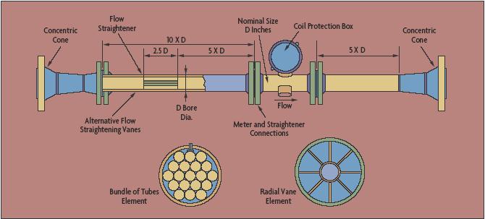
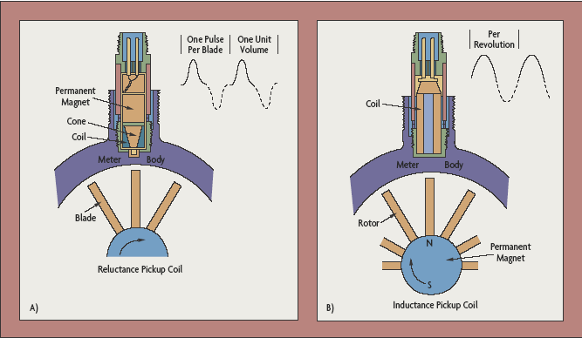
Turbine Flow Meters
It consists of a multi-bladed rotor mounted at right angles to the flow and suspended in the fluid stream on a free-running bearing.
The diameter of the rotor is very slightly less than the inside diameter of the metering chamber, and its speed of rotation is proportional to the volumetric flow rate.

Slide 40
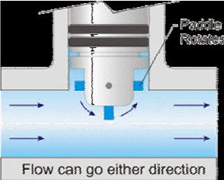
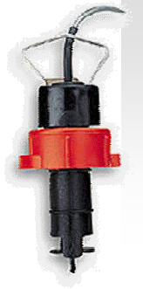
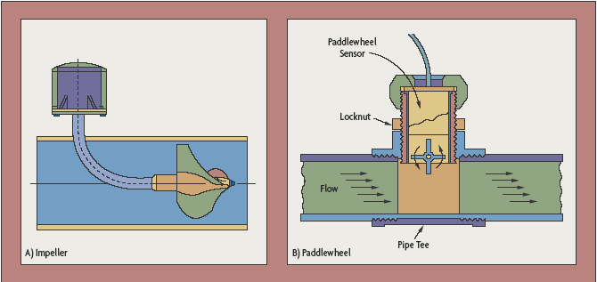
Paddle Wheel meters
The working principle of a paddle wheel flowmeter is simple.
A paddle wheel probe is in contact with the process fluid and, as the fluid flows in the flowmeter, it makes the paddle wheel rotate at a speed proportional to the flow rate.
A magnetic or an optical sensor detects the movement of the paddle wheel and relays the information to the flowmeter which converts it to a flow rate reading.

Slide 41
Inferential Meters
Advantages
Very good repeatability
Reduced susceptibility to fouling and deposits
Less sensitive to viscosity changes
Available in large sizes, good value for high flow rates
Low maintenance
Registers near zero flow rate
Disadvantages
High pressure drop that increases drastically with viscosity
Relatively high cost
Indirect measurement

Slide 42
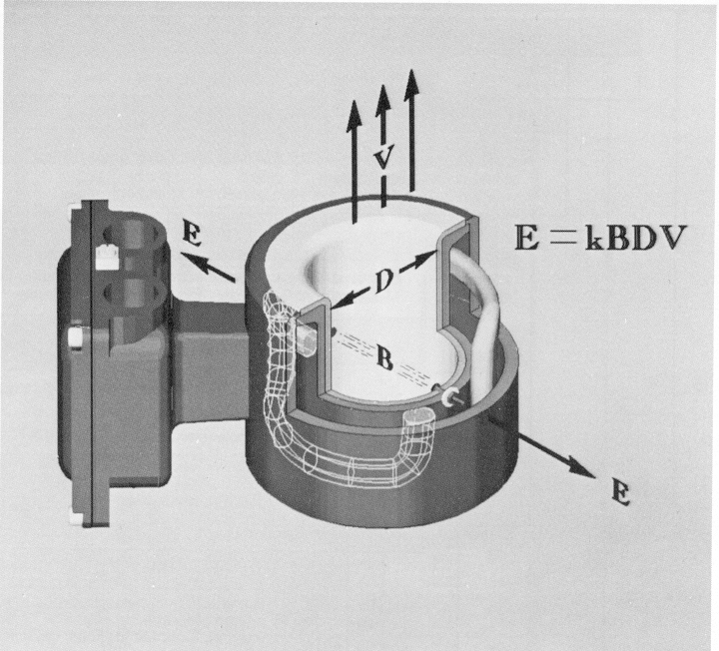
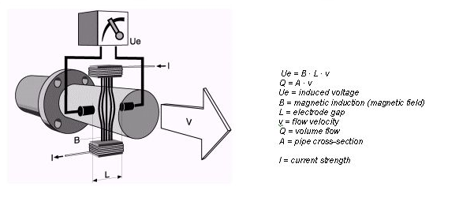
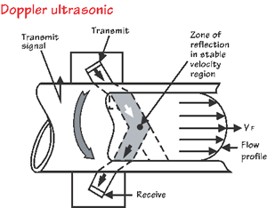
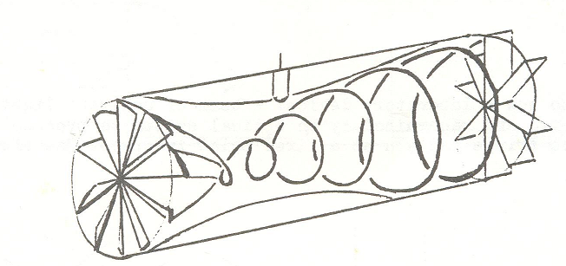
New Flow Meters
Electromagnetic (EM) Meter
Vortex Shedding Meter
Vortex Generation Meter
Ultrasonic Flowmeters
Magnetic Flowmeters
Swirl Meter
Coriolis Mass Flowmeters

Slide 43

Electromagnetic Flowmeters

Slide 44


Vortex Flowmeters

Slide 45

Ultrasonic Flowmeters

Slide 46

Mass Flowmeters

Slide 47

Coriolis Flowmeters

Slide 48

Coriolis Flowmeters

Slide 49

Thermal Mass Flowmeters

