Slide 1
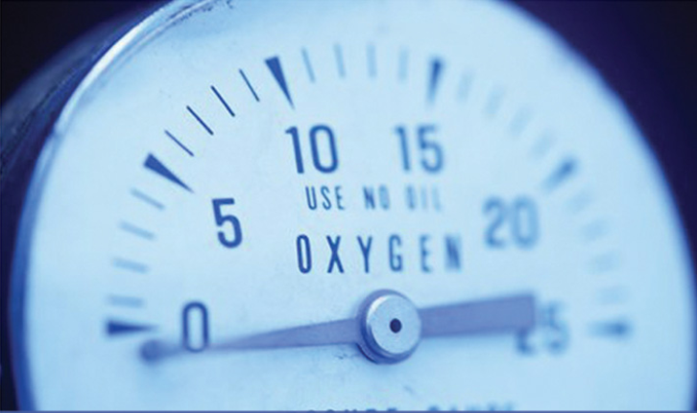
pH MEASUREMENT

Slide 2
What ıs pH?
pH is a unit of measure which describes the degree of acidity or alkalinity (basic) of a solution.
It is measured on a scale of 0 to 14.
The formal definition of pH is the negative logarithm of the hydrogen ion activity.
The activity is an effective concentration of hydrogen ions.
pH = -log [H⁺]
For example pure water H⁺ ion concentration is 1 x 10⁻⁷ M, therefore the pH would then be 7.

Slide 3
Potentıal Hydrogen, ph
pH = “Potential Hydrogen” or Power of Hydrogen
The pH of pure water around room temperature is about 7. This is considered "neutral" because the concentration of hydrogen ions (H⁺) is exactly equal to the concentration of hydroxide (OH⁻) ions produced by dissociation of the water.
Increasing the concentration of H⁺ in relation to OH⁻ produces a solution with a pH of less than 7, and the solution is considered "acidic".
Decreasing the concentration H⁺ in relation to OH⁻ produces a solution with a pH above 7, and the solution is considered "alkaline" or "basic".

Slide 4
ph scale

Slide 5
Acıds and bases
An acid can be defined as a proton donor, a chemical that increases the concentration of hydrogen ions in solution.
A base can be defined as a proton acceptor, a chemical that reduces the concentration of hydrogen ions in solution.
The addition of acid to water increases the concentration of hydrogen ions and reduces the concentration of hydroxyl ions
The addition of a base would increase the concentration of hydroxyl ions and decrease the concentration of hydrogen ions

Slide 6
Measurement of ph: electrochemıcal method
Depends on hydrogen activity in the solution
It consists of two electrodes
1. Measuring electrode
2. Reference electrode
E=E⁰ + 2.3RT*log a_{H+}
F
E⁰ = constant
R = the gas constant
T = temperature(K)

Slide 7
MEASUREMENT OF ph
A pH measurement system consists of three parts: a pH measuring electrode, a reference electrode, and a high input meter.
The pH measuring electrode is a hydrogen ion sensitive glass bulb.
The reference electrode output does not vary with the activity of the hydrogen ion.
When two solutions containing different concentrations of H⁺ ions are separated by a glass membrane, a voltage potential is developed across the membrane. (Sensing electrode)
A voltage potential is also generated from the reference electrode.
The pH meter measures the voltage potential difference (mV) between the sensing electrode and the outside sample (reference electrode) and via an algorithm displays a pH value.

Slide 8
GlASS ELECTRODE
Dependent on hydrogen activity
Glass membrane sensitive to H⁺ ions

Slide 9
GLASS MEMBRANE

Slide 10
REFERENCE ELECTRODE
Insensitive to the H⁺ ions in the solution
Most widely used is the silver/silver chloride electrode
Another commonly used reference electrode is the calomel

Slide 11
COMBINED ELECTRODE

Slide 12
pH Meter
A sample is placed in a cup and the glass probe at the end of the retractable arm is placed in it.
The probe is connected to the main box.
There are two electrodes inside the probe that measure voltage.
One is contained in liquid with fixed pH.
The other measures the acidity of the sample through the amount of H⁺ ions.
A voltmeter in the probe measures the difference between the voltages of the two electrodes.
The meter then translates the voltage difference into pH and displays it on the screen.
Before taking a pH measurement the meter must be calibrated using a solution of known pH.

Slide 13
Temperature and Buffers
Temperature compensation is contained within the instrument because pH electrodes are temperature sensitive.
Temperature compensation only corrects for the change in the output of the electrode, not for the change in the actual solution.
Buffers are solutions that have constant pH values and the ability to resist changes in pH.
They are used to calibrate the pH meter.

Slide 14
Other methods
Optical Methods
-Indicator papers
ISFET electrode
-CMOS based electrode

