Slide 1
Mass Spectrometry (MS) & Secondary ion mass spectrometry (SIMS)
L. Seda Mut 20970802
Neslihan Ötük 20622809
Beytepe Ankara
12.04.2012

Slide 2
Outline
Historical Background of MS and SIMS
What is MS and SIMS?
Working Principle of MS and SIMS
Instrumental Structures
What properties can be measured with MS, SIMS?
Advantages and Disadvantages

Slide 3
Historical background
History of MS
JJ Thomson built MS prototype to measure m/z of electron, awarded Nobel Prize in 1906
MS concept first put into practice by Francis Aston, a physicist working in Cambridge England in 1919 and awarded Nobel Prize in 1922
1948-52 - Time of Flight (TOF) mass analyzers introduced
1955 - Quadrupole ion filters introduced by W. Paul, also invents the ion trap in 1983 (wins 1989 Nobel Prize)
1968 - Tandem mass spectrometer appears
Mass spectrometers are now one of the MOST POWERFUL ANALYTIC TOOLS IN CHEMISTRY

Slide 4
History of SIMS
In 1910 British physicistJ. J. Thomson observed a release of positive ions and neutral atoms from a solid surface induced by ion bombardment.
Improved vacuum pump technology in the 1940s enabled the first prototype experiments on SIMS at the University of Vienna, Austria
In the early 1960s two SIMS instruments were developed. One was an American project for analyzing moon rocks the other at the University of Paris.
These first instruments were based on a magnetic double focusing sector field mass spectrometer and used argon for the primary beam ions.
Recent developments are focusing on novel primary ion species likeC60or ionized clusters of gold and bismuth

Slide 5
Mass Spectrometry
Mass spectrometry (MS) is an analytical technique that measures the mass-to-charge ratio of charged particles.
Mass spectrometers have been used in both qualitative and quantitative ways to determine the elemental composition and structure of specific compounds.
Analytical method to measure the molecular or atomic weight of samples.

Slide 6
Mass Spectrometry is Used for
Determining the chemical and structural information about molecules
Idenfication of unknown compounds
Quantification of known compounds
Determining the relative abundance of the isotopes and to measure their exact masses
Measuring molecular mass of a sample

Slide 7
MS applications
Geological: Oil composition
Pharmaceutical:Drug mechanisms, pharmacokinetics, drug discovery
Space applications: analysis the composition of plasmas and solar wind.
Clinical:Drug testing, hemoglobin analysis
Environmental:Water quality, food contamination
Biotechnology:The analysis of proteins, peptides etc.
Vacuums: In high-vacuum systems, mass spectrometers are used to measure for any residual gases.

Slide 8
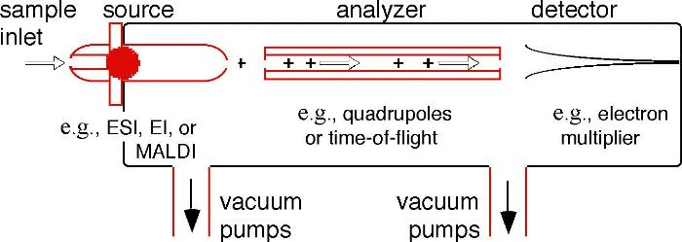
Mass Spectrometer
MS instruments consist of three modules:
Mass spectrometer components
(http://www.emsl.pnl.gov/capabilities/viewInstrument.jsp?id=34006)

Slide 9
How a mass spectrometer works?
An ion source, converts
gas phase sample molecules --> ions
A mass analyzer;
sorts the ions by their masses by applying electromagnetic fields
A detector;
measures the value of an indicator quantity and thus provides data for calculating the abundances of each ion present

Slide 10
Mass Spectrometry Principles
Sample
+
_
Ionizer
Mass Analyzer
Detector
Mass spectrometry illustration
(http://www.lamondlab.com/MSResource/LCMS/MassSpectrometry/massSpectrometry.php)

Slide 11
Mass Spectrometer
Create ions
Separate ions
Detect ions
Ionization method
MALDI
Electrospray
(Proteins must be charged and dry)
Mass analyzer
MALDI-TOF
Triple Quadrapole
MALDI-QqTOF
QqTOF
Mass spectrum
Database analysis

Slide 12
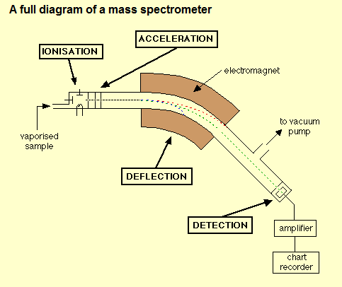
Mass spectrometer
(http://www.chemguide.co.uk/analysis/masspec/howitworks.html)

Slide 13
Data analysis of MS
Many mass spectrometers work in either negative ion mode or positive ion mode. It is very important to know whether the observed ions are negatively or positively charged.
This is often important in determining the neutral mass but it also indicates something about the nature of the molecules.
Different types of ion source result in different arrays of fragments produced from the original molecules. An electron ionization source produces many fragments and mostly single-charged (1-) radicals (odd number of electrons), whereas an electrospray source usually produces non-radical quasimolecular ions that are frequently multiply charged

Slide 14
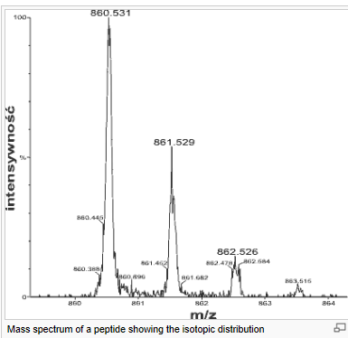
By understanding the origin of a sample, certain expectations can be assumed as to the component molecules of the sample and their fragmentations. A sample from a synthesis/manufacturing process will probably contain impurities chemically related to the target component. A relatively crudely prepared biological sample will probably contain a certain amount of salt, which may form adducts with the analyte molecules in certain analyses
Results can also depend heavily on how the sample was prepared and how it was run/introduced
An example to a mass spectrum
(http://en.wikipedia.org/wiki/Mass_spectrometry#Chromatographic_techniques_combined_with_mass_spectrometry)

Slide 15
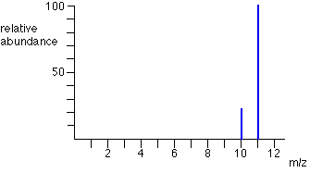
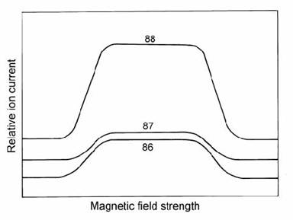
Examples of mass spec data output
Ex: B
You can scan in B or V to sweep masses
across a single detector.
OR
You can put different masses into
multiple cups without changing B or V.

Slide 16
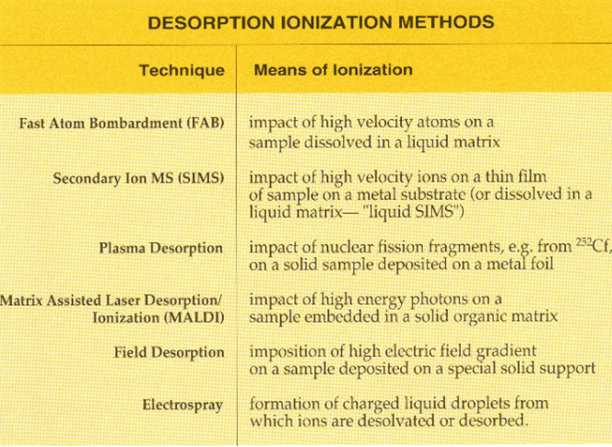
Ionizers
(http://www.asms.org/whatisms/p12.html)

Slide 18
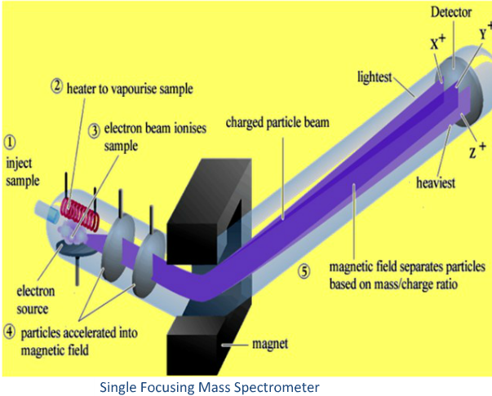
http://www.authorstream.com/Presentation/sreeramdileep-584348-mass-spectroscopy/

Slide 20
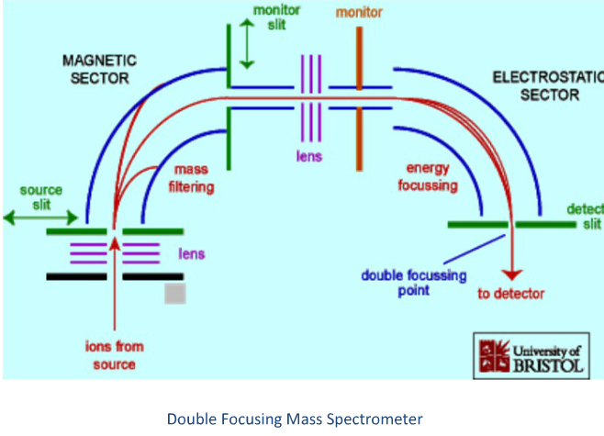
http://www.authorstream.com/Presentation/sreeramdileep-584348-mass-spectroscopy/

Slide 21
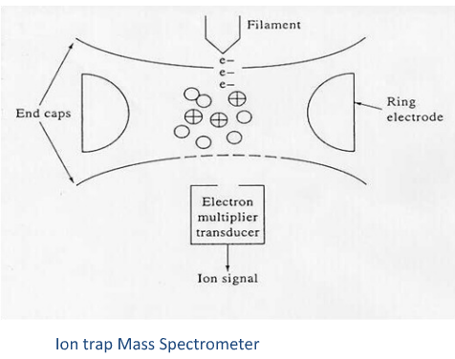
http://www.authorstream.com/Presentation/sreeramdileep-584348-mass-spectroscopy/

Slide 22
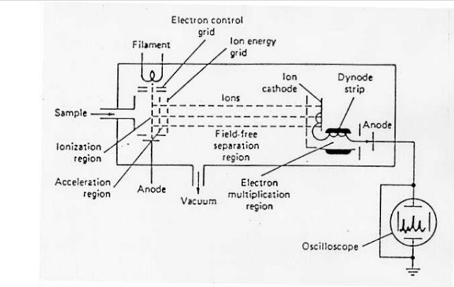
http://www.authorstream.com/Presentation/sreeramdileep-584348-mass-spectroscopy/

Slide 23
Advantages of Mass Spectroscopy
• Providesmolecular weightsof peptides and proteins with highaccuracy (0.1-0.01%)
•Highlysensitive
•Sample puritynot important
•Can be coupledwith on-lineseparationmethodssuch as HPLC and capillaryelectrophoresisfor the analysis of mixtures

Slide 24
Disadvantages of Mass Spectroscopy
•Noncovalentcomplexesare oftendisrupted
•Cannotdistinguishstereoisomers
•Expensiveinstrumentation
•Fewfor proteins and peptides, as purityand sample requirementsare not restrictive(fmol-pmolquantitiescan be used)
•Otherbiopolymers(nucleicacid, carbohydrates) are moredifficultto analyze

Slide 25
SIMS
Secondary ion mass spectrometry (SIMS) is based on the observation that charged particles
(Secondary Ions) are ejected from a sample surface when bombarded by a primary beam of heavy
particles.

Slide 26
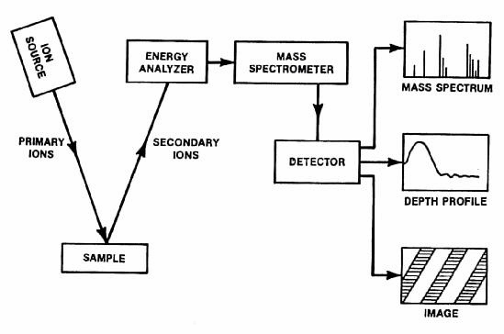
Secondary ion mass spectroscopy
Basic Overview

Slide 27
What properties can be measured/tested with SIMS?
-Secondary ion mass spectrometry(SIMS) is a technique used inmaterials science and surface science to analyze the composition of solid surfaces andthin films by sputtering the surface of the specimen with a focused primaryion beamand collecting and analyzing ejected secondary ions.
-These secondary ions are measured with a mass spectrometerto determine the elemental, isotopic, or molecular composition of the surface.

Slide 28
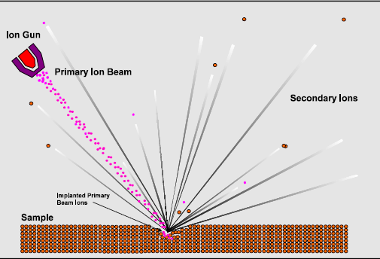
SECONDARY ION SPUTTERING
http://www.geos.ed.ac.uk/facilities/ionprobe/SIMS4.pdf

Slide 29
Advantages of SIMS
The elements from H to U may be detected.
Most elements may be detected down to concentrations of 1ppm or 1ppb.
Isotopic ratios may be measured, normally to a precision of 0.5 to 0.05%.
Two dimensional ion images may be acquired. A secondary ion leaves the surface at a point close to its original location. This enables localised analysis of the sample to be undertaken and is the cornerstone of ion imaging.

Slide 30
The volume of material sputtered is small. Using a high-energy and high primary beam
densities (dynamic SIMS) a volume of a 100 to 1000 μm3 is analysed. In contrast, using lowenergy
and low primary beam densities (static SIMS) the material sputtered is exceedingly
small, with surface mono-layers lasting hours or days.
Three dimensional ion images may be acquired by scanning (rastering) the primary beam and
detecting the ion signal as the sample is gradually eroded.
Little or no sample preparation may be needed.

Slide 31
Limitations of SIMS
The material sputtered from the sample surface consists not only of mono-atomic ions but molecular species that in places can dominate the mass spectrum, making analysis of some elements impossible.
The sputtering process is poorly understood. No quantitative model currently exists that can accurately predict the secondary ionisation process. In order to obtain quantitative information a suitable standard has to be used and empirical corrections applied.
The sensitivity of an element is strongly dependent on the composition of the matrix and the type of primary beam used. Standards should, therefore, be close to the composition of the
unknown. This is particularity true for isotopic analysis.
Samples must be compatible with an ultra high vacuum.

Slide 32
TYPICAL APPLICATIONS of SIMS •Analyzing biological materials •The investigation of possible links between glass failure and polishing residue in optical components used in powerful lasers,

Slide 33
References
http://www.authorstream.com/Presentation/aSGuest114953-1199123-mass-spectrometry/
http://www.ehow.com/list_7150856_uses-mass-spectrometer.html
http://www2.chemistry.msu.edu/faculty/reusch/VirtTxtJml/Spectrpy/MassSpec/masspec1.htm
http://www.chemguide.co.uk/analysis/masspec/howitworks.html
http://www.emsl.pnl.gov/capabilities/viewInstrument.jsp?id=34006
http://en.wikipedia.org/wiki/Secondary_ion_mass_spectrometry
http://www.lamondlab.com/MSResource/LCMS/MassSpectrometry/massSpectrometry.php
http://www.chemguide.co.uk/analysis/masspec/howitworks.html
http://en.wikipedia.org/wiki/Mass_spectrometry#Chromatographic_techniques_combined_with_mass_spectrometry
http://www.asms.org/whatisms/p12.html
http://www.authorstream.com/Presentation/sreeramdileep-584348-mass-spectroscopy/

