Slide 1
KMU 402
FLOW IN CIRCULAR PIPES
2019-2020 Spring Semester
Teaching Assistants
Dr. Özge Yüksel Orhan
İlkay Koçer

Slide 2
2
THEORY

Slide 3

Introduction
3
Transfer
Molecular (Conductive)
Bulk
(Convective)
Newton’s Law
Fourier’s Law
Fick’s Law
$$Rate of transfer process= \frac{Driving force}{Resistance}$$

Slide 4
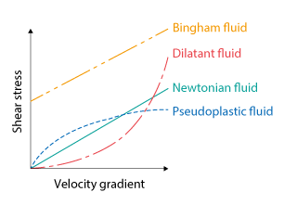
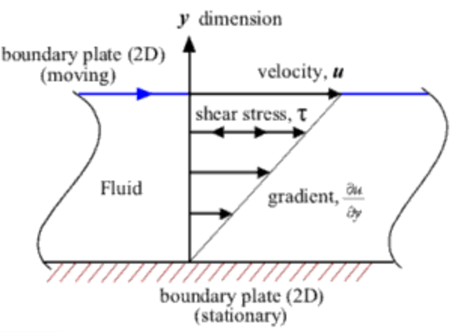

Newton’s Law of Viscosity
4
Shear stress / shear rate = constant
= viscosity
$τ_{yz}$ = -µ $\frac{dV_{z}}{dy}$
Viscosities of Newtonian Fluids
Gases:
µ T
Liquids:
µ T
µ P (> 1000 kPa)
not effected by pressure

Slide 5
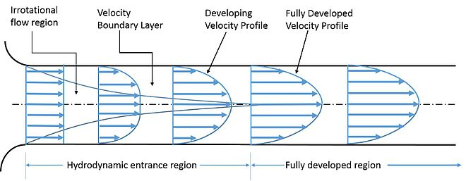
Fully Developed Flow Velocity Profile

Slide 6


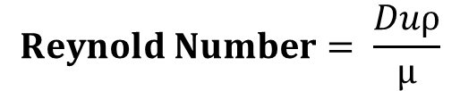
Classification of Flow Regimes
Laminar flow occurs when a fluid flows in parallel layers, with no disruption between the layers. At low velocities, the fluid tends to flow without lateral mixing, and adjacent layers slide past one another like playing cards.
Turbulent flow is a flow regime characterized by chaotic property changes. This includes rapid variation of pressure and flow velocity in space and time. In contrast to laminar flow the fluid no longer travels in layers and mixing across the tube is highly efficient.
$$Reynold Number= \frac{Duρ}{µ}$$

Slide 7
Classification of Flow Types
Compressible flow: The fluid density varies significantly in response to a change in pressure.
Incompressible flow: (i) the substance flowing is a liquid or (ii) if it is a gas whose density changes within the system by no more than 10 percent.
Steady flow: The flow properties at every point remain constant with respect to time.
Gravity flow: A flow of liquid drawn under the force of gravity, fall to the ground.

Slide 8


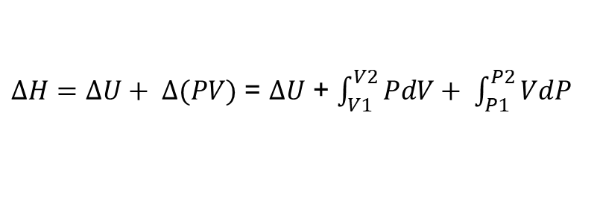

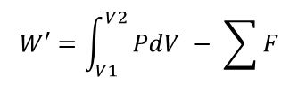
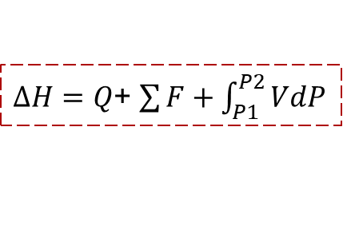
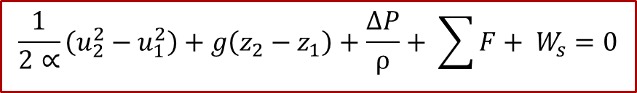
Derivation of Bernoulli Equation
Continuity Equation:
General Energy Balance:
Overall Mechanical Energy Balance

Slide 9
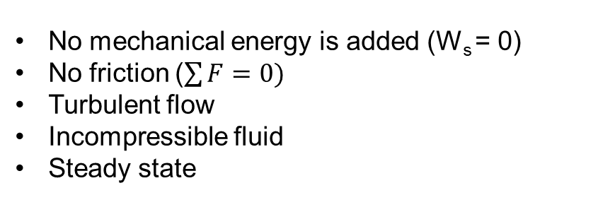


Derivation of Bernoulli Equation
$\frac{1}{2∝}\left(u_{2}^{2}−u_{1}^{2}\right)$ + g ($z_{2}$-$z_{1})+ \frac{∆P}{ρ}$ + $\sum{F+ W_{s}=0}$
No mechanical energy is added (W_{s} = 0)
No friction ($\sum{F=0)}$
Turbulent flow
Incompressible fluid
Steady state
Assumptions:
$\frac{u_{1}^{2}}{2}$ + $z_{1}$g + $\frac{P_{1}}{ρ}= \frac{u_{2}^{2}}{2}$ + $z_{2}$g + $\frac{P_{2}}{ρ}$

Slide 10
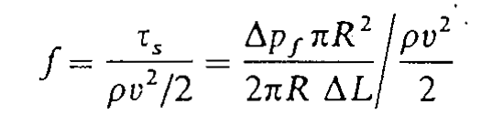


Friction Losses in Bernoulli Equation
Friction Loss in Straight Pipes
(1) Hagen-Poiseuille Equation:
$${∆p}_{f}= \frac{32µv(L_{2}−L_{1})}{D^{2}}$$
(2) Friction factor:
$${∆p}_{f}= \frac{4 f ρ(L_{2}−L_{1})V^{2}}{2D}$$
laminar
f(N_{Re})
f
turbulent
f(N_{Re} , Ɛ/D )

Slide 11
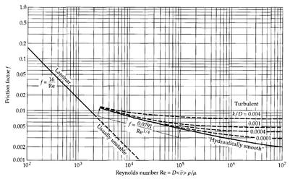
Friction Losses in Bernoulli Equation
Calculation of friction factor
(1)
(2)
Blasius Equation

Slide 12
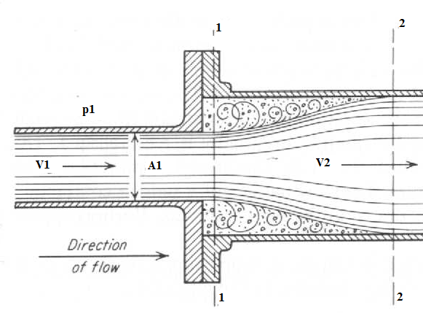
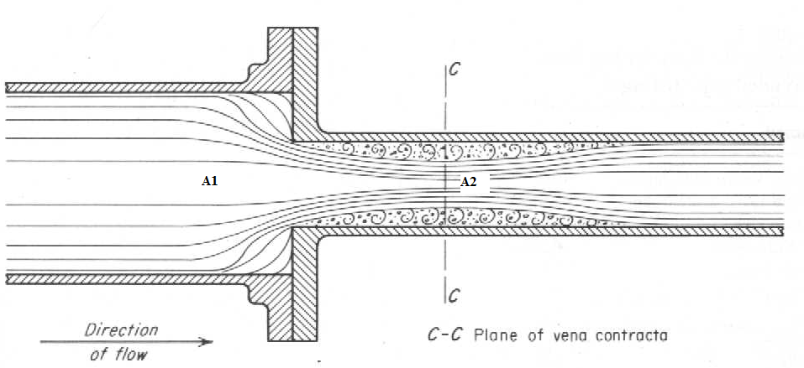
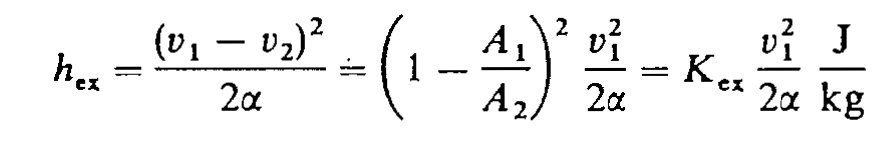
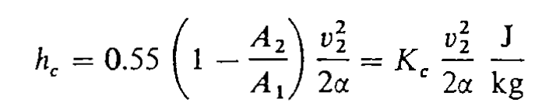
Friction Losses in Bernoulli Equation
Sudden Expansion
Sudden Contraction
Bends

Slide 13
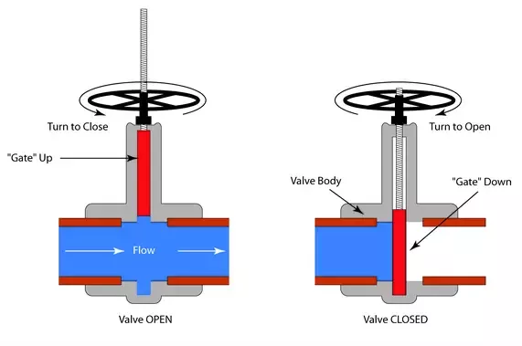
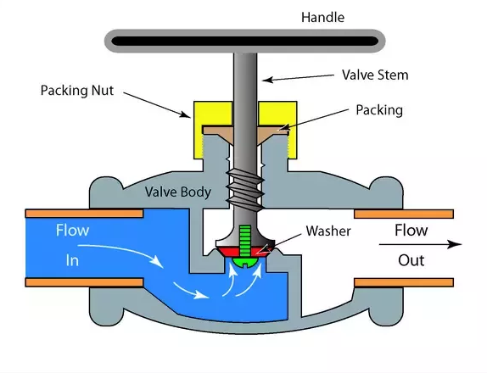
Valves
Gate Valve
Globe Valve
A ball valve has a gate that closes across the flow.
Only fully close or fully open position is required,
Used for on-off control
Small pressure drop across the valve
A globe valve uses a plug (stem) that closes against the flow
Can also be used for the flow regulation
Has a high pressure drop even in fully
open conditions

Slide 14
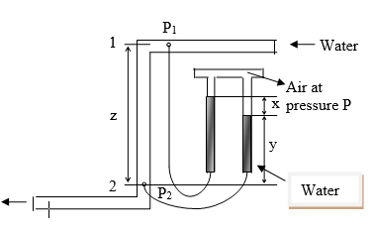
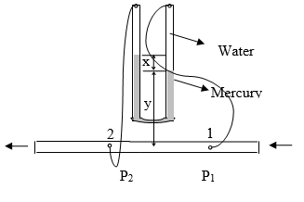


Principles of Pressure Loss Measurements
h_{f} = x
s = spesific gravity of mercury
Δh = 12.6x

Slide 15
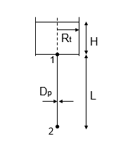
Modelling of Efflux Time for a Cylindrical Tank with an Exit Pipe
V₁ = V₂
z₂ = 0
z₁ = L
P₁ = P_{atm} + hρg
P₂ = P_{atm}
Laminar flow
Turbulent flow

Slide 16
16
EXPERIMENTAL PROCEDURE

Slide 17
Aim of The Experiment
To study pressure loses due to viscous and localized effects in incompressible fluid flows through pipes,
To make energy balance for a cylindrical tank with an exit pipes of different lengths and diameters,
To calculate energy losses and efflux time,
To compare experimental data with theoretical data.

Slide 18
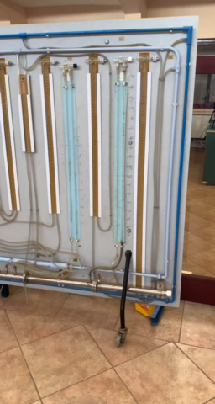
Part I – Experimental Setup
The apparatus consists of two separate hydraulic circuits,
one painted dark blue,
one painted light blue,
each one containing a number of pipe system components.
Both circuits are supplied with water from the hydraulic bench.

Slide 19
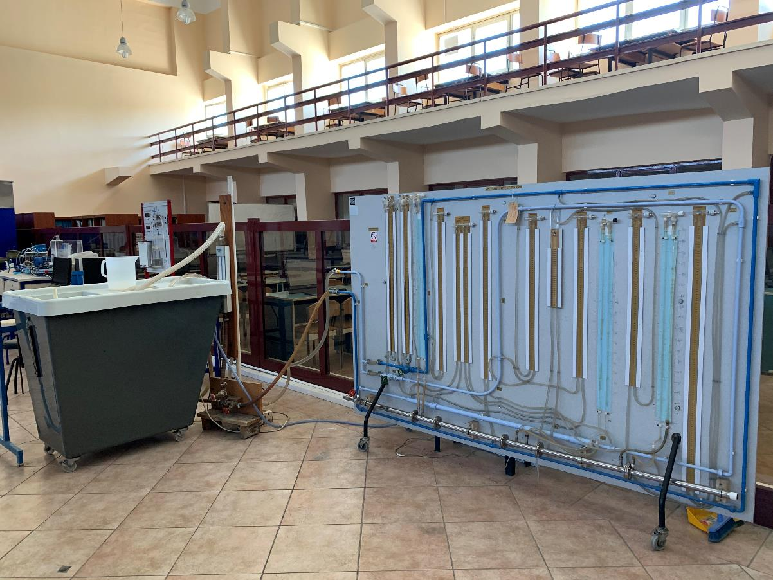
Part I – Arrangement of Apparatus
hydraulic bench
In all cases (except the gate and globe valves) a pair of pressurised piezometer tubes measures the pressure change across each of the components.
In the case of the valves, pressure measurement is made by U-tubes containing mercury.

Slide 20
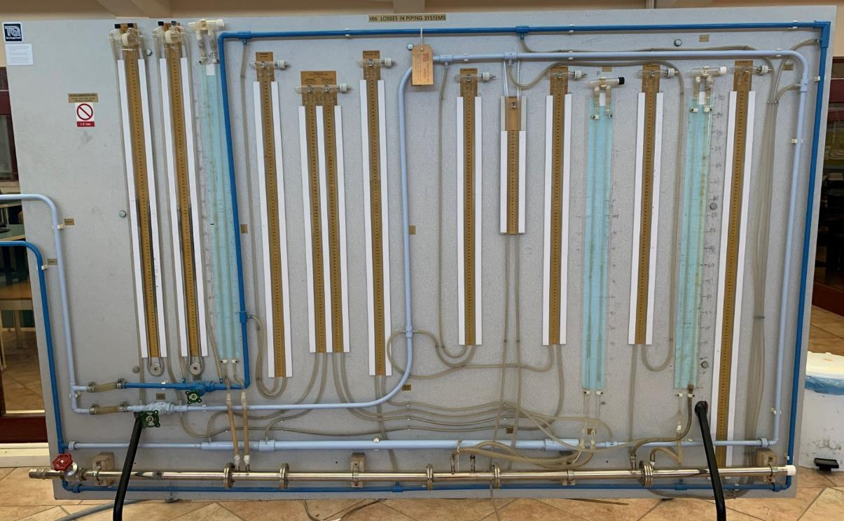
Part I – Components of Apparatus
1
6
11
16
5
15
OUTLET
INLET
2
13
12
A
B
14
9
10
7
8
3
4
Dark Blue Circuit
1-2 Standard Elbow Bend
3-4 Straight Pipe (13.6 mm)
5-6 90° Mitre Bend
A Gate Valve
Light Blue Circuit
7-8 Sudden Expansion 13.7 mm / 26.4 mm
9-10 Sudden Contraction 26.4 mm/ 13.7 mm
11-12 101.6 mm 90° Radius Bend
13-14 152.4 mm 90° Radius Bend
15-16 50.8 mm 90° Radius Bend
B Globe Valve

Slide 21

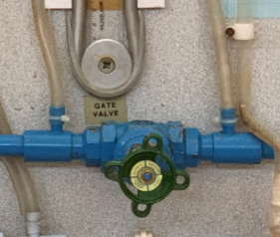
Part I – Experimental Procedure
1. Open fully the water control valve on the hydraulic bench.
2. With globe valve closed, open the gate valve fully to obtain maximum flow through the Dark Blue circuit.

Slide 22
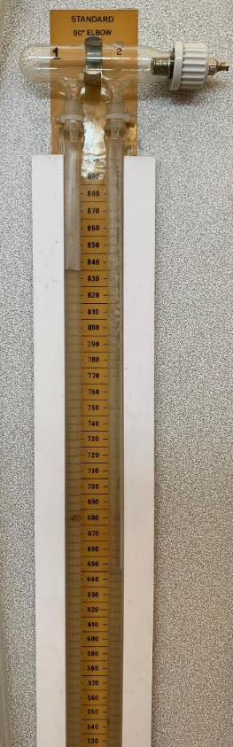
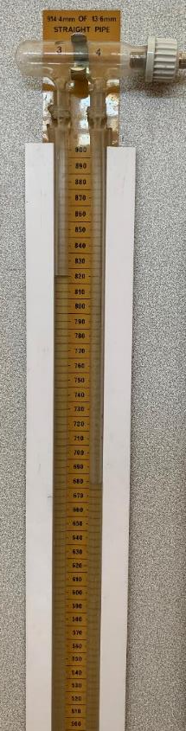
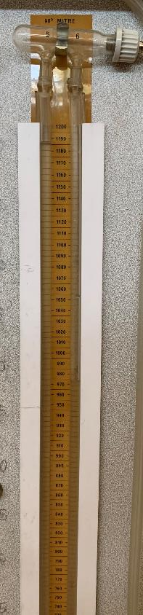
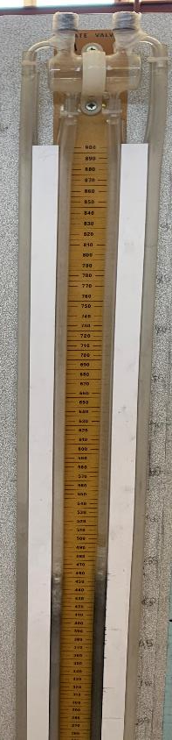
Part I – Experimental Procedure
3. Record the readings on the piezometer tubes (mm H₂O) and the U-tube (mm Hg).

Slide 23
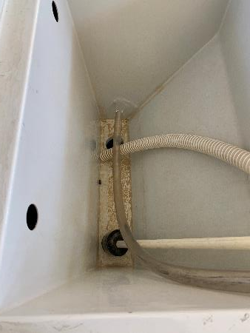
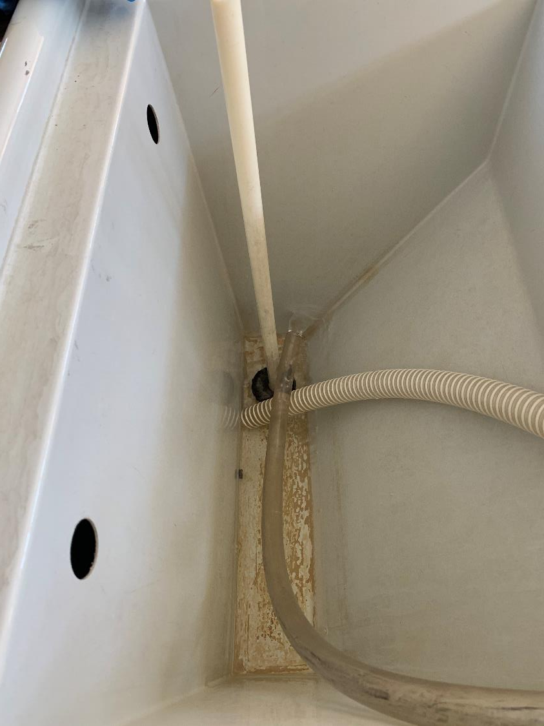
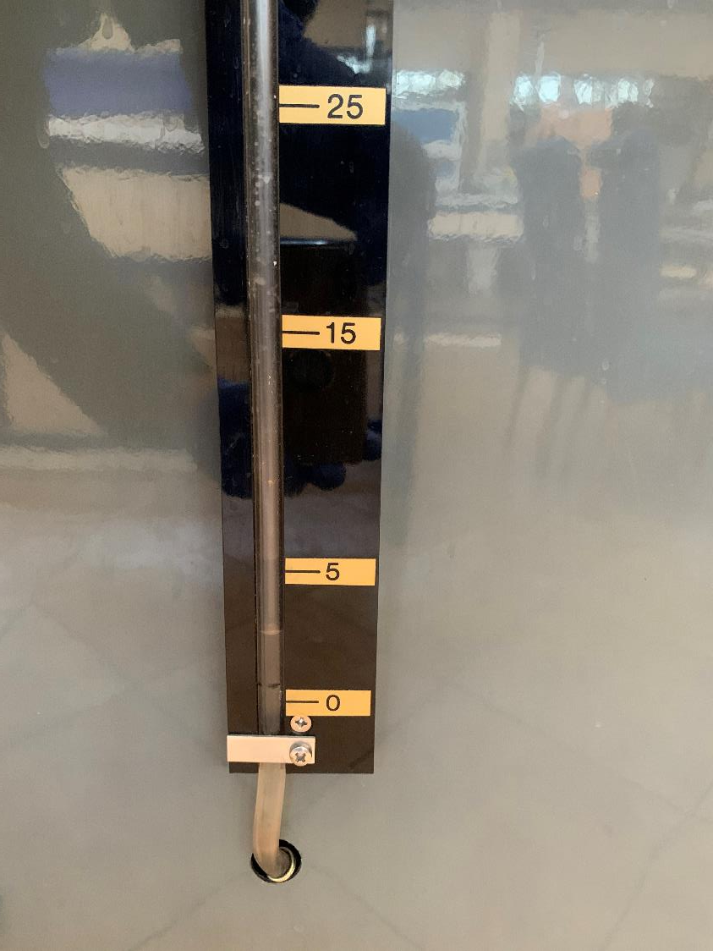
Part I – Experimental Procedure
4. Record the time to collect 5 L of water in the weighing tank.
5. Repeat the procedure for a total of six different flow rates, obtained by closing gate valve.

Slide 24
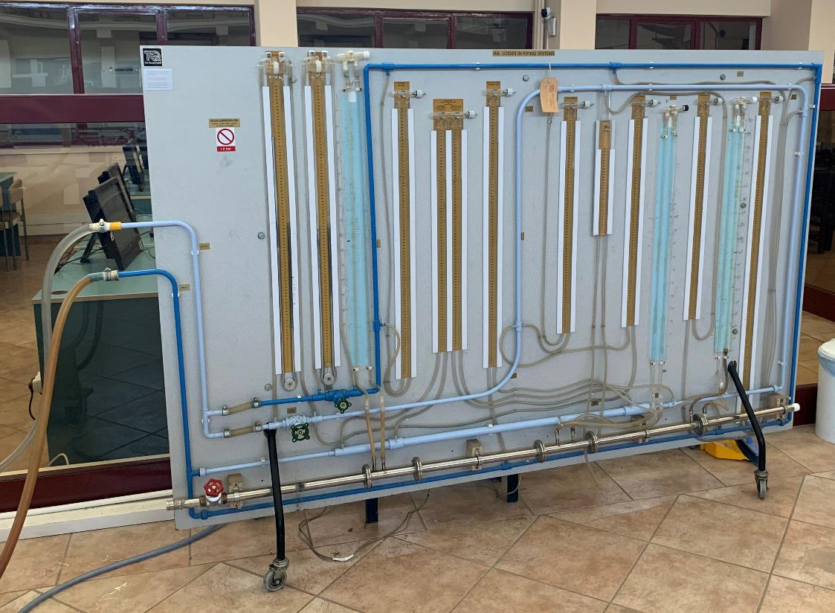
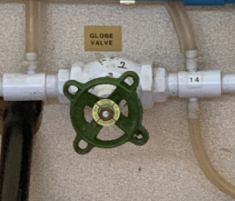
Part I – Experimental Procedure
6. After taking data at six different flow rates, switch off the pump, close the gate valve and open the globe valve.

Slide 25
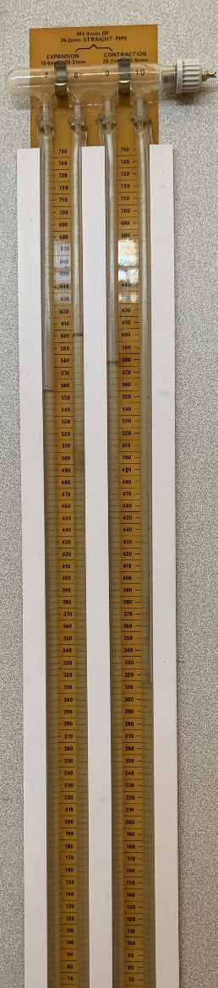
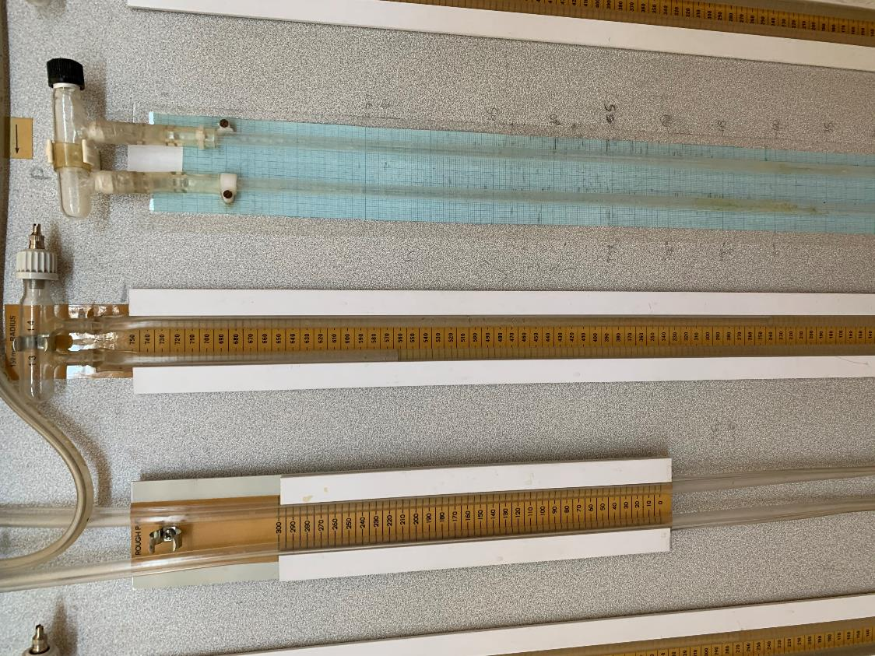
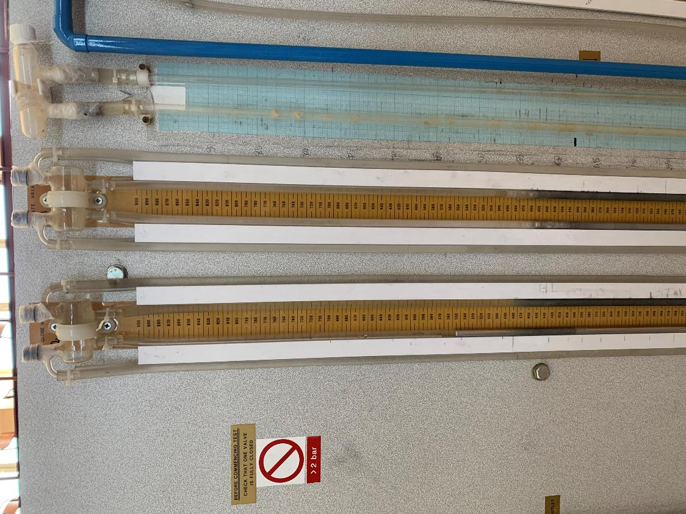
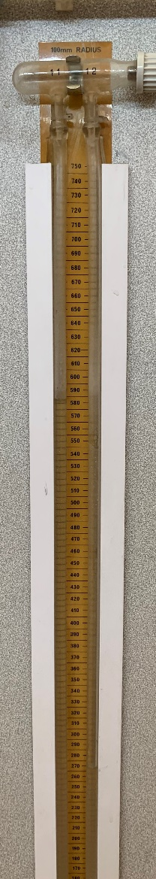
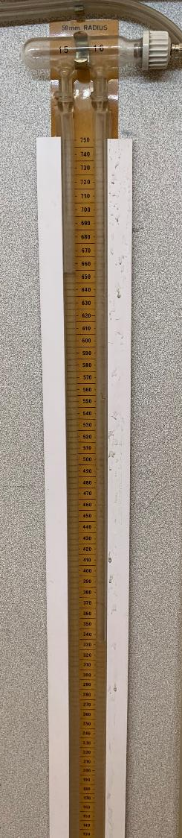
Part I – Experimental Procedure
7. Repeat the experimental procedure for the Light Blue circuit.

Slide 26
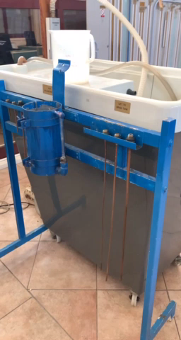
Part II – Experimental Setup
The apparatus consists of a cylindrical tank and interchangeable exit pipes of different lengths and diameters.

Slide 27
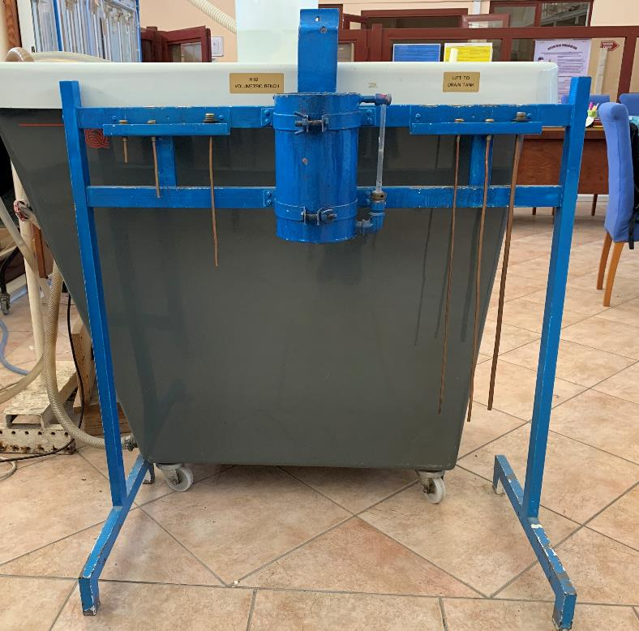
Part II – Experimental Setup
L = 8 cm
L = 14.8 cm
L = 30.1 cm
1
2
3
D_{p} = 0.17 cm
D_{p} = 0.22 cm
D_{p} = 0.355 cm
4
5
6
D_{p}= 0.28 cm
L = 61.4 cm

Slide 28
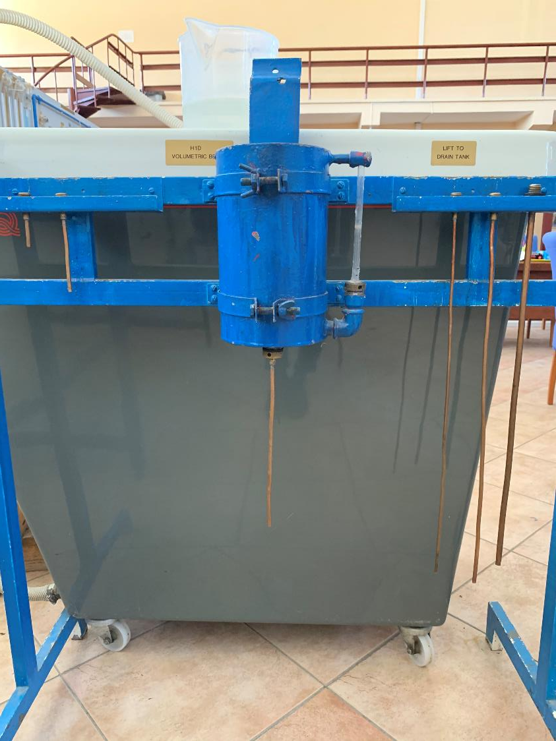
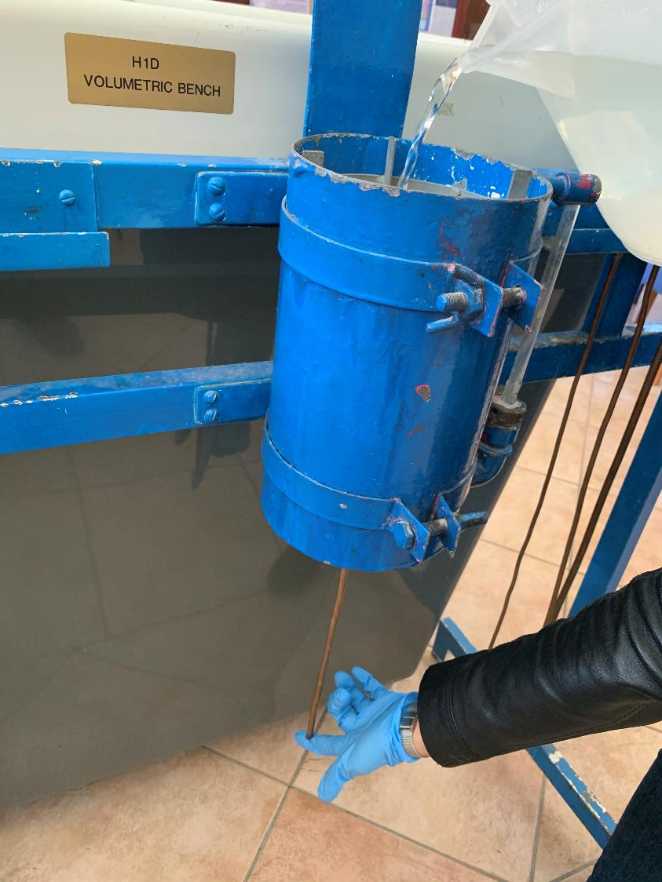
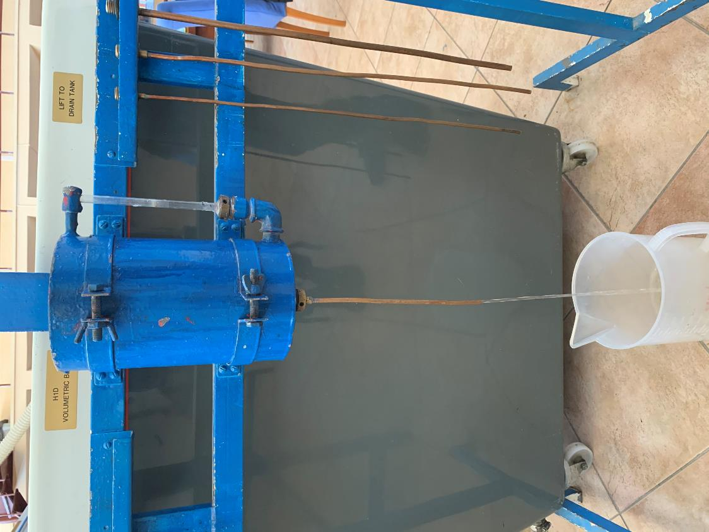
Part II – Experimental Procedure
1. Insert the pipe to the
tank.
2. Fill the cylindrical tank
with water.
3. Measure and record the initial time and efflux time for each pipe.

Slide 29
29
CALCULATIONS

Slide 30
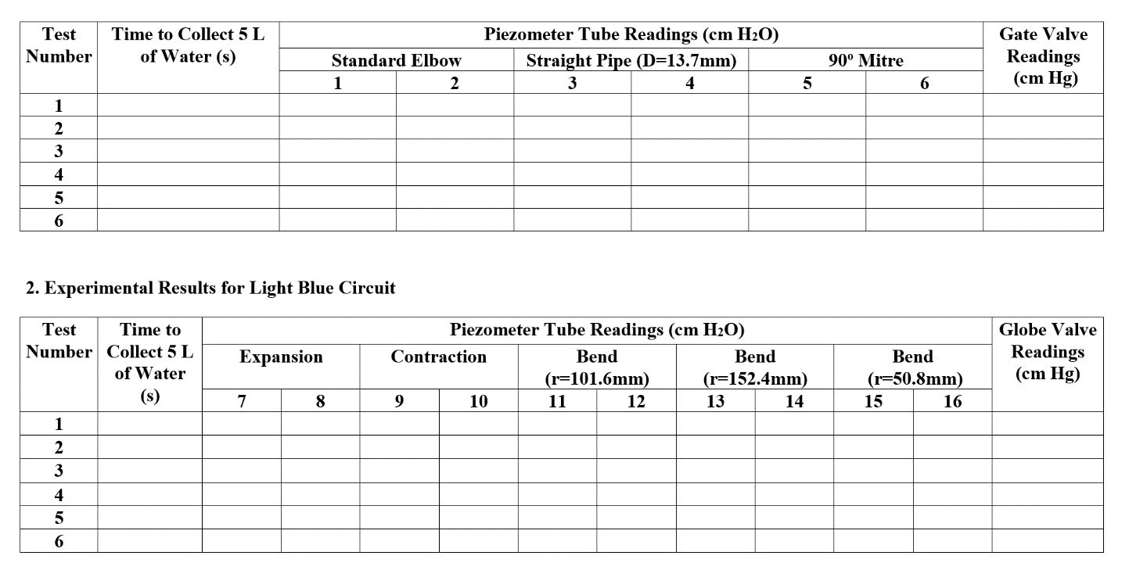
Part I – Data Sheet

Slide 31
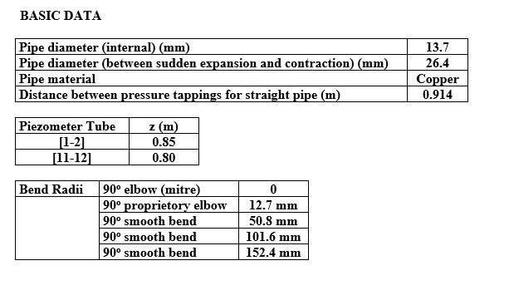
Part I – Data Sheet

Slide 32




Part I – Calculations
(1) Calculation of the pressure loss in piezometer tubes
Table 1& Table 6 ( [1-2] and [11-12] )
$$∆P=P_{1}−P_{2}=\left(h_{L}−z\right)ρg$$
Table 2 - Table 8
[3-4], [5-6], [7-8], [9-10], [13-14], [15-16]
$$∆P=P_{1}−P_{2}=h_{L}ρg$$
Test No | 1 2 (mm water) | h_{L} (mm water) | h_{L} (m water) | P₁ – P₂ (N/m²)
(2) Calculation of the pressure loss in U-tubes
$$h_{L}=12.6x$$
$$∆P={(h}_{L})ρ_{H_{2}O}g$$
x: height difference
Table 9 & Table 10
Test No | Valve (mm Hg) | x (mm Hg) | h_{L} (mm water) | h_{L} (mwater) | P₁ – P₂ (N/m²)

Slide 33

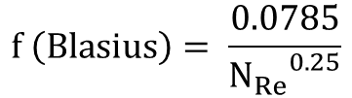
Part I – Calculations
(3) Calculate the friction factor in straight pipes using friction loss and also using
Blasius's equation
[This tables will be prepared for [3-4] and [8-9] piezometer tubes]
Table 11& Table 12
Test No | t (s) | m (kg/s) | Q (m³/ s) | V (m/s) | h_{L} (m water) | Re | f (head loss) | f (Blasius)

Slide 34
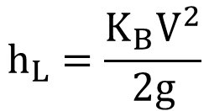
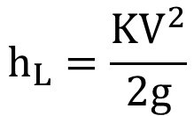
Part I – Calculations
(4) Calculation of Loss Coefficient Values for Five Bends
[This tables will be prepared for [1-2], [5-6], [11-12], [13-14] and [15-16] piezometer tubes]
Table 13 - Table 17
$$h_{L}=\frac{K_{B}V^{2}}{2g}$$
Test No | t (s) | m (kg/s) | Q (m³/ s) | V (m/s) | h_{L} (m water) | K_{B}
r: bend radii
D: pipe diameter
Draw r/D vs. K_{B,mean} for five bends
K_{B, mean}
(5) Calculation of Loss Coefficient Values for Gate and Globe Valves
Table 18 & Table 19
Test No | t (s) | m (kg/s) | Q (m³/ s) | V (m/s) | x (cm Hg) | h_{L} (m water) | K
$$h_{L}=\frac{KV^{2}}{2g}$$
Draw flow rate vs. K for the gate valve and the globe valve.

Slide 35
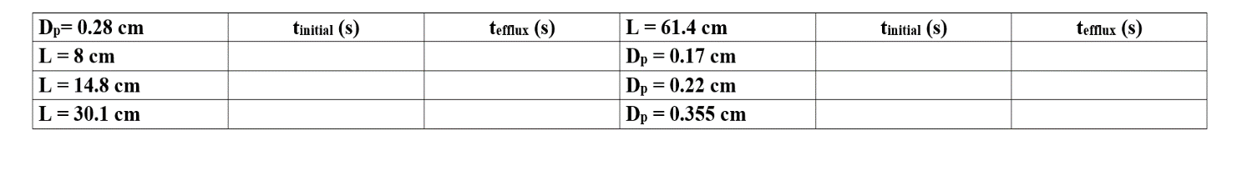
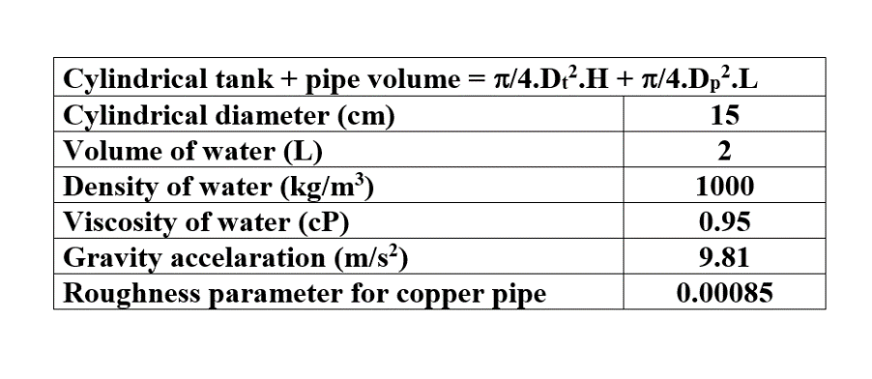
Part II – Data Sheet

Slide 36



Part II – Calculations
(1) Calculation of the initial and final Re Number
Table 20
Test No | D pipe (m) | L pipe (m) | Vinitial (m/s) | Re (initial) | Vfinal (m/s) | Re (final) | f
$$H_{i}=1 cm$$
$$t_{i}=t_{inital}(s)$$
$$V_{i}=\frac{H_{i}}{t_{i}}$$
$${Re}_{i}=\frac{{DV}_{i}ρ}{μ}$$
If Re(final) < 4000
(1)
(2)
If Re(final) > 4000
(3)
(4)
For Re final: Firstly, the flow is assumed as laminar, then from eqn(1), V=Vfinal is found. Then Re(final) is calculated. If the Re(final)<4000, eqn(2) is used to calculate the f value. If the calculated Re(final)>4000, then it is assumed that the flow is turbulent. So from eqn(3) V=Vfinal is
found. After that, Re(final) is calculated. If the Re(final)>4000, eqn(4) is used to calculate the f value.

Slide 37




Part II – Calculations
(2) Calculation of the kinetic energy values of fluid
Table 21
Test No | D pipe (m) | L pipe (m) | m initial (kg) | Vinitial (m/s) | EK initial (J) | m final (kg) | Vfinal (m/s) | EK final (J) | Delta EK (J)
$$m_{f}= V_{pipe }ρ_{H_{2}O}$$

Slide 38







Part II – Calculations
(3) Calculation of the potential energy values at h=H1 and h=H2
Table 22
Test No | D pipe (m) | L pipe (m) | H= H1 (m) | EP1 (J) | m final (kg) | H= H2 (m) | EP2 (J) | Delta EP (J)
$$EP_{H1}=m_{i}.g.(H+L)$$
$$EP_{H2}=m_{f}.g.L$$

Slide 39

Part II – Calculations
(4) Calculation of the viscous energy losses in the pipe
Table 23
Test No | D pipe (m) | L pipe (m) | Vfinal (m/s) | f | hf (m)
$$h_{f}=\frac{2fLV^{2}}{gD}$$
(5) Calculation of the efflux time values for each pipe
Table 24
Test No | D pipe (m) | L pipe (m) | Vinitial (m/s) | Vfinal (m/s) | Vmean (m/s) | Re_{mean} | teff (cal.) (s) | teff (exp.) (s)
Laminar
Turbulent

