Slide 1

kmu402
Experiment #3: Distillation
Dr. Gökçe Alp
Murat Akdoğan

Slide 2
Distillation
Material balance
Energy balance
Heat transfer
Mass transfer

Slide 3
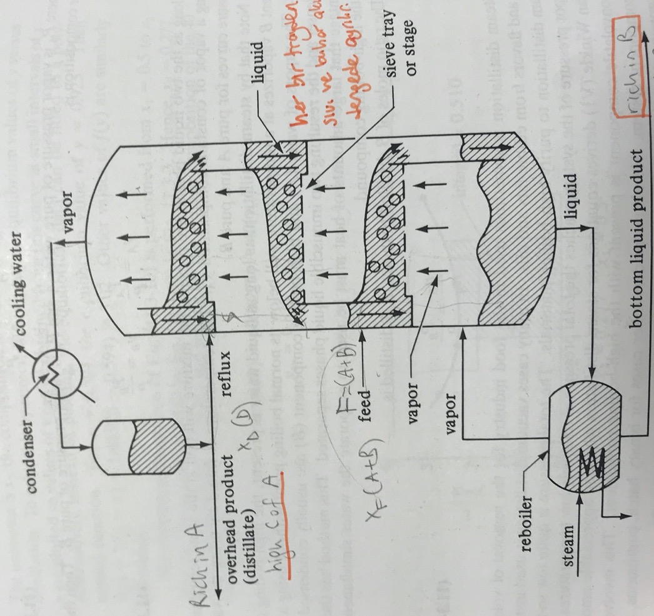
Feed flows down to a stage
Vapor enters the tray and bubbles through the liquid as the liquid flows across
The vapor and liquid leaving the tray are essentially in equilibrium
Vapor continues up to the next stage, where it is again contacted with a downflowing liquid.

Slide 4
Aim of the experiment:
*Batch
*Continuous
*Feed
*Distillate
*Bottom product
*Reflux
*Relative volatility
*Coning
*Weeping
*Flooding
*Priming
*Column efficiency
*McCabe Thiele method

Slide 5
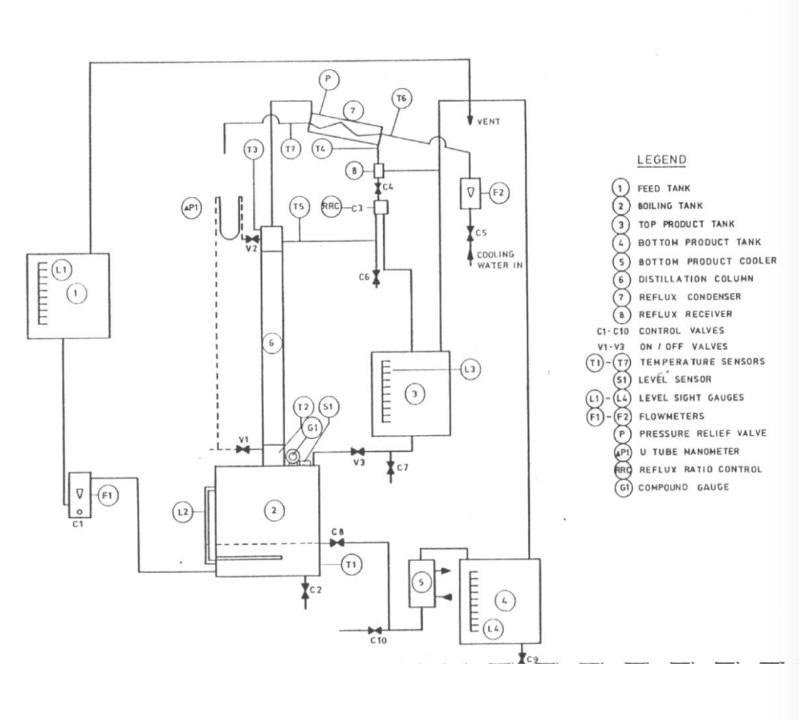
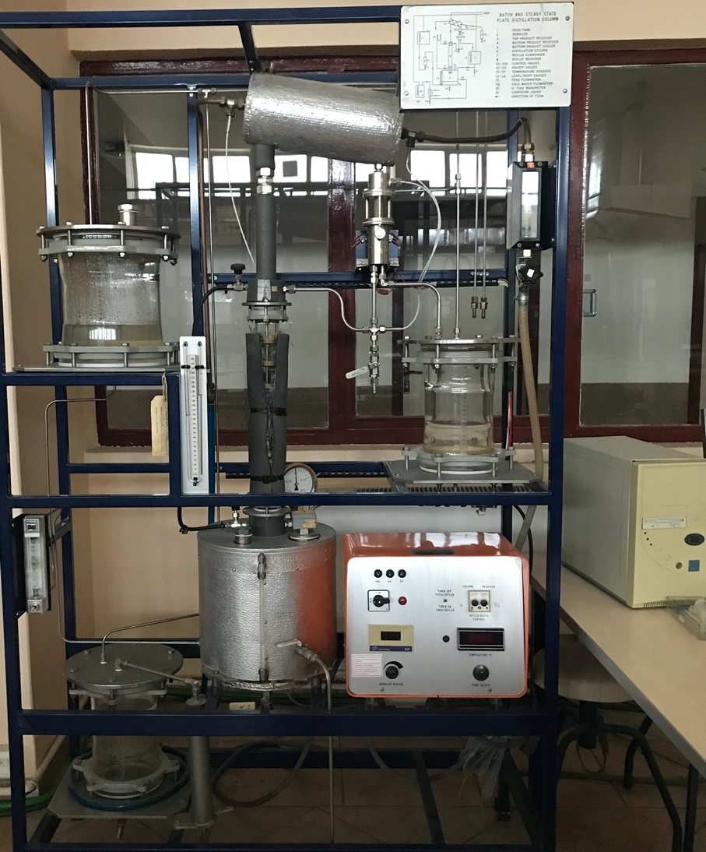
Condenser
Feed tank
Top Product Tank
Column
Reboiler

Slide 6
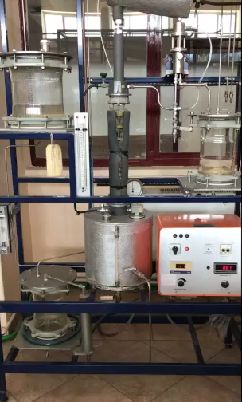
Overvıew
Experiment will be implemented at 3 parts:
Part I: Batch operation at total reflux
Part II: Batch operation at minimum reflux
Part III: Continuous operation

Slide 7
Experimental Method
Batch I
Effect of power on several parameters
Power optimization
Batch II
Effect of time
Cont.
Effect of reflux ratio
Min. reflux

Slide 8
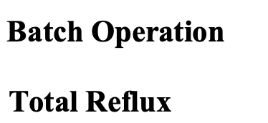
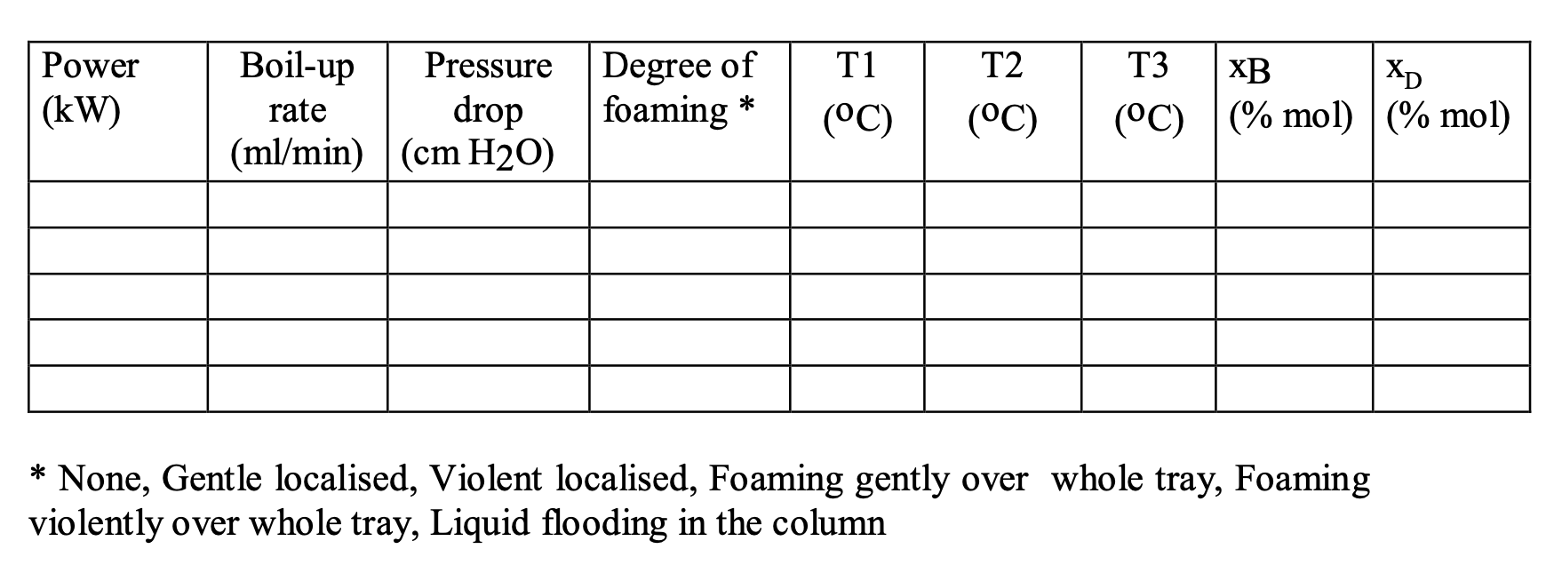
Experimental Method – Part I:
*Find the optimum power
via chronometer
From U-manometer
From column
From computer
From refractometer
0.25
0.50
0.75
1.00
1.25

Slide 9
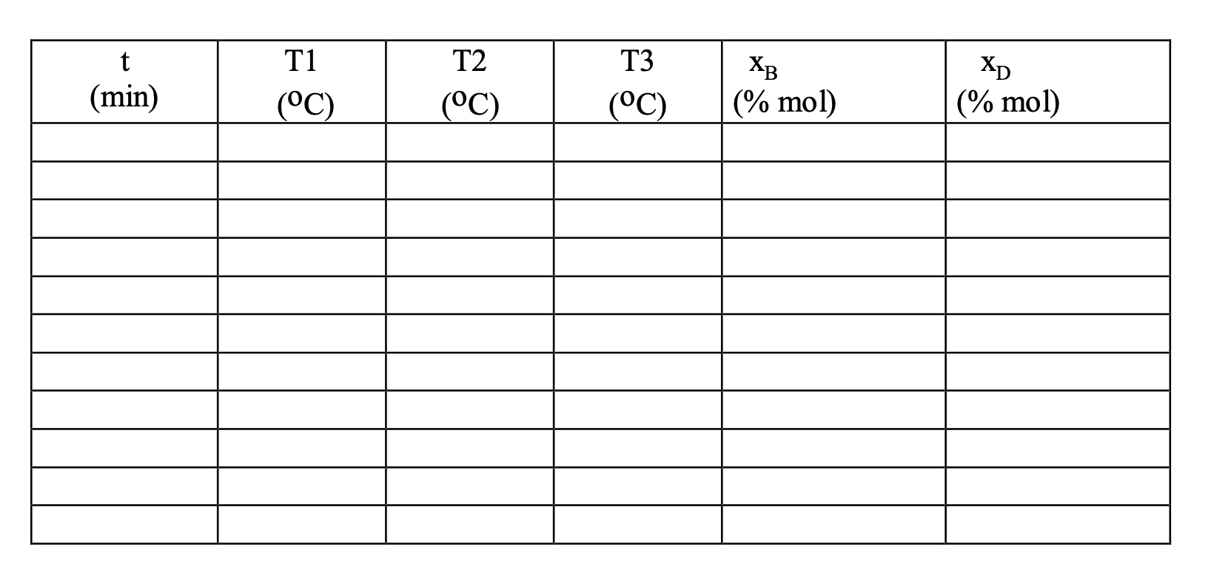
Experimental Method – Part II @optimum Power
*Observe the effect of time
From computer
From refractometer
initial (t=0)
5
10
15
20
25

Slide 10
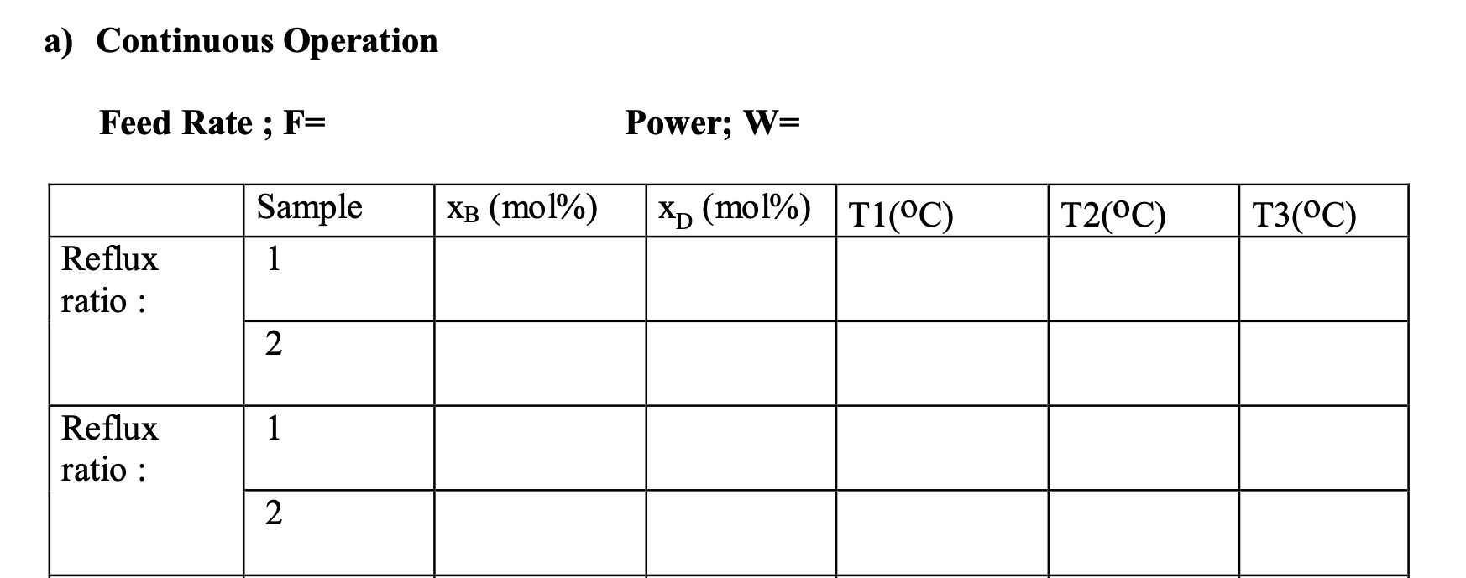
Experimental Method – Part III Continuous Operation
*Observe the effect of reflux ratio on the products
Optimum power which was found at the first part
50 cm³/min

Slide 11
Calculations-Part I: Effect of Power on the system
Power (kW) | Boil-up rate (ml/min) | log(Boil-up rate) | 𝝙P (cmH₂O) | log𝝙P
0.25
0.50
0.75
1.00
1.25
Boil-up rate = 10 ml / time (min)
Determination of weeping and flooding points
log𝝙P
Show weeping & flooding points
Discuss the figure
log(boil-up rate)

Slide 12
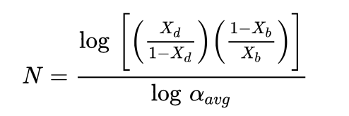
Calculations-Part I: Effect of Power on the system
Power (kW) | x_{B} | y_{B} | x_{D} | y_{D} | 𝛼_{AB} | Nmin + 1 | Column efficiency
0.25
0.50
0.75
1.00
1.25
Fenske Eq. For min. # of stages
Column efficiency = (N_{min}/N_{actual})*100
Power (kW) | T_{av} (°C) | 𝜌_{gas} (g/L) | 𝜌_{liquid} (g/L) | U_{t} (m/min) | F_{gt} (m/min)(kg/m³)^{0.5}
0.25
0.50
0.75
1.00
1.25

Slide 13
Calculations-Part II: Change of mole fractions with time
t (min) | x_{B} (mole%) | x_{D} (mole%)
0
5
10
15
20
25
30
x_{B}
x_{D}
t (min)
t (min)

Slide 14
Calculations-Part III: Continuous Distillation
Effect of Reflux ratio on the Efficiency
R_{D} | x_{B} (mole%) | x_{D} (mole%) | Number of plates | %Efficiency
2
5
10
From refractometer
«McCabe-Thiele Method»
to calculate the Number of Theoretical Stages

Slide 15
McCabe Thiele Method
*** An equimolar overflow through the tower.
Enriching section
distillate
D mol/h, x_{D}
feed
n-1
F mol/h, x_{F}
V_{n} , y_{n}
L_{n-1} , x_{n-1}
n
Stripping section
V_{n+1} , y_{n+1}
L_{n} , x_{n}
n+1
bottoms
W mol/h, x_{W}
Total material balance:
V_{n+1} + L_{n-1} = V_{n} + L_{n}
F = D + W,
Fx_{F} = Dx_{D} +Wx_{w}
Component balance on A:
V_{n+1}y_{n+1} + L_{n-1}x_{n-1} = V_{n}y_{n} + L_{n}x_{n}

Slide 16
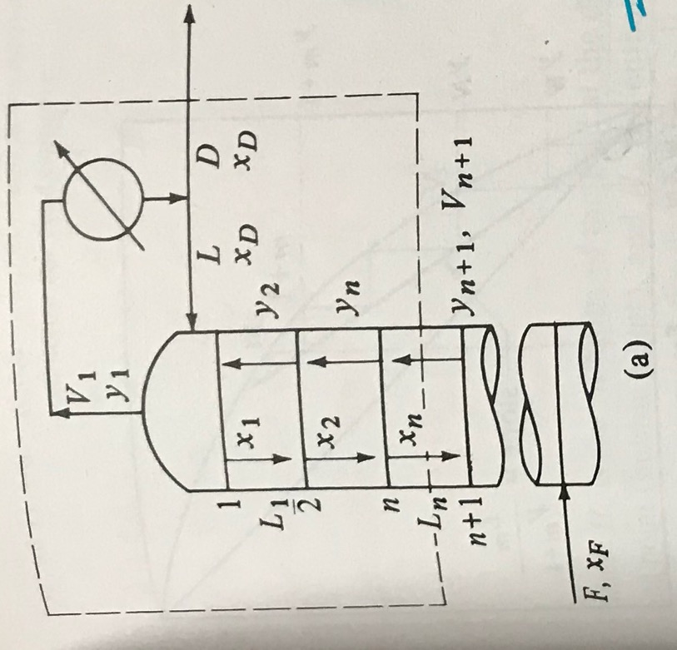
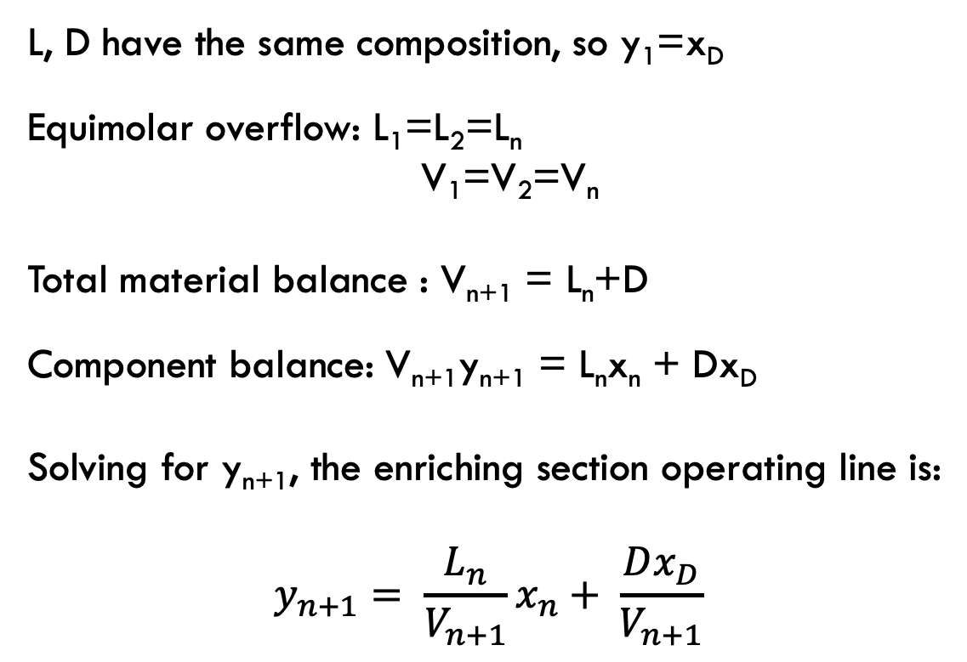
L, D have the same composition, so y₁=x_{D}
Equimolar overflow: L₁=L₂=L_{n}
V₁=V₂=V_{n}
Total material balance : V_{n+1} = L_{n}+D
Component balance: V_{n+1}y_{n+1} = L_{n}x_{n} + Dx_{D}
Solving for y_{n+1}, the enriching section operating line is:
$$y_{n+1}= \frac{L_{n}}{V_{n+1}}x_{n}+ \frac{Dx_{D}}{V_{n+1}}$$

Slide 17
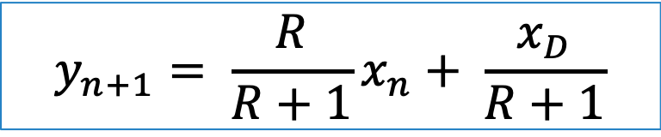
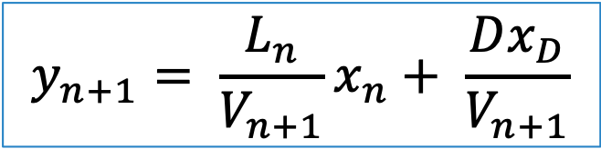
y₁
1
$$y_{n+1}= \frac{L_{n}}{V_{n+1}}x_{n}+ \frac{Dx_{D}}{V_{n+1}}$$
2
y₁
n
Reflux ratio: R= L_{n}/D
y
Slope= L_{n}/V_{n+1}
intercept
x_{D}/(R+1)
V_{n+1} = L_{n}+D,
L_{n}/V_{n+1}= R/(R+1)
x_{n}
x₁
x_{D}
$$y_{n+1}= \frac{R}{R+1}x_{n}+ \frac{x_{D}}{R+1}$$
x

Slide 18
Thank you!
Questions?

