Slide 1
KMU 402
EXPERIMENT 4
BOILING AND CONDENSATION
Arş. Gör. Tülay Selin Ertekin

Slide 2






Boiling Heat Transfer
When a liquid at saturation temperature is in contact with the surface of a solid (usually metal) at a higher temperature, heat is transferred to the liquid and a phase change (evaporation) of some of the liquid occurs.
Water at RT
Water at 100 ℃
Due to surface tension, the vapour inside a bubble must be at a higher pressure then the surrounding liquid. The pressure difference increases as the diameter of the bubble decreases, and is insignificant when the bubble is large.
Heating
(Şekiller CC BY-SA 4.0. lisansı altında www.mindthegraph.com adresindeki ikonlar kullanılarak çizilmiştir).

Slide 3
Classification of Pool Boiling
Depending on the presence of bulk fluid motion;
Pool boiling refers to the type of boiling experienced when the heating surface is surrounded by a relatively large body of fluid which is not flowing at any appreciable velocity and is agitated only by the motion of the bubbles and by natural-convection currents. Two convection currents. Two types of pool boiling are possible.

Slide 4
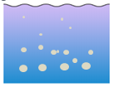
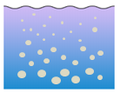
Classification of Pool Boiling
Subcooled Boiling
Bubbles form on the heating surface and the bubbles release from the surface are absorbed by the mass of the liquid
Saturated Boiling
Bubbles form on the heating surface and the bubbles release from the surface are reach the water surface
Water at 70 ℃
Water at 100 ℃
T _{sur} < T _{sat}
T _{sur} ≥ T _{sat}
(Şekiller CC BY-SA 4.0. lisansı altında www.mindthegraph.com adresindeki ikonlar kullanılarak çizilmiştir).

Slide 5
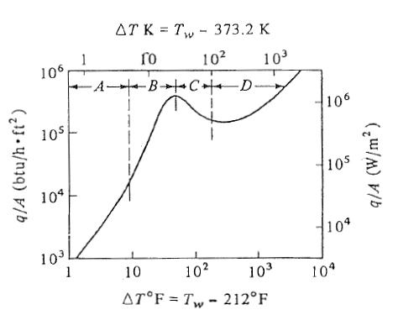

Pool Boiling
Boiling takes different forms, depending on the ΔT_{excess} =T_{s}-T_{sat}

Slide 6
Condensation
Condensation occurs when a saturated vapor comes in contact with a surface whose
temperature is below the saturation temperature. Condensation of a vapour onto a cold
surface may be
Film condensation
Dropwise condensation

Slide 7
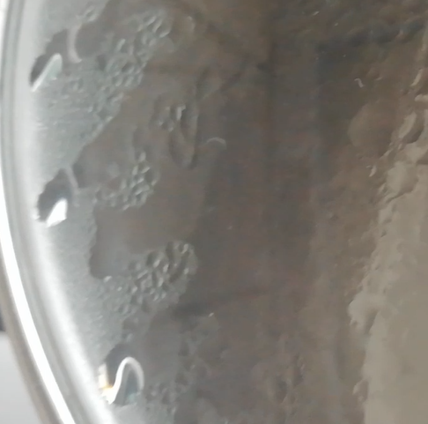
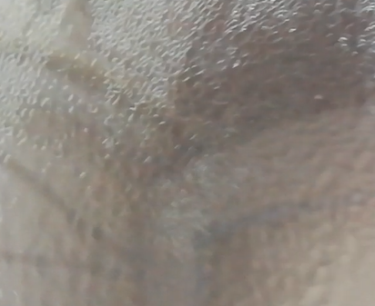
Condensation
Film condensation
When filmwise condensation occurs, the surface is
completely wetted by the condensate
Condensation is onto the outer layer of the liquid
film.
Dropwise condensation
• The surface is not wetted by the liquid and the surface
becomes covered with beads of liquid which coalesce to form drops
Notes:
ldöfdmfm

Slide 8
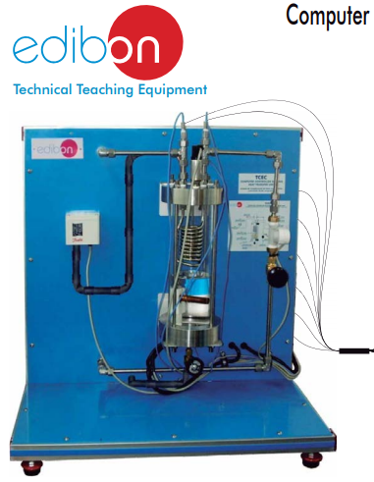
WHY SES36?
Thermal properties:
- Boiling Point: 36.7 ℃
Uses:
- Heat transfer medium, Refrigerant and Solvent

Slide 9
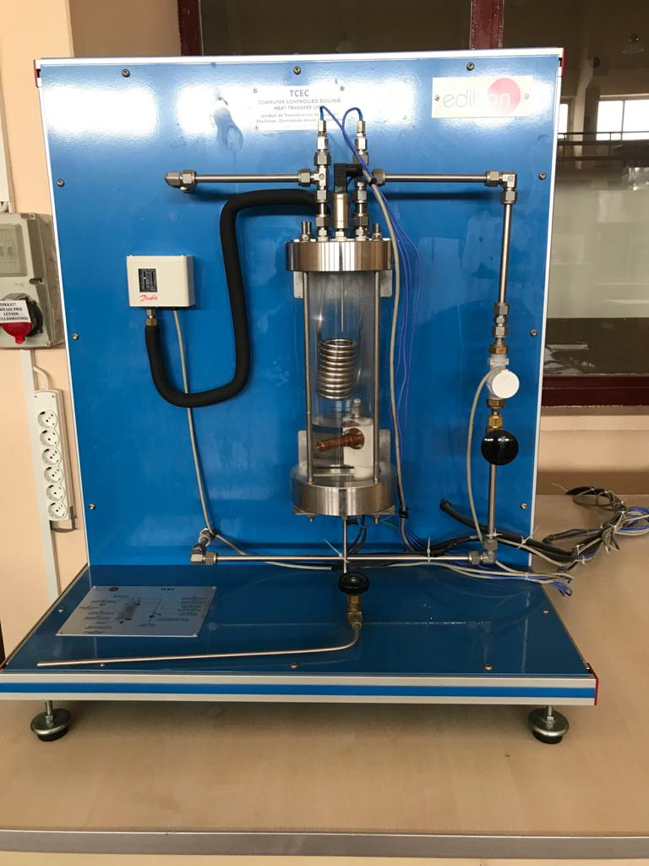
Cooling coils
Heating element
Valve to control flow rate
Liquid SES36

Slide 10

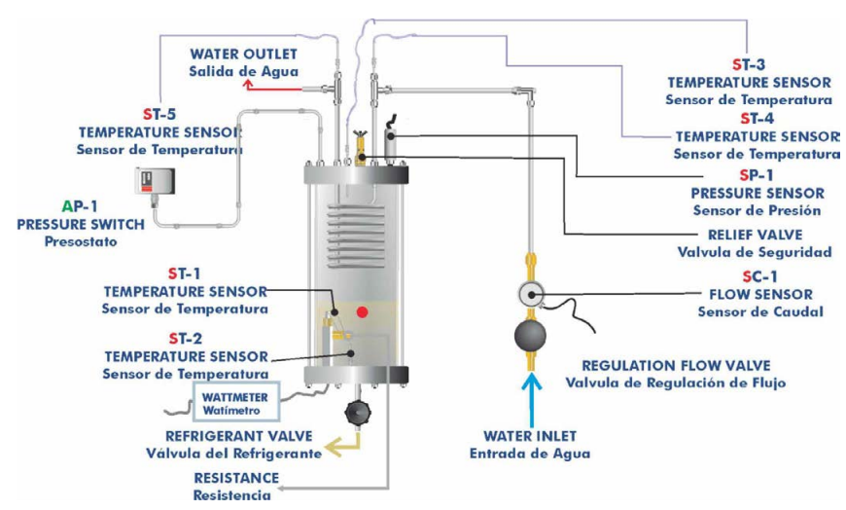
Procedures

Slide 11
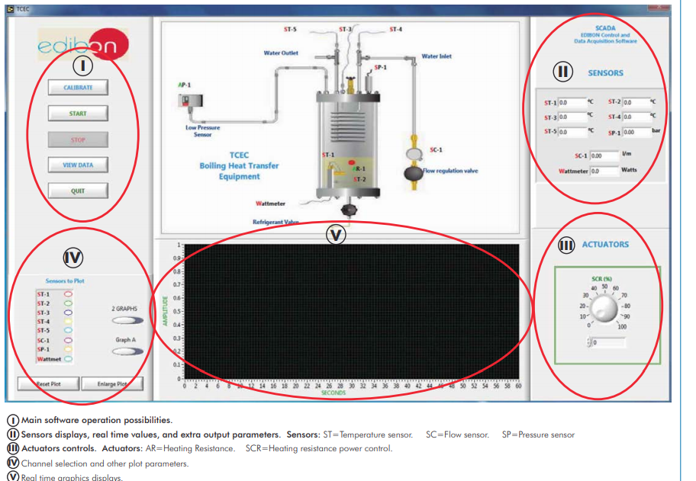

Slide 12
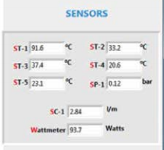
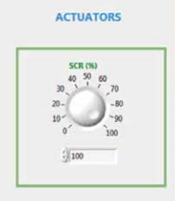
1 ) Data for the pressure-temperature relations at constant power
Akış hızını değiştir
Güç sabit

Slide 13


DATA
In the first section our aim is to draw a P_{abs}- T_{sat} curve for SES36
How can we do that?
- To change the temperature of the cooling fluid (tap water) in the coils
- To change the flow rate of the cooling fluid (tap water) in the coils
As a result ; we take the data for the pressure-temperature relations at constant power
SC1
ST2
T_{sat, exp} (℃)
M _{water} (L/min) | P_{abs} (bar) | T_{sat, exp} (℃) | T_{sat, lit} (℃) | Error (%)
1
2
3
4
5
P_{abs} (bar)

Slide 14
2) Data for the pressure-heat flux relation at constant flow rate
Akış hızı sabit
Gücü değiştir

Slide 15
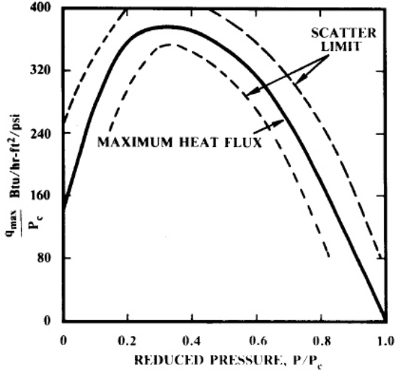
DATA
In the second section our aim is to observe the pressure-heat flux relation at constant flow rate
% Power | q/A, _{exp} ( kW/ m²) | q/A, _{theo} ( kW/ m²) | Error (%)
20
30
40
50
q/A (kW/ m²)
P_{abs} (bar)

Slide 16
DATA
In the third section our aim is to draw a Boiling Curve observe the mechanism of each region
As a result ; we take the data for the determination of heat flux and surface heat transfer coefficient at constant pressure
log h (W/ m²)
log q/A (W/ m²)
log ΔT_{e} (℃)
log ΔT_{e} (℃)
In the last section our aim is to calculate the overall heat transfer coefficient

Slide 17
REFERENCES
1. Perry, D. Green: , 6th ed., McGraw-Hill International Editions/Chemical Engineering Series, New York, 1984
3. L. McCabe, J. C. Smith, P. Harriott: , 5th ed. McGraw-Hill, New York, 1988
4. J. Geankoplis: , 3rd ed., Prentice-Hall International, Inc., New York, 1993
5. Zuber, N., “ ”, Trans. ASME. 80: 711, 1958.

Slide 18
TEŞEKKÜRLER…

