Slide 1
HACETTEPE UNIVERSITY
DEPARTMENT OF CHEMICAL ENGINEERING
KMU 402 - Chemical Engineering Laboratory II
Experiment No: 5
Experiment Name: CHEMICAL REACTORS

Slide 2
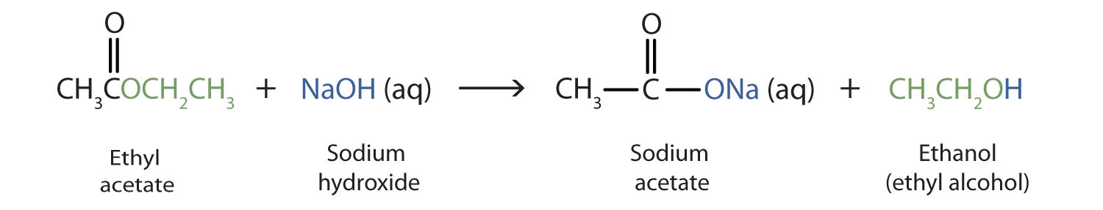
Main Reaction : saponification of the ethyl-acetate with sodium hydroxide
Aim of experiment :
Obtaining the reaction rate constant (k) and the reaction order (α) with respect to ethyl-acetate in batch reactor.
Demostrate the dependency of the k with T obeying the law of Arrhenius
Study the difference between discontinuous and continuos operation

Slide 3
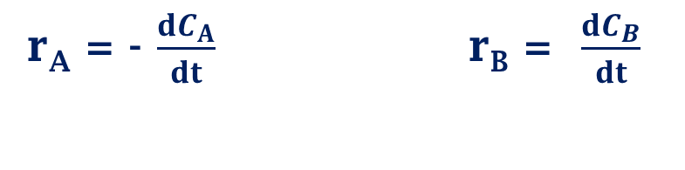
THEORY
A
B
Reaction rate: the amount of substance produced - spent per unit time and unit volume
Rate of reactant: (-) Rate of product: (+)
r_{A} = - $\frac{dC_{A}}{dt}$ r_{B} = $\frac{dC_{B}}{dt}$
r_{A} = mol/dm³s
r_{A} is not a function of reactor type !

Slide 4

THEORY
Reactor
F_{A0}
F_{A}
(Inlet rate of A) – (Outlet rate of A) + (Consumption rate) = Accumulation
F_{A0} – F_{A} + r_{A}V = $\frac{dNA}{dt}$
F_{A0} = mol/s C_{A} = mol/ m³ N_{A} = mol
k = 1/s V = m³

Slide 5
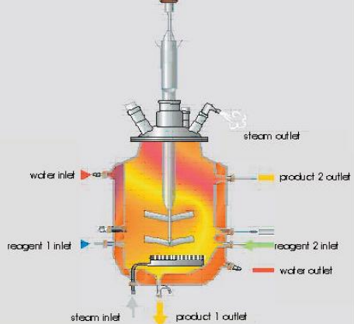
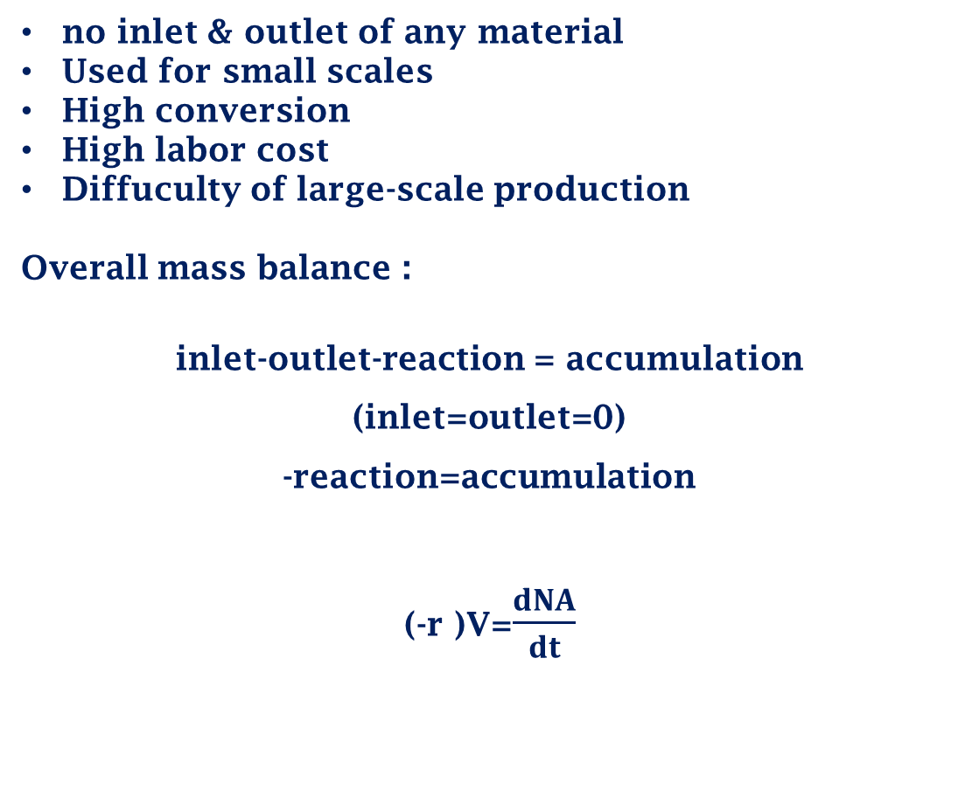

THEORY
Discontinuous (Batch) Reactor
no inlet & outlet of any material
Used for small scales
High conversion
High labor cost
Diffuculty of large-scale production
Overall mass balance :
inlet-outlet-reaction = accumulation (inlet=outlet=0)
-reaction=accumulation
(-r )V=$\frac{dNA}{dt}$
t =-C_{Ao} $\int_{0}^{X_{A}}{\frac{dX_{A}}{{−r}_{A}}}$

Slide 6
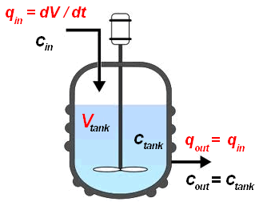

Continuous Stirred Tank Reactor (CSTR)
Most common type of reactor in industry
Well-mixed process
No accumulation
inlet-outlet-reaction = accumulation
F_{A0} – F_{A} + r_{A}V = 0
F_{A} = F_{A0}(1-X_{A})
$\frac{V}{F_{A0}}$ = $\frac{X_{A}}{{−r}_{A}}$

Slide 7
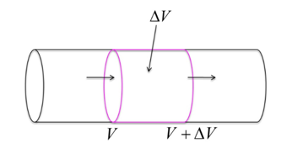
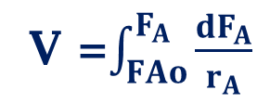
Plug Flow Reactor (PFR)
Low volume needed for desired concentration
Hard to control the temperature
Volume of CSTR > Volume of PFR (Levenspiel Plot)
V =$\int_{FAo}^{F_{A}}{\frac{dF_{A}}{r_{A}}}$

Slide 8
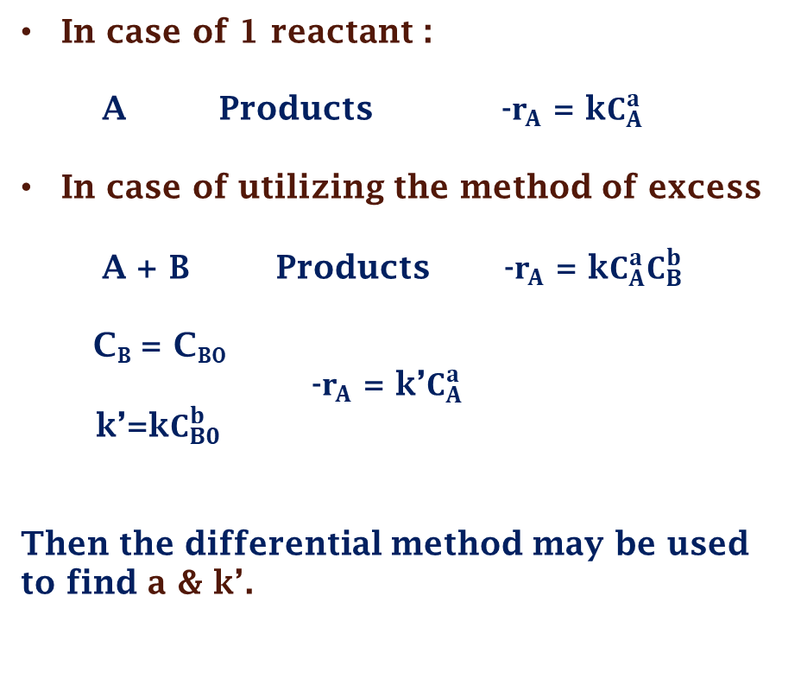
Determination of the Kinetic Parameters
In case of 1 reactant :
A Products -$r_{A}$ = k$C_{A}^{a}$
In case of utilizing the method of excess
A + B Products -$r_{A}$ = k$C_{A}^{a}C_{B}^{b}$
C_{B} = C_{B0}
-$r_{A}$ = k’$C_{A}^{a}$
k’=k$C_{B0}^{b}$
Then the differential method may be used to find a & k’.

Slide 9

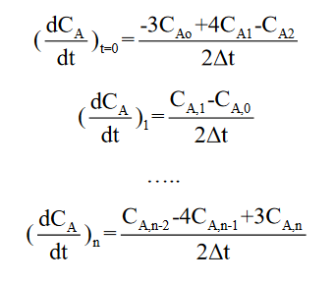
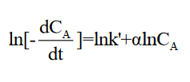
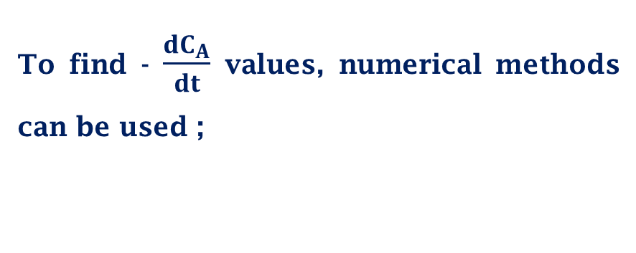
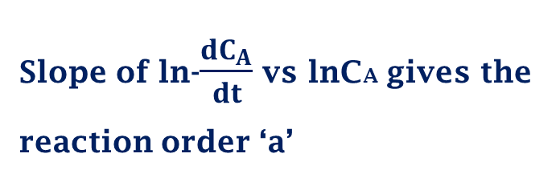
Differential Method of Analysis
To find - $\frac{dC_{A}}{dt}$ values, numerical methods can be used ;
Slope of ln-$\frac{dC_{A}}{dt}$vs lnCA gives the reaction order ‘a’

Slide 10
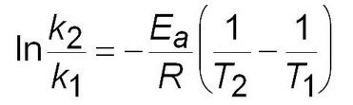
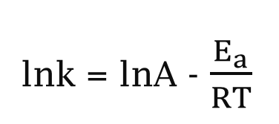
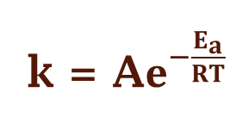
The Effects of A Change in the Temperature
Ea is the activation energy of the gases
A is the factor A of Arrhenius
k = f (T)
k = A$e^{−\frac{E_{a}}{RT}}$
lnk = lnA - $\frac{E_{a}}{RT}$
Arrhenius equation gives the relation between reaction rate constant and temperature

Slide 11
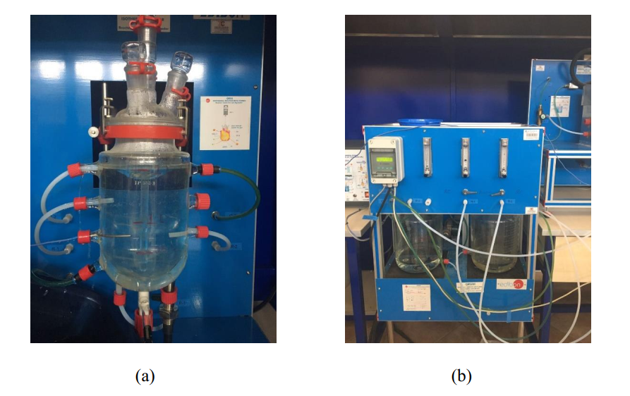
Experimental Method
Experiment consists of 3 parts;
Discontinuous Isothermal Operation (Batch System) at 25ºC
Discontinuous Isothermal Operation (Batch System) at 35ºC
Continuous Isothermal Operation (CSTR System) at 35ºC
Equipments of the experiment (a) Pyrex-glass reactor (b) Flow control system

Slide 12
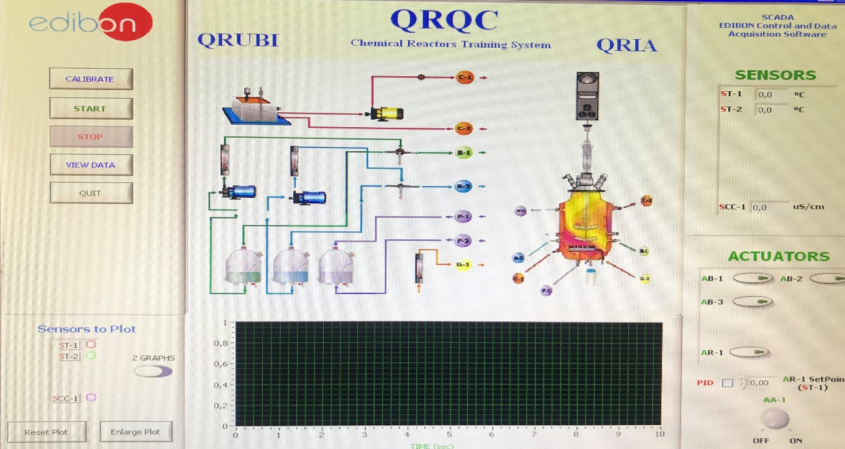
Conductivity to Concentration
The control of the reaction is carried out using a conductivity cell with conductimeter
conductivity is the transport of electric current by charged ions.
In the experiment, the ions that effect the conductivity are:
Na⁺ OH⁻ R

Slide 13
Batch System Experiments
Materials;
0,02 M , 5 liter (EtOAc) solution.
1 M , 5 liter NaOH solution
QRIA system
Software SACED-QRIA
QRIA practice manual
Demonstrate that the saponification of the ethyl-acetate with sodium hydroxide is a reaction of first order respect to ethyl-acetate.
find the k and make an assessment between the experimental and theoretical values of k.
Both in 25ºC and 35ºC

Slide 14
CSTR System Experiments
Materials;
0,02 M , 5 liter (EtOAc) solution.
0,02 M , 5 liter NaOH solution
QRIA practice manual
QRIA equipment
SACED-QRIA software
Study the difference between discontinuous and continuous operation.
At 35ºC

Slide 15
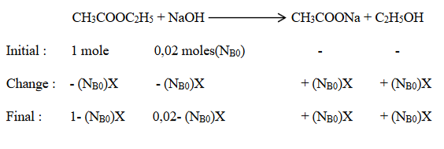
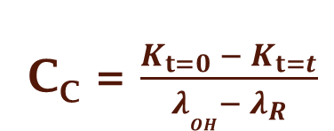
Calculations of Experiment
Calculations for batch system
NaOH & CH3COONa effect the conductivity
CH3COOC2H5 & C2H5OH doesn’t effect the conductivity
@ t=0 K_{t=0} = λ_{Na}.C_{Bo} + λ_{OH}. C_{Bo}
C_{C} = $\frac{K_{t=0} − K_{t=t}}{λ_{OH}− λ_{R}}$
@ t=t K_{t=t} = λ_{Na}.(C_{Bo}-C_{C}) + λ_{Na}.C_{C} + λ_{OH}.(C_{Bo}-C_{C}) + λ_{R}.C_{C}

Slide 16
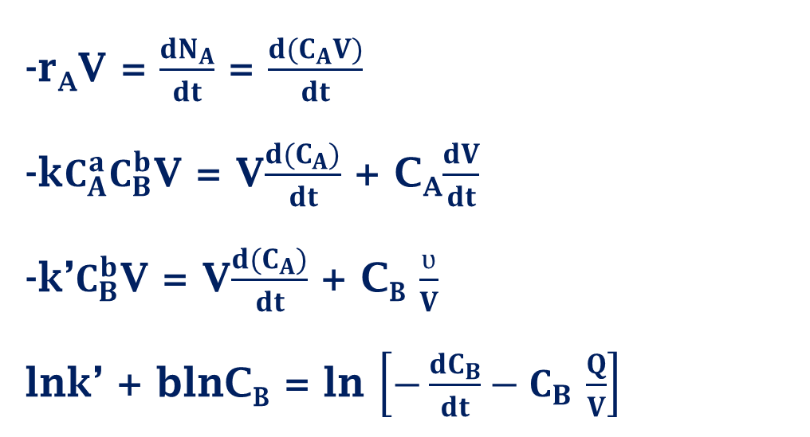
Calculations for batch system
CH₃COOC₂H₅ + NaOH CH₃COONa + C₂H₅OH
A + B C + D
-r_{A}V = $\frac{dN_{A}}{dt}$ = $\frac{d(C_{A}V)}{dt}$
-k$C_{A}^{a}C_{B}^{b}$V = V$\frac{d(C_{A})}{dt}$ + C_{A}$\frac{dV}{dt}$
-k’$C_{B}^{b}$V = V$\frac{d(C_{A})}{dt}$ + C_{B} $\frac{ʋ}{V}$
lnk’ + blnC_{B} = ln $\left[−\frac{dC_{B}}{dt}−C_{B }\frac{Q}{V}\right]$
Y
Slope = b
Intercept = lnk’
X
Y
X

Slide 17
Calculations for batch system
CH₃COOC₂H₅ + NaOH CH₃COONa + C₂H₅OH
A + B C + D
time (s) | Kx10^3 (ms) | vol (L) | C_{EtONa}(mol/L) | N_{EtONa}(mol) | N_{NaOH-} N_{EtONa} (mol) | C_{NaOH} (mol/L) | C_{NaOH}Q/v (mol/L.s)
0
60
120
X (conversion)
Reaction order
Reaction rate constant (k)

Slide 18
Calculations for batch system
Same calculation steps are done for 35 ºC and same parameters are found.
Theoretical k value @35C is found from Arrhenius Equation ;
Temp.(ºC) | kexp (l/mol) | ktheo(l/mol) | % Error
25
35

Slide 19
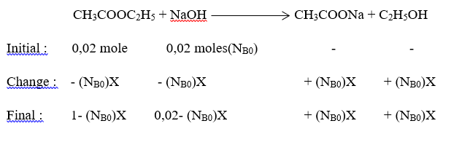
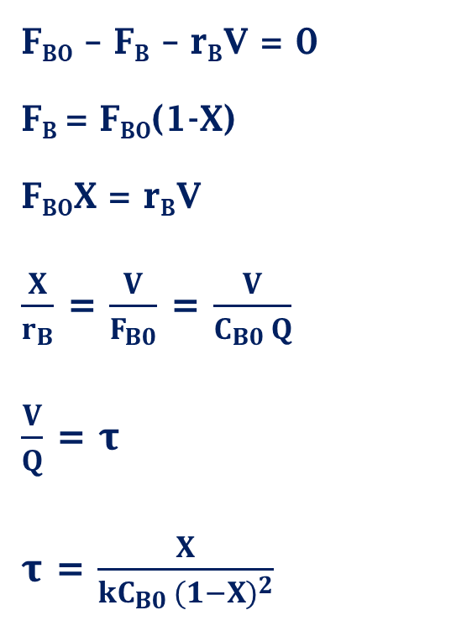
Calculations for CSTR system
F_{B0} – F_{B} – r_{B}V = 0
F_{B} = F_{B0}(1-X)
F_{B0}X = r_{B}V
$\frac{X}{r_{B}}$ = $\frac{V}{F_{B0}}$ = $\frac{V}{C_{B0 }Q}$
$\frac{V}{Q}$ = $τ$
$τ$ = $\frac{X}{kC_{B0 }{(1−X)}^{2}}$
x_{exp} | x_{theo} | Error (%)

Slide 20
THANKS FOR LISTENING

