Slide 1
EXPERIMENT 6
CATALYTIC REACTORS
KMU 402
CHEMICAL ENGINEERING LABORATORY II
RES. ASST. DR. HANDE GÜNAN YÜCEL
RES. ASST. ANIL KUBAN

Slide 2
AIMS OF THE EXPERIMENT
To observe a catalytic reaction process in a tubular reactor.
To observe the effects of temperature, reactant flow rate and catalyst grain size on the reaction yield.
To gain detailed information on catalysts, enzymes and heterogeneous catalytic reactions.

Slide 3
EXPERIMENTAL SET-UP
AND
PROCEDURE

Slide 4
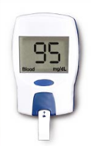
EXPERIMENTAL SET-UP
Packed bed reactors filled with different grain size particles
Temperature should be kept constant
The reactors are jacketed and hot water circulates through them
Blood glucose meter is used for measuring the glucose concentration at the outlet stream
Valves are used to regulate the flow direction
Pump is used to circulate hot water
Peristaltic pump is used to feed the reactors
Reactant feed
(sucrose solution)
Hot water reservoir

Slide 5
REACTORS
There are two fixed-bed chemical reactors in this system.
Reactor 1
Reactor 2
Both reactors are filled with the same ion exchange resin to catalyze the sucrose hydrolysis reaction. But the grain size of the particles are different.
Particle diameter:
0.4 mm
Particle diameter:
0.8 mm
The reactors are jacketed and hot water circulate though them. Water temperature is measured and regulated to maintain the reaction at isothermal conditions.

Slide 6

THE REACTION
Sucrose
+
Water
Glucose
Fructose
Sucrose is a disaccharide that is composed by the glucose and fructose. monosaccharides
+
T
Catalyst
C₁₂H₂₂O₁₁
C₆H₁₂O₆
C₆H₁₂O₆
Sucrose hydrolysis: Water breaks down the bonds in sucrose. Glucose and fructose is produced.
This product is called
«invert sugar». It is sweeter than sucrose.
Important for food industry

Slide 7
EXPERIMENTAL PROCEDURE
150 g/L sucrose solution is prepared with distilled water and it is poured to the reactant flask.
Before initiating the experiment, the temperature is set to the desired value to keep it constant during the experiment.
The peristaltic pump is activated and reactant flow is started.
It is waited for 30 minutes.
The peristaltic pump is switched off and the experiment is stopped.
Sample is taken from the «product solution».
Glucose conentration in the product solution is determined in mg/dL by using a blood glucose meter.
It includes glucose, fructose, water and unconverted sucrose.

Slide 8
EXPERIMENTAL PARAMETERS
Glucose concentrations are determined at the temperature and reactant flow rate values which are listed in the table below:
These are measured during the experiment.
 | Reactor 1 | Reactor 2
Temperature (ºC) | Volumetric Flow Rate (mL/min) | Volumetric Flow Rate (mL/min)
50 | 20 | -
 | 25 | -
 | 30 | -
70 | 20 | 20
 | 25 | -
 | 30 | -
In this experiment, the effects of;
temperature
reactant flow rate
catalyst grain size
parameters on;
conversion
reaction rate constant
thiele modulus
effectiveness factor
are tested.
These are calculated after the experiment for your report.

Slide 9
THEORY
-THE KEY POINTS-

Slide 10
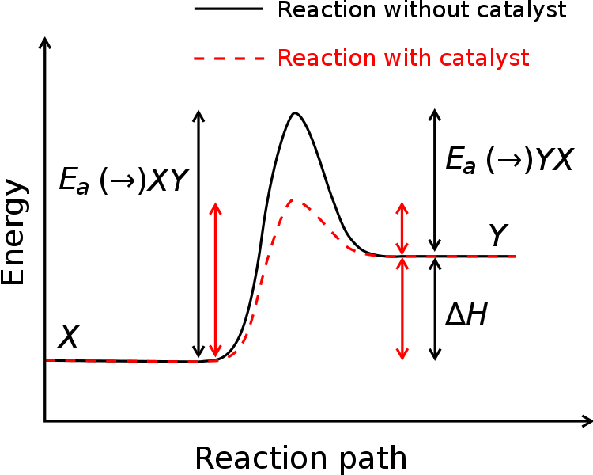
ENERGY OF REACTIONS
Activation energy is always required for occurrence of any chemical reaction. It is the amount of energy needed to cause a reaction to occur.
For reactants alone, it is very tedious to achieve this barrier.
But when a catalyst is present in a particular reaction it decreases the activation energy barrier. So, reaction occurs at a rate faster than before.
IN THIS CASE, CATALYST SPEEDS UP THE REACTION.
The energy required to enter transition state decreases

Slide 11
ARRHENIUS EQUATION
It gives the relationship between the activation energy and the rate at which a reaction proceeds.
A: Frequency factor for the reaction
R: Universal gas constant
T: Temperature (K)
k: Reaction rate coefficient

Slide 12
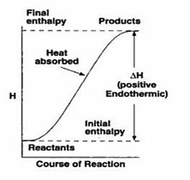
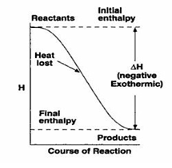
ENDOTHERMIC-EXOTHERMIC REACTIONS
Endothermic reaction
Products absorb part of the reagents’ energy.
This means, where part of the energy (ΔH) needed for the reaction to take place, is absorbed by the products.
Exothermic reaction:
The energy level of the products is lower than that of the reagents
Energy is released to the environment.

Slide 13
FACTORS AFFECTING REACTION RATES
Nature of the bonds in the reacting substances affect the reaction rate.
Reaction rate is usually proportional to the concentrations of the reactants.
In general, as the temperature increases, reaction rate increases due to increase in average kinetic energies of the molecules.
The catalyst provides an alternative pathway by which the reaction can proceed and in which the activation energy is lower.
Nature of the Reactants
Initial Reactant Concentrations
Presence of Catalyst
Temperature

Slide 14
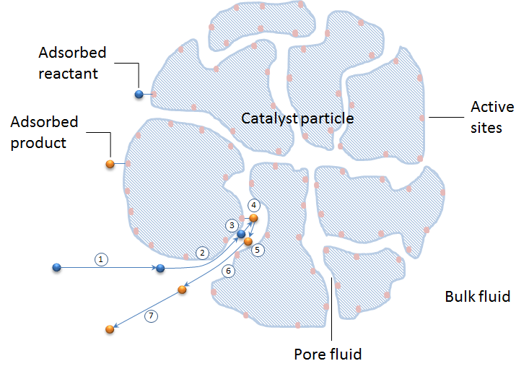
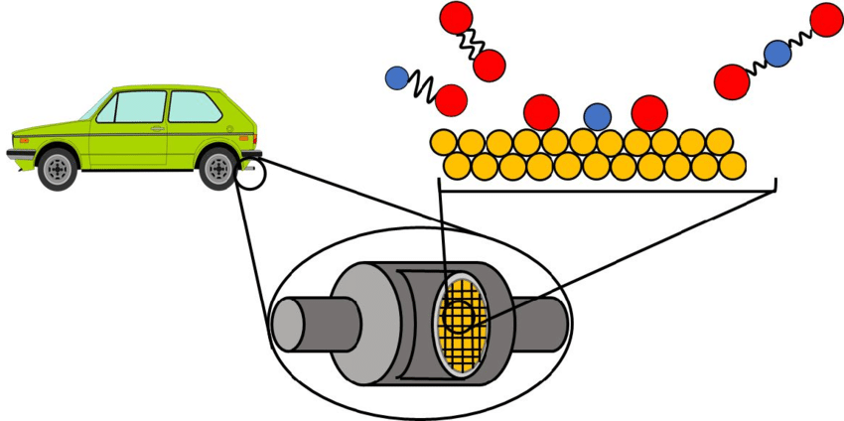
CATALYSTS
It can be synthetic, organic or simply a metal.
In ideal conditions, its structure does not change during reaction.
It can be easily recovered after the reaction and can be reused for other reactions.
Catalysts are classified according to their kinetics:
Positive catalysts (Activators):
Increase the speed of the chemical reaction
Negative catalysts (Inhibitors):
Decrease the speed of a chemical reaction
Industrial Applications:
Fertilizers
Catalytic Converters
Metal Catalysts

Slide 15
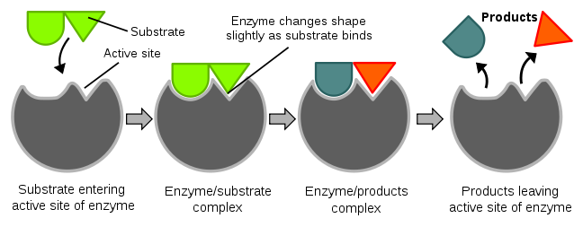
ENZYMES
Enzymes are catalytic proteins that speed up chemical reactions.
Like other proteins, enzymes consist of long chains of amino acids held together by peptide bonds.
They catalyze only biochemical reactions.
Enzymes are much more specific than catalysts and for proper working they depend upon strict optimum conditions.
In living systems, enzymes have crucial role.
Each enzyme has a unique 3-D shape, including a surface groove called an active site, which fits its target substrate much like a key fits in a lock. Other substances that don’t fit can't enter the active site and no reaction occurs.

Slide 16
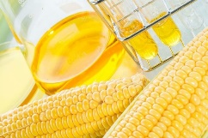
SUCROSE HYDROLYSİS
Sucrose
+
Water
Glucose
Fructose
Sucrose is a disaccharide that is composed by the glucose and fructose. monosaccharides
+
T
Catalyst
C₁₂H₂₂O₁₁
C₆H₁₂O₆
C₆H₁₂O₆
Sucrose hydrolysis: Water breaks down the bonds in sucrose. Glucose and fructose is produced.
This product is called
«invert sugar». It is sweeter than sucrose.
Important for food industry
(HIGH FRUCTOSE CORN SYRUP)

Slide 17
SUCROSE HYDROLYSIS METHODS
Advantage:
Low cost
Disadvantage:
Additional neutralization step is necessary
The most popular method
Advantage:
High efficiency
Disadvantage:
Expensive
Temperature and pH limitations
Hydrolysis
by
Acids
Hydrolysis
by Cation Exchange Resins
Hydrolysis
by
Enzymes

Slide 18
REACTION ORDER
AND CONVERSION
The rate of inversion reaction is given by:
Rate = k [Sucrose] [H₂O]
This reaction seems to be second order, i.e. first order with respect to each sucrose and H₂O. The [H₂O] is also constant as it is used as solvent and present in large amount. Therefore, the reaction is only first order with respect to sucrose.
For ion exchange based fixed bed reactors, the simplest approach is to describe it as an ideal plug flow reactor, and therefore the conversion can be derived for a first order reaction as:
ln (1-X)=-kτ
X=fractional conversion
k= reaction rate constant for a first order reaction, s⁻¹
τ= space time, s

Slide 19
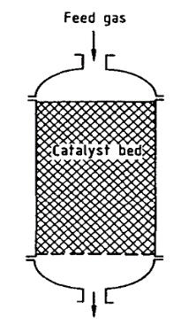
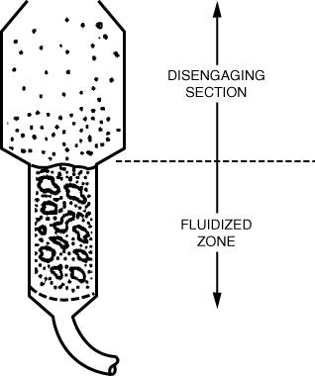
PACKED BED REACTOR
It is commonly used in heterogeneous catalytic processes.
The tubular reactor consists in essence of a container filled with catalyst particles.
The porous structure should be described for modelling.
FIXED BED REACTORS
Catalyst pellets do not move.
Reaction occurs within the catalyst particles.
Catalytic particles can vary in size and shape: granular, cylindrical, spherical, etc.
FLUIDIZED BED REACTORS
Particle-fluid mixture behaves as though it is a fluid.
Effective agitation of the solids in contact with the fluid.
This means that nearly uniform temperatures can be maintained even in highly exothermic reactions.

Slide 20
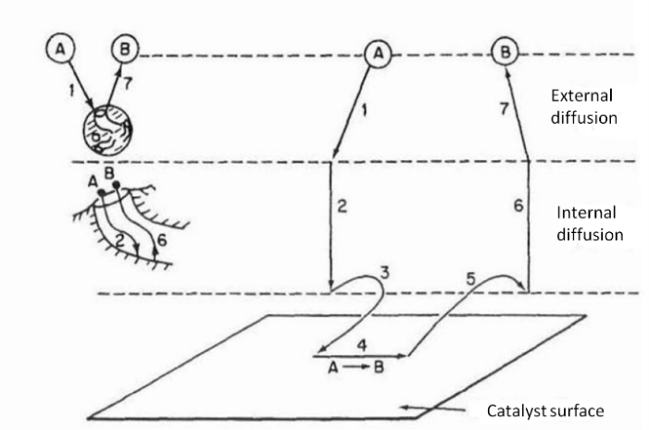
STEPS IN CATALYTIC REACTION
1. Mass transfer (diffusion) of the reactant(s) (e.g., species A) from the bulk fluid to the external surface of the catalyst pellet.
2. Diffusion of the reactant from the pore mouth through the catalyst pores to the immediate vicinity of the internal catalyst surface.
3. Adsorption of reactant A onto the catalyst surface.
4. Reaction on the surface of the catalyst (e.g., A →B).
5. Desorption of the products (e.g., B) from the surface.
6. Diffusion of the products from the interior of the pellet to the pore mouth at the external surface.
7. Mass transfer of the products from the external pellet surface to the bulk fluid.

Slide 21
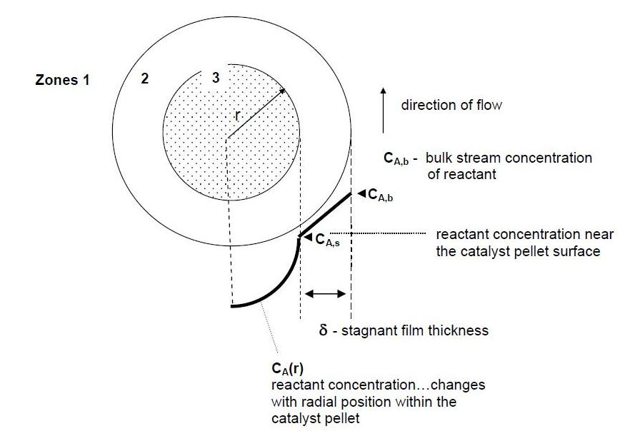
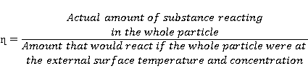
EFFECTIVENESS FACTOR
η= r_{A}/r_{s}
Smaller the effectiveness factor means larger importance of the physical processes of mass transfer.
The case of an effectiveness factor greater than 1 shows high temperatures within the particle.

Slide 22
THIELE MODULUS
De>>k
Process is kinetically controlled
De<<k
Process is diffusion controlled
What is your recommendation to increase conversion if the process is kinetically controlled?
What is your recommendation to increase conversion if the process is diffusion controlled?
How do the Thiele modulus and effectiveness factor change with temperature?

