Slide 1
KMU 402 Chem Eng Lab II
Exp. 7: Cooling Towers

Slide 2
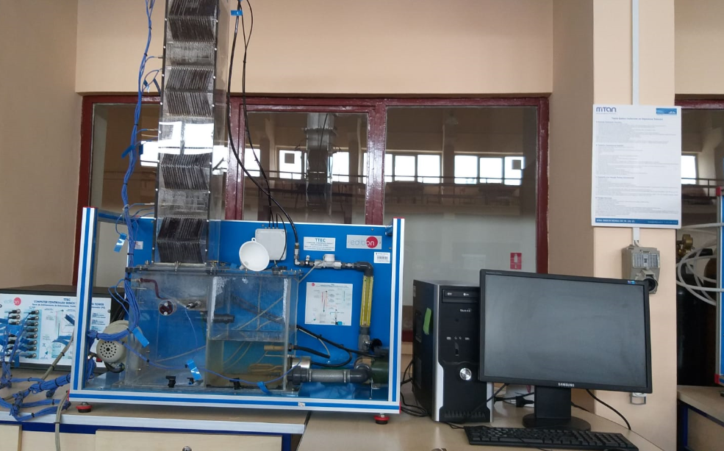
Fig.1. Cooling tower experimental system

Slide 3
Fig.2. Schematic drawing of the cooling tower

Slide 4
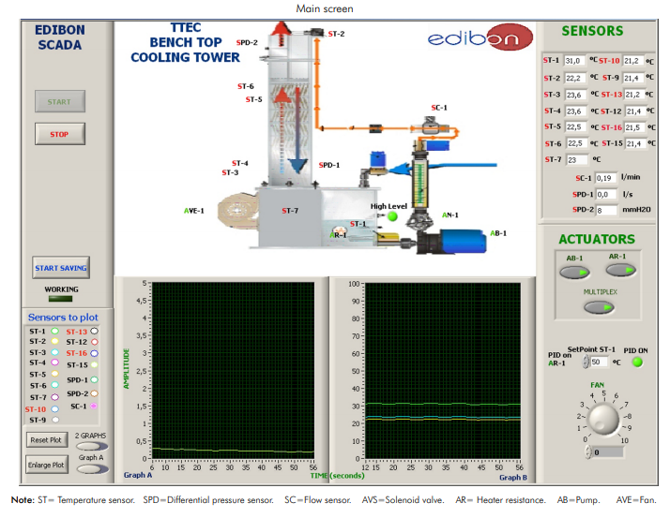
Fig.3. Computer controlled TTEC element screen
Fig.4. TTEC Control Interface Box

Slide 5
Step-by-step Experimental Setup-1
Run TTEC program on desktop.
AR-1 and AB-1 set ON position (green)
PID ONformat and the system temperature (ST1) was set 50 °C.

Slide 6
Step-by-step Experimental Setup-2
SPD-1 (l/s) shows the air flow rate set by Fan button
Air flow rate (7 l/s) was set from Fan button to experiment parameters.

Slide 7
Step-by-step Experimental Setup-3
SC-1 (l/min) display the water flow rate set by flowmeter (1 l/min)
Flow meter(rotameter)
Set Valve for water flow rate

Slide 8
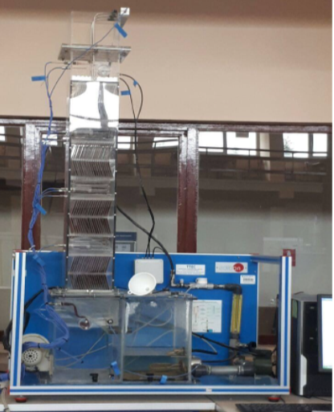
Step-by-step Experimental Setup-4
Moisten the cotton for wet bulb temperature measurement (air outlet wet bulb temp)
Moisten the cotton for wet bulb temperature measurement (air inlet wet bulb temp)

Slide 9
Step-by-step Experimental Setup-5
Temperature measurements recorded at 3 min interval for 15 minutes

Slide 10
Step-by-step Experimental Setup-6
2nd part, the air flow rate constant. The water flow rate set at 1.2 L / min.
T measurements recorded at intervals of 3 minutes intervals for 15 minutes.
3rd part, the water flow rate constant according to the best range value . The air flow set to higher fan speed (23 L/s).
T measurements were recorded at intervals of 3 minutes intervals for 15 minutes.

Slide 11
The objectives of the experiment
To understand the working principles of cooling towers
How to use the psychrometric chart for determining the humid air properties such as specific humidity, specific enthalpy, relative humidity, etc.
To calculate effectiveness of the cooling tower, T range, T approach
To observe how the flow rates of water and air affect to the system.
To calculate mass and enery balances on the cooling system.

Slide 12
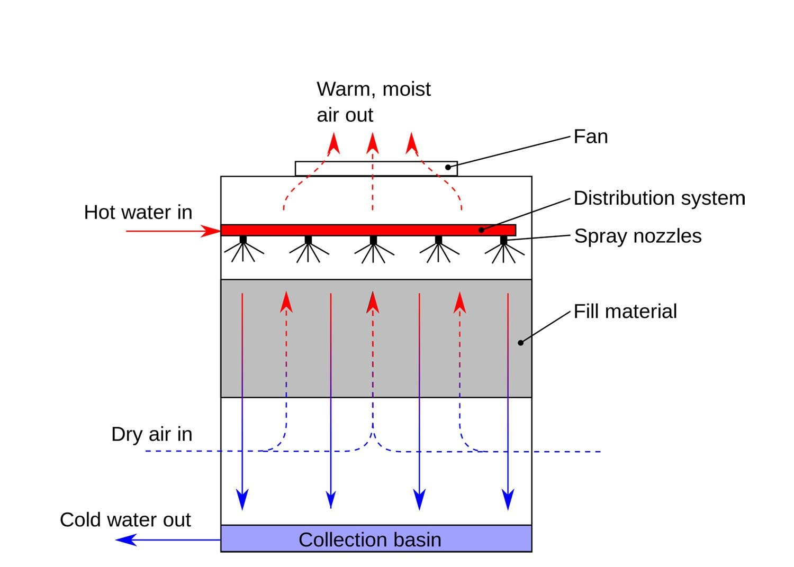
Theory
What is evaporative-cooling principle?
Evaporative cooling is the process where warm water from an industrial process is pumped up to the top of the cooling tower.
The water then gets distributed by cooling tower nozzles to the wet deck.
At the same time, air is being drawn through the air-inlet louvers forcing water to evaporate.
Evaporation causes the heat to be removed from the make up water. The hot air naturally rises out of the tire.
Fig.5. Counter flow cooling tower model

Slide 13
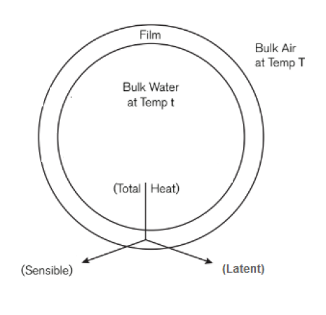
In counter flow model;
At the interface, the water has a film surrounded by air.
Both sensible and latent heat transfer occur between the film and surrounding air when the hot water and cold air meet within the tower.
The cold air stream removes sensible heat from the saturated film, cooling down the water stream.
At the same time, latent heat evaporates water droplets, resulting in mass transfer of water into the air stream.
These two heat transfers, driving force within the tower to cool down the hot water stream.
Fig. 6. A model of a water particle in a cooling tower

Slide 14
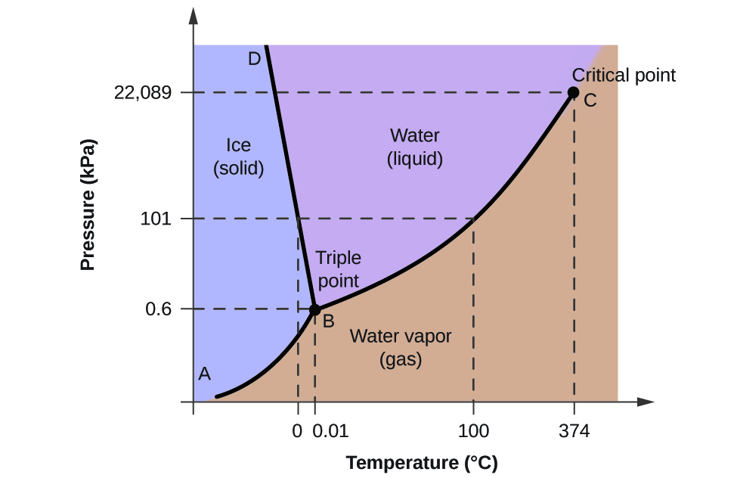
Pscyhrometric chart
Humidification & dehumidification processes
Physical properties of air-water vapor mixtures or humid air. (1 atm abs pressure)
Key terms
Absolute Humidity (ha)
Relative humidity (hr)
Humid Heat (Cs)
Specific enthalpy of saturated air (H)
Humid Volume (Vh)
Dew point(Tdp)
Dry-bulb temperature (Tdb)
Wet-bulb temperature (Twb)
Fig.7. Phase diagram of water

Slide 15
Fig. 8. Psychrometric chart

Slide 16
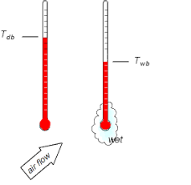
Dry bulb temperaure: the temperature that is usually thought of as air temperature measured by a regular thermometer exposed to the airstream.
Wet bulb temperature: The minimum temperature at which a material can be cooled by evaporation. A porous material like cloth or cotton is soaked in water and wrapped around the bulb of thermometer is placed in a stream of flowing air.
The wet bulb temperature of the humid air depens on dry bulb and moisture content of air.
If air is saturated; Twb = Tdb
The lower the humidity, the greater the difference between Tdb and Twb
Fig. 9. The dry bulb and wet bulb temperatures

Slide 17
Heat Transfer in Cooling Towers
The most generally accepted theory for cooling tower heat transfer process is Merkel’s Theory.
The enthalpy potential difference is analyzed to be the driving force.
Each particle of water is assumed to be surrounded by an air film, and the enthalpy difference between the film and surrounding air , the driving force for the cooling process.

Slide 18
Design of Cooling Towers

Slide 19
Cooling Tower Performance
The following factors affect the performance of a cooling tower:
(i) The air flow rate
(ii) The water flow rate
(iii) The water temperature
(iv) The air temperature and humidity at inlet (particularly the wet bulb temperature)
(v) The type of packing used
(vi) The area and volume of the packing.
Fig. 10. Range and Approach in Cooling Tower

Slide 20
Cooling Tower Effectiveness: This is the ratio between the range and ideal range, between water inlet temperature and ambient wet bulb temperature, in other words;
Effectiveness = Range/(Range + Approach).
Evaporation loss: This is the water quantity evaporated for cooling process.
Cooling capacity: This is the heat rejected in kcal/h, given as product of mass flow rate of water, specific heat and temperature difference.
Cycles of concentration: This is the ratio of dissolved solids in circulating water to the dissolved solids in make up water.

Slide 23
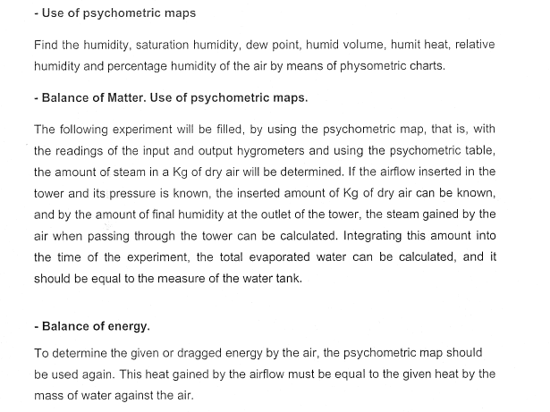
Calculations

