Slide 1
Experiment – 8:
Dynamic Behaviour of U Manometers
&
Process Control
RES. ASST. DR. HANDE GÜNAN YÜCEL
RES. ASST. ANIL KUBAN

Slide 2
1. Dynamic Behaviour of U-Manometers
The aim of the experiment is to comprehend to dynamic behavior of control systems, to acknowledge information about the main principles of U-tube manometer and process control characteristics of U-manometers as an example of second order systems.
Also terms like,
  Transfer function,
  Different input tranfer function types such as; impulse, step, ramp, sinusoidal etc,
  Damping factors and overdamped, critically damped and underdamped systems,
  Overshoot, undershoot, decay ratio, rise time, response time, period of oscillation, error and offset
  was discussed.

Slide 3
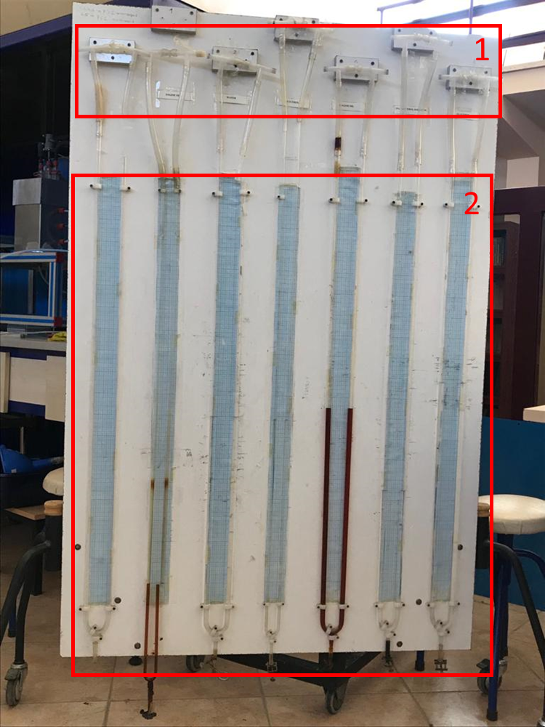
Experimental Setup
The experimental set-up consist of the various U-manometers in different diameters and length that contain several kind of liquids with the different properties such as water, glycerol, engine oil and their mixtures. (Properties of these six U-manometers are given at the Data Sheet)
With these manometers you should predict and calculate the effect of;
  Length of liquid in the manometer,
  Diameter of manometer,
  Properties of liquid (density, viscosity etc.).
  on the dynamic behaviour of manometer.

Slide 4
Experimental Setup
The pressure difference in the U-manometer is created by a vacuum pump which is attached from one open end of the manometer. The other end of the manometer is open and at open air pressure. (Manometer ends are shown as 1)
Step input function is used for overdamped manometers and both step and impulse input functions are used for underdamped manometers.
Experimental method is given on the experimental study sheet.

Slide 5







Calculations
By accepting the initial conditions as zero, the rate of Laplace transformation between the output (response) function and the input function of a system is called the transfer function. The transfer function defines the dynamic characteristics of the system. It is a system feature. It does not give information about the physical structure of the system, the transfer functions of different physical systems may be the same.
1st order systems:
2nd order systems:
Damping factor
Time constant
Kp Gain

Slide 6



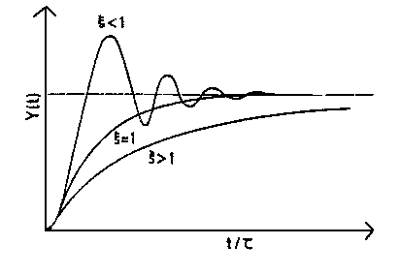
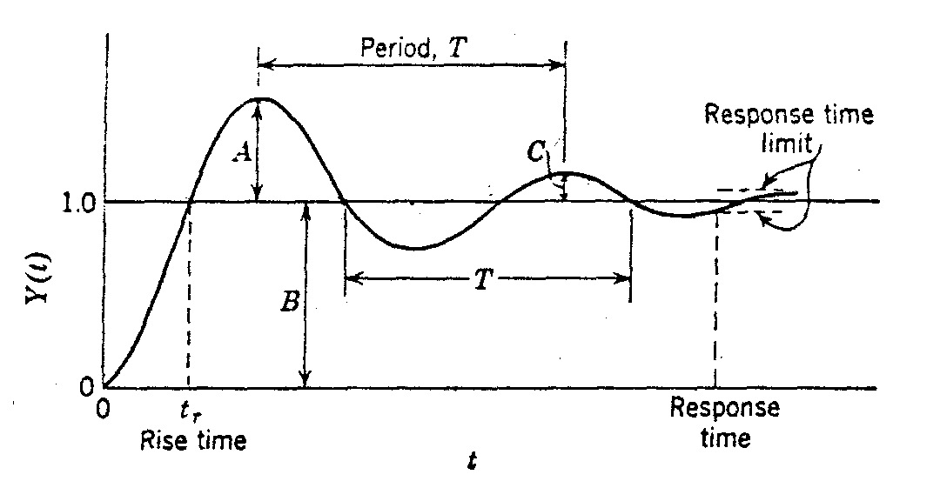
Damping factor
Time constant
Kp Gain
ξ | Nature of roots | Description of response
<1 | Complex | Underdamped
=1 | Real and equal | Critically damped
>1 | Real | Overdamped
Rise time. This is the time required for the response to first reach its ultimate value
Response time. This is the time required for the response to come within 5% percent of its ultimate value and remain there.

Slide 7
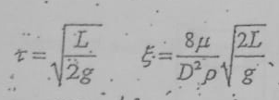
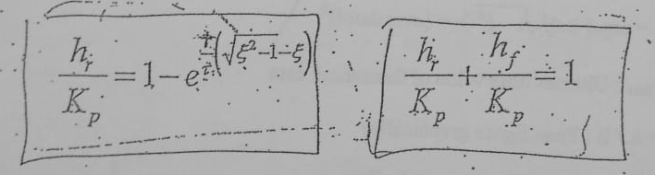

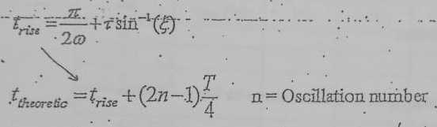
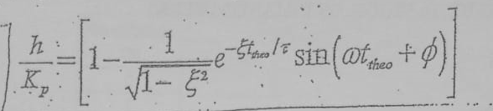
Calculations
Overdamped manometers:
Underdamped Manometers:

Slide 8
2. Process Control
This experiment is an illustrative example of a closed control system.
The purpose of the experiment is to introduce some of the basic principles involved in process control by using “Computer Controlled System”.
In the experiment;
Manuel Control, On-off Control, Proportional Control, Derivative Control, Integral Control and their combinations
are used to control temperature, liquid level and especially flow rate .

Slide 9
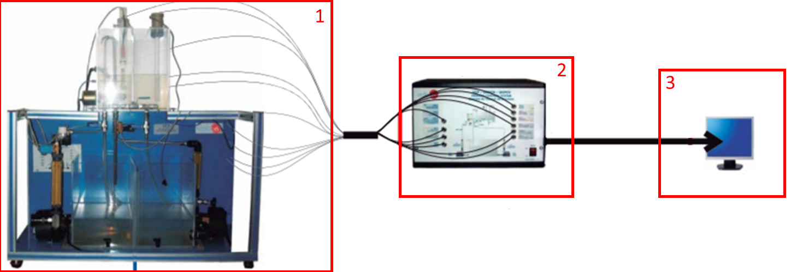
Experimental Setup
Experiment system,
Control box,
Computer.
For more detailed information about system;
https://www.edibon.com/en/files/equipment/UCPCV/catalog
https://www.youtube.com/watch?v=UBMPMaJM3Qo

Slide 10
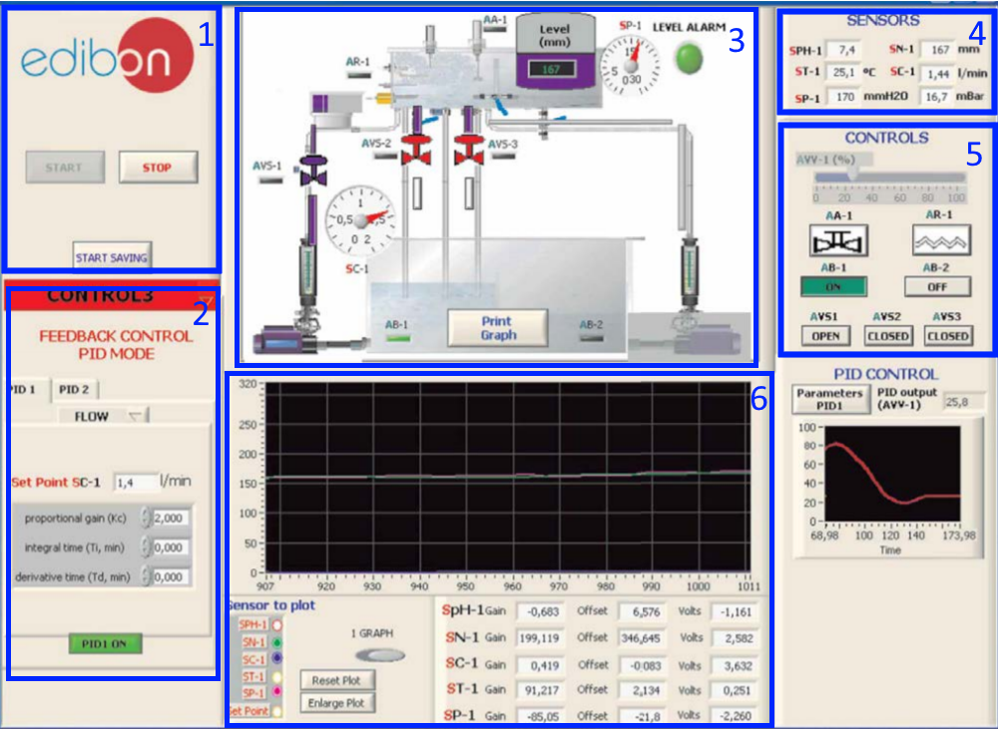
Computer Application Interface:
Main Controls
Control options
(Manuel, on-off, PID control)
Real time experiment setup illustration
Sensors
Controls
Real time graphics

Slide 11
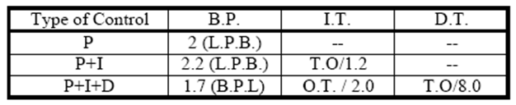
Calculations - Ziegler-Nichols Method
Close all controls except P control in the system.
Set the system to a low Kc value and operate and observe the system.
If the system did not oscillate, increase the Kc value.
Repeat steps 2 and 3 until the system oscillates.
Record the Kc and the period at the first value that the system oscillates.
B.P (%)= 100/Kc
B.P (%) = 1.25*L.P.B.
I.T. (MIN/REP) = 0.6*O.T.
D.T. (MIN) = 0.19*O.T.s4

