Slide 1


On-demand (voltage-tunable) integrated entanglement device via nonlinear Fano resonances
Mehmet Emre Tasgin
Institute of Nuclear Sciences
Hacettepe University, Turkey
27 Agu 2025

Slide 2
Presentation is short.
Please pause me and kindly ask your questions

Slide 3



Slide 4
faculty positions
on Quantum Optics

Slide 5
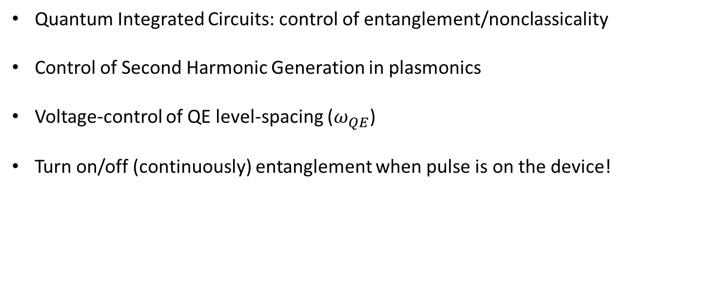
Outline
Quantum Integrated Circuits: control of entanglement/nonclassicality
Control of Second Harmonic Generation in plasmonics
Voltage-control of QE level-spacing ($ω_{QE}$)
Turn on/off (continuously) entanglement when pulse is on the device!

Slide 6
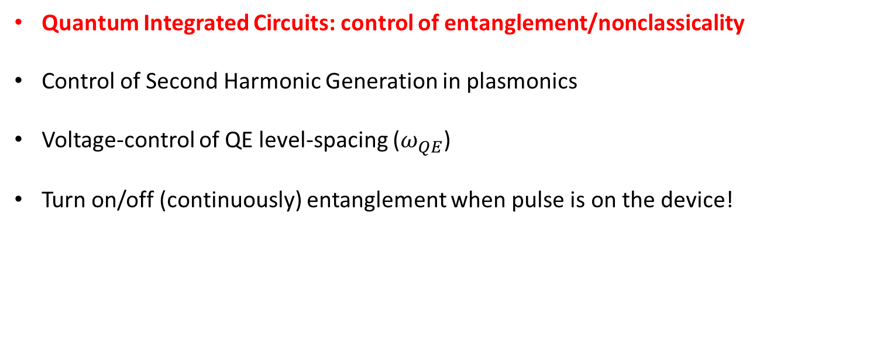
Outline
Quantum Integrated Circuits: control of entanglement/nonclassicality
Control of Second Harmonic Generation in plasmonics
Voltage-control of QE level-spacing ($ω_{QE}$)
Turn on/off (continuously) entanglement when pulse is on the device!

Slide 7
Quantum Integrated Circuit technology
[4] S. Rodt and S. Reitzenstein, Integrated nanophotonics for the development of fully functional quantum circuits based on on-demand single-photon emitters, APL Photonics 6, 010901 (2021). [Perpective]

Slide 8
What is needed?

Slide 9

Quantum Integrated Circuit technology (what’s needed?)
nonlinear medium
$$χ^{(2)}$$
(integrated laser)
Entanglement/
Nonclass.
Device
BS
Integ. BS
coherent
source

Slide 10
Quantum Integrated Circuit technology (what’s needed?)
nonlinear medium
$$χ^{(2)}$$
(integrated laser)
Entanglement/
Nonclass.
Device
BS
Integ. BS
coherent
source
squeezed light

Slide 11
Quantum Integrated Circuit technology (what’s needed?)
entangled
nonlinear medium
$$χ^{(2)}$$
(integrated laser)
Entanglement/
Nonclass.
Device
BS
Integ. BS
coherent
source
squeezed light

Slide 12
Quantum Integrated Circuit technology (what’s needed?)
entangled (but always!)
nonlinear medium
$$χ^{(2)}$$
(integrated laser)
Entanglement/
Nonclass.
Device
BS
Integ. BS
coherent
source
squeezed light

Slide 13
Quantum Integrated Circuit technology (what’s needed?)
entangled (but always!)
nonlinear medium
$$χ^{(2)}$$
Sometimes
want not to entangle
(integrated laser)
Entanglement/
Nonclass.
Device
BS
Integ. BS
coherent
source
squeezed light

Slide 14
Quantum Integrated Circuit technology (what’s needed?)
entangled (but always!)
nonlinear medium
$$χ^{(2)}$$
Sometimes
want not to entangle
(integrated laser)
Entanglement/
Nonclass.
Device
BS
Integ. BS
coherent
source
squeezed light
Question: Can we turn on/off (continuously) the nonclassicality?

Slide 15
Quantum Integrated Circuit technology (what’s needed?)
entangled (but always!)
nonlinear medium
$$χ^{(2)}$$
Sometimes
want not to entangle
(integrated laser)
Entanglement/
Nonclass.
Device
BS
Integ. BS
coherent
source
squeezed light
Question: Can we turn on/off (continuously) the nonclassicality?
when pulse is on the entanglement device?

Slide 16
Quantum Integrated Circuit technology (what’s needed?)
entangled (but always!)
nonlinear medium
$$χ^{(2)}$$
Sometimes
want not to entangle
(integrated laser)
Entanglement/
Nonclass.
Device
BS
Integ. BS
coherent
source
V
squeezed light
Question: Can we turn on/off (continuously) the nonclassicality?
when pulse is on the entanglement device?
Can we do that with nm-thick wires?

Slide 17
Quantum Integrated Circuit technology (what’s needed?)
entangled (but always!)
nonlinear medium
$$χ^{(2)}$$
Sometimes
want not to entangle
(integrated laser)
Entanglement/
Nonclass.
Device
BS
Integ. BS
coherent
source
V
squeezed light
Question: Can we turn on/off (continuously) the nonclassicality?
when pulse is on the entanglement device?
Can we do that with nm-thick wires?
Can we tune the entanglement/squeezing degree?

Slide 18
Quantum Integrated Circuit technology (what’s needed?)
entangled (but always!)
nonlinear medium
$$χ^{(2)}$$
Sometimes
want not to entangle
(integrated laser)
Entanglement/
Nonclass.
Device
BS
Integ. BS
coherent
source
V
squeezed light
YES, we can!
Question: Can we turn on/off (continuously) the nonclassicality?
when pulse is on the entanglement device?
Can we do that with nm-thick wires?
Can we tune the entanglement/squeezing degree?
[7] M. Günay, P. Das, E. Yüce, E. O. Polat, A. Bek and M. E. Tasgin, On-demand continuous-variable quantum entanglement source for integrated circuits, Nanophotonics 12, 229-237 (2023).

Slide 19
Current status?

Slide 20
Quantum Integrated Circuit technology (current state?)

Slide 21
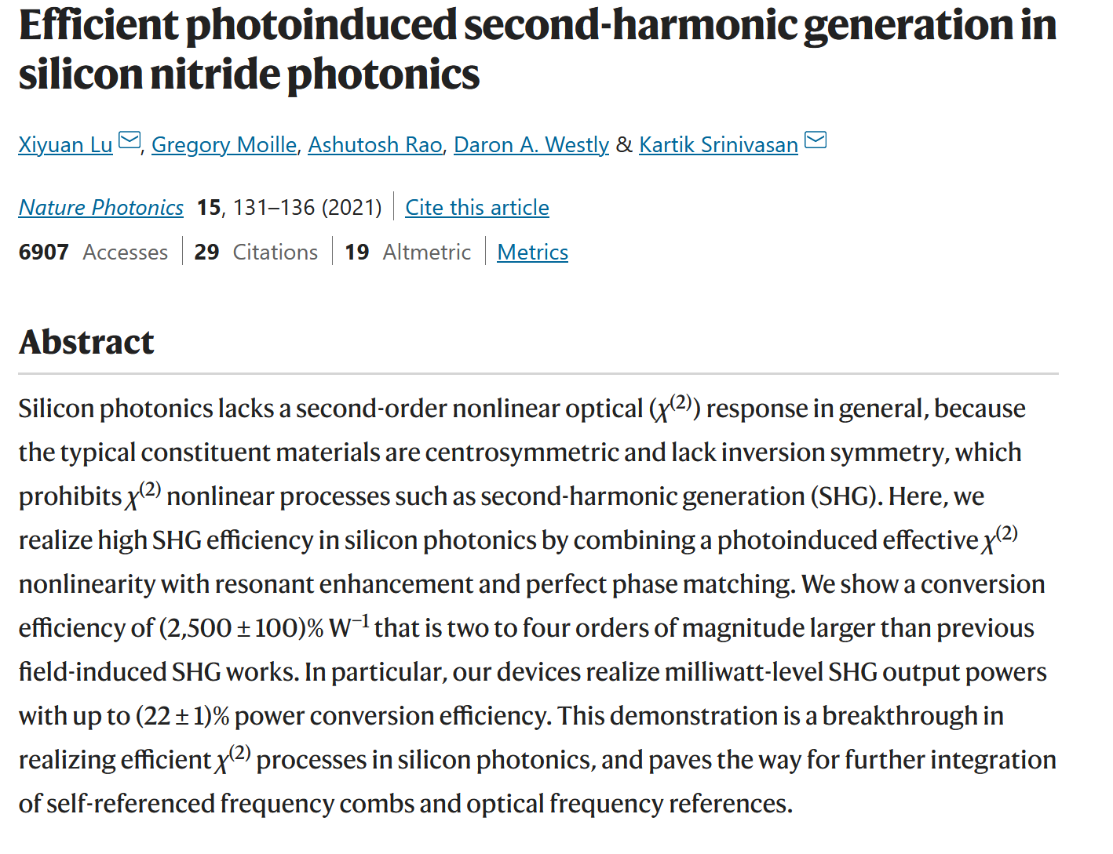
Quantum Integrated Circuit technology (current state?)

Slide 22
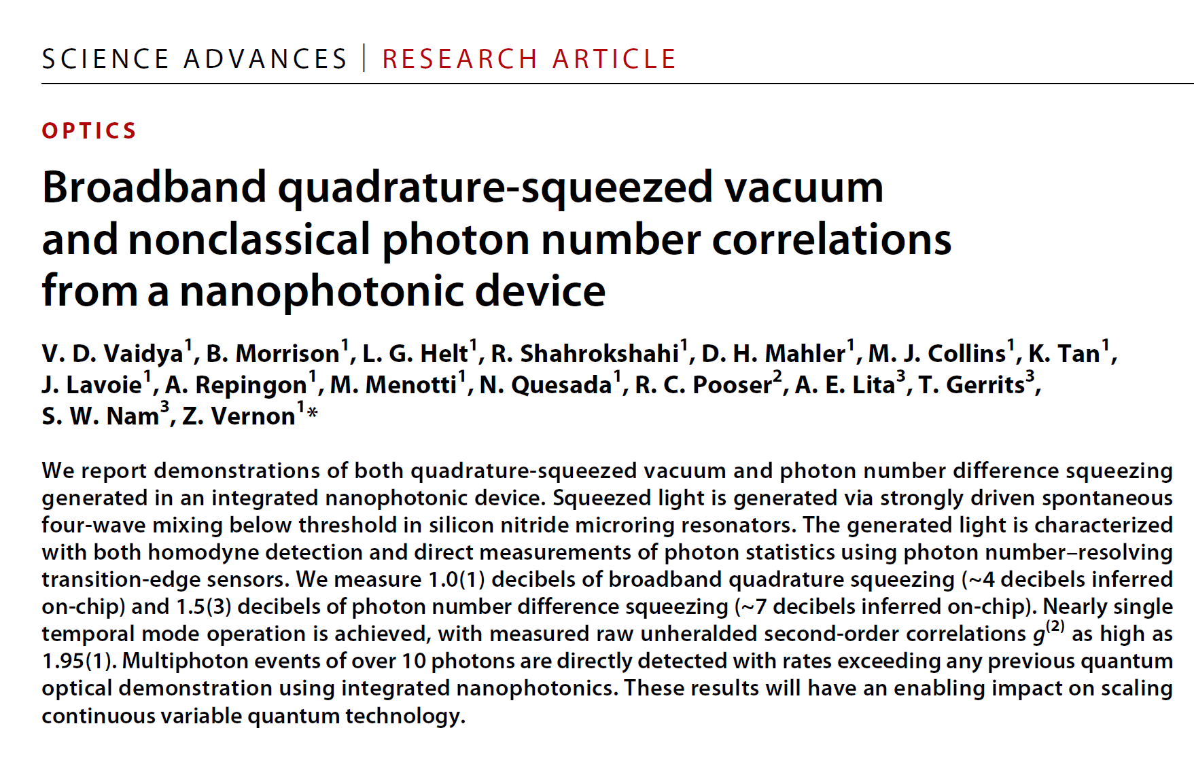
Quantum Integrated Circuit technology (current state?)

Slide 23
Quantum Integrated Circuit technology (current state?)
Generation of nonclassicality
In
Photonic circuits

Slide 24

Quantum Integrated Circuit technology (current state?)
Generation of nonclassicality
In
Photonic circuits

Slide 25
Quantum Integrated Circuit technology (current state?)
Generation of nonclassicality
In
Photonic circuits
Control of Generation of nonclassicality
In
Photonic circuits ?

Slide 26
Quantum Integrated Circuit technology (current state?)
?
Generation of nonclassicality
In
Photonic circuits
Control of Generation of nonclassicality
In
Photonic circuits ?
?
?

Slide 27
What we did:
Electrically-controlled integrated quadrature-squeezer

Slide 28
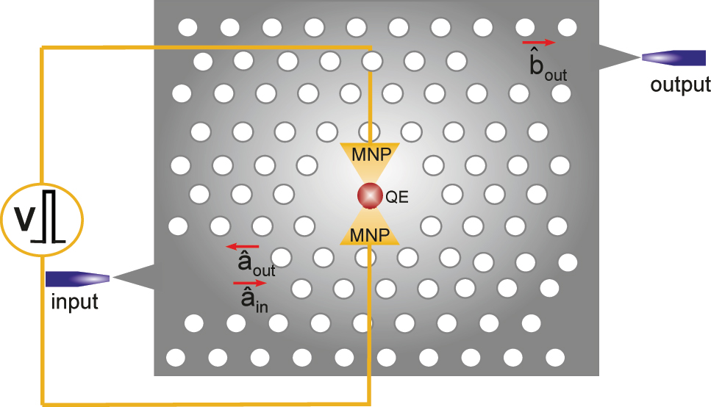
Electrically-controlled integrated quadrature-squeezer
Mehmet Günay, Priyam Das, Emre Yüce, Emre Ozan Polat, Alpan Bek and Mehmet Emre Tasgin, On-demand continuous-variable quantum entanglement source for integrated circuits, Nanophotonics 12, 229-237 (2023).

Slide 29
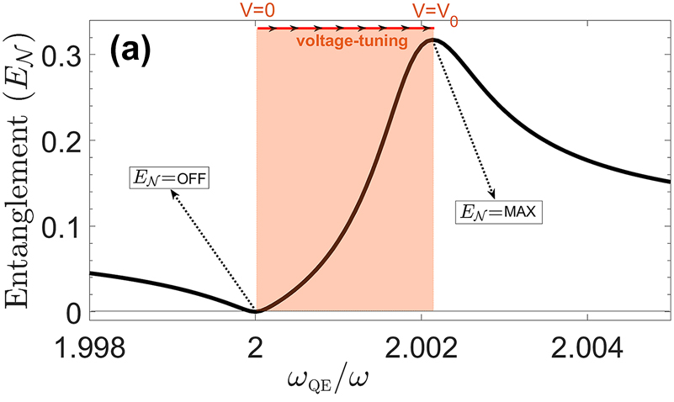
Electrically-controlled integrated quadrature-squeezer
Mehmet Günay, Priyam Das, Emre Yüce, Emre Ozan Polat, Alpan Bek and Mehmet Emre Tasgin, On-demand continuous-variable quantum entanglement source for integrated circuits, Nanophotonics 12, 229-237 (2023).

Slide 30
Electrically-controlled integrated quadrature-squeezer
Picosecond!
Mehmet Günay, Priyam Das, Emre Yüce, Emre Ozan Polat, Alpan Bek and Mehmet Emre Tasgin, On-demand continuous-variable quantum entanglement source for integrated circuits, Nanophotonics 12, 229-237 (2023).

Slide 31
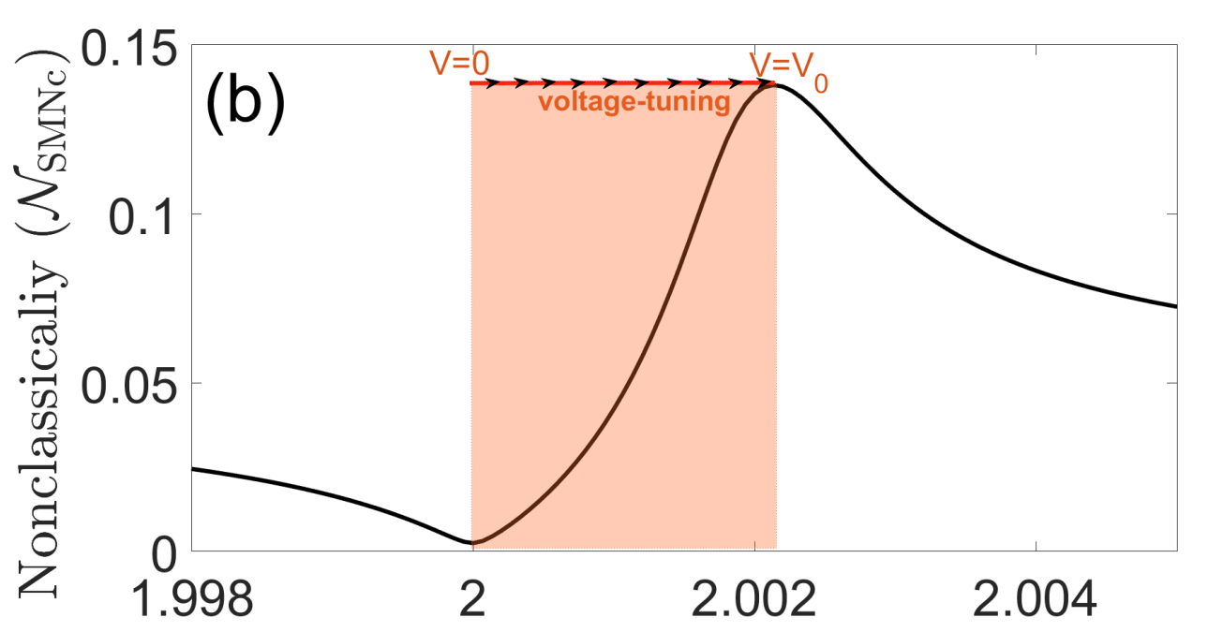
No need for
BS tuning
picosecond
tuning
[7] M. Günay, P. Das, E. Yüce, E. O. Polat, A. Bek and M. E. Tasgin, On-demand continuous-variable quantum entanglement source for integrated circuits, Nanophotonics 12, 229-237 (2023).

Slide 32
Mehmet Günay, Priyam Das, Emre Yüce, Emre Ozan Polat, Alpan Bek and Mehmet Emre Tasgin, On-demand continuous-variable quantum entanglement source for integrated circuits, Nanophotonics 12, 229-237 (2023).

Slide 33
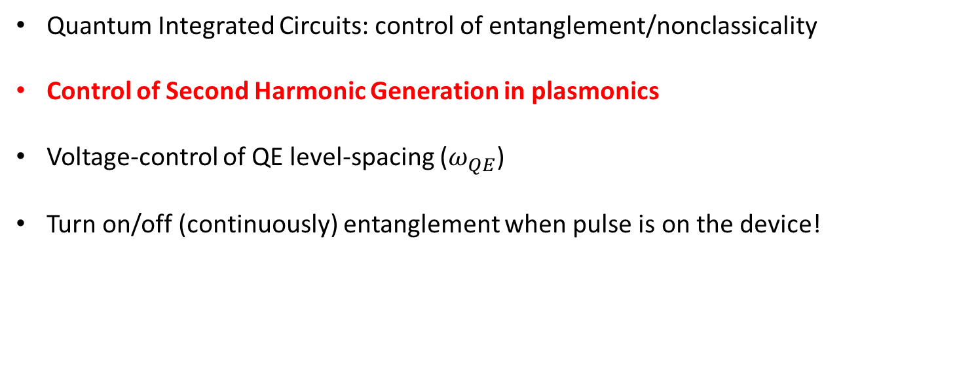
Outline
Quantum Integrated Circuits: control of entanglement/nonclassicality
Control of Second Harmonic Generation in plasmonics
Voltage-control of QE level-spacing ($ω_{QE}$)
Turn on/off (continuously) entanglement when pulse is on the device!

Slide 34
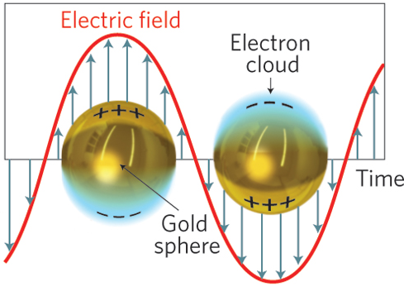



Plasmonics (nano-optics) ?
E(t)=E₀ e^{-iωt}
$I_{0}=$|E₀|²
Hot spot
$I$= 10⁵ ×|E₀|²
M. L. Juan, M. Righini, and R. Quidant, Nature Photonics 5, 349 (2011).

Slide 35
Plasmonics (nano-optics) ?
Hot spot
Very strong
Light-molecule
interaction
quantum optics
features
quantum
plasmonics
molecule
$I$= 10⁵ ×|E₀|²

Slide 36
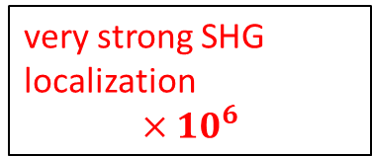
Nonlinearity is also enhanced
ω
MNP
MNP
very strong SHG
localization
$$×{10}^{6}$$
2ω
[1] M. Celebrano,....., B. Hecht, Nature Nanotechnology 10, 412 (2015).

Slide 37
Controlling Second Harmonic Generation
via Fano resonances
(analog of nonlinear index enh.)

Slide 38
Enhancement/suppression of Second Harmonic Generation
ω
MNP
MNP
Quantum
Emitter
QD, Color-center
at the hot-spot
?
?
2ω
We can control this nonlinearity via Quantum Emitter!
[4] D. Turkpence, Gursoy B. Akguc, Alpan Bek, M. E. Tasgin, J. Opt. 16, 105009 (2014).
[5] Chapter 1, in Fano resonances in optics and microwaves: Physics and application (2018), Springer Publishing

Slide 39
Enhancement/suppression of Second Harmonic Generation
ω
MNP
MNP
Quantum
Emitter
QD, Color-center
at the hot-spot
?
?
2ω
MNP cross-section
modes of MNP
[4] D. Turkpence, Gursoy B. Akguc, Alpan Bek, M. E. Tasgin, J. Opt. 16, 105009 (2014).
[5] Chapter 1, in Fano resonances in optics and microwaves: Physics and application (2018), Springer Publishing

Slide 40
Enhancement/suppression of Second Harmonic Generation
ω
MNP
MNP
Quantum
Emitter
QD, Color-center
at the hot-spot
?
?
2ω
MNP cross-section
modes of MNP
ω_{QE}
ω_{QE} ~ 2ω~ω₂
[4] D. Turkpence, Gursoy B. Akguc, Alpan Bek, M. E. Tasgin, J. Opt. 16, 105009 (2014).
[5] Chapter 1, in Fano resonances in optics and microwaves: Physics and application (2018), Springer Publishing

Slide 41
Enhancement/suppression of Second Harmonic Generation
ω
MNP
MNP
Quantum
Emitter
QD, Color-center
at the hot-spot
?
?
2ω
MNP cross-section
modes of MNP
ω_{QE}
Linear response not modified
ω_{QE} ~ 2ω~ω₂
[4] D. Turkpence, Gursoy B. Akguc, Alpan Bek, M. E. Tasgin, J. Opt. 16, 105009 (2014).
[5] Chapter 1, in Fano resonances in optics and microwaves: Physics and application (2018), Springer Publishing

Slide 42
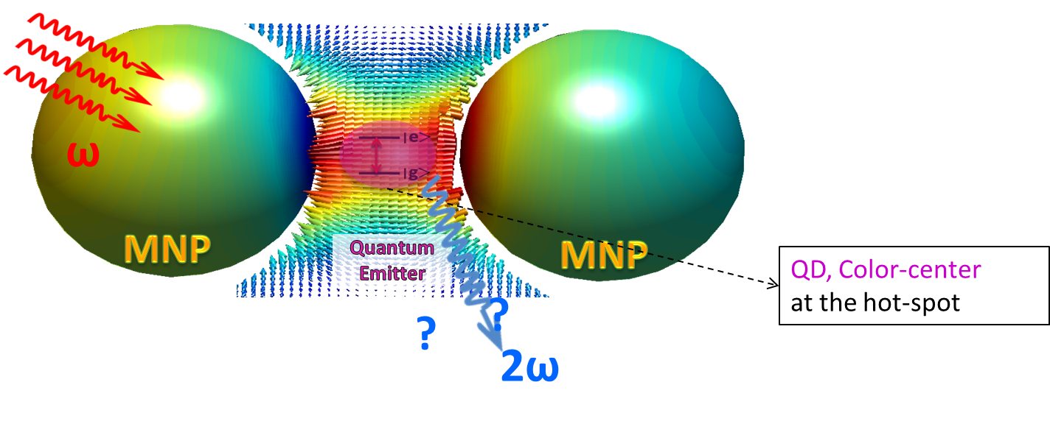
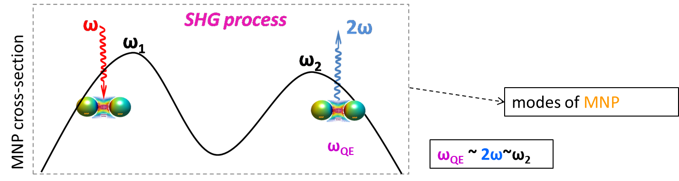


Enhancement/suppression of Second Harmonic Generation
Enhancement $30×{10}^{6}$
Suppression ${10}^{−4}×{10}^{6}$
ω_{QE}
ω_{QE}

Slide 43



FDTD simulation
Suppression ${10}^{−4}×{10}^{6}$
$$ω_{QE}$$
[4] D. Turkpence, Gursoy B. Akguc, Alpan Bek, M. E. Tasgin, J. Opt. 16, 105009 (2014).
[5] M. Günay, Z. Artvin, Alpan Bek & M. E. Tasgin, J. Mod. Opt. 66, 1-9 (2018)
$$ω_{QE}$$
Mehmet Günay, Priyam Das, Emre Yüce, Emre Ozan Polat, Alpan Bek and Mehmet Emre Tasgin, On-demand continuous-variable quantum entanglement source for integrated circuits, Nanophotonics 12, 229-237 (2023).

Slide 44


Enhancement/suppression of Second Harmonic Generation (Maxwell solutions!)
Enhancement $30×{10}^{6}$
Suppression ${10}^{−4}×{10}^{6}$
[4] D. Turkpence, Gursoy B. Akguc, Alpan Bek, M. E. Tasgin, J. Opt. 16, 105009 (2014).
[5] M. Günay, Z. Artvin, Alpan Bek & M. E. Tasgin, J. Mod. Opt. 66, 1-9 (2018)

Slide 45
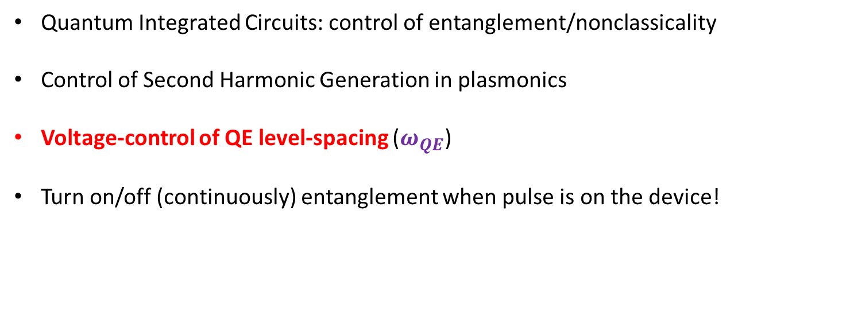
Outline
Quantum Integrated Circuits: control of entanglement/nonclassicality
Control of Second Harmonic Generation in plasmonics
Voltage-control of QE level-spacing ($ω_{QE}$)
Turn on/off (continuously) entanglement when pulse is on the device!

Slide 46
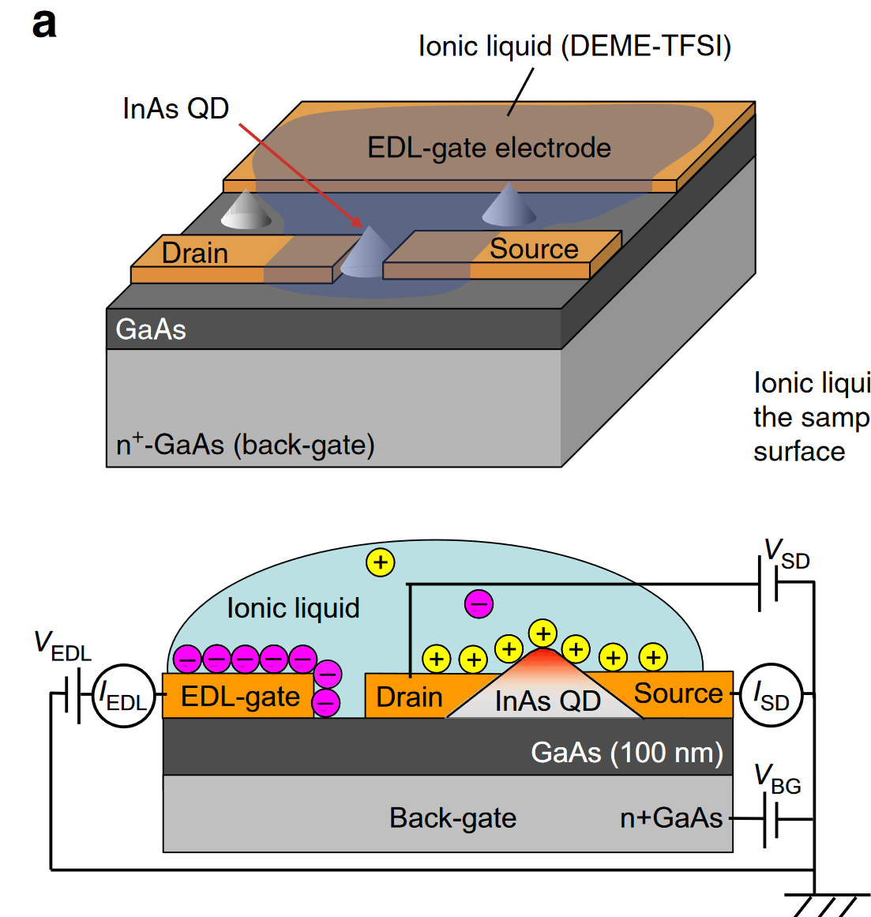
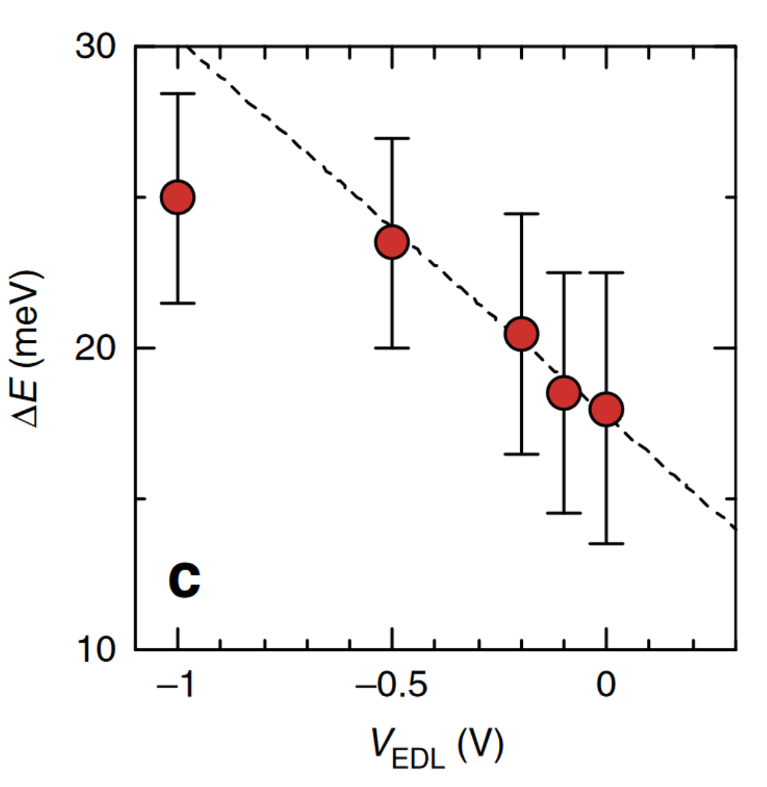
Tuning $ω_{QE}$ by voltage
[6] K. Shibata, H. Yuan, Y. Iwasa, and K. Hirakawa, Large modulation of zero-dimensional electronic states in quantum dots by electric-double-layer gating, Nature Communications 4, 1 (2013).

Slide 47
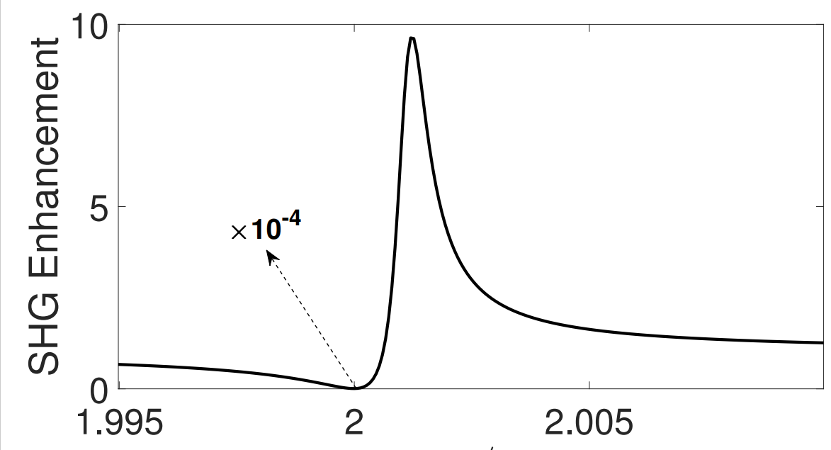
Tuning $ω_{QE}$ by voltage
ω_{QE}
Voltage
[6] K. Shibata, H. Yuan, Y. Iwasa, and K. Hirakawa, Large modulation of zero-dimensional electronic states in quantum dots by electric-double-layer gating, Nature Communications 4, 1 (2013).

Slide 48
Tuning $ω_{QE}$ by voltage
ω_{QE}
Voltage
Question: can we use in Integrated Photonic Circuits?
[6] K. Shibata, H. Yuan, Y. Iwasa, and K. Hirakawa, Large modulation of zero-dimensional electronic states in quantum dots by electric-double-layer gating, Nature Communications 4, 1 (2013).

Slide 49
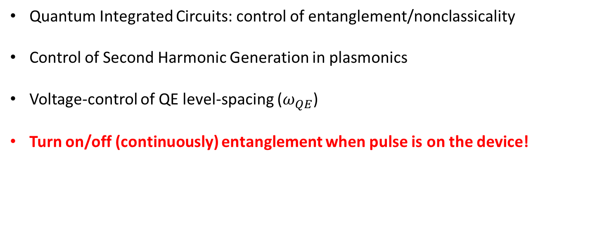
Outline
Quantum Integrated Circuits: control of entanglement/nonclassicality
Control of Second Harmonic Generation in plasmonics
Voltage-control of QE level-spacing ($ω_{QE}$)
Turn on/off (continuously) entanglement when pulse is on the device!

Slide 50

Voltage-tunable, integrable entanglement device
Enh. Fac. $×{10}^{6}$
ω_{QE}
Voltage
[7] M. Günay, P. Das, E. Yüce, E. O. Polat, A. Bek and M. E. Tasgin, On-demand continuous-variable quantum entanglement source for integrated circuits, Nanophotonics 12, 229-237 (2023).

Slide 51
Quantum Integrated Circuit technology (what’s needed?)
entangled (but always!)
nonlinear medium
$$χ^{(2)}$$
Sometimes
want not to entangle
(integrated laser)
Entanglement/
Nonclass.
Device
BS
Integ. BS
coherent
source
V
squeezed light

Slide 52
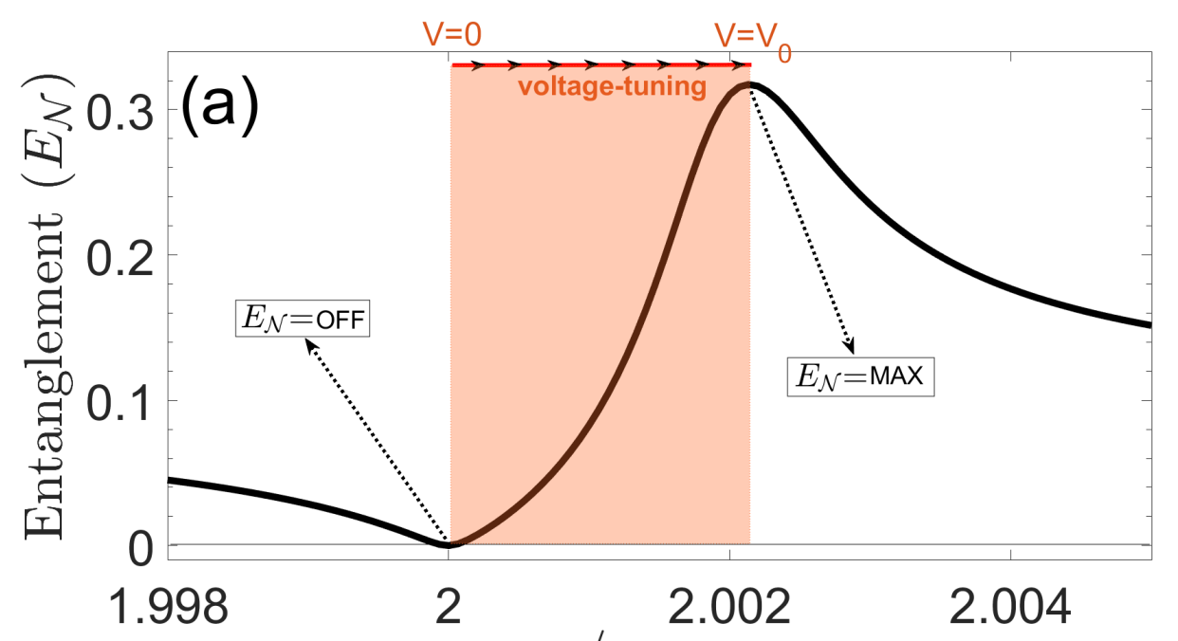

Voltage-tunable, integrable entanglement device
${\hat{a}}_{out}$ & ${\hat{b}}_{out}$ entanlement
ω_{QE}
Voltage
[7] M. Günay, P. Das, E. Yüce, E. O. Polat, A. Bek and M. E. Tasgin, On-demand continuous-variable quantum entanglement source for integrated circuits, Nanophotonics 12, 229-237 (2023).

Slide 53

Voltage-tunable, integrable entanglement device
${\hat{b}}_{out}$ nonclassicality (sqz.)
[7] M. Günay, P. Das, E. Yüce, E. O. Polat, A. Bek and M. E. Tasgin, On-demand continuous-variable quantum entanglement source for integrated circuits, Nanophotonics 12, 229-237 (2023).

Slide 54
Quantum Integrated Circuit technology (what’s needed?)
entangled (but always!)
nonlinear medium
$$χ^{(2)}$$
Sometimes
want not to entangle
(integrated laser)
Entanglement/
Nonclass.
Device
BS
Integ. BS
coherent
source
V
squeezed light
Question: Can we turn on/off (continuously) the nonclassicality?
when pulse is on the entanglement device?
Can we do that with nm-thick wires?
Can we tune the entanglement/squeezing degree?

Slide 55

Voltage-tunable, integrable entanglement device
${\hat{b}}_{out}$ nonclassicality (sqz.)
Linear response not modified!
[7] M. Günay, P. Das, E. Yüce, E. O. Polat, A. Bek and M. E. Tasgin, On-demand continuous-variable quantum entanglement source for integrated circuits, Nanophotonics 12, 229-237 (2023).

Slide 56
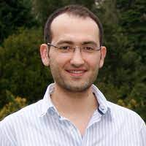


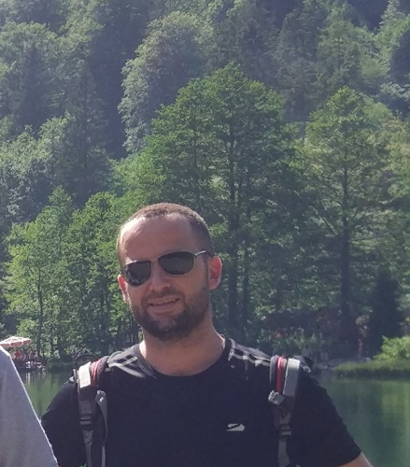

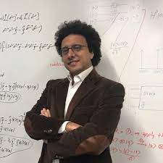
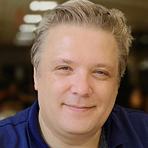
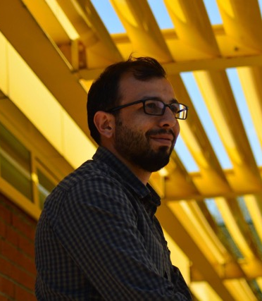
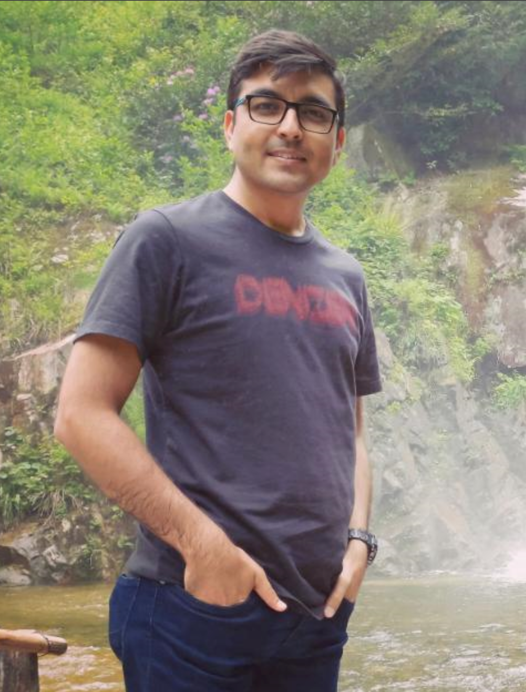
My Friends, doing great research …
Emre Yüce
Mehmet Günay
Priyam Das
Emre Ozan Polat
Alpan Bek
Deniz Türkpençe
Gürsoy Akgüç
Zafer Artvin
Shakir Ullah

Slide 57
THANK YOU
Special thanks to Zhenghong Li

Slide 58
Some other recent technologies for Quantum Int. Circ.

Slide 59
2) Electrically-controlled excitation lifetime
Emre Ozan Polat, Zafer Artvin, Yusuf Şaki, Alpan Bek, Ramazan Sahin, Continuous and Reversible Electrical Tuning of Fluorescent Decay Rate via Fano Resonance, arXiv:2412.20199

Slide 60

2) Electrically-controlled excitation lifetime
$$ω_{QE}$$
Emre Ozan Polat, Zafer Artvin, Yusuf Şaki, Alpan Bek, Ramazan Sahin, Continuous and Reversible Electrical Tuning of Fluorescent Decay Rate via Fano Resonance, arXiv:2412.20199

Slide 61
2) Electrically-controlled excitation lifetime
Emre Ozan Polat, Zafer Artvin, Yusuf Şaki, Alpan Bek, Ramazan Sahin, Continuous and Reversible Electrical Tuning of Fluorescent Decay Rate via Fano Resonance, arXiv:2412.20199

Slide 62
2) Electrically-controlled excitation lifetime
Emre Ozan Polat, Zafer Artvin, Yusuf Şaki, Alpan Bek, Ramazan Sahin, Continuous and Reversible Electrical Tuning of Fluorescent Decay Rate via Fano Resonance, arXiv:2412.20199

Slide 63
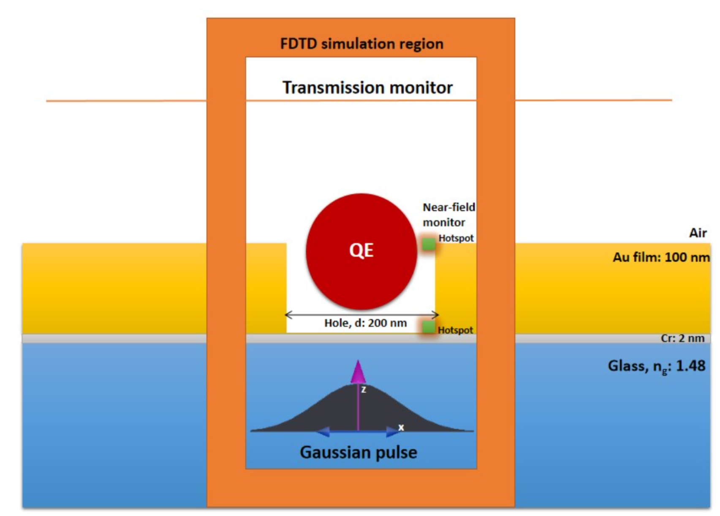
3) Voltage-controlled EOT device
Hira Asif, Alpan Bek, Mehmet Emre Tasgin and Ramazan Sahin, Voltage-tunable quantum control of extraordinary optical transmission in the visible regime, accepted Phys. Rev. B (2024).

Slide 64
4) single-molecule-resolution litography
Rasim Volga Ovali & Mehmet Emre Tasgin, Single-molecule resolution lithography via Fano resonance

Slide 65
5) Voltage tunable plasmo-mechanics:
Rasim Volga Ovali, Mehmet Emre Tasgin, Voltage-tunable, femtometer-precision plasmo-mechanical displacement at fixed gap size, arXiv:2505.04495

Slide 66
5) Voltage tunable plasmo-mechanics:
Rasim Volga Ovali, Mehmet Emre Tasgin, Voltage-tunable, femtometer-precision plasmo-mechanical displacement at fixed gap size, arXiv:2505.04495

Slide 67
6) Measurable entanglement criterion for (optical) lattices
Measure via Raman Sca.
Mott-Charge Dens. Wave
phase transition
Mott-Superfluid
phase transition
Mehmet Emre Tasgin and Hyunchul Nha, Measurable entanglement criterion for extended Bose-Hubbard model, arXiv:2402.05477

Slide 68
Thanks for listening.

