Slide 1

1) Compact entanglement devices for photonic quantum computing
2) Precision-measurement for few-body quantum systems
Mehmet Emre Tasgin
Institute of Nuclear Sciences
Hacettepe University, Turkey
4 Nov. 2025
TUBİTAK NATIONAL METROLOGY INSTITUTE (UME)
Notes:
1

Slide 2
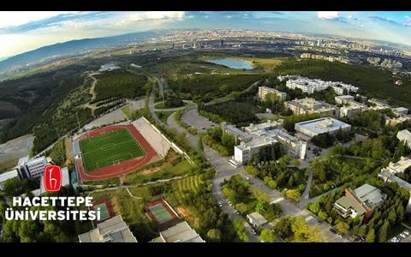


Slide 3
faculty positions
on Quantum Optics

Slide 4


Slide 5

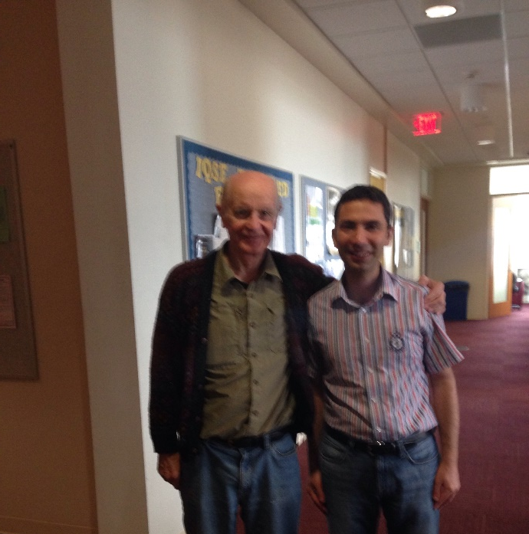
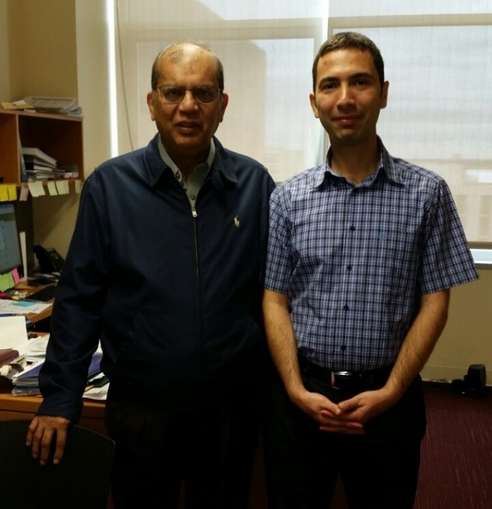
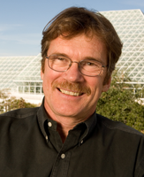
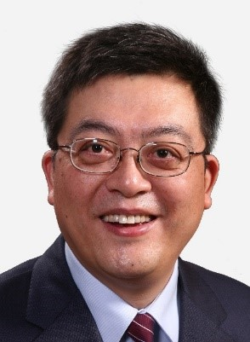
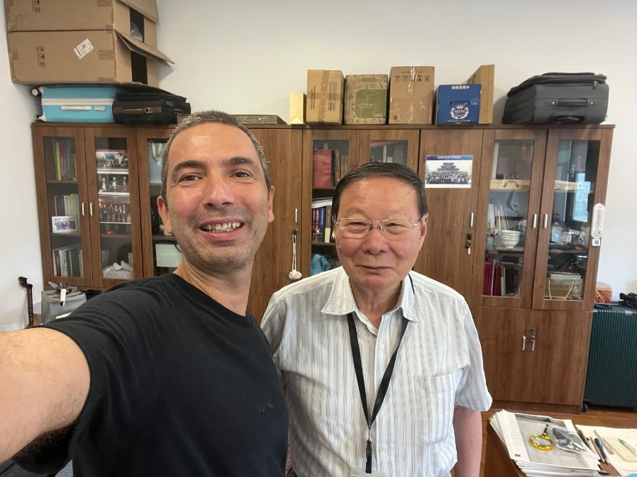
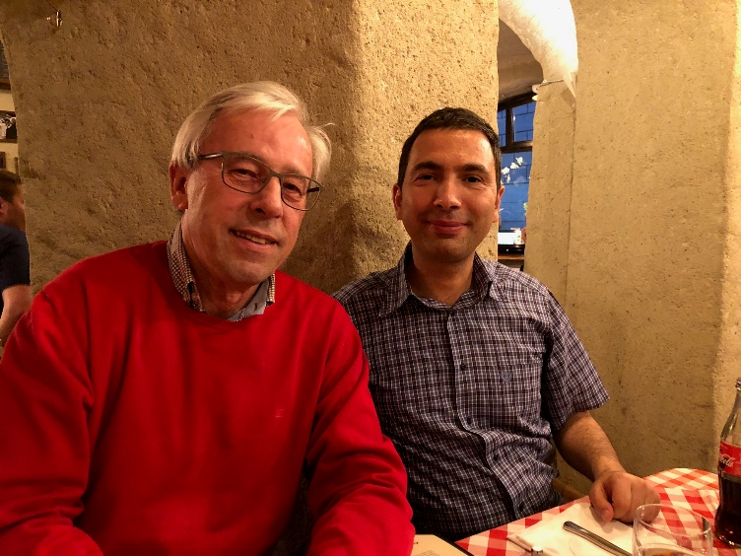
Brief CV of the Project Manager
BSc: Bilkent University, Physics Dep. 2003
PhD: Bilkent University, Physics Dep. 2009 with Mehmet Ozgur Oktel & Ozgur E. Mustecaplioglu
Postdoc: Koç Univ. 6 months with Ozgur E. Mustecaplioglu
Postdoc: The University Arizona 2010-2011 with Pierre Meystre (former lead-Editor of PRL, PRA-PRE)
Visit many times: Institute for Quantum Sciences and Engineering, Texas A&M Univ.
5 papers with M. Suhail Zubairy
3 papers with Li You
References from: Pierre Meystre, M. Suhail Zubairy, Marlan O. Scully
Peter Zoller
Suhail Zubairy
Pierre Meystre
Li You, Tsinghua Univ.
Shi-Yao Zhu
Marlan Scully
3

Slide 6
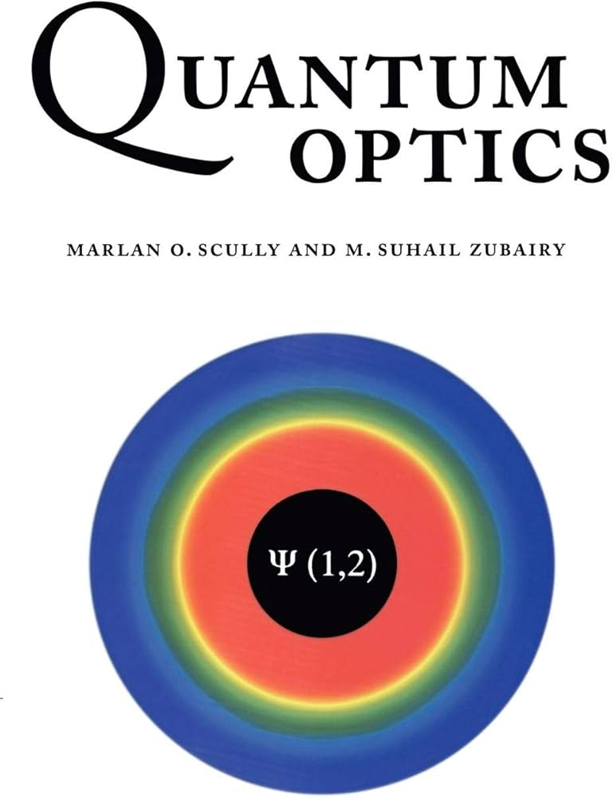
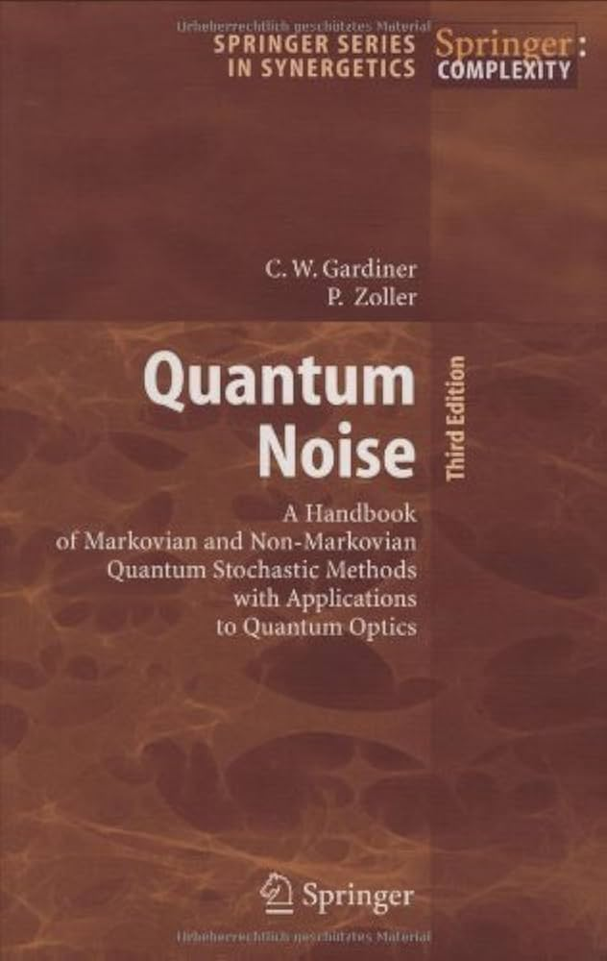
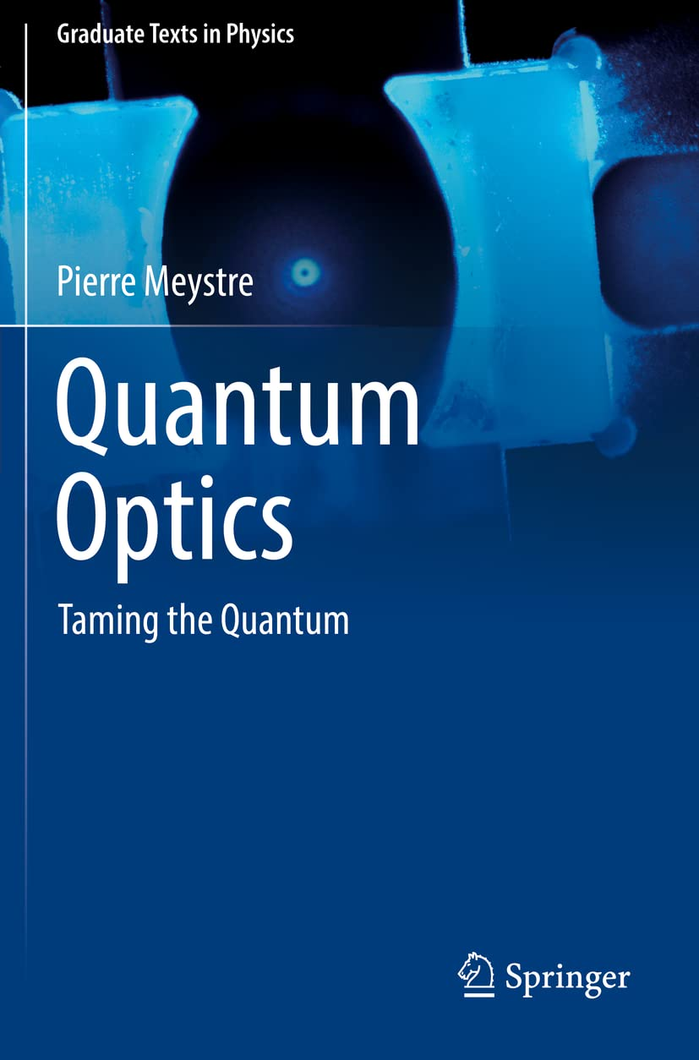

Brief CV of the Project Manager
BSc: Bilkent University, Physics Dep. 2003
PhD: Bilkent University, Physics Dep. 2009 with Mehmet Ozgur Oktel & Ozgur E. Mustecaplioglu
Postdoc: The University Arizona 2010-2011 with Pierre Meystre (former lead-Editor of PRL, PRA-PRE)
Visit many times: Institute for Quantum Sciences and Engineering, Texas A&M Univ.

Slide 7
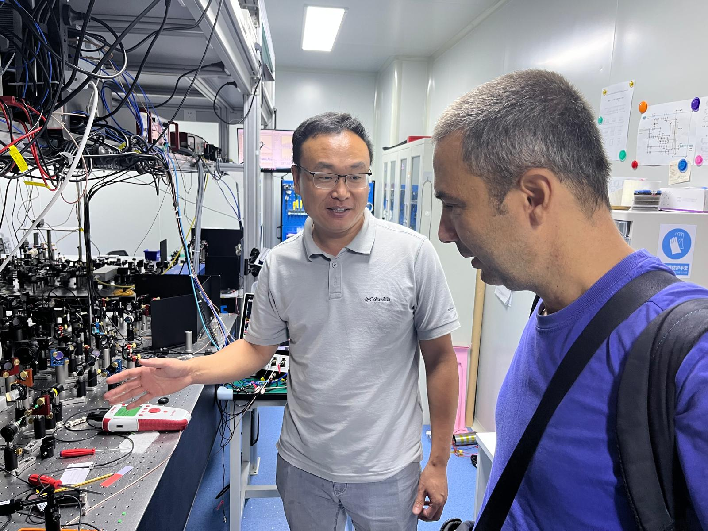
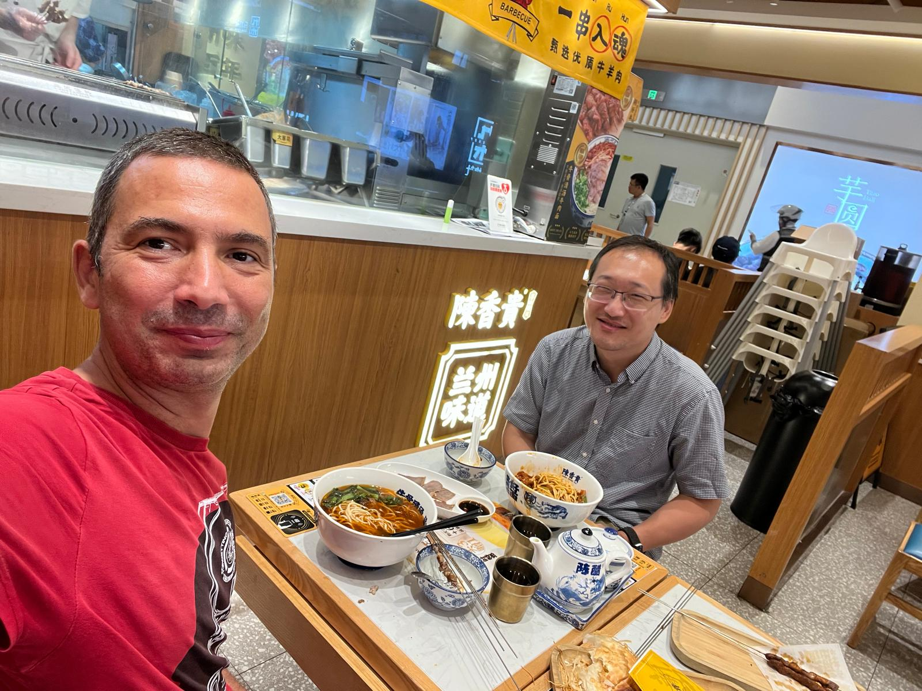
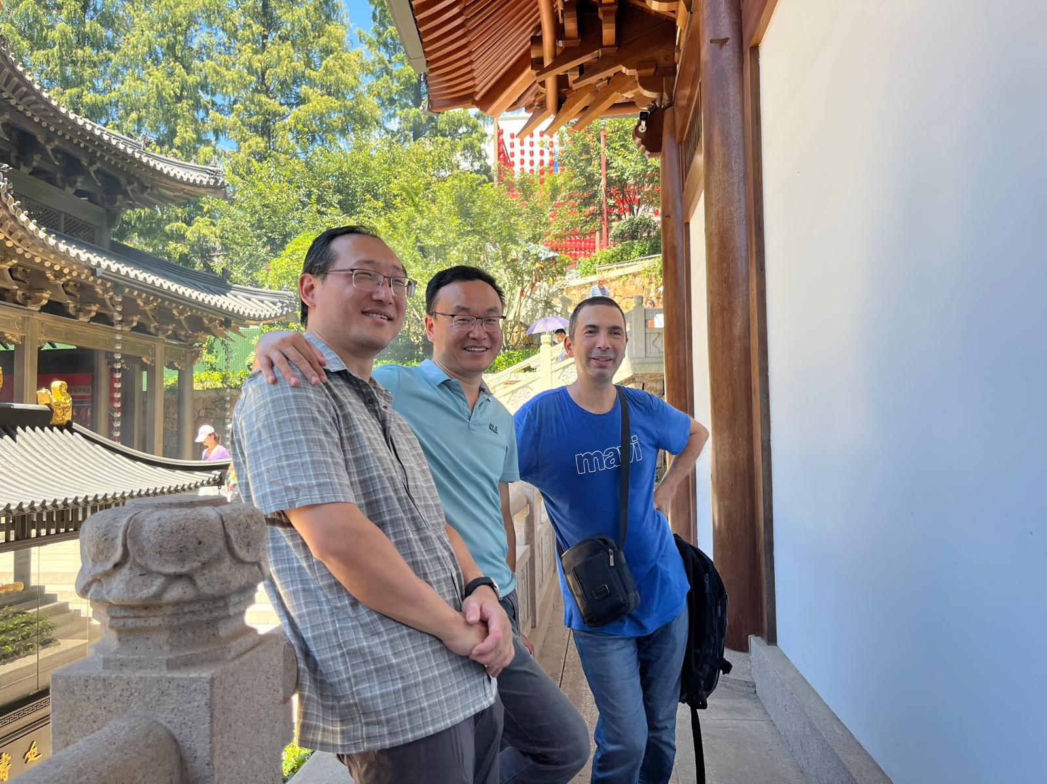
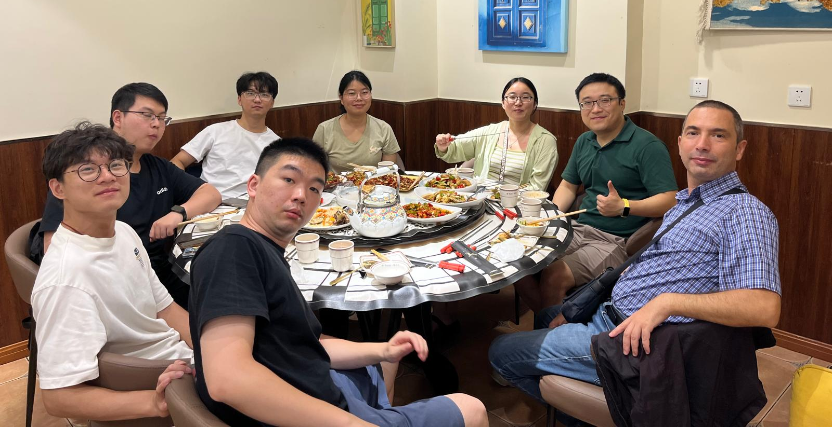
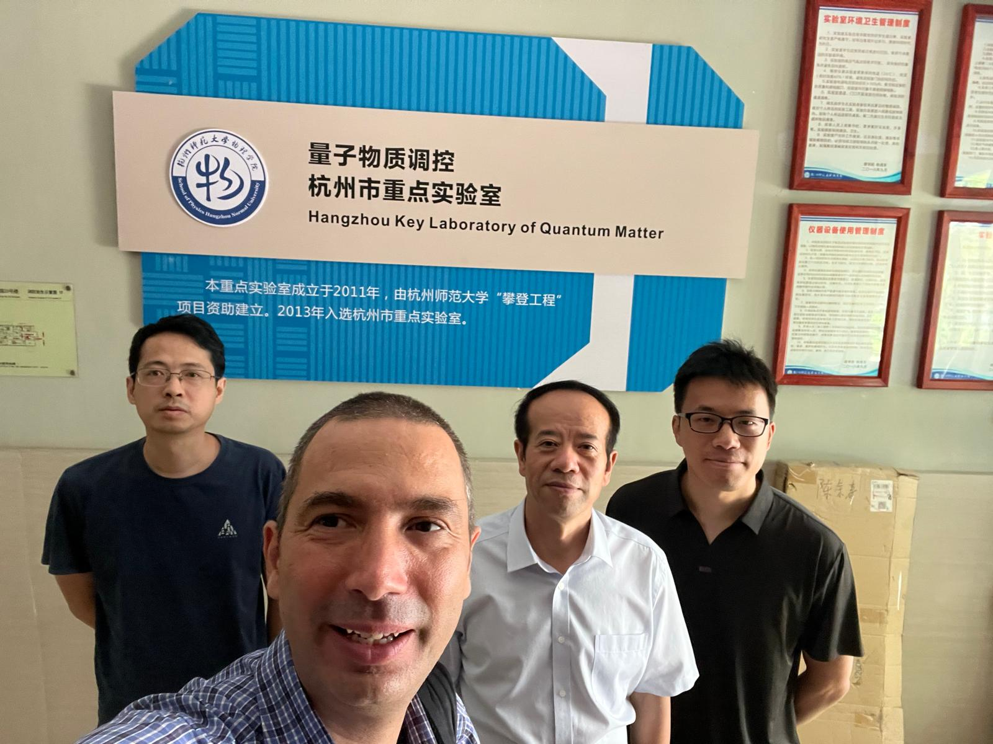
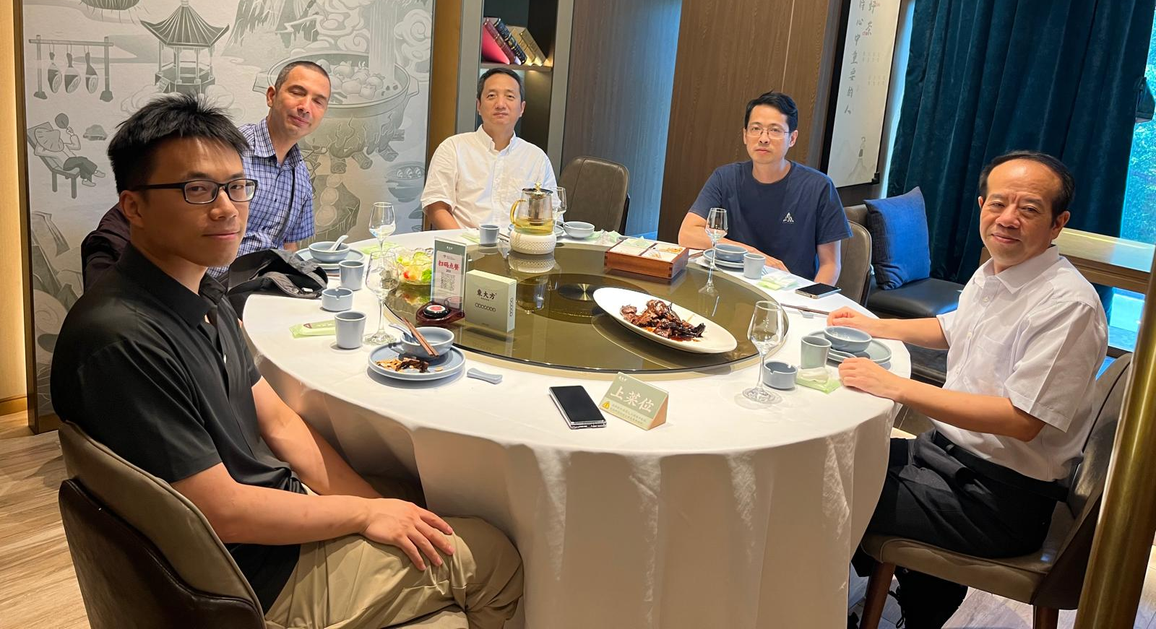
CHINA
Da-Wei Wang, Zhejiang Univ.
Youngest Lamb Award Winner
Zheng-Hong Li, Shanghai Univ.
Hangzhou, Normal Univ.
Hangzhou, Dianzi Univ.

Slide 8
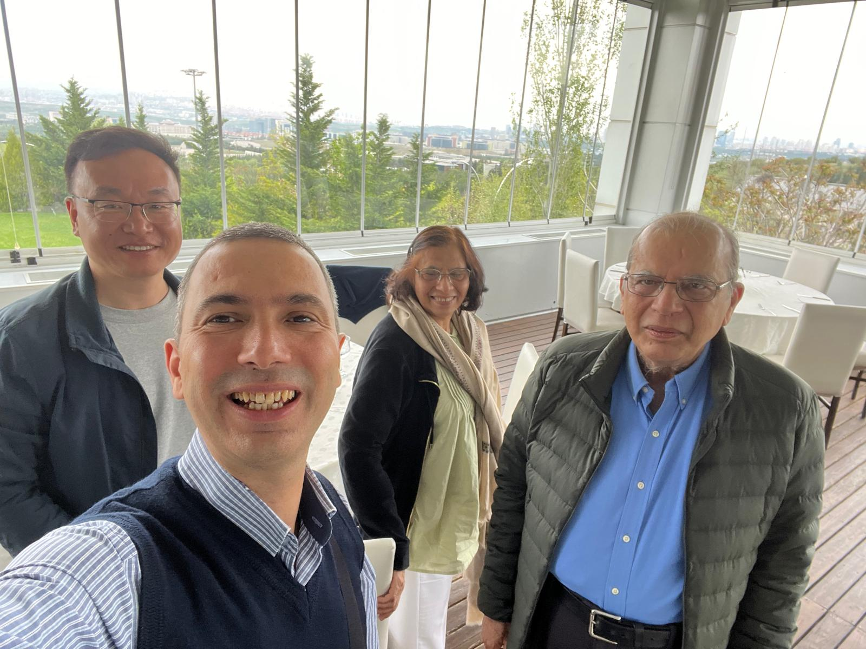
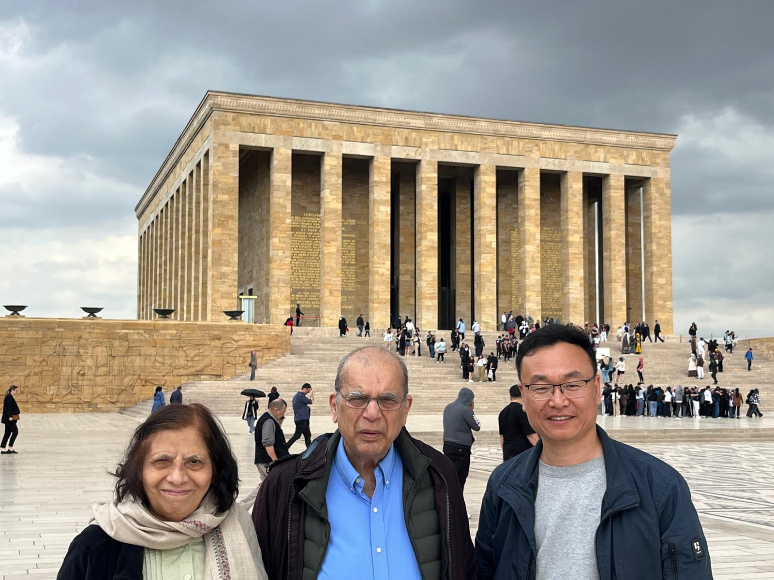
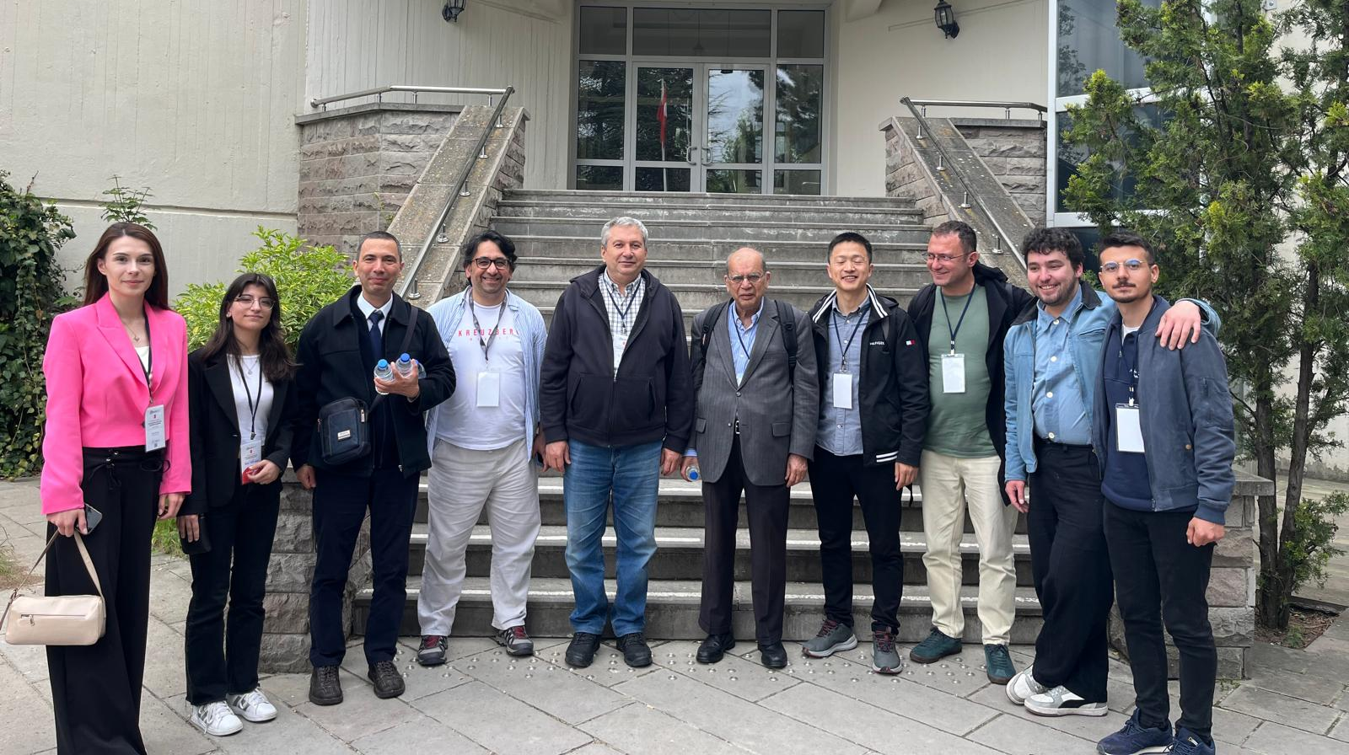
TURKEY
Da-Wei Wang, Zhejiang Univ.
Youngest Lamb Award Winner
Da-Wei Wang
Xiongfeng Ma Tsinghua University

Slide 9
Selected publications for last 5 years
1) Compact entanglement devices for photonic quantum computing
M.Günay, P. Das, E. Yüce, E. O. Polat, A. Bek and M. E. Tasgin, On-demand continuous-variable quantum entanglement source for integrated circuits, Nanophotonics 12, 229-237 (2023).
M. Günay, A. Cicek, N. Korozlu, A. Bek, M. E. Tasgin, Fano Control of Unlocalized Nonlinear Processes, Phys. Rev. B 104, 235407 (2021).
Shakir Ullah, M. E. Tasgin, R. V. Ovali, Mehmet Gunay, Electrically-programmable frequency comb for compact quantum photonic circuits,
Emre Yuce, Zafer Artvin, Ramazan Sahin, Alpan Bek, Mehmet Emre Tasgin, Ultra-large actively tunable photonic band gaps via plasmon-analog of index enhancement, Appl. Phys. Lett. 119, 211103 (2021).
H. Asif, A. Bek, M. E. Tasgin and R. Sahin, Voltage-control of extraordinary optical transmission in the visible regime, Phys. Rev. B 109, 125425 (2024).
R. V. Ovali and M.E. Tasgin, Voltage-tunable, Voltage-tunable, femtometer-precision cantilever displacement and squeezing in a plasmo-mechanical system, arXiv:2505.04495
M. E. Tasgin, A. Bek, S. Postacı, Fano resonances in the linear and nonlinear plasmonic response, Chapter 1 in, E. O. Kamenetskii, A. Sadreev, and A. Miroshnichenko (Editors), Fano resonances in optics and microwaves: Physics and application (2018), Springer Publishing

Slide 10
Selected publications for last 5 years
1) Compact entanglement devices for photonic quantum computing
3

Slide 11
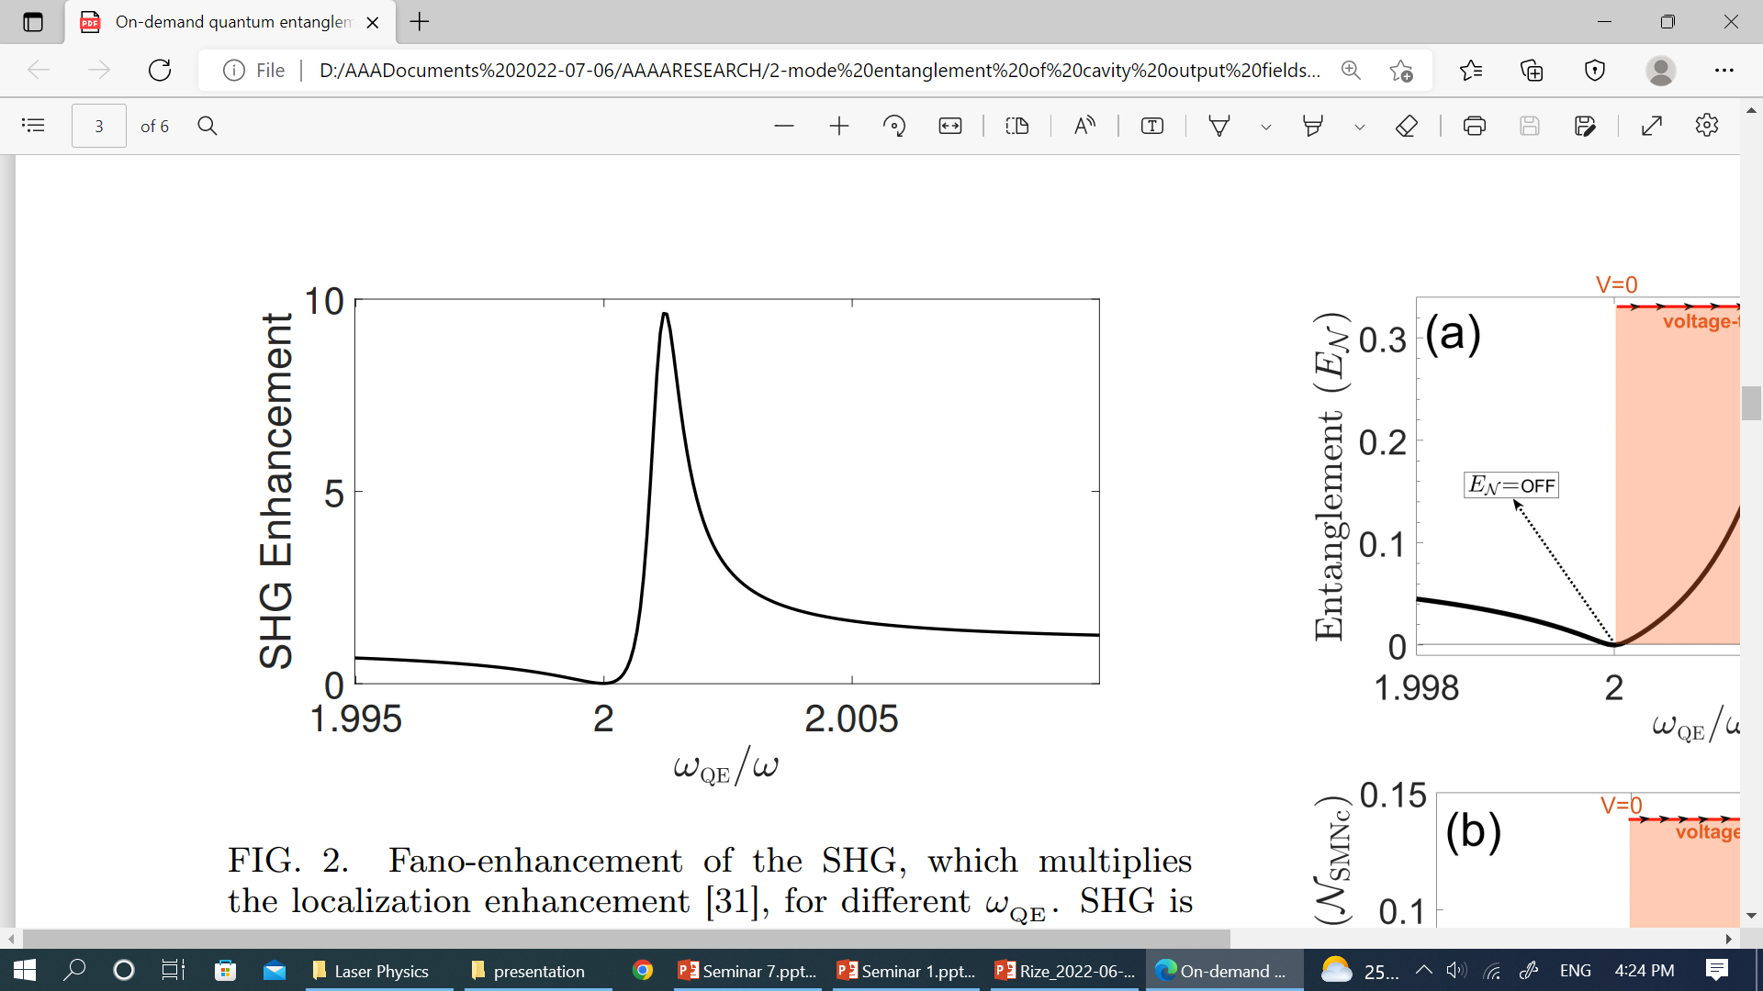

Selected publications for last 5 years
1) Compact entanglement devices for photonic quantum computing
$${10}^{−4}$$
ω_{QE}
Voltage
3

Slide 12
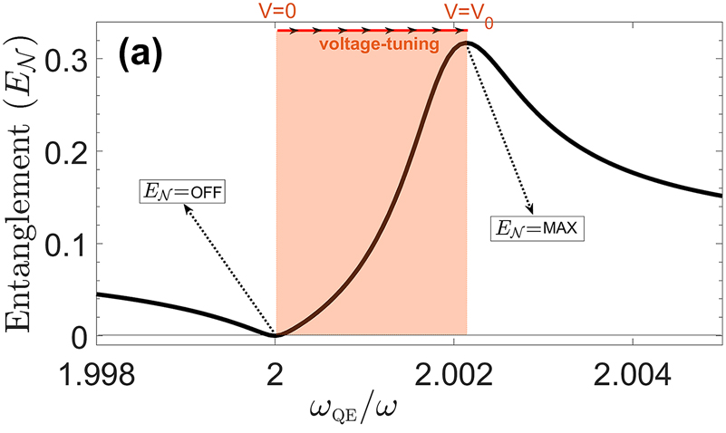
Selected publications for last 5 years
1) Compact entanglement devices for photonic quantum computing
Picosecond!
3

Slide 13
Selected publications for last 5 years
1) Compact entanglement devices for photonic quantum computing
3

Slide 14
Selected publications for last 5 years
2) Precision-measurement for few-body quantum systems
M. E. Tasgin, Many-particle entanglement criterion for superradiant-like states, Phys. Rev. Lett. 119, 033601 (2017).
M. E. Tasgin and M. S. Zubairy, Quantifications for multi-mode entanglement, Phys. Rev. A 101, 012324 (2020).
M. E. Tasgin, M. Gunay and M. S. Zubairy, Nonclassicality and entanglement for wavepackets, Phys. Rev. A 101, 062316 (2020).
M. Günay, Ö. E. Müstecaplıoğlu and M. E. Tasgin, Entanglement of two interacting ensembles via a Dicke-like quantum phase transition, Phys. Rev. A 100, 063838 (2019).
W. Ge, M. E. Tasgin*, M. Suhail Zubairy, Conservation relation of nonclassicality and entanglement for Gaussian states in a beam splitter, Phys. Rev. A 92, 052328 (2015).
M.E. Taşgın and P. Meystre, Spin squeezing with coherent light via entanglement swapping, Physical Review A 83, 053848 (2011).
S.K. Steinke, S. Singh, M.E. Taşgın, P. Meystre, K.C. Schwab, M. Vengalattore, Quantum measurement backaction from a BEC coupled to a mechanical oscillator, Physical Review A 83, 053848 (2011).
Mehmet Emre Tasgin and Hyunchul Nha, Measurable entanglement criterion for extended Bose-Hubbard model, arXiv:2402.05477 (2024).
M. E. Tasgin, Single-mode nonclassicality criteria via Holstein-Primakoff transformation, J. Phys. B: At. Mol. Opt. Phys. 53 245501 (2020).
M.E. Tasgin, Anatomy of entanglement and nonclassicality criteria, arXiv:1901.04045
I already perform
many-body simulations
Entanglement Witness
Find the squeezed
variable
control the variable
3

Slide 15
Brief Description of Proposed Project
1) Compact entanglement devices for photonic quantum computing
(i) The findings are theoretical. Can we end up with the realization of such a device?
4

Slide 16
Brief Description of Proposed Project
1) Compact entanglement devices for photonic quantum computing
(ii) The findings are theoretical. Can we end up with the realization of such a device?
4

Slide 17
Brief Description of Proposed Project
2) Precision-measurement for few-body quantum systems
(i) Control of entanglement of particles in Optical Lattices (WHAT YOU NEED?)
Mehmet Emre Tasgin and Hyunchul Nha, Measurable entanglement criterion for extended Bose-Hubbard model, arXiv:2402.05477 (2024).
4

Slide 18

Infrastructure Facilities
I am a theoretical researcher.
7

Slide 19
Human Resources & Duration & Budget
Main Researchers: Principal Investigator, Researchers, PostDoc and PhD/MSc Students
Estimated Budget: Not Much!
8

Slide 20
Outcomes & IP
1) Compact entanglement devices for photonic quantum computing
Electric-control over micron/sub-micron-size.
integrable nonlinearity generators.
Fast control (in principle picoseconds).
Use the current technology/platforms.
Do not feed noise into Quantum Integrated Circuit.
Works also for mechanical control.
Electric-control of radiation lifetime (decay rate)!
Electrical control of EOT.
9

Slide 21
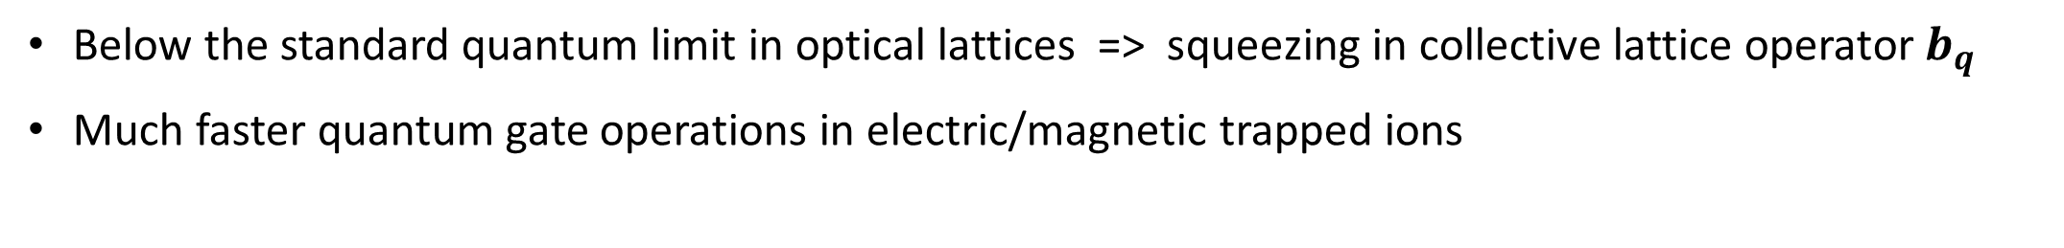
Outcomes & IP
1) Compact entanglement devices for photonic quantum computing
Electric-control over micron/sub-micron-size.
integrable nonlinearity generators.
Fast control (in principle picoseconds).
Use the current technology/platforms.
Do not feed noise into Quantum Integrated Circuit.
Works also for mechanical control.
Electric-control of radiation lifetime (decay rate)!
Electrical control of EOT.
2) Precision-measurement for few-body quantum systems
Below the standard quantum limit in optical lattices => squeezing in collective lattice operator $b_{q}$
Much faster quantum gate operations in electric/magnetic trapped ions
9

Slide 22

THANKS FOR YOUR ATTENTION

