Slide 1
COMPOSITE MATERIALS
HACETTEPE UNIVERSITY
DEPARTMENT OF CHEMICAL ENGINEERING
PREPARED BY;
TUĞBA KOÇAK-20519833
SEVİNÇ KARADAĞ-20519756
TOLGA NAİL SEVİNDİK-20574649
ULYA KIBRIS-20772663
KMU 479 MATERIAL SCIENCE AND TECNOLOGY II

Slide 2
THIS PRESENTATION INCLUDES
11.11.2009
What is Composite?
Properties of Composites
Types of Composites
Advantages of Composites
Disadvantages of Composites
Application of Composites
Components of Composites
Producing of Composites
2

Slide 3
WHAT IS COMPOSITES?
11.11.2009
Composite materials are engineered materials made from two or more constituent materials with significantly different physical or chemical properties which remain separate and distinct on a macroscopic level within the finished structure.
http://en.wikipedia.org/wiki/Composite_material
3
Notes:
http://en.wikipedia.org/wiki/Composite_material

Slide 4
A cloth of woven carbon fiber filaments, a common element in
composite materials
http://en.wikipedia.org/wiki/Composite_material

Slide 5
PROPERTIES OF COMPOSITES
Specific strength^{[1]}
Expense^{[1]}
Application^{[1]}
Processability^{[1]}
Orthotropic ^{[2]}
Inhomogeneous^{[3]}
Do not dissolve or merge completely into another^{[4]}
[1]http://www.pslc.ws/macrog/mpm/analysis/general.htm
[2]http://en.wikipedia.org/wiki/Composite_material
[3] http://www.sonatest.com/applications/Composite%20Materials.html
[4] http://www.unitedcomposites.net/usapages/whycomposites2.htm
5

Slide 6
APPLICATION OF COMPOSITES
11.11.2009
aircraft industry
space industry
auto and transportation industry
utility industry
chemical industry
http://www.quakewrap.com/frp%20papers/Application-of-Composites-in-Infrastructure-Part-I-and-II-(a-brief-report-on-materials-and-construction).pdf
6

Slide 7
some examples of composites
civil infrastructure such as bridges, roads, earthquake retrofitting of buildings etc.
various aircraft, helicopters and rockets
engine parts
marine vessels
sports
printed circuit board
large trucks
shipping containers
tank
ships
http://www.quakewrap.com/frp%20papers/Application-of-Composites-in-
Infrastructure-Part-I-and-II-(a-brief-report-on-materials-and-construction).pdf

Slide 8
http://www.advancedthermalsupplies.com.au/im/CompositeMaterials/Composites1.gif

Slide 9
COMPONENTS OF COMPOSITES
11.11.2009
Matrix phase: bulk materials such as: Metals, Ceramics, Polymers
Reinforcement: fibers and particulates such as: Glass, Carbon,Kevlar, Silicon Carbide, Boron,Ceramic, MetallicAggregate
Interface: area of mechanical
http://www.ndt-ed.org/EducationResources/CommunityCollage/Materials/Structıre/composite.htm
9

Slide 10
Composite properties determined by the matrix:
Transverse mechanical properties
Interlaminar shear strength
Compressive strength
Plasticisation of the matrix
Service temperature
Fire and corrosion resistance
Tool design and fabrication process
http://www.quakewrap.com/frp%20papers/Application-of-Composites-in-Infrastructure-Part-I-and-II-(a-brief-report-on-materials-and-construction).pdf
11.11.2009
10

Slide 11
Composite properties influenced by fibres:
Rigidity (Modulus of elasticity)
Tensile Longitudinal Strength
Initiation of fracture of fibres
Properties controlled by Interface / bonding:
Fracture energy/Fracture toughness
Interlaminar fracture energy
http://www.quakewrap.com/frp%20papers/Application-of-Composites-in-Infrastructure-Part-I-and-II-(a-brief-report-on-materials-and-construction).pdf
11.11.2009
11

Slide 12
TYPES OF COMPOSITES
1. Particulate –Reinforced Composite
2. Fiber – Reinforced Composite
3. Structural Composite
3.a. Laminar Composite
3.b. Plate Composite

Slide 13
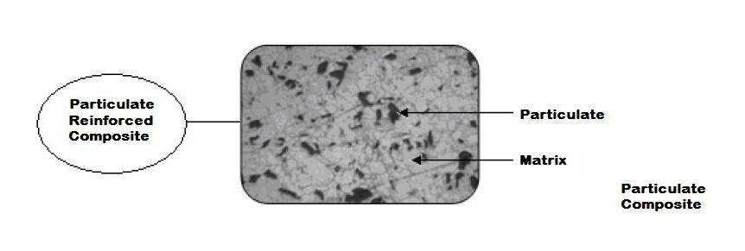
1. Particulate – Reinforced Composite
Dr. Uğur SOY, Sakarya Üniversitesi, Kompozit Malzemeler, Ekim 2009
A composite that consists of tiny particles of one material embedded in another material.
- Particles are most often used to extend the strength or other properties of inexpensive materials by the addition of other materials.

Slide 14
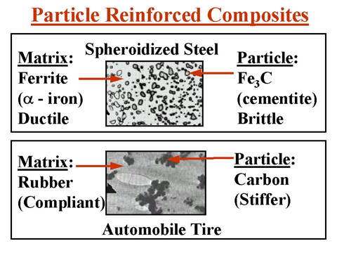
http://info.lu.farmingdale.edu/depts/met/met205/particlerc.JPG
Particles may have any shape or size, but are generally spherical, ellipsoidal, polyhedral, or irregular in shape.
They may be added to a liquid matrix that later solidifies; grown in place by a reaction such as agehardening.

Slide 15
2. Fiber – Reinforced Composite (FRC)
Dr. Uğur SOY, Sakarya Üniversitesi, Kompozit Malzemeler, Ekim 2009
- A FRC consists of three components: (i) fibers as the discontinuous or dispersed phase, (ii) the matrix as the continuous phase, and (iii) the fine interphase region.
Fibers increase the modulus of the matrix material.
The strong covalent bonds along the fiber's length gives them a very high
modulus in this direction.

Slide 16
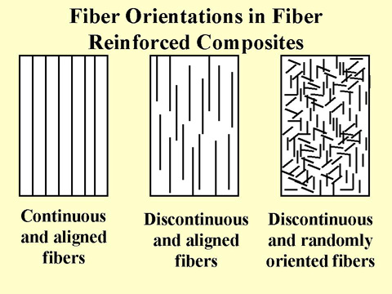
http://info.lu.farmingdale.edu/depts/met/met205/composites.html
- Consideration of orientation and fiber length for a particular composites depends on the level and nature of the applied stress.
- Fibers have a very high modulus along their axis, but have a low modulus perpendicular to their axis.

Slide 17
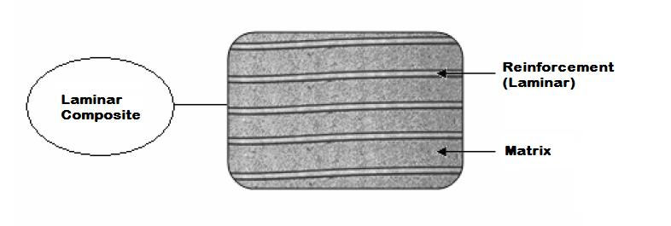
3. Structural Composite 3.a. Laminar Composite
Dr. Uğur SOY, Sakarya Üniversitesi, Kompozit Malzemeler, Ekim 2009
- Laminar composites are composed of two-dimensional sheets or panels that have a preferred high strength direction.

Slide 18
3. Structural Composite 3.b. Plate Composite
- Composites that composed of plate shape reinforcement agents in the matrix phase.

Slide 19
ADVANTAGES OF COMPOSITES
Weight saving
Very high specific strength
Great freedom of shape
Less parts, longer life
Material can be tailored
Thermal isolation habits

Slide 20
Chemical resistance against acids etc.
Electrical habits
Impact habbits
EXCELLENT
Weather / water resistance
Excellent fatigue endurance
RAM features (Radar Absorbing Materials)

Slide 21
Resistance to corrosion and aggressive media
man-hours needed for maintenance
of structures (painting, repair, replacement of components)
Reduction of
environmental impact
storage costs of semi-finished products

Slide 22
DISADVANTAGES OF COMPOSITES
High cost (compared to metals)
Expensive raw materials
Manufacturing time
Difficult to repair
Insufficient design data

Slide 23
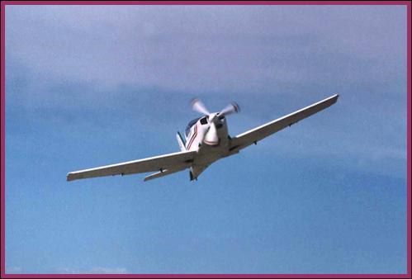
It is the fastest growing "materials" market segment
Automotive
Composites are used in a variety of automotive components, from original equipment like driveshafts and truck beds, to after-market equipment like camper shells.
Aerospace
strong enough to take harsh
loading conditions such as
aerospace components (tails,
wings, fuselages, propellers)
Full Composite Aircraft FAJR-3
http://www.alibaba.com/productshowimg/rahtair-11089275 10758595/Full_Composite_Aircraft_FAJR_3.html

Slide 24
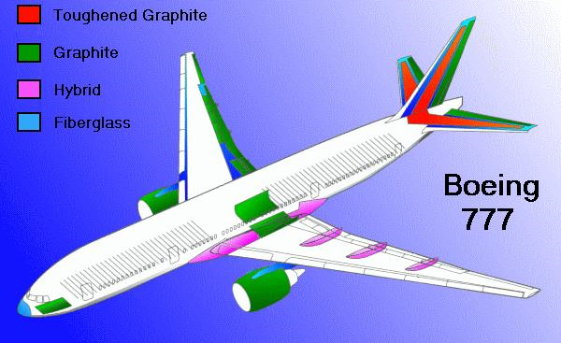
Various composite materials are used in structures such as the Boeing 777 because of their strength, and weight savings. Composites also offer resistance to fatigue, corrosion and impact damage.
http://www.aviation-history.com/theory/composite.htm

Slide 25
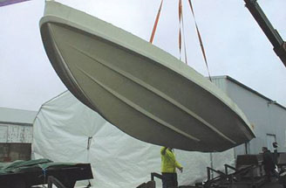
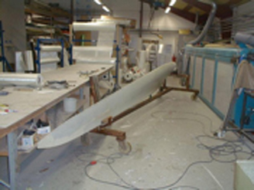
World’s 1st Thermoplastic composite boat hull (courtesy of VT Halmatic Ltd)
boat and scull hulls
bicycle frames and racing car bodies
Thermoplastic composite wind turbine
http://www.eplcompositesolutions.co.uk/composite/VacuumMouldingCompositeStructures.asp
fishing rods, storage tanks,
and baseball bats
http://www.eplcompositesolutions.co.uk/composite/VacuumMouldingCompositeStructures.asp

Slide 26
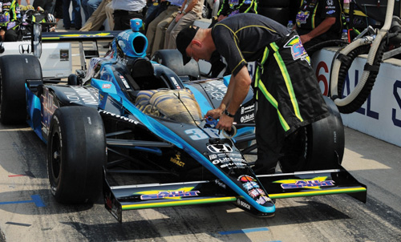
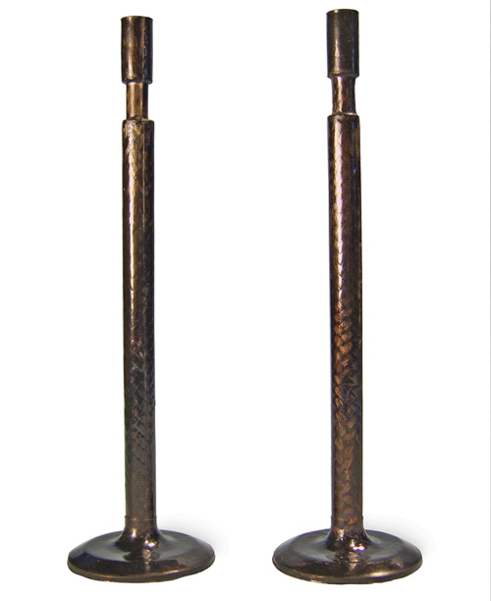
engine parts
The need for weight reduction and increased engine rpm in race cars like this one has
motivated serious research into engine valves of carbon fiber-reinforced polymer composites.
(http://www.compositesworld.com/articles/composite-engine-valves.aspx)
chemical industry
Valves molded using the CSU team’s carbon braid-reinforced, high-temperature polyimide resin. Soure: D. Radford, Colorado State University
marine vessels
(http://www.compositesworld.com/articles/composite-engine-valves.aspx)

Slide 27
Producing OF compositeS
Short fiber- reinforced composites
mixing the fibers with a liquid or plastic matrix
Polymer base composites
Injection molding
Spray-up method
Metal- matrix composites
Casting

Slide 28
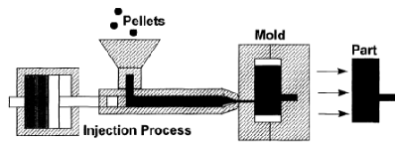
Injection molding method
Figure: www.engineershandbook.com/mfg.method/injectionmolding

Slide 29
Spray-up method
Figure:www.wacker.com/cms/sprayup.jsp/

Slide 30
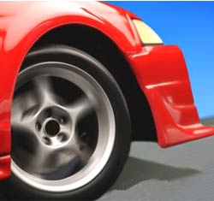
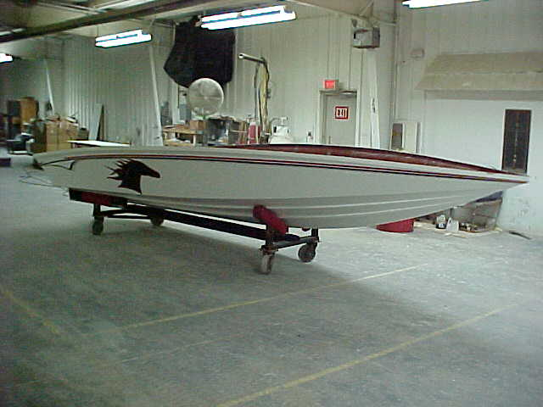
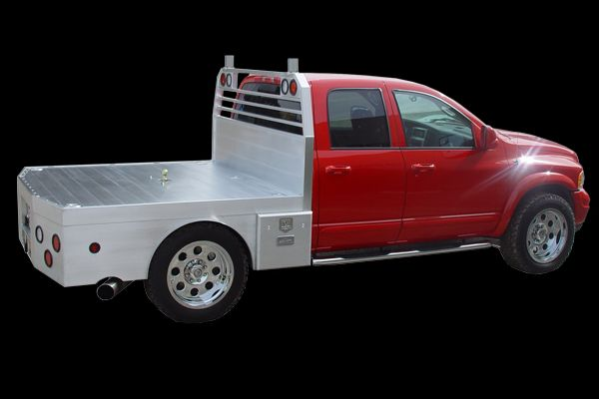
hand lay-up technic
Figure:www.flexidynamic.com/method
The simplest and oldest
Low volume
Labor intensive
For large components

Slide 31
Pressure bag molding
figure:www.nextcraft.com/media/rc_tips/vacuum_bag_tests
High pressure, usually 30 to 50 psi, gases or vacuum and excess resin are introduced to force the plies together for good bonding during curiying.
By this technique, large polymer matrix component for the skins of military aircraft, tanks, containers, wind turbine blades have been produced.

Slide 32
Matched die molding
Short fibers or mats are placed in two part die, when die is closed the composite shape is formed.
This method is used for thermoplastics.

Slide 33
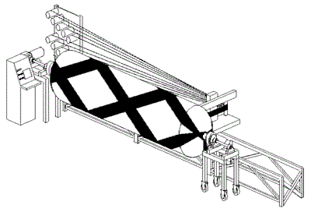
Filament winding
Fibers are wrapped around the mandrel.
The filament is supplied in the polymer matrix resin prior or around the fiber.
Curing is completes the production of the high performance composite.
Figure: www..addax.com/images/technology

Slide 34
http://www.youtube.com/watch?v=wb1kor4RuPA

