Slide 1
MAD 475 • TUNNELING & SUPPORT DESIGN
Rock Mass Classification Systems in Mining & Tunneling
Engineering Characterization, Empirical Design, and Support Selection Guidelines
INSTITUTION
Hacettepe University, Department of Mining Engineering
Notes:
Welcome to MAD 475. Today's 90-minute lecture covers empirical rock mass classification—the critical engineering bridge between geological mapping and structural design in tunneling and underground mining.

Slide 2

90-MINUTE LECTURE STRUCTURE
Lecture Agenda & Learning Objectives
MODULES 1–3
MODULES 4–5
MODULES 6–7
Foundations & Legacy Systems
Core Quantitative Rating Systems
GSI, Synthesis & Numerical Models
•
•
•
Intact Rock vs. Rock Mass: Discontinuities
RMR System (Bieniawski 1973/1989): Parameters & Support
Geological Strength Index (GSI): Matrix Chart
•
Terzaghi (1946): Rock Load Factor
•
Lauffer (1958): Active Span & Stand-up Time
•
Mining RMR Extensions: MRMR & MBR Systems
•
Constitutive Links: Non-linear Hoek-Brown Model
•
Deere (1967): Core Quality Designation (RQD)
•
Slope Mass Rating (SMR): Slope Adjustments
•
Empirical Correlations: $RMR↔Q↔GSI$
•
Wickham (1972): Rock Structure Rating (RSR)
•
Q-System (Barton 1974/2002): 3 Quotients
•
System Comparisons: Strengths & Limitations
•
Support Sizing Charts: $D_{e}$ vs $Q$ Engineering Maps
•
Design Workflow: Integrated Engineering Pipeline
Notes:
Outline the lecture timing: 25 mins on historical foundations and RQD/RSR; 35 mins on RMR and Q-system; 20 mins on GSI and Hoek-Brown linkage; 10 mins on design synthesis and Q&A.

Slide 3
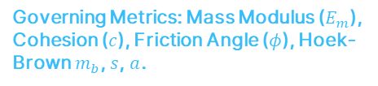

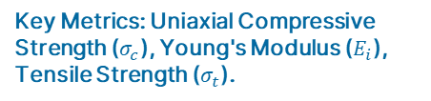
MODULE 1 • FUNDAMENTALS
Fundamental Mechanics: Intact Rock vs. Rock Mass
Intact Rock Material
Rock Mass System
Discontinuities
Continuous mineral aggregate bounded between discontinuities. Behavior governed by primary mineralogy, micro-cracks, and grain boundary cementation.
Discontinuous, anisotropic, non-homogeneous assemblage of rock blocks acting as a structural continuum or block system under stress.
Planar structural weaknesses (joints, bedding planes, faults, shears). Impart anisotropic, non-linear shear behavior and high hydraulic permeability.
+
=
Key Metrics: Uniaxial Compressive Strength ($σ_{c}$), Young's Modulus ($E_{i}$), Tensile Strength ($σ_{t}$).
Key Metrics: Spacing, Persistence, Roughness ($J_{r}$), Infilling/Alteration ($J_{a}$).
Governing Metrics: Mass Modulus ($E_{m}$), Cohesion ($c$), Friction Angle ($φ$), Hoek-Brown $m_{b}$, $s$, $a$.
Notes:
Bieniawski's fundamental rule: Rock mass strength is significantly lower than intact rock strength because structural discontinuities dictate macro-scale stability.

Slide 4
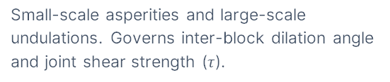
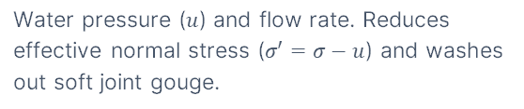
MODULE 1 • GEOLOGICAL INPUTS
Essential Discontinuity Parameters in Engineering
Orientation
Spacing
Persistence
Strike and dip relative to tunnel drive axis. Determines kinematic feasibility of block sliding or wedge falls.
Perpendicular distance between adjacent discontinuities. Controls individual block size and overall degree of jointing.
Discontinuity trace length in exposed rock faces. Defines potential failure plane extent and continuous slip paths.
Roughness
Aperture & Infilling
Groundwater Inflow
Small-scale asperities and large-scale undulations. Governs inter-block dilation angle and joint shear strength ($τ$).
Perpendicular distance between joint walls and type of gouge (clay, quartz). Controls cohesion loss and wall separation.
Water pressure ($u$) and flow rate. Reduces effective normal stress ($σ′=σ−u$) and washes out soft joint gouge.
Notes:
Discontinuities act as weak links. Point out that orientation relative to excavation direction is often the single most critical parameter determining local wedge stability.

Slide 5

MODULE 1 • ENGINEERING FUNCTION
Core Objectives of Classification Systems
1
Divide Rock Mass into Domain Classes
Categorizes complex, highly variable rock formations into structural regions of similar geotechnical quality.
2
Provide Standardized Communication
Establishes a quantitative common language between mining engineers, geologists, contractors, and designers.
Bieniawski's Warning
"Rock mass classification is an empirical design aid—it is NOT a replacement for field observations, analytical studies, structural modeling, or sound engineering judgment."
3
Derive Quantitative Engineering Inputs
Yields mechanical properties ($E_{m},c,φ$) for analytical calculations and finite element / boundary element numerical simulations.
4
Recommend Empirical Ground Support
Guides installation of rock bolts, fiber shotcrete, mesh, and steel ribs based on historical case studies.
Notes:
Stress to students that empirical systems are preliminary tools. They are invaluable during feasibility studies when data is sparse, but must be cross-checked during final design.

Slide 6
MODULE 1 • HISTORICAL CONTEXT
Evolution of Major Classification Systems (1879–Present)
1879
Ritter: First empirical approach relating rock conditions to tunnel support needs.
1946
Terzaghi: Rock Load Factor Classification for steel-arch supported rail tunnels (USA).
1958
Lauffer: Stand-up Time vs Active Span relationships (Austria - NATM foundation).
1967
Deere et al.: Rock Quality Designation ($RQD$) quantitative drill-core indexing (USA).
1973/89
Bieniawski: Rock Mass Rating ($RMR$) Geomechanics Classification (South Africa / USA).
1974/02
Barton et al. (NGI): Tunneling Quality Index ($Q$-System) for fiber shotcrete design (Norway).
1994/06
Hoek & Brown: Geological Strength Index ($GSI$) for non-linear constitutive numerical models.
Notes:
Note the trend: Classification evolved from qualitative descriptive classes (Terzaghi) to quantitative rating indexes (RMR/Q) and finally to constitutive model parameters (GSI).

Slide 7


MODULE 2 • CLASSICAL EMPIRICAL SYSTEMS
Terzaghi's Rock Load Classification (1946)
First comprehensive classification in English integrating geology into tunnel support design. Designed specifically for sizing heavy steel sets in blasted rail tunnels.
$$p=H_{p}⋅γ$$
Mechanics of Load Transfer
$p$ = Equivalent roof support pressure (${\text{kN/m}}^{2}$)
$H_{p}$ = Height of loosened rock zone above tunnel crown ($\text{m}$)
When a tunnel is excavated, the surrounding rock mass tends to yield into the opening. A parabola of loosened rock of height $H_{p}$ detaches and rests its full dead weight upon the support structure.
$γ$ = Unit weight of the rock mass (${\text{kN/m}}^{3}$)
$B$ = Tunnel width ($\text{m}$), $H_{t}$ = Tunnel height ($\text{m}$)
Arching action transfers the weight of the remaining overburden to the sides of the tunnel opening.
Notes:
Explain $H_{p}$ rock load factor. Terzaghi categorized rock into 9 classes based on jointing, swelling, and squeezing potential to estimate $H_{p}$.

Slide 8
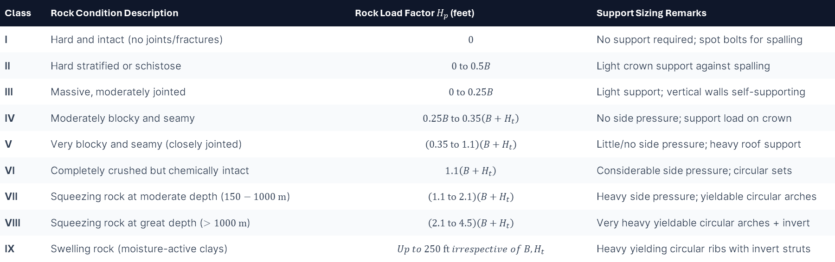
MODULE 2 • TERZAGHI SYSTEM
Terzaghi Rock Classes & Rock Load Factors ($H_{p}$)
Class | Rock Condition Description | Rock Load Factor $H_{p}$ (feet) | Support Sizing Remarks
I | Hard and intact (no joints/fractures) | $$0$$ | No support required; spot bolts for spalling
II | Hard stratified or schistose | $$0\text{ to }0.5B$$ | Light crown support against spalling
III | Massive, moderately jointed | $$0\text{ to }0.25B$$ | Light support; vertical walls self-supporting
IV | Moderately blocky and seamy | $$0.25B\text{ to }0.35\left(B+H_{t}\right)$$ | No side pressure; support load on crown
V | Very blocky and seamy (closely jointed) | $$\left(0.35\text{ to }1.1\right)\left(B+H_{t}\right)$$ | Little/no side pressure; heavy roof support
VI | Completely crushed but chemically intact | $$1.1\left(B+H_{t}\right)$$ | Considerable side pressure; circular sets
VII | Squeezing rock at moderate depth ($150−1000\text{ m}$) | $$\left(1.1\text{ to }2.1\right)\left(B+H_{t}\right)$$ | Heavy side pressure; yieldable circular arches
VIII | Squeezing rock at great depth ($>1000\text{ m}$) | $$\left(2.1\text{ to }4.5\right)\left(B+H_{t}\right)$$ | Very heavy yieldable circular arches + invert
IX | Swelling rock (moisture-active clays) | $$Up to 250\text{ ft} irrespective of B,H_{t}$$ | Heavy yielding circular ribs with invert struts
Notes:
Note rules of thumb: Below groundwater table, reduce loads by 50% for dry tunnels above table (Rose 1982). For TBM excavations, reduce $H_{p}$ by 20–25% due to reduced blast disturbance.

Slide 9
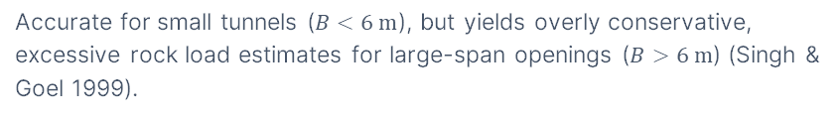
MODULE 2 • SYSTEM EVALUATION
Limitations of Terzaghi's Rock Load Method
1. Overestimates Support for Large Spans
2. Limited to Steel Arch Supports
Accurate for small tunnels ($B<6\text{ m}$), but yields overly conservative, excessive rock load estimates for large-span openings ($B>6\text{ m}$) (Singh & Goel 1999).
Developed specifically for passive steel ribs. Does not account for modern active rock reinforcement like fully-grouted rock bolts, cable bolts, or sprayed shotcrete shell linings (Cording & Deere 1972).
3. Subjective Qualitative Rock Inputs
4. Wide Squeezing/Swelling Ranges
Relies on descriptive terms ("blocky and seamy", "crushed") without objective numerical measurement parameters like RQD, joint spacing, or joint shear strength (Cecil 1970).
Load ranges for classes VII–IX are too broad to allow precise engineering design without extensive secondary field stress measurements.
Notes:
Summarize: While Terzaghi was a massive historical leap forward, its conservatism and focus on steel ribs necessitated modern multi-parameter quantitative systems.

Slide 10
MODULE 2 • CLASSICAL EMPIRICAL SYSTEMS
Lauffer's Stand-Up Time Concept (1958)
Definition: Active Unsupported Span
The unsupported tunnel section width, or the distance from the excavated tunnel face to the nearest installed permanent support (if greater than tunnel span).
Lauffer's Rock Mass Classes
Definition: Stand-Up Time
Classified rock mass quality into 7 categories:
The elapsed time span during which an excavated active tunnel span can remain open without any support or reinforcement before collapse begins.
Class A: Very Good (Indefinite stand-up time)
Class B: Good
Class C: Fair
Class D: Poor
Foundation of NATM: Lauffer showed that as active span increases, stand-up time decreases exponentially. This principle forms the base of the New Austrian Tunneling Method (Pacher et al. 1974).
Class E: Very Poor
Class F: Extremely Poor
Class G: Completely Crushed / Squeezing
Notes:
Emphasize: In NATM, support must be installed within the stand-up time window to prevent ring closure collapse while allowing controlled stress relief.

Slide 11

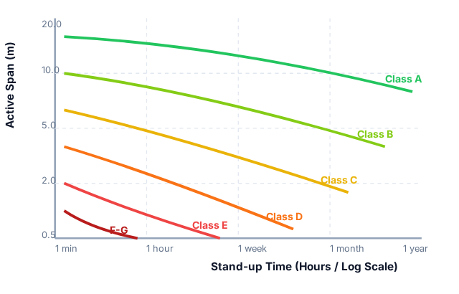



MODULE 2 • RECONSTRUCTED DIAGRAM
Active Span vs. Stand-Up Time Relationships
Key Design Insight
In Class E rock (Very Poor), a $5\text{ m}$ span will collapse in less than 1 hour if left unsupported.
Class A (Very Good)
A $15\text{ m}$ span can stand unsupported for over 20 years without structural decay.
RMR Linkage
Bieniawski later correlated these curves directly with numeric RMR rating bands ($100−81→\text{Class A}$, $<20→\text{Class E}$).
Notes:
Walk students through reading the chart. Highlight how active span size dramatically compresses available stand-up time in poorer rock classes.

Slide 12
MODULE 2 • PARADIGM SHIFT
Transition to Quantitative Multi-Parameter Systems
Why Single Indicators Fail
Multi-Parameter Quantitative Solution
•
Qualitative Ambiguity: Terms like "moderately jointed" mean different things to different engineers.
•
Objective Indexing: Uses measured core lengths, joint counts, laboratory strength, and water inflows.
•
Single Parameter Blindness: Intact rock strength alone does not govern stability when joints control failure.
•
Mathematical Combination: Combines parameters via addition (RMR) or multiplicative ratios (Q).
•
Ignoring Ground Water: Pore water pressure drastically reduces joint friction without altering core appearance.
•
Direct Support Maps: Output maps directly to concrete shotcrete thickness, bolt lengths, and spacing.
•
In-situ Stress Ignored: Deep high-stress rock bursts cannot be predicted by shallow load factors.
•
Numerical Modeling Input: Directly yields equivalent deformation modulus ($E_{m}$) and Mohr-Coulomb parameters.
Notes:
We now examine core quantitative parameters, starting with Deere's Rock Quality Designation (RQD).

Slide 13
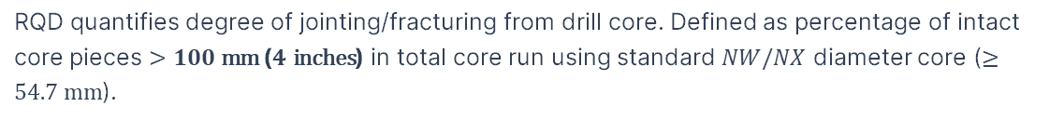
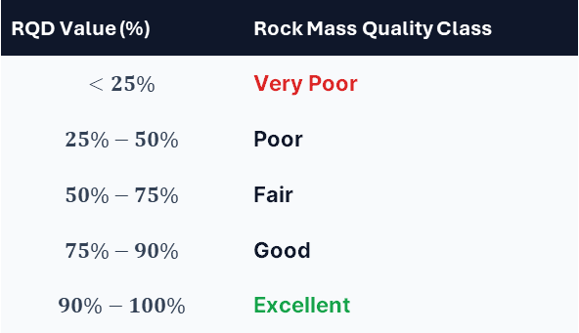

MODULE 3 • CORE QUANTITATIVE PARAMETERS
Rock Quality Designation (RQD) (Deere 1967)
RQD quantifies degree of jointing/fracturing from drill core. Defined as percentage of intact core pieces $>100\text{ mm}$ ($4\text{ inches}$) in total core run using standard $NW/NX$ diameter core ($≥54.7\text{ mm}$).
$$RQD=\frac{\sum{\text{Length of intact core pieces}}>10 \text{cm}}{\text{Total Core Run Length}}×100\%$$
RQD Classification Scale
RQD Value (%) | Rock Mass Quality Class
$$<25\%$$ | Very Poor
$$25\%−50\%$$ | Poor
$$50\%−75\%$$ | Fair
$$75\%−90\%$$ | Good
$$90\%−100\%$$ | Excellent
Standard Logging Rules
•
Only hard, intact core pieces $>10\text{ cm}$ are summed.
•
Mechanical breaks caused by drilling must be fitted together and counted as unbroken intact pieces.
•
Weathered, soft, or highly altered core pieces are excluded even if $>10\text{ cm}$.
Notes:
Emphasize: RQD is a standard input parameter in both Bieniawski's RMR and Barton's Q-system.

Slide 14



MODULE 3 • RQD MECHANICS
RQD Measurement Procedure & Worked Example
Core Run Total Length = 200 cm
38 cm
✓ Counted (> 10 cm)
Calculation Steps
Sum of sound pieces $>10\text{ cm}$:
8 cm
✗ Discarded (< 10 cm)
38 + 30 + 30 + 40 + 30 = 168 cm
30 cm
✓ Counted (> 10 cm)
Divide by total run length ($200\text{ cm}$):
4
cm
✗ Discarded (< 10 cm)
$$RQD=\frac{168}{200}×100=84\%$$
30 cm
✓ Counted (> 10 cm)
40 cm
✓ Counted (> 10 cm)
5 cm
✗ Discarded (< 10 cm)
Result Classification: "GOOD" Rock Mass Quality ($75\%−90\%$).
30 cm
✓ Counted (> 10 cm)
Notes:
Point out the traps: Drilling mechanical breaks must be fitted together and logged as unbroken core. Soft clayey core pieces $>10\text{ cm}$ are excluded due to lack of sound intact matrix.

Slide 15



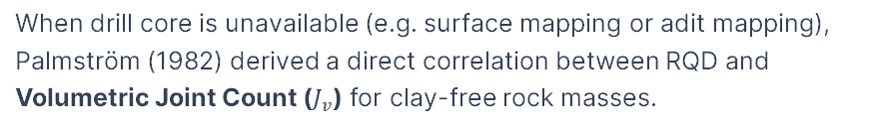
MODULE 3 • OUTCROP ESTIMATION
RQD Estimation from Volumetric Joint Count ($J_{v}$)
When drill core is unavailable (e.g. surface mapping or adit mapping), Palmström (1982) derived a direct correlation between RQD and Volumetric Joint Count ($J_{v}$) for clay-free rock masses.
$$RQD=115−3.3J_{v} \left(\text{for }RQD≤100\right)$$
Major Advantage of $J_{v}$
Volumetric Joint Count Formula ($J_{v}$)
Direct borehole logging suffers heavily from directional orientation bias (boreholes parallel to a major joint set miss joints and overestimate RQD).
$J_{v}$ is the sum of the number of joints per meter for all joint sets:
$$J_{v}=\sum_{i=1}^{N}{\frac{1}{S_{i}}}+\frac{N_{r}}{5}$$
Using 3D volumetric joint count ($J_{v}$) eliminates orientation bias and yields a representative spatial rock mass index.
Where $S_{i}$ = average joint spacing (m) for set $i$, $N_{r}$ = number of random joints per ${\text{m}}^{3}$.
Note: If $J_{v}<4.5$, $RQD=100\%$. If $J_{v}>35$, $RQD=0\%$. $J_{v}$ is extremely useful during preliminary geological field mapping before drilling begins.

Slide 16
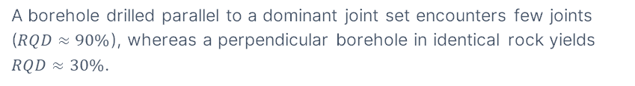
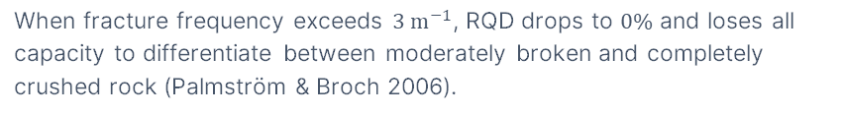
MODULE 3 • PARAMETER EVALUATION
Critical Limitations of the RQD Index
1. Directional Borehole Sensitivity
2. Insensitive to Joint Surface Condition
A borehole drilled parallel to a dominant joint set encounters few joints ($RQD≈90\%$), whereas a perpendicular borehole in identical rock yields $RQD≈30\%$.
Treats unweathered, rough, tightly interlocked joints identically to smooth, slickensided joints filled with soft swelling clay.
3. Step-Function Arbitrary Threshold
4. Insensitive at High Fracture Frequencies
A core piece of $9.5\text{ cm}$ scores $0\%$, while a piece of $10.5\text{ cm}$ scores $100\%$. This creates artificial step-function distortions in uniform joint spacing.
When fracture frequency exceeds $3{\text{ m}}^{−1}$, RQD drops to $0\%$ and loses all capacity to differentiate between moderately broken and completely crushed rock (Palmström & Broch 2006).
RQD is a valuable index parameter, but NEVER use RQD as a standalone rock engineering design index.

Slide 17
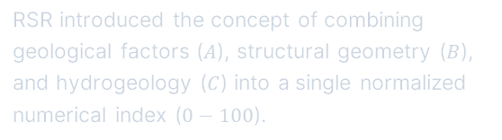
MODULE 3 • WICKHAM SYSTEM (1972)
Rock Structure Rating (RSR) Overview
Developed by Wickham et al. (1972) from case histories of small steel-supported tunnels. First complete quantitative rating model to make reference to shotcrete support.
$$RSR=A+B+C \left(\text{Max }RSR=100\right)$$
Parameter A: Geology
Max 30 pts
Historical Significance
Rock origin (igneous, metamorphic, sedimentary), rock hardness, and structural folding/faulting.
RSR introduced the concept of combining geological factors ($A$), structural geometry ($B$), and hydrogeology ($C$) into a single normalized numerical index ($0−100$).
Parameter B: Geometry
Max 45 pts
Joint spacing, joint orientation relative to tunnel axis, and drive direction (with/against dip).
Parameter C: Water & Joints
Max 25 pts
Directly inspired Bieniawski's Rock Mass Rating (RMR) system. Note: RSR tables use Imperial units.
Combined sum of A+B, joint surface condition (good/fair/poor), and water inflow rate (gpm/1000 ft).
RSR support charts. RSR provided charts for 10 ft, 20 ft, and 24 ft tunnels recommending shotcrete thickness, bolt spacing, and steel rib spacing.

Slide 18

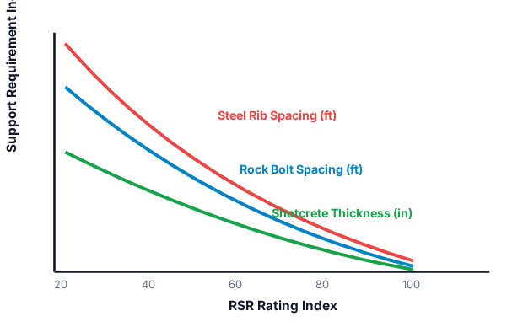



MODULE 3 • RSR APPLICATION
RSR Ground Support Prediction Curves ($7.3\text{ m}$ Tunnel)
Economic Sizing Trade-Off
RSR allowed engineers to compare costs between alternative support systems: steel arches vs rock bolts + shotcrete for a given tunnel diameter.
High RSR ($>80$)
Massive rock requires no rib support or light spot bolting.
Low RSR ($<30$)
Heavily jointed rock requires heavy steel ribs spaced $<3\text{ ft}$ apart or $6′′$ shotcrete lining.
Notes:
Transition to Module 4. We now delve into Bieniawski's Rock Mass Rating (RMR) system—the most globally utilized civil/mining classification system.

Slide 19
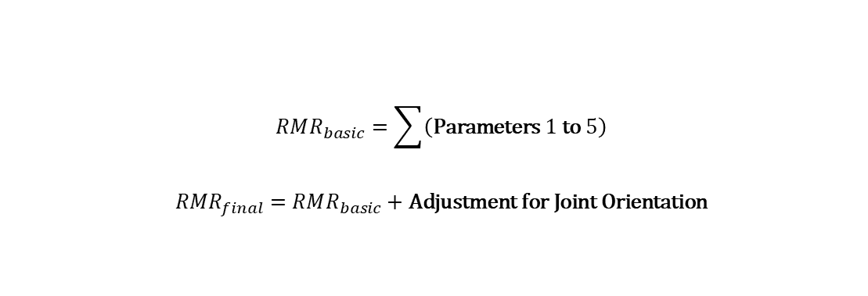
MODULE 4 • BIENIAWSKI SYSTEM (1973/1989)
Bieniawski's Rock Mass Rating (RMR) System
The Geomechanics Classification (RMR) evaluates 6 basic parameters to derive a total score ranging from 0 to 100. Higher numerical ratings indicate better rock mass quality.
$$RMR_{basic}=\sum{\left(\text{Parameters }1\text{ to }5\right)}$$
$$RMR_{final}=RMR_{basic}+\text{Adjustment for Joint Orientation}$$
Structural Regions
1. UCS ($σ_{c}$): Max 15 pts
2. RQD (%): Max 20 pts
In field application, the site is first divided into distinct structural regions separated by major faults or lithological boundaries.
3. Joint Spacing: Max 20 pts
4. Joint Condition: Max 30 pts
Each structural region is classified independently using the RMR rating breakdown.
5. Groundwater: Max 15 pts
6. Orientation Adjust: 0 to -60 pts
RMR basic sums parameters 1–5 (Max 100). Parameter 6 is an explicit penalty adjustment based on whether joint dip/strike orientation is favorable or unfavorable.

Slide 20
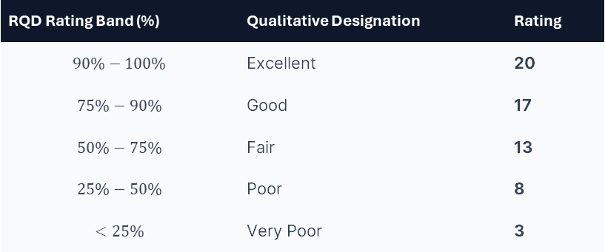
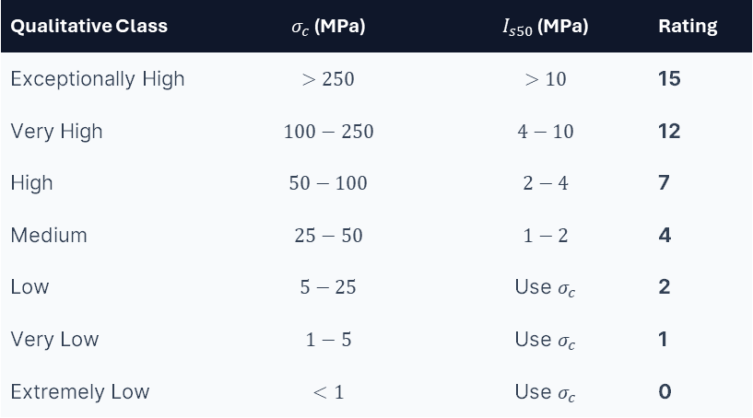


MODULE 4 • RATING PARAMETERS
RMR Parameters 1 & 2: Intact Strength & RQD
1. Intact Strength ($σ_{c}$ / $I_{s50}$)
Max 15 pts
2. Core Quality Designation ($RQD$)
Max 20 pts
Qualitative Class | $σ_{c}$ (MPa) | $I_{s50}$ (MPa) | Rating
Exceptionally High | $$>250$$ | $$>10$$ | 15
Very High | $$100−250$$ | $$4−10$$ | 12
High | $$50−100$$ | $$2−4$$ | 7
Medium | $$25−50$$ | $$1−2$$ | 4
Low | $$5−25$$ | Use $σ_{c}$ | 2
Very Low | $$1−5$$ | Use $σ_{c}$ | 1
Extremely Low | $$<1$$ | Use $σ_{c}$ | 0
RQD Rating Band (%) | Qualitative Designation | Rating
$$90\%−100\%$$ | Excellent | 20
$$75\%−90\%$$ | Good | 17
$$50\%−75\%$$ | Fair | 13
$$25\%−50\%$$ | Poor | 8
$$<25\%$$ | Very Poor | 3
Note: For low strength ranges ($σ_{c}<10\text{ MPa}$), point load testing is invalid; use UCS uniaxial lab testing.
Intact matrix properties account for up to 35 points combined out of 100 in basic RMR.

Slide 21
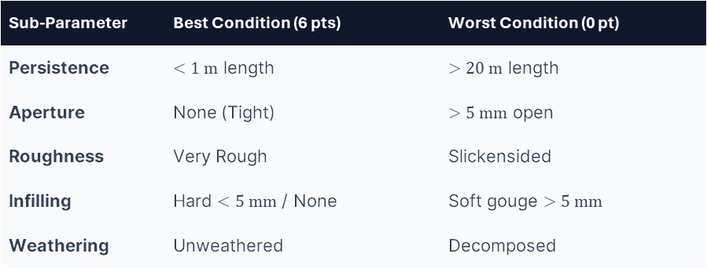
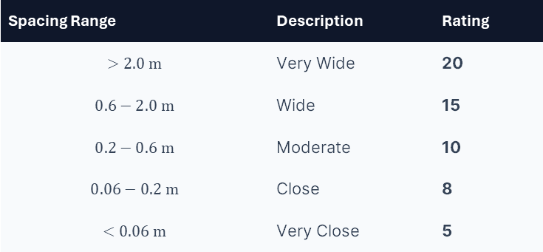
MODULE 4 • RATING PARAMETERS
RMR Parameters 3 & 4: Joint Spacing & Condition
3. Discontinuity Spacing
Max 20 pts
4. Condition of Discontinuities
Max 30 pts
Spacing Range | Description | Rating
$$>2.0\text{ m}$$ | Very Wide | 20
$$0.6−2.0\text{ m}$$ | Wide | 15
$$0.2−0.6\text{ m}$$ | Moderate | 10
$$0.06−0.2\text{ m}$$ | Close | 8
$$<0.06\text{ m}$$ | Very Close | 5
Evaluated via 5 sub-parameter ratings (6 pts max each):
Sub-Parameter | Best Condition (6 pts) | Worst Condition (0 pt)
Persistence | $<1\text{ m}$ length | $>20\text{ m}$ length
Aperture | None (Tight) | $>5\text{ mm}$ open
Roughness | Very Rough | Slickensided
Infilling | Hard $<5\text{ mm}$ / None | Soft gouge $>5\text{ mm}$
Weathering | Unweathered | Decomposed
Parameter 4 is the heaviest individual weighted component (30 points). Roughness and infilling gouge dictate whether joints develop friction or slip freely.

Slide 22
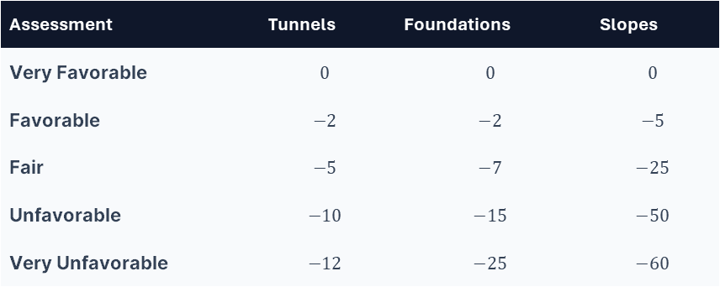
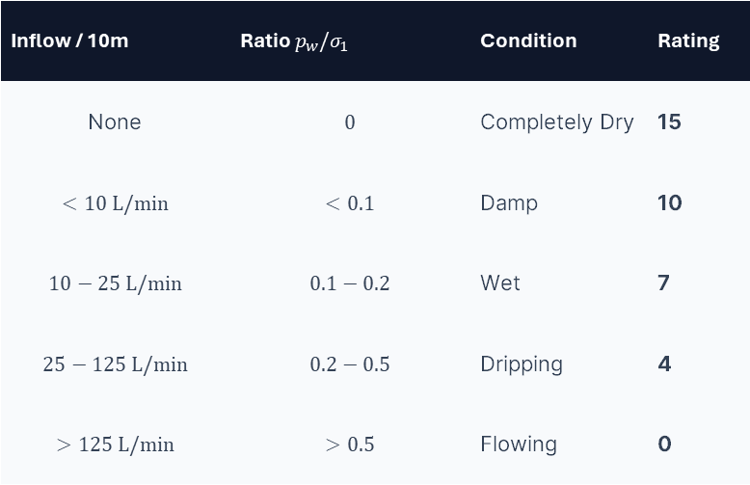
MODULE 4 • RATING ADJUSTMENTS
RMR Parameter 5 (Water) & Orientation Adjustments
5. Groundwater Condition
Max 15 pts
6. Discontinuity Orientation Penalty
0 to -60 pts
Inflow / 10m | Ratio $p_{w}/σ_{1}$ | Condition | Rating
None | $$0$$ | Completely Dry | 15
$$<10\text{ L/min}$$ | $$<0.1$$ | Damp | 10
$$10−25\text{ L/min}$$ | $$0.1−0.2$$ | Wet | 7
$$25−125\text{ L/min}$$ | $$0.2−0.5$$ | Dripping | 4
$$>125\text{ L/min}$$ | $$>0.5$$ | Flowing | 0
Assessment | Tunnels | Foundations | Slopes
Very Favorable | $$0$$ | $$0$$ | $$0$$
Favorable | $$−2$$ | $$−2$$ | $$−5$$
Fair | $$−5$$ | $$−7$$ | $$−25$$
Unfavorable | $$−10$$ | $$−15$$ | $$−50$$
Very Unfavorable | $$−12$$ | $$−25$$ | $$−60$$
Drive with dip ($45−{90}^{∘}$) = Very Favorable. Drive against dip ($45−{90}^{∘}$) = Unfavorable.
Stress tunneling strike/dip rule: Driving perpendicular to joint strike and driving WITH dip ($45−{90}^{∘}$) yields the safest arch geometry.

Slide 23
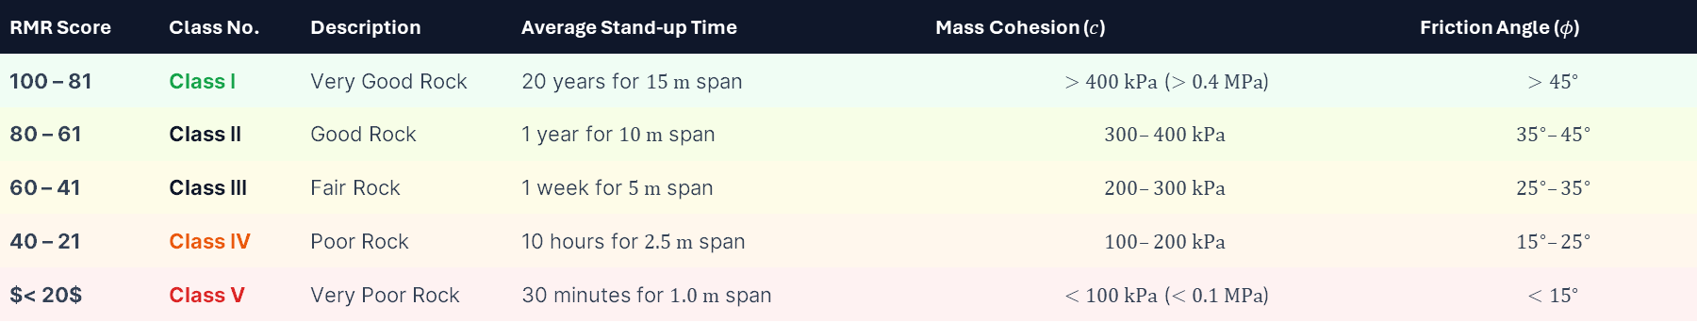
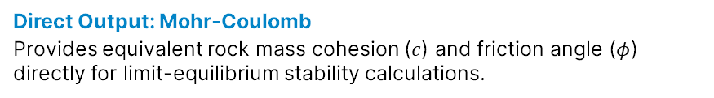
MODULE 4 • FINAL CLASS DETERMINATION
RMR Rock Mass Classes & Mechanical Properties
RMR Score | Class No. | Description | Average Stand-up Time | Mass Cohesion ($c$) | Friction Angle ($φ$)
100 – 81 | Class I | Very Good Rock | 20 years for $15\text{ m}$ span | $>400\text{ kPa}$ ($>0.4\text{ MPa}$) | $$>{45}^{∘}$$
80 – 61 | Class II | Good Rock | 1 year for $10\text{ m}$ span | $$300–400\text{ kPa}$$ | $${35}^{∘}–{45}^{∘}$$
60 – 41 | Class III | Fair Rock | 1 week for $5\text{ m}$ span | $$200–300\text{ kPa}$$ | $${25}^{∘}–{35}^{∘}$$
40 – 21 | Class IV | Poor Rock | 10 hours for $2.5\text{ m}$ span | $$100–200\text{ kPa}$$ | $${15}^{∘}–{25}^{∘}$$
$< 20$ | Class V | Very Poor Rock | 30 minutes for $1.0\text{ m}$ span | $<100\text{ kPa}$ ($<0.1\text{ MPa}$) | $$<{15}^{∘}$$
Direct Output: Mohr-Coulomb
Provides equivalent rock mass cohesion ($c$) and friction angle ($φ$) directly for limit-equilibrium stability calculations.
Stand-Up Guidance
Determines allowable unsupported excavation span and time delay before primary support must be installed.
Mohr-Coulomb mapping: RMR converts field observations into quantitative mechanics ($c$ and $φ$) required by geotechnical engineers.

Slide 24


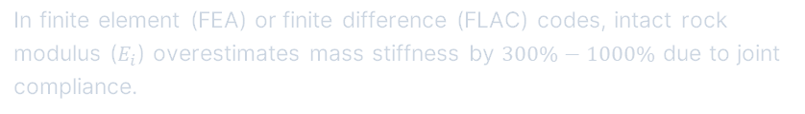


MODULE 4 • GEOMECHANICAL INPUT
Estimating Rock Mass Modulus ($E_{m}$) from RMR
Bieniawski (1978) (for $RMR > 50$)
$$E_{m}=2⋅RMR−100 \left(\text{GPa}\right)$$
Serafim & Pereira (1983) (for $σ_{c}<100\text{ MPa}$ or $RMR<50$)
$$E_{m}={10}^{\left(\frac{RMR−10}{40}\right)} \left(\text{GPa}\right)$$
Numerical Simulation Role
In finite element (FEA) or finite difference (FLAC) codes, intact rock modulus ($E_{i}$) overestimates mass stiffness by $300\%−1000\%$ due to joint compliance.
Galera et al. (2005) (Continuous Range)
$$E_{m}=0.0876⋅RMR \left(\text{for }RMR>50\right)$$
Empirical equations scale $E_{i}$ down to equivalent mass deformation modulus ($E_{m}$) to accurately predict surface settlement and tunnel convergence.
Without $E_{m}$, finite element simulations will severely underestimate tunnel wall deformations and ground surface settlement basins.

Slide 25
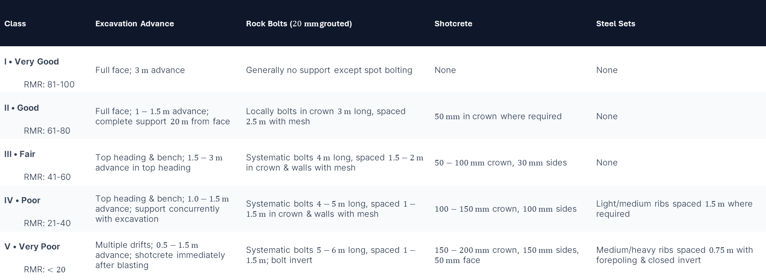
MODULE 4 • BIENIAWSKI SUPPORT TABLE
RMR Support Guidelines ($10\text{ m}$ Span Horseshoe Tunnel)
Class | Excavation Advance | Rock Bolts ($20\text{ mm}$ grouted) | Shotcrete | Steel Sets
I • Very Good RMR: 81-100 | Full face; $3\text{ m}$ advance | Generally no support except spot bolting | None | None
II • Good RMR: 61-80 | Full face; $1−1.5\text{ m}$ advance; complete support $20\text{ m}$ from face | Locally bolts in crown $3\text{ m}$ long, spaced $2.5\text{ m}$ with mesh | $50\text{ mm}$ in crown where required | None
III • Fair RMR: 41-60 | Top heading & bench; $1.5−3\text{ m}$ advance in top heading | Systematic bolts $4\text{ m}$ long, spaced $1.5−2\text{ m}$ in crown & walls with mesh | $50−100\text{ mm}$ crown, $30\text{ mm}$ sides | None
IV • Poor RMR: 21-40 | Top heading & bench; $1.0−1.5\text{ m}$ advance; support concurrently with excavation | Systematic bolts $4−5\text{ m}$ long, spaced $1−1.5\text{ m}$ in crown & walls with mesh | $100−150\text{ mm}$ crown, $100\text{ mm}$ sides | Light/medium ribs spaced $1.5\text{ m}$ where required
V • Very Poor RMR: $<20$ | Multiple drifts; $0.5−1.5\text{ m}$ advance; shotcrete immediately after blasting | Systematic bolts $5−6\text{ m}$ long, spaced $1−1.5\text{ m}$; bolt invert | $150−200\text{ mm}$ crown, $150\text{ mm}$ sides, $50\text{ mm}$ face | Medium/heavy ribs spaced $0.75\text{ m}$ with forepoling & closed invert
For drill-and-blast horseshoe tunnels $<900\text{ m}$ depth, modern engineering practice frequently replaces wire mesh + shotcrete with steel fiber reinforced shotcrete (SFRS).

Slide 26


MODULE 4 • MINING APPLICATIONS
Modifications to RMR for Underground Mining
LAUBSCHER System
Modified RMR ($MRMR$)
KENDORSKI System
Modified Basic RMR ($MBR$)
Tailored specifically for block caving and hard rock mining operations where stresses dynamically redistribute (Laubscher 1990).
Developed for block cave development drifts, extraction horizons, and major drawpoint intersections (Cummings et al. 1982).
Adjustment Factors Applied to Basic RMR:
Key Modifications:
•
•
In-situ and induced mining stresses
Differs parameter weightings for fault gouge
•
Stress changes due to face advancement
•
Distance adjustments relative to active face
•
•
Blasting damage adjustments
Provides specific support designs for isolated drifts vs long-term intersections
•
Environmental weathering exposure over time
Contrast in civil vs mining tunneling: Civil tunnels maintain static equilibrium. Mining excavations experience dynamic stress changes as the face moves.

Slide 27

MODULE 4 • SLOPE MASS RATING
Slope Mass Rating ($SMR$) (Romana 1985)
Extends Bieniawski's basic RMR for rock slope engineering by incorporating specific structural adjustment factors for joint orientation and excavation method.
$$SMR=RMR_{basic}+\left(F_{1}⋅F_{2}⋅F_{3}\right)+F_{4}$$
SMR Stability Classes
$F_{1}$: Parallelism between joint strike and slope face strike ($F_{1}={\left(1−\sin\left|α_{j}−α_{s}\right|\right)}^{2}$).
SMR Score | Class | Stability | Failure Mode
81 – 100 | I • Very Good | Completely Stable | None
61 – 80 | II • Good | Stable | Some blocks
41 – 60 | III • Fair | Partially Stable | Some wedges
21 – 40 | IV • Poor | Unstable | Planar / Large wedges
0 – 20 | V • Very Poor | Completely Unstable | Circular / Mass flow
$F_{2}$: Joint dip angle in planar mode ($F_{2}={\left({\tan{β}}_{j}\right)}^{2}$). $F_{2}=1.0$ for toppling.
$F_{3}$: Relationship between slope dip and joint dip ($β_{j}−β_{s}$).
$F_{4}$: Excavation method (Natural slope $+15$, Presplit $+10$, Smooth blast $+8$, Blasting $0$, Deficient blast $−8$).
SMR evaluates planar sliding and toppling mechanisms. Notice $F_{3}$ penalizes joint sets that daylight into the slope face ($β_{j}<β_{s}$).

Slide 28





MODULE 5 • BARTON SYSTEM (1974/2002)
Norwegian Tunneling Quality Index ($Q$-System)
Developed at NGI by Barton, Lien, and Lunde (1974) based on 212 Scandinavian hard rock tunnel case histories.
Defines an open logarithmic index $Q$ ranging from 0.001 (Exceptionally Poor) to 1000 (Exceptionally Good).
Additive vs Multiplicative Logic
Unlike RMR (which sums parameters linearly), the Q-System multiplies three structural quotients representing independent physical parameters.
6 Basic Input Parameters
1. $RQD$: Rock Quality Designation percentage
2. $J_{n}$: Joint Set Number (number of sets)
3. $J_{r}$: Joint Roughness Number
4. $J_{a}$: Joint Alteration / Filling Number
5. $J_{w}$: Joint Water Reduction Factor
6. $SRF$: Stress Reduction Factor
Q-value is calculated from 6 parameters grouped into 3 distinct mathematical ratios.

Slide 29


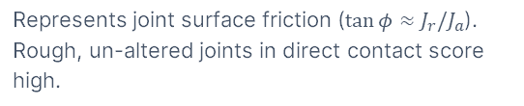

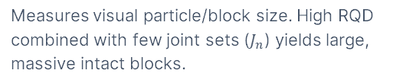
MODULE 5 • MATHEMATICAL STRUCTURE
The Q-System Equation: Three Structural Quotients
$$Q=\left(\frac{RQD}{J_{n}}\right)⋅\left(\frac{J_{r}}{J_{a}}\right)⋅\left(\frac{J_{w}}{SRF}\right)$$
QUOTIENT 1
QUOTIENT 2
QUOTIENT 3
$$\frac{RQD}{J_{n}}$$
$$\frac{J_{r}}{J_{a}}$$
$$\frac{J_{w}}{SRF}$$
Relative Block Size
Inter-block Shear Strength
Active Stress State
Measures visual particle/block size. High RQD combined with few joint sets ($J_{n}$) yields large, massive intact blocks.
Represents joint surface friction ($\tan{φ}≈J_{r}/J_{a}$). Rough, un-altered joints in direct contact score high.
Empirical stress factor. High pore water pressure or heavy squeezing/rock burst conditions severely lower this quotient.
Physical insight: Quotient 1 = block geometry; Quotient 2 = inter-block friction; Quotient 3 = active stress environment.

Slide 30


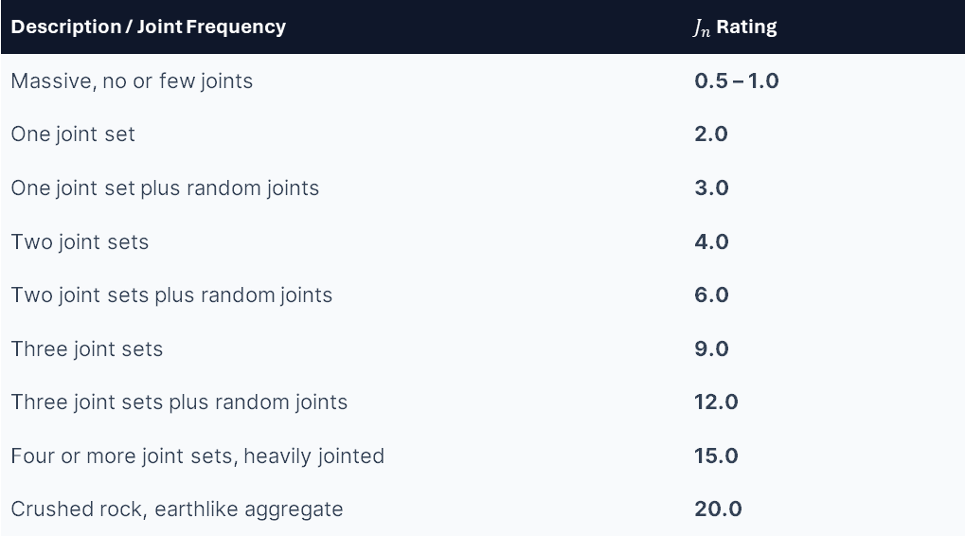



MODULE 5 • Q PARAMETER DETAILS
Quotient 1: Joint Set Number ($J_{n}$) Sizing
Joint Set Rating Table ($J_{n}$)
Special Field Rules for $J_{n}$
Description / Joint Frequency | $J_{n}$ Rating
Massive, no or few joints | 0.5 – 1.0
One joint set | 2.0
One joint set plus random joints | 3.0
Two joint sets | 4.0
Two joint sets plus random joints | 6.0
Three joint sets | 9.0
Three joint sets plus random joints | 12.0
Four or more joint sets, heavily jointed | 15.0
Crushed rock, earthlike aggregate | 20.0
•
Tunnel Intersections: Multiply $J_{n}$ by $3.0$ ($3.0×J_{n}$).
•
Portal Zones: Multiply $J_{n}$ by $2.0$ ($2.0×J_{n}$) to account for surface stress relaxation.
•
Nominal $RQD$: If measured $RQD≤10$, use a fixed nominal value of $10$ in formula.
Why intersections use $3×J_{n}$: At tunnel intersections, geometry creates extra degrees of freedom for block detachment.

Slide 31
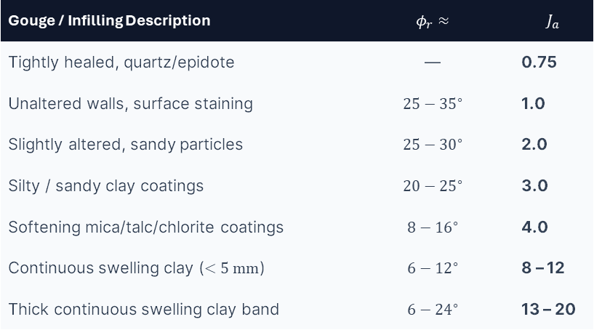

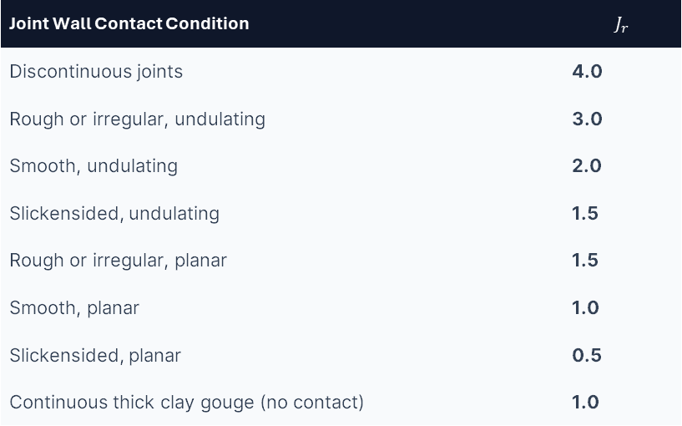

MODULE 5 • Q PARAMETER DETAILS
Quotient 2: Joint Roughness ($J_{r}$) & Alteration ($J_{a}$)
Joint Roughness ($J_{r}$)
Joint Alteration ($J_{a}$)
Joint Wall Contact Condition | $$J_{r}$$
Discontinuous joints | 4.0
Rough or irregular, undulating | 3.0
Smooth, undulating | 2.0
Slickensided, undulating | 1.5
Rough or irregular, planar | 1.5
Smooth, planar | 1.0
Slickensided, planar | 0.5
Continuous thick clay gouge (no contact) | 1.0
Gouge / Infilling Description | $$φ_{r}≈$$ | $$J_{a}$$
Tightly healed, quartz/epidote | — | 0.75
Unaltered walls, surface staining | $$25−{35}^{∘}$$ | 1.0
Slightly altered, sandy particles | $$25−{30}^{∘}$$ | 2.0
Silty / sandy clay coatings | $$20−{25}^{∘}$$ | 3.0
Softening mica/talc/chlorite coatings | $$8−{16}^{∘}$$ | 4.0
Continuous swelling clay ($<5\text{ mm}$) | $$6−{12}^{∘}$$ | 8 – 12
Thick continuous swelling clay band | $$6−{24}^{∘}$$ | 13 – 20
Note rule for $J_{r}/J_{a}$: Evaluate $J_{r}$ and $J_{a}$ for the joint set or weakness plane that is LEAST favorable for structural stability in orientation.

Slide 32
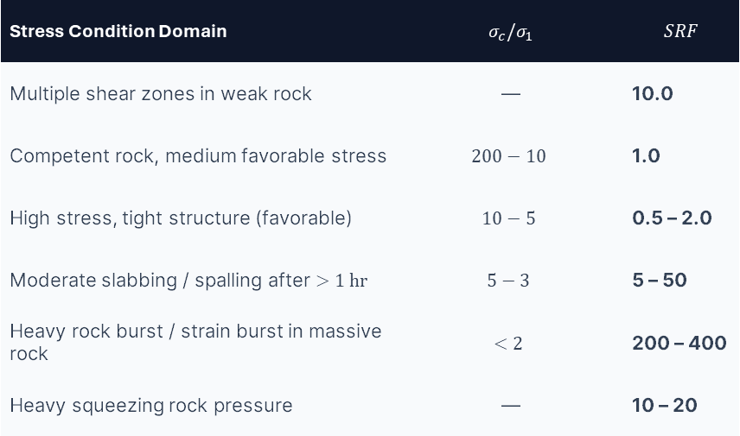

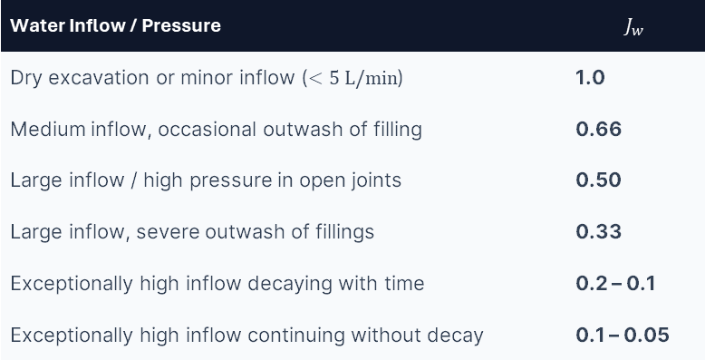

MODULE 5 • Q PARAMETER DETAILS
Quotient 3: Joint Water ($J_{w}$) & Stress Reduction ($SRF$)
Water Reduction Factor ($J_{w}$)
Stress Reduction Factor ($SRF$)
Water Inflow / Pressure | $$J_{w}$$
Dry excavation or minor inflow ($<5\text{ L/min}$) | 1.0
Medium inflow, occasional outwash of filling | 0.66
Large inflow / high pressure in open joints | 0.50
Large inflow, severe outwash of fillings | 0.33
Exceptionally high inflow decaying with time | 0.2 – 0.1
Exceptionally high inflow continuing without decay | 0.1 – 0.05
Stress Condition Domain | $$σ_{c}/σ_{1}$$ | $$SRF$$
Multiple shear zones in weak rock | — | 10.0
Competent rock, medium favorable stress | $$200−10$$ | 1.0
High stress, tight structure (favorable) | $$10−5$$ | 0.5 – 2.0
Moderate slabbing / spalling after $>1\text{ hr}$ | $$5−3$$ | 5 – 50
Heavy rock burst / strain burst in massive rock | $$<2$$ | 200 – 400
Heavy squeezing rock pressure | — | 10 – 20
Stress reduction factor ($SRF$) reflects 3 physical cases: 1) loosening load in fault zones; 2) rock bursting in hard high-stress rock; 3) squeezing in soft plastic rock.

Slide 33
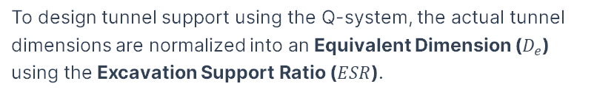
MODULE 5 • SUPPORT DIMENSIONING
Equivalent Dimension ($D_{e}$) & Support Ratio ($ESR$)
To design tunnel support using the Q-system, the actual tunnel dimensions are normalized into an Equivalent Dimension ($D_{e}$) using the Excavation Support Ratio ($ESR$).
$$D_{e}=\frac{\text{Excavation Span, Diameter, or Height (m)}}{ESR}$$
ESR Category Values (Barton et al. 1974)
Excavation Category | ESR
A. Temporary mine openings | 3.0 – 5.0
B. Permanent mine openings, hydro water tunnels, pilot drifts | 1.6
C. Storage caverns, minor road/rail tunnels, access drifts | 1.3
D. Power stations, major railway/highway tunnels, portals | 1.0
E. Nuclear power stations, underground sports arenas, factories | 0.8
Use roof span width for designing roof support. Use wall height for designing sidewall support.
ESR reflects allowable risk. A temporary mine opening ($ESR=3−5$) accepts minor spalling, permitting lighter support than a nuclear facility ($ESR=0.8$).

Slide 34
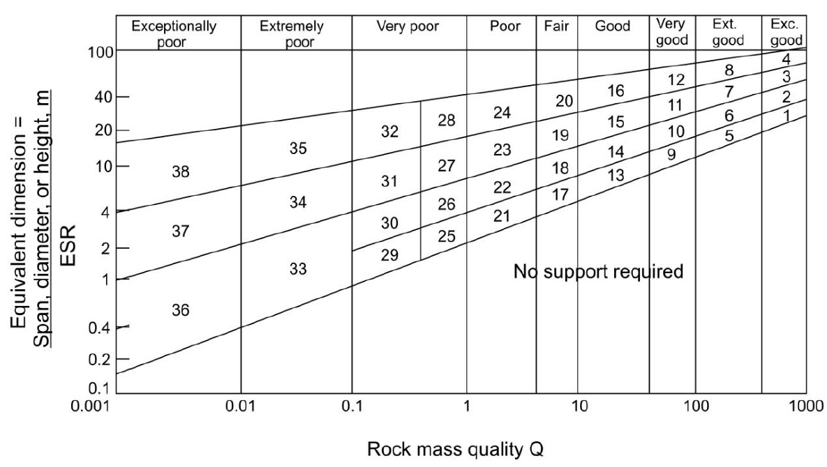





MODULE 5 • RECONSTRUCTED ENGINEERING CHART
Barton Q Support Chart ($D_{e}$ vs $Q$-Index)
Bolt Length Formula ($L$)
$$L=2+0.15\left(\frac{B}{ESR}\right)$$
Where $B$ = tunnel excavation span width (m).
Max Unsupported Span ($S_{max}$)
$$S_{max}=2⋅ESR⋅Q^{0.4}$$
Notes:
Demonstrate using chart: Plot $Q$ on horizontal axis and $D_e$ on vertical axis. Their intersection selects one of 38 support categories (Grimstad & Barton 1993).

Slide 35
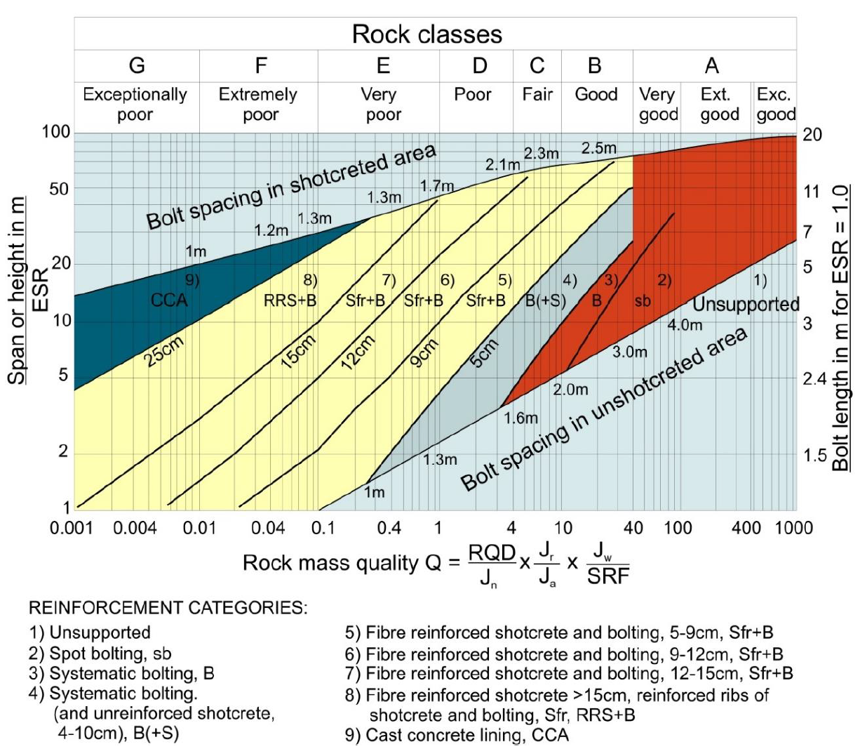

Slide 36

MODULE 5 • MODERN Q MODIFICATIONS
UCS Normalized Index ($Q_{c}$) & Roof Support Pressure
To adjust for intact rock strength ($σ_{c}$) variations in unusually soft or hard rocks, Barton (2002) introduced the normalized $Q_{c}$ index:
$$Q_{c}=Q⋅\left(\frac{σ_{c}}{100}\right)$$
Permanent Roof Support Pressure ($P_{roof}$)
Estimated directly from $Q$ and joint roughness ($J_{r}$):
Steel Fiber Shotcrete (SFRS) Era
$$P_{roof}=\frac{2\sqrt{J_{n}}⋅Q^{−1/3}}{3J_{r}} \left({\text{kg/cm}}^{2} \text{or bar}\right)$$
Since the 1990s, Grimstad & Barton updated the support chart to mandate Steel Fiber Reinforced Shotcrete (SFRS) instead of wire mesh.
SFRS forms an active ductile arches shell bonded directly to the irregular rock perimeter, preventing wedge fallout.
If $J_{r}$ is low (smooth planar joints), $P_{roof}$ increases rapidly because joint wall friction is inadequate to prevent block dropouts.

Slide 37




MODULE 5 • EMPIRICAL CORRELATIONS
Rock Mass Modulus ($E_{m}$) & Squeezing Thresholds
Barton (1995) Modulus (for $Q>1$)
$$E_{m}=25\log_{10}{Q} \left(\text{GPa}\right)$$
Barton (2002) Strength-Normalized Modulus
$$E_{m}=10{\left(Q⋅\frac{σ_{c}}{100}\right)}^{1/3}=10Q_{c}^{1/3} \left(\text{GPa}\right)$$
Squeezing Mechanics
When depth $H>350Q^{1/3}$, in-situ overburden stress exceeds the ultimate rock mass compressive strength ($σ_{cm}≈7γQ^{1/3}\text{ MPa}$).
Squeezing Condition Threshold (Singh et al. 1992)
Tunneling under depth $H$ (meters) experiences plastic squeezing when:
$$H>350⋅Q^{1/3} \left(\text{meters}\right)$$
The rock slowly advances plastically into the tunnel without volume increase. Requires yielding support arches and immediate invert closure.
Notes:
We now examine Hoek's Geological Strength Index (GSI)—developed specifically to feed non-linear numerical constitutive models.

Slide 38


MODULE 6 • HOEK & BROWN SYSTEM (1994)
Geological Strength Index ($GSI$) Genesis
Introduced by Evert Hoek (1994) to overcome severe limitations of RMR when applied to heavily jointed, weak, or tectonically sheared rock masses.
Primary Engineering Purpose
Provides a direct qualitative/quantitative index to scale intact laboratory Hoek-Brown failure parameters ($m_{i},σ_{ci}$) down to field rock mass strength parameters ($m_{b},s,a$).
Relies on visual assessment of two fundamental geological observations: Rock Mass Structure (interlocking) and Joint Surface Quality.
Geological Observation First
Hoek designed GSI to keep engineers focused on visual geological mapping in the adit face rather than getting lost in laboratory arithmetic formulas.
GSI Scale Range: 10 (Crushed/Sheared) to 100 (Intact Massive).
GSI is NOT a support table lookup like RMR or Q. GSI is a constitutive input generator for numerical simulation engines.

Slide 39
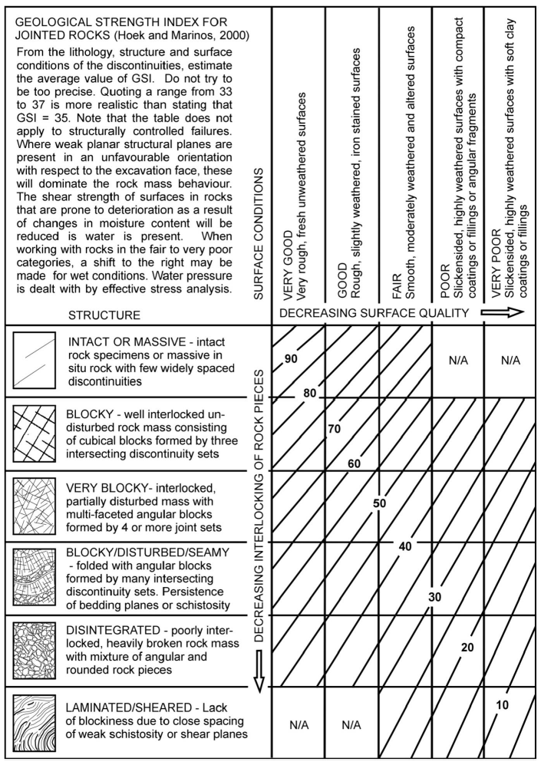
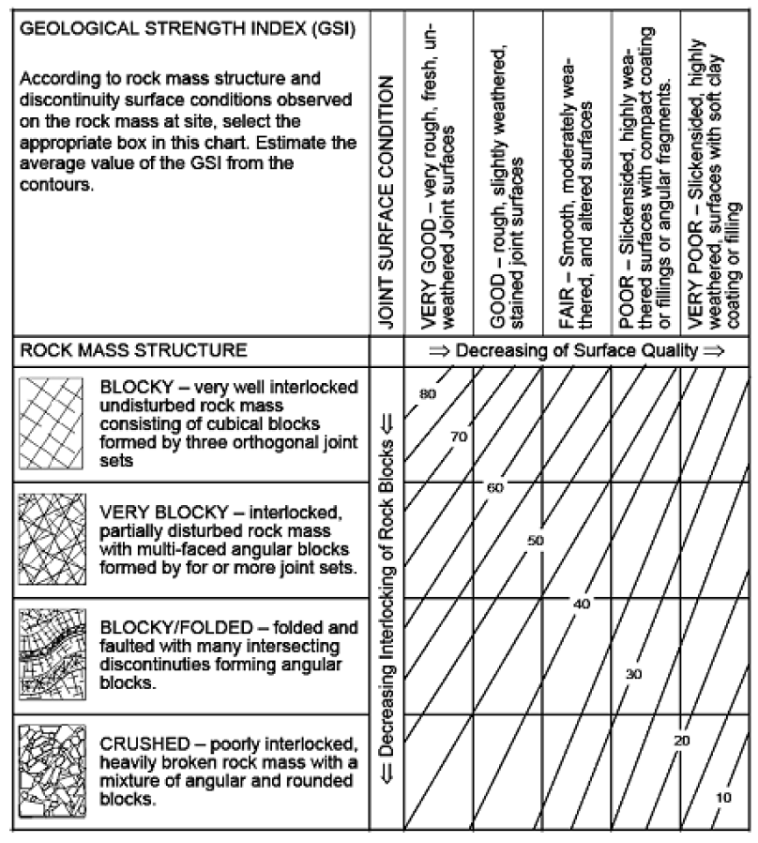

Slide 40
MODULE 6 • GSI MATRIX LOGIC
GSI Matrix Architecture: Two Fundamental Axes
VERTICAL AXIS
HORIZONTAL AXIS
Rock Mass Structure
Discontinuity Surface Quality
Measures degree of block interlocking and joint set density:
Measures weathering, roughness, and infilling coatings:
+
•
Intact / Massive: Few widely spaced joints
•
Very Good: Very rough, fresh, unweathered surfaces
•
Blocky: Well interlocked cubical blocks (3 joint sets)
•
Good: Rough, slightly weathered, stained surfaces
•
Very Blocky: Multi-faceted angular blocks (4+ sets)
•
Fair: Smooth, moderately weathered/altered
•
Blocky / Folded: Heavily folded/faulted angular blocks
•
Poor: Slickensided, highly weathered with compact coatings
•
Crushed: Poorly interlocked, heavily broken mixture
•
Very Poor: Slickensided with soft clay coatings
Diagonal contouring: The intersection box selected by the geologist yields an average diagonal contour value (e.g., GSI = 45–55).

Slide 41
MODULE 6 • RECONSTRUCTED VISUAL MATRIX
Geological Strength Index ($GSI$) Contour Chart
Structure / Surface | VERY GOOD Rough, Unweathered | GOOD Rough, Stained | FAIR Smooth, Weathered | POOR Slickensided | VERY POOR Soft Clay Coatings
BLOCKY (3 joint sets) | GSI 80 | GSI 70 | GSI 60 | GSI 50 | GSI 40
VERY BLOCKY (4+ sets) | GSI 70 | GSI 60 | GSI 50 | GSI 40 | GSI 30
BLOCKY / FOLDED | GSI 60 | GSI 50 | GSI 40 | GSI 30 | GSI 20
CRUSHED (Poorly interlocked) | GSI 50 | GSI 40 | GSI 30 | GSI 20 | GSI 10
Always estimate a RANGE of GSI values (e.g., GSI 45–55) rather than a single discrete integer to account for field spatial variability.

Slide 42


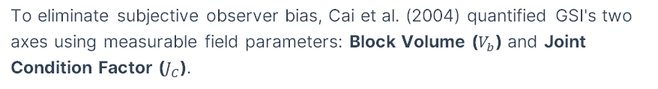
MODULE 6 • MATHEMATICAL QUANTIFICATION
Quantification of GSI: Block Volume ($V_{b}$) & Joint Condition ($J_{C}$)
To eliminate subjective observer bias, Cai et al. (2004) quantified GSI's two axes using measurable field parameters: Block Volume ($V_{b}$) and Joint Condition Factor ($J_{C}$).
Joint Condition Factor ($J_{C}$)
$$J_{C}=\frac{J_{w}⋅J_{s}}{J_{a}}$$
Where $J_{w}$ = Waviness ($1−3$), $J_{s}$ = Smoothness ($0.75−3$), $J_{a}$ = Alteration ($0.75−12$).
Quantitative Chart Placement
Calculating $V_{b}$ (${\text{cm}}^{3}$) gives the precise ordinate on the vertical axis.
Persistent Block Volume ($V_{0}$)
$$V_{0}=\frac{S_{1}⋅S_{2}⋅S_{3}}{{\sin{γ}}_{1}⋅{\sin{γ}}_{2}⋅{\sin{γ}}_{3}}$$
Calculating $J_{C}$ gives the precise abscissa on the horizontal axis. Intersection pinpoints exact objective GSI value.
Where $S_{i}$ = joint set spacing ($\text{m}$), $γ_{i}$ = angles between joint sets.
$J_{C}$ components: $J_{w}$ (large scale undulation), $J_{s}$ (small scale asperities), $J_{a}$ (mineral weathering).

Slide 43
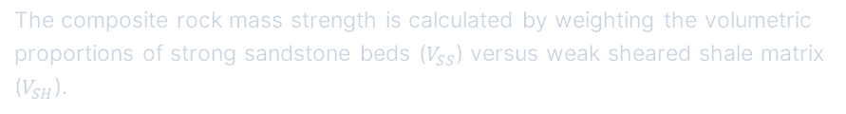
MODULE 6 • COMPLEX GEOLOGIES
Extending GSI to Complex & Heterogeneous Flysch
Tectonically sheared, interbedded sandstone-siltstone-shale sequences (Flysch / Athens Schist) lack distinct continuous joint sets, rendering standard blocky GSI charts unusable.
Hoek & Marinos (2000) Special Categories
•
Sub-category A: Intact interbedded sandstone/siltstone beds.
•
Sub-category B: Folded sandstone beds with minor shearing.
•
Sub-category C: Heavily sheared siltstone containing broken sandstone fragments.
Weighted Matrix Approach
•
Sub-category D: Tectonically crushed clayey matrix with isolated sandstone lenses.
The composite rock mass strength is calculated by weighting the volumetric proportions of strong sandstone beds ($V_{SS}$) versus weak sheared shale matrix ($V_{SH}$).
Prevents extreme over-design in complex alpine flysch tunnels.
Flysch complexity: Sandstone beds provide structural skeleton while clay/shale matrix controls continuous squeeze deformations.

Slide 44






MODULE 6 • CONSTITUTIVE MECHANICS
Linking GSI to Non-Linear Hoek-Brown Criterion
$$σ_{1}′=σ_{3}′+σ_{ci}{\left(m_{b}\frac{σ_{3}′}{σ_{ci}}+s\right)}^{a}$$
$m_{b}$ = Frictional rock mass material constant:
$$m_{b}=m_{i}⋅\exp\left(\frac{GSI−100}{28−14D}\right)$$
DISTURBANCE FACTOR D
Blast Damage Factor ($D$)
$s$ = Cohesive rock mass tensile strength constant:
$D=0$ for un-disturbed TBM excavations or controlled smooth blasting.
$$s=\exp\left(\frac{GSI−100}{9−3D}\right)$$
$D=0.8−1.0$ for severe blast damage in bench blasting or poor production shooting.
$a$ = Curvature exponent constant ($a=0.5$ for $GSI>25$):
$$a=\frac{1}{2}+\frac{1}{6}\left(e^{−GSI/15}−e^{−20/3}\right)$$
GSI scales intact rock parameter $m_{i}$ down to$m_{b}$, and intact cohesion down to $s$. $D$ accounts for blast stress damage.

Slide 45
MODULE 6 • SYSTEM LIMITS
Limitations & Correct Application of GSI
1. DO NOT Use for Structurally Controlled Wedge Falls
2. Assumes Isotropic Homogeneous Media
When excavation stability is governed by 1 or 2 dominant intersecting joint sets forming discrete wedges, use kinematic stereonet analysis and UNWEDGE software, NOT GSI.
GSI assumes the rock mass contains sufficient randomly oriented joint sets (3+ sets) that it can be treated as an equivalent isotropic continuum.
3. Inapplicable to Deep Hard Rock Bursting
4. Yields NO Support Recommendations
Brittle strain-bursting and face spalling in deep massive hard rock under extreme stress ($σ_{1}>0.4σ_{c}$) cannot be predicted by GSI.
GSI does NOT provide empirical tables for shotcrete thickness or bolt spacing (unlike RMR/Q). Support sizing must be calculated via numerical FEA simulation.
Notes:
We now compare all major systems and establish an integrated geotechnical design workflow.

Slide 46


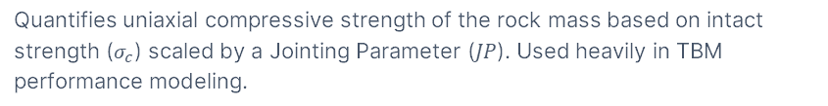
MODULE 7 • SECONDARY SYSTEMS
Alternative European Systems: $RM_{i}$ & Rock Mass Number ($N$)
PALMSTRÖM (1995)
Rock Mass Index ($RM_{i}$)
STRESS-FREE INDEX
Rock Mass Number ($N$)
$$RM_{i}=σ_{c}⋅JP=σ_{c}⋅0.2\sqrt{j_{C}}⋅V_{b}^{D}$$
$$N=\left(\frac{RQD}{J_{n}}\right)⋅\left(\frac{J_{r}}{J_{a}}\right)⋅J_{w}$$
Quantifies uniaxial compressive strength of the rock mass based on intact strength ($σ_{c}$) scaled by a Jointing Parameter ($JP$). Used heavily in TBM performance modeling.
Defines a stress-free Q-index ($N=Q\text{ for }SRF=1$). Eliminates difficulty in estimating $SRF$ in deep tunneling for squeezing assessment.
Useful secondary systems in European TBM tunneling and squeezing rock evaluations.

Slide 47




MODULE 7 • SYSTEM CROSS-CORRELATIONS
Empirical Correlations Between $RMR$, $Q$, and $GSI$
Bieniawski (1976) Correlation (111 Tunnel Case Histories)
$$RMR=9\ln{Q}+44$$
Abad et al. (1983) Correlation (187 Coal Mining Cases)
$$RMR=10.5\ln{Q}+42$$
Correlation Warning
Hoek, Kaiser & Bawden (1995) GSI Correlation (for $RMR_{89}>23$, Dry)
$$GSI=RMR_{89}−5$$
Scatter across conversion equations can exceed $±15$ rating points.
NEVER rely solely on converted ratings for final support design. Always map parameters independently in the field.
Correlations provide useful sanity checks, but field data must be collected separately for both systems.

Slide 48
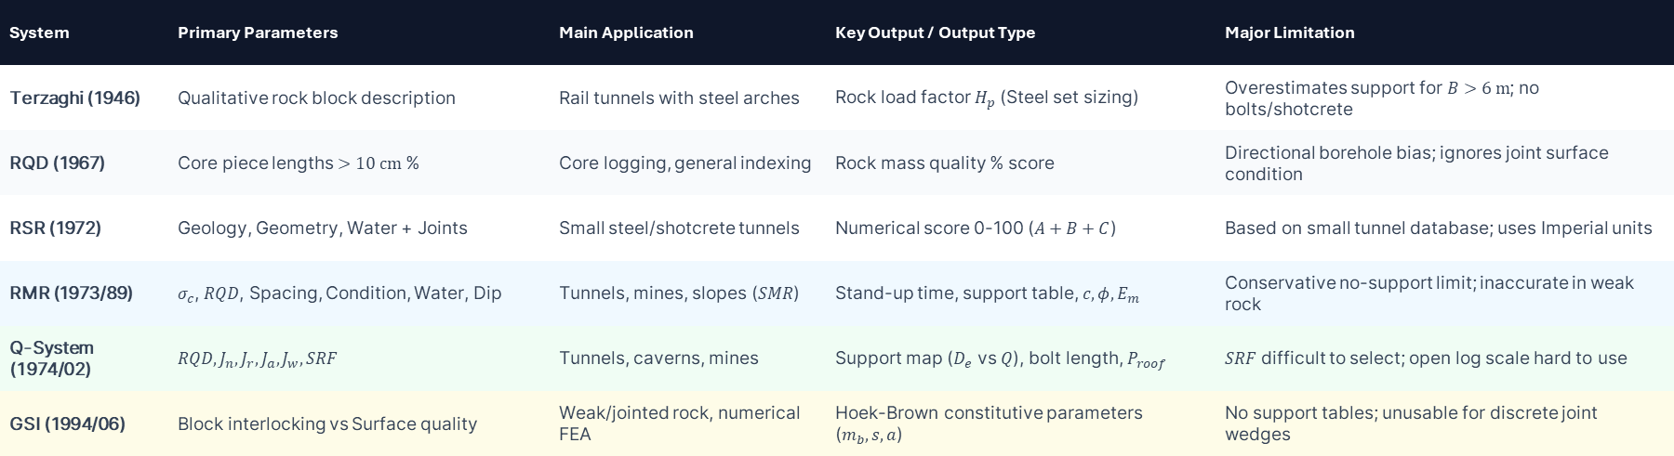
MODULE 7 • SYSTEM SYNTHESIS
Systematic Comparison Matrix of Major Systems
System | Primary Parameters | Main Application | Key Output / Output Type | Major Limitation
Terzaghi (1946) | Qualitative rock block description | Rail tunnels with steel arches | Rock load factor $H_{p}$ (Steel set sizing) | Overestimates support for $B>6\text{ m}$; no bolts/shotcrete
RQD (1967) | Core piece lengths $>10\text{ cm}$ % | Core logging, general indexing | Rock mass quality % score | Directional borehole bias; ignores joint surface condition
RSR (1972) | Geology, Geometry, Water + Joints | Small steel/shotcrete tunnels | Numerical score 0-100 ($A+B+C$) | Based on small tunnel database; uses Imperial units
RMR (1973/89) | $σ_{c}$, $RQD$, Spacing, Condition, Water, Dip | Tunnels, mines, slopes ($SMR$) | Stand-up time, support table, $c,φ,E_{m}$ | Conservative no-support limit; inaccurate in weak rock
Q-System (1974/02) | $$RQD,J_{n},J_{r},J_{a},J_{w},SRF$$ | Tunnels, caverns, mines | Support map ($D_{e}$ vs $Q$), bolt length, $P_{roof}$ | $SRF$ difficult to select; open log scale hard to use
GSI (1994/06) | Block interlocking vs Surface quality | Weak/jointed rock, numerical FEA | Hoek-Brown constitutive parameters ($m_{b},s,a$) | No support tables; unusable for discrete joint wedges

Slide 49
MODULE 7 • PRACTICAL ENGINEERING WORKFLOW
Integrated Engineering Design Pipeline
1
Geological Mapping & Core Logging: Measure intact UCS ($σ_{c}$), log RQD, joint set count ($J_{n}$), spacing, roughness ($J_{r}$), alteration ($J_{a}$), and water inflow.
2
Calculate Empirical Ratings: Independently compute $RMR_{89}$, $Q$-index, and select visual $GSI$ range. Cross-check for inconsistencies.
3
Empirical Support Selection: Sizing primary temporary support (rock bolt pattern, SFRS shotcrete thickness) using Barton $Q−D_{e}$ chart and RMR tables.
4
Kinematic Stability Analysis: Perform stereonet projection (UNWEDGE / DIPS) to verify roof and sidewall structural wedge fall safety.
5
Numerical Simulation (FEA / FLAC): Input $GSI$, $E_{m}$, and Hoek-Brown $m_{b},s,a$ into 2D/3D numerical engines to verify tunnel plastic zones and convergence.
6
Observational Method & Instrumentation: Monitor real-time tunnel convergence with optical targets and MPBX extensometers to adjust support in field.
Empirical classification guides initial support installation, but field monitoring (Observational Method) confirms safety during excavation.

Slide 50

Summary & Core Takeaways
1. Engineering Aids, Not Cookbooks
Classifications guide empirical design—they never replace analytical, kinematic, or numerical field monitoring studies.
2. Always Cross-Check Systems
Apply at least TWO independent classification systems (e.g., RMR and Q) on every geotechnical project.
3. Direct Mechanics Mapping
RMR yields $c,φ$; Q yields support maps ($D_{e}$ vs $Q$); GSI yields non-linear Hoek-Brown numerical inputs ($m_{b},s,a$).
4. Respect System Boundaries
Do NOT use GSI for wedge falls; do NOT use RMR for squeezing rock; do NOT use Terzaghi for rock bolts.
Questions & Discussion

